Slide 1
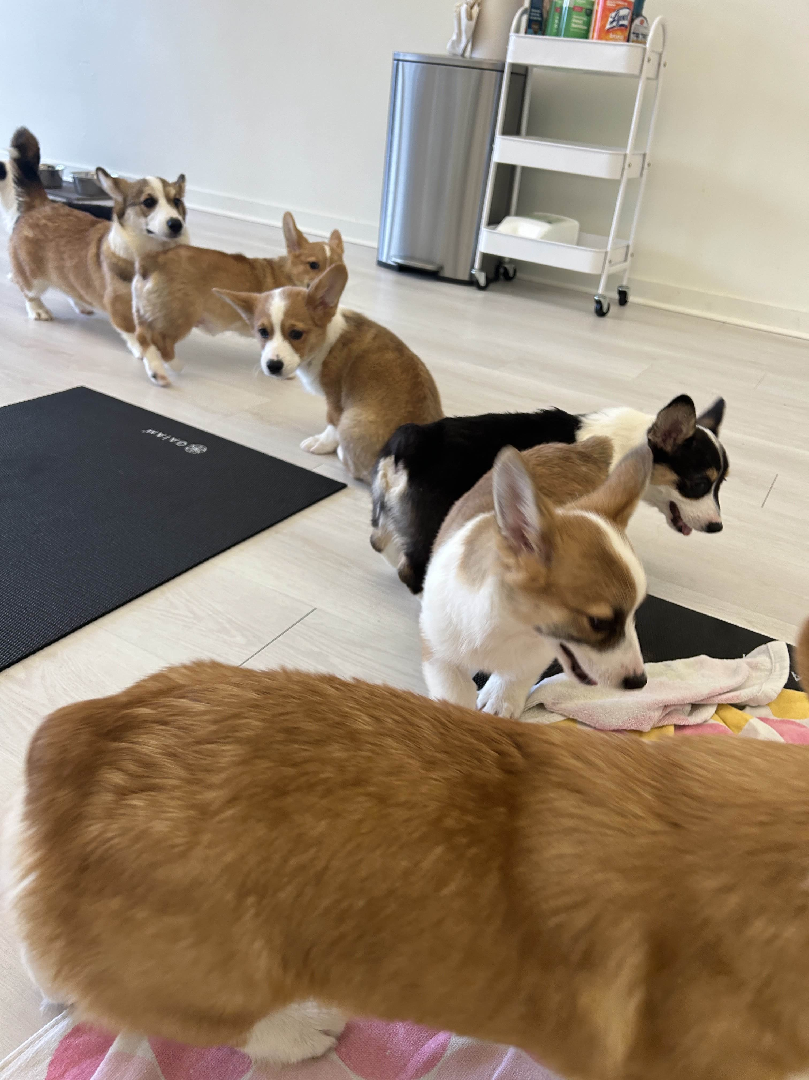
for Loops
BEFORE WE START
Talk to your neighbors:
Have you heard of corgi yoga?
LEC 04
Music: ♣️CSE 121 25su Lecture Tunes ♣️
Instructor:
Hannah Swoffer
TAs:
Abby
Hannah
Julia
Merav
Trey

Slide 2

Agenda
Announcements, Reminders
Strings and Characters Review
Code example!
for Loop Review
Code example!

Slide 3
Announcements, Reminders
Feedback for C0 released!
  Please view your feedback – crucial part of learning process
  For regrades (not resubs), please make a private Ed post
Grade calculator
C1 and R1 releasing later today, both due Tuesday, July 15th
Quiz 0 is on Thursday, July 17th (in your registered quiz section)
  Can’t make it? Email Hannah ASAP

Slide 4
Agenda
Announcements, Reminders
Strings and Characters Review
Code example!
for Loop Review
Code example!

Slide 5
PCM: Strings & chars
Recall: String literals are a sequence of characters that are strung together, begin and end with ""
  Use zero-based indexing
A char represents a single character
  Begin and end with single quotes ( ' )
  Strings are made up of chars!
g | u | m | b | a | l | l
0 | 1 | 2 | 3 | 4 | 5 | 6
char letter = 'g';
char anotherLetter = 'b';

Slide 6
PCM: String Methods
Usage: <string_variable>.<method>(…)
Method | Description
length() | Returns the length of the string.
charAt(i) | Returns the character at index i of the string
indexOf(s) | Returns the index of the first occurrence of s in the string; returns -1 if s doesn't appear in the string
substring(i, j) or substring(i) | Returns the characters in this string from i (inclusive) to j (exclusive); if j is omitted, goes until the end of the string
contains(s) | Returns whether or not the string contains s
equals(s) | Returns whether or not the string is equal to s (case-sensitive)
equalsIgnoreCase(s) | Returns whether or not the string is equal to s ignoring case
toUpperCase() | Returns an uppercase version of the string
toLowerCase() | Returns a lowercase version of the string

Slide 7
Variables and Strings
Variables
  Container that stores a specific data type
  Must declare and initialize
    int version = 5;
Strings
  Sequence of characters treated as one, yet can be indexed as individual parts
  char represents a single character
version
5
b | u | b | b | l | e |  | g | u | m
0 | 1 | 2 | 3 | 4 | 5 | 6 | 7 | 8 | 9

Slide 8
Think Pair Share: gumball Variables (Think)
Suppose s contains the String "bubble gum".
Which statement would result in s containing "Gumball" instead?
s.substring(7) + "ball";
s = s.substring(7, 9) + "ball";
s = ("" + s.charAt(7)).toUpperCase() + "ball";
s = s.substring(7, 8).toUpperCase()
+ s.substring(8) + "ball";
b | u | b | b | l | e |  | g | u | m
0 | 1 | 2 | 3 | 4 | 5 | 6 | 7 | 8 | 9

Slide 9
Think Pair Share: gumball Variables (Pair)
Suppose s contains the String "bubble gum".
Which statement would result in s containing "Gumball" instead?
s.substring(7) + "ball";
s = s.substring(7, 9) + "ball";
s = ("" + s.charAt(7)).toUpperCase() + "ball";
s = s.substring(7, 8).toUpperCase()
+ s.substring(8) + "ball";
b | u | b | b | l | e |  | g | u | m
0 | 1 | 2 | 3 | 4 | 5 | 6 | 7 | 8 | 9

Slide 10
Chaining methods in expressions
b | u | b | b | l | e |  | g | u | m
0 | 1 | 2 | 3 | 4 | 5 | 6 | 7 | 8 | 9
s.substring(7, 8).toUpperCase() + s.substring(8) + "ball"
"g".toUpperCase() + s.substring(8) + "ball"
"G" + s.substring(8) + "ball"
"G" + "um" + "ball"

Slide 11
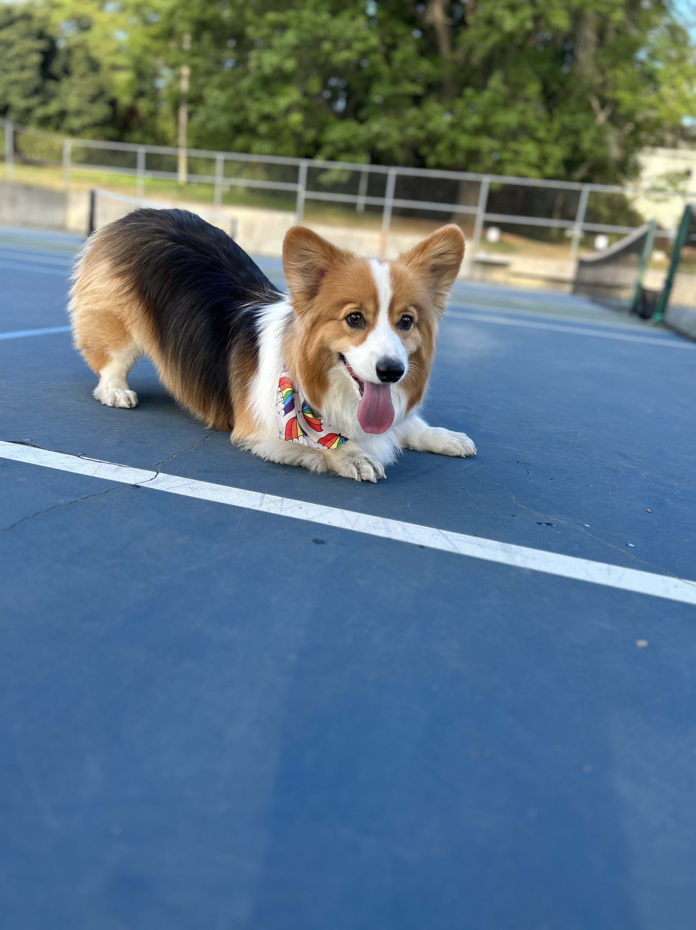
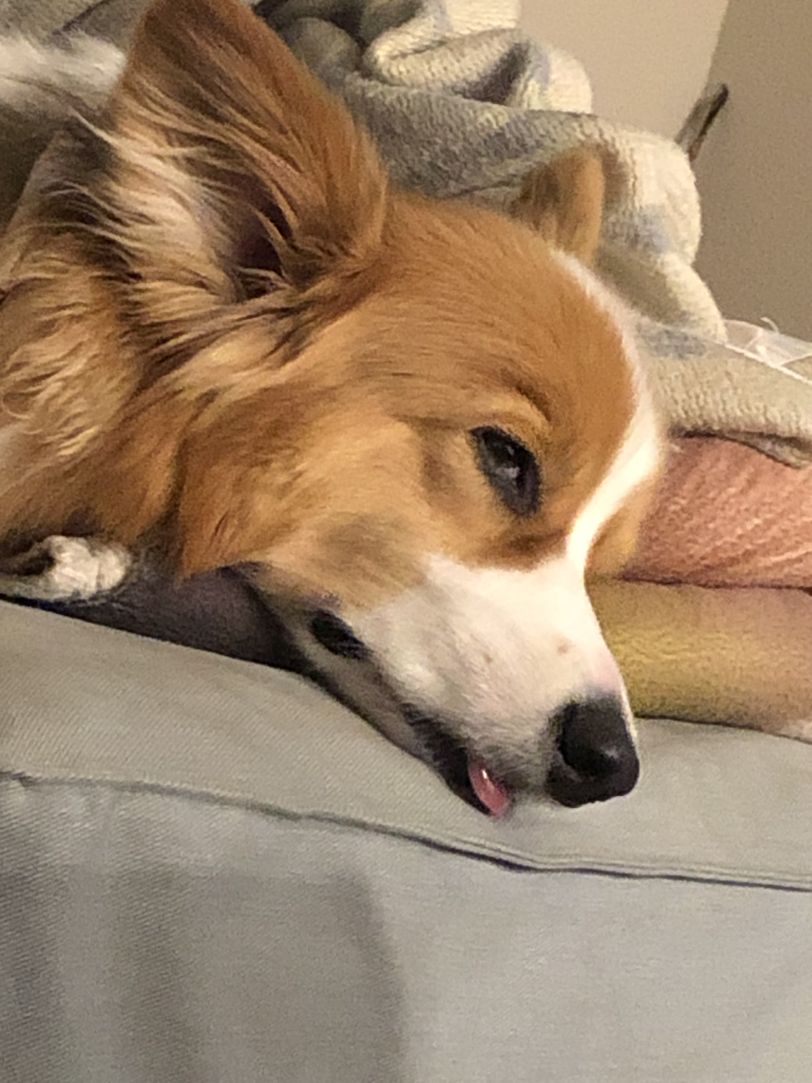

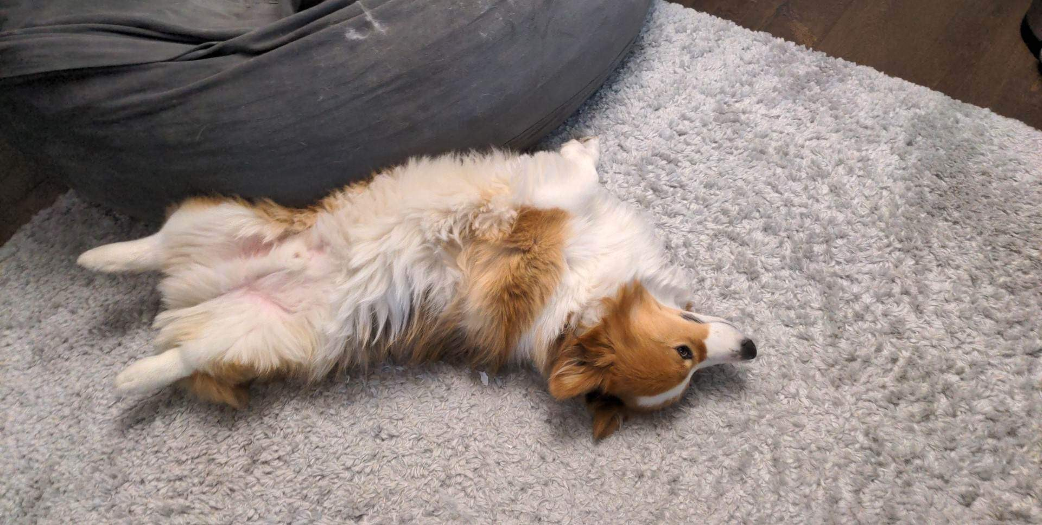
Aside: Gumball

Slide 12
Agenda
Announcements, Reminders
Strings and Characters Review
Code Example! Strings, Names, and Substrings
For Loop Review
Code Example! Countdown
Code Example! Spelling

Slide 13
Agenda
Announcements, Reminders
Strings and Characters Review
Code Example! Strings, Names, and Substrings
For Loop Review
Code Example! Countdown
Code Example! Spelling

Slide 14
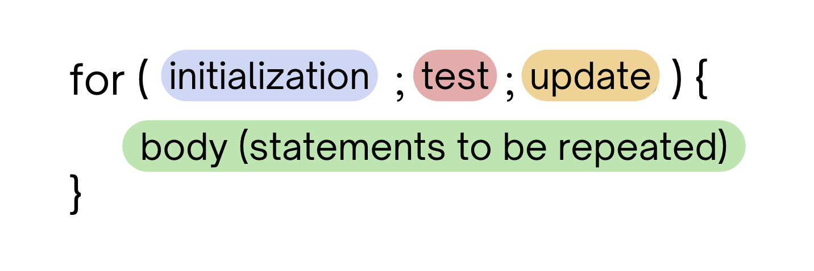
PCM Review: for loops!
For loops are our first control structure: a syntax structure that controls the execution of other statements.

Slide 15
PCM Review: for loops (example)
for (int counter = 1; counter <= 5; counter++) {
System.out.println("I love CSE 121!");
}

Slide 16
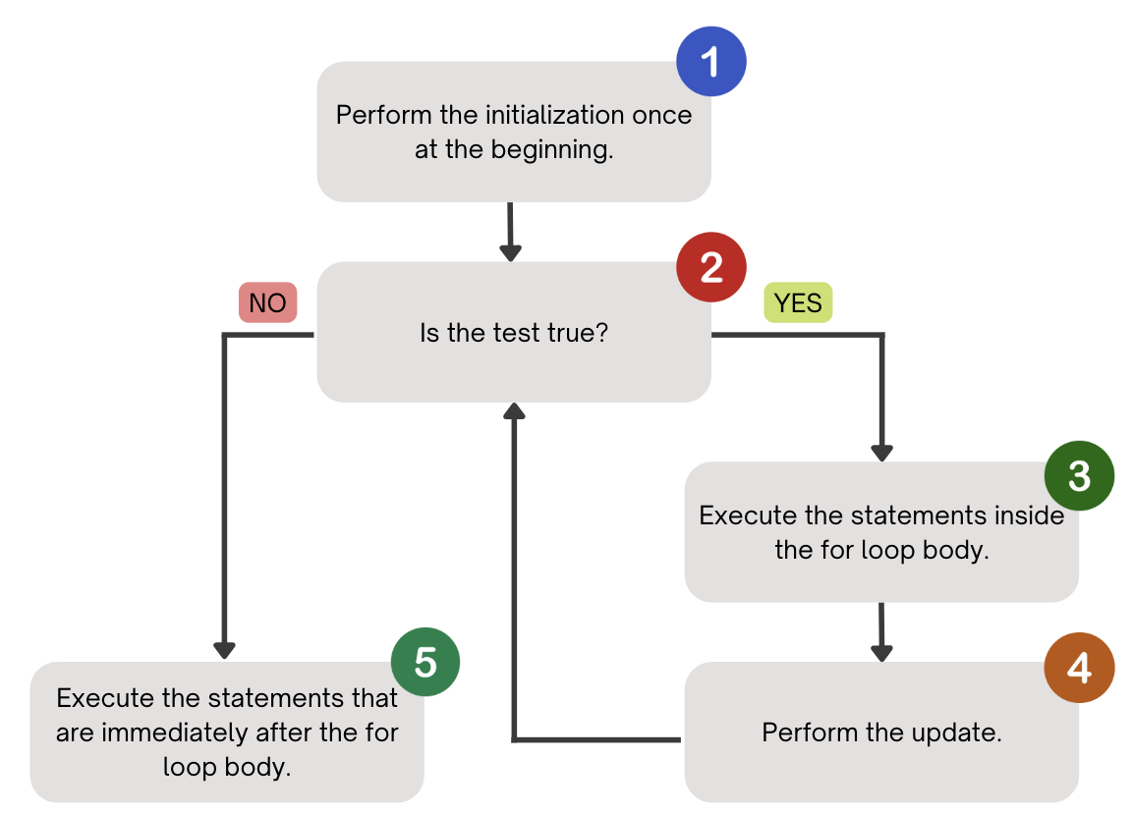
PCM Review: for loops (a helpful flowchart)

Slide 17
Thinking about for loops
counter
1
2
4
1
2
3
4
5
6
for (int counter = 1; counter <= 5; counter++) {
System.out.println("I love CSE 121!");
}
3
5
I love CSE 121!
I love CSE 121!
I love CSE 121!
I love CSE 121!
I love CSE 121!

Slide 18
Think Pair Share: squared loops (Think)
What output does the following code produce?
for (int i = 1; i <= 7; i++) {
System.out.println(i + " squared = " + i * i);
}
A.
i squared = i * i
i squared = i * i
i squared = i * i
i squared = i * i
i squared = i * i
i squared = i * i
B.
i squared = i * i
i squared = i * i
i squared = i * i
i squared = i * i
i squared = i * i
i squared = i * i
i squared = i * i
C.
1 squared = 1
2 squared = 4
3 squared = 9
4 squared = 16
5 squared = 25
6 squared = 36
D.
1 squared = 1
2 squared = 4
3 squared = 9
4 squared = 16
5 squared = 25
6 squared = 36
7 squared = 49

Slide 19
Think Pair Share: squared loops (Pair)
What output does the following code produce?
for (int i = 1; i <= 7; i++) {
System.out.println(i + " squared = " + i * i);
}
A.
i squared = i * i
i squared = i * i
i squared = i * i
i squared = i * i
i squared = i * i
i squared = i * i
B.
i squared = i * i
i squared = i * i
i squared = i * i
i squared = i * i
i squared = i * i
i squared = i * i
i squared = i * i
C.
1 squared = 1
2 squared = 4
3 squared = 9
4 squared = 16
5 squared = 25
6 squared = 36
D.
1 squared = 1
2 squared = 4
3 squared = 9
4 squared = 16
5 squared = 25
6 squared = 36
7 squared = 49

Slide 20
Agenda
Announcements, Reminders
Strings and Characters Review
Code Example! Strings, Names, and Substrings
for Loop Review
Code Example! Countdown
Code Example! Spelling

Slide 21
PCM Review: String Traversals
// For some String s
for (int i = 0; i < s.length(); i++) {
// do something with s.charAt(i)
}
b | u | b | b | l | e |  | g | u | m
0 | 1 | 2 | 3 | 4 | 5 | 6 | 7 | 8 | 9

Slide 22
Go Huskies?
h-u-s-k-i-e-s

Slide 23
The Fencepost Pattern
Some task where one piece is repeated n times, and another piece is repeated n-1 times and they alternate
h-u-s-k-i-e-s

Slide 24
Agenda
Announcements, Reminders
Strings and Characters Review
Code Example! Strings, Names, and Substrings
for Loop Review
Code Example! Countdown
Code Example! Spelling

