Slide 1
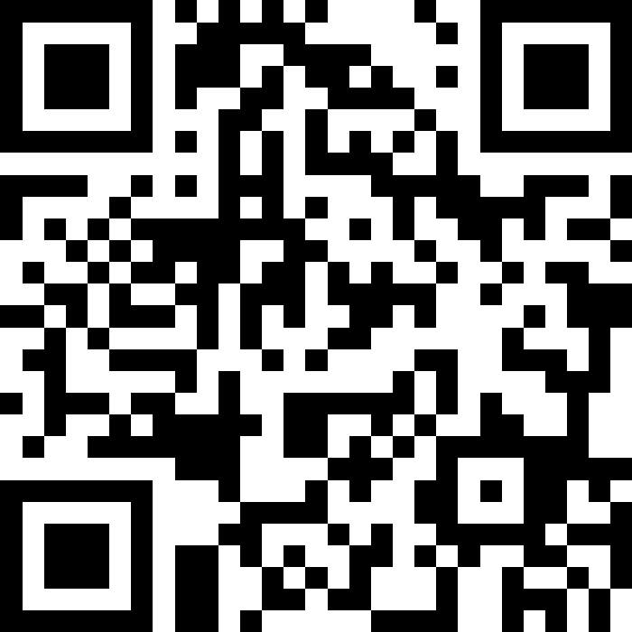
CSE 121 Lesson 19:
Final Exam Review & Victory Lap!
Matt Wang
Spring 2024
TAs:
Andy | Anju | Archit | Arkita | Autumn | Christian
Hannah H | Hannah S | Heather | Hibbah | Janvi | Jessie
Jonus | Julia | Luke | Maria | Mia | Ritesh
Shayna | Simon | Trey | Vidhi | Vivian | Gumball?
sli.do #cse121-19
Today’s playlist:
CSE 121 lecture beats 24sp

Slide 2
Announcements, Reminders
R7 due June 6th – all assignments eligible!
today is the last day for IPL + instructor office hours
Final Exam: Wednesday, June 5th from 2:30-4:20 in KNE 120
TA-led Review Session: Monday, June 3rd from 4:30-6:50 in JHN 102
other exam reminders:
  please look at seating charts and let me know ASAP if you’re not there!
  review Exam Resource Bank!

Slide 3
Evaluations and Awards
Course Evals are due Sunday, June 2nd at 11:59 PM
  currently just 16% (36/219) – we can do better than that :’)
CERSE survey – please see Dan Grossman’s email!
  This is a different kind of feedback from course evals
Bob Bandes TA Award nominations open!

Slide 4
Applications of CS
or “What can I do with what I learned?” – outside of just “write code”:
Detect and prevent toxicity online & recognize disinformation
Help deaf & hard-of-hearing people identify sounds
Develop a programming language that celebrates the world’s languages
Build battery-free robots & put them on insects (and... track murder hornets?)
Computational knitting & carpentry
Create an interactive atlas of millions of refugee experiences
Fix Olympic badminton & identify cheating in chess
and so much more!

Slide 5
… including your projects! (1/2)
Computational Biology & Medicine (P2, P3)
  fun fact: Matt did some DNA sequencing (P3+++) in grad school at UCLA!
  at UW: Chris Thachuk, Linda Shapiro, Sara Mostafavi, Sui-In Lee; BIME & Med!
Turtle (C0, C1)
  fun fact: maps well to stitching & embroidery or laser cutting!
  at UW: “Cultural-Centric Computational Embroidery”, CSE + iSchool, SIGCSE ’24

Slide 6
… including your projects! (2/2)
Games & Graphics (C1, C3):
  fun fact: Foldit (from UW) is a crowd-sourced game for protein folding!
  at UW: many labs in CSE and iSchool’s GAMER group
Social Computing (P1, C2):
  at UW: Amy Zhang’s Social Futures Lab + so much of iSchool!
and many side quests (in lecture, section, PCM): accessibility (e.g. UW CREATE), weather forecasting, chatbots, software tools, and lots of math

Slide 7
Future Courses
More 12X!
Course | Overview
CSE 122 | Introduction to Computer Programming II
CSE 123 | Introduction to Computer Programming III
or “What can I do next?”
Non-majors
Course | Overview
CSE 154 | Intro. to web programming (several languages)
CSE 160 | Intro programming, data analysis (Python)
CSE 163 | Intermediate programming, data analysis (Python)
CSE 180 | Introduction to data science (Python)
CSE 373 | Data structures and algorithms (in Java)
CSE 374 | Low-level programming and tools (C/C++)
CSE 412 | Intro to Data Visualization
CSE 416 | Intro. to Machine Learning
Majors
Course | Overview
CSE 311 | Mathematical foundations
CSE 331 | Software design/implementation
CSE 340 | Interaction programming (mobile apps)
CSE 341 | Programming languages (!!)
CSE 351 | Low-level computer organization/abstraction
Other tech-related majors:
Informatics, ACMS, HCDE, Electrical & Computer Engineering, …
See: https://www.cs.washington.edu/academics/ugrad/current-students and https://www.cs.washington.edu/academics/ugrad/nonmajor-options/nonmajor-courses

Slide 8
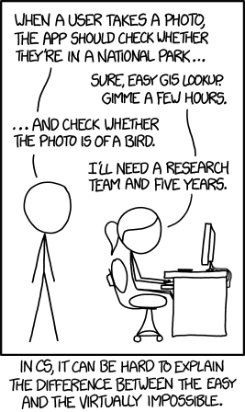
Frequently Asked Questions
How can I get better at programming?
  Practice!
How can I learn to X?
  Search online, read books, look at examples :)
What should I work on next?
  Anything you can think of! (Here are some ideas)
  Beware: it’s hard to tell what’s easy and what’s hard.
Should I learn another language? Which one?
  That depends–what do you want to do?
What’s the best programming language?
  😠 (take CSE 341 or CSE 413)

Slide 9

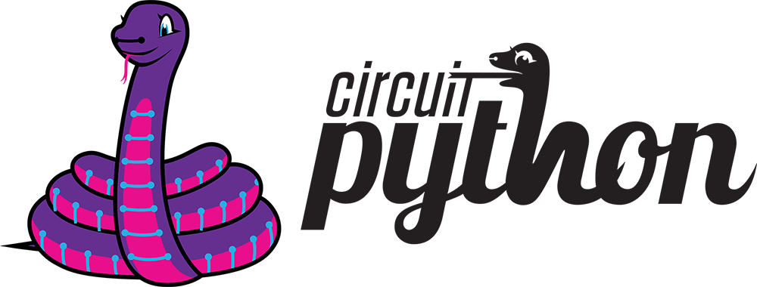

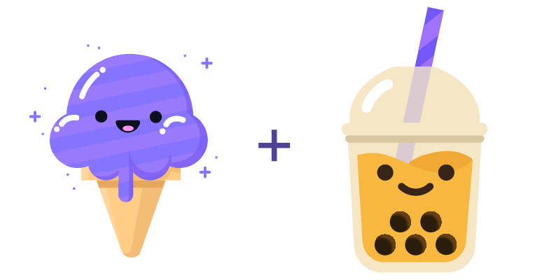

Aside: Cute Programming Language Logos

Slide 10
Summer Project: Tic Tac Toe (1/2)
Build your own Tic Tac Toe game (and “AI”)!
How would you represent a Tic Tac Toe game in Java?
(hint: arrays will be very, very helpful!)
Write a method that tells you if a Tic Tac Toe game is won (or playable).
Write a method that gets input from the user and “makes” a move.
Wrap it all up – into a nice two-player game!

Slide 11
Summer Project: Tic Tac Toe (2/2)
Wait, there’s more!
Make some “AI” that…
just makes a random valid move (you should be able to beat this!)
tries to make a “good” move (~ some if statements)
never loses
  Tic Tac Toe is a “solved game”: a perfect player will never lose.
Or, extend this idea to other grid-based games!
similar-ish: connect four, checkers, battleship
much harder: sudoku, chess, go, othello

Slide 12
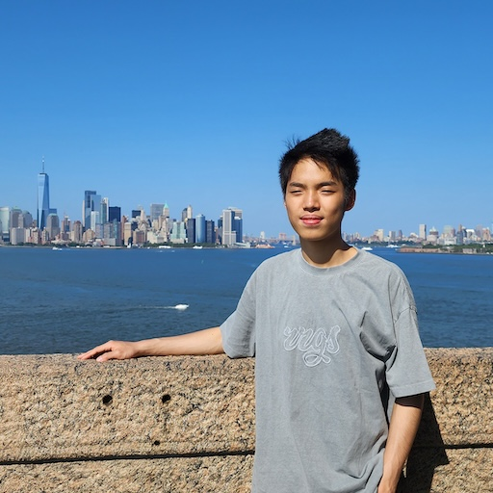

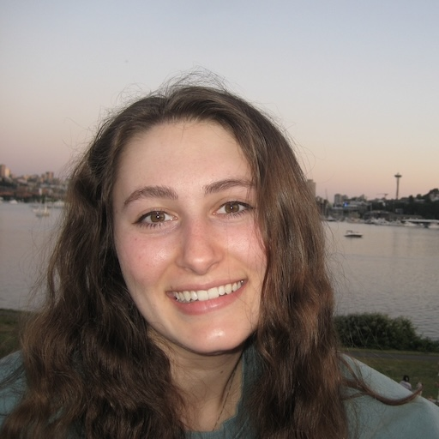
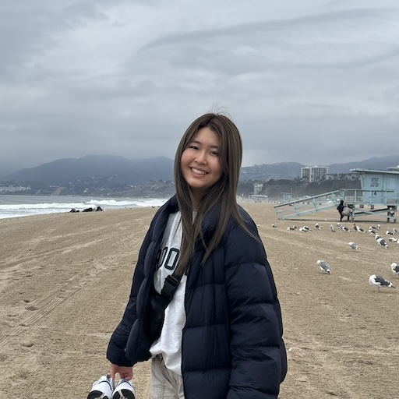
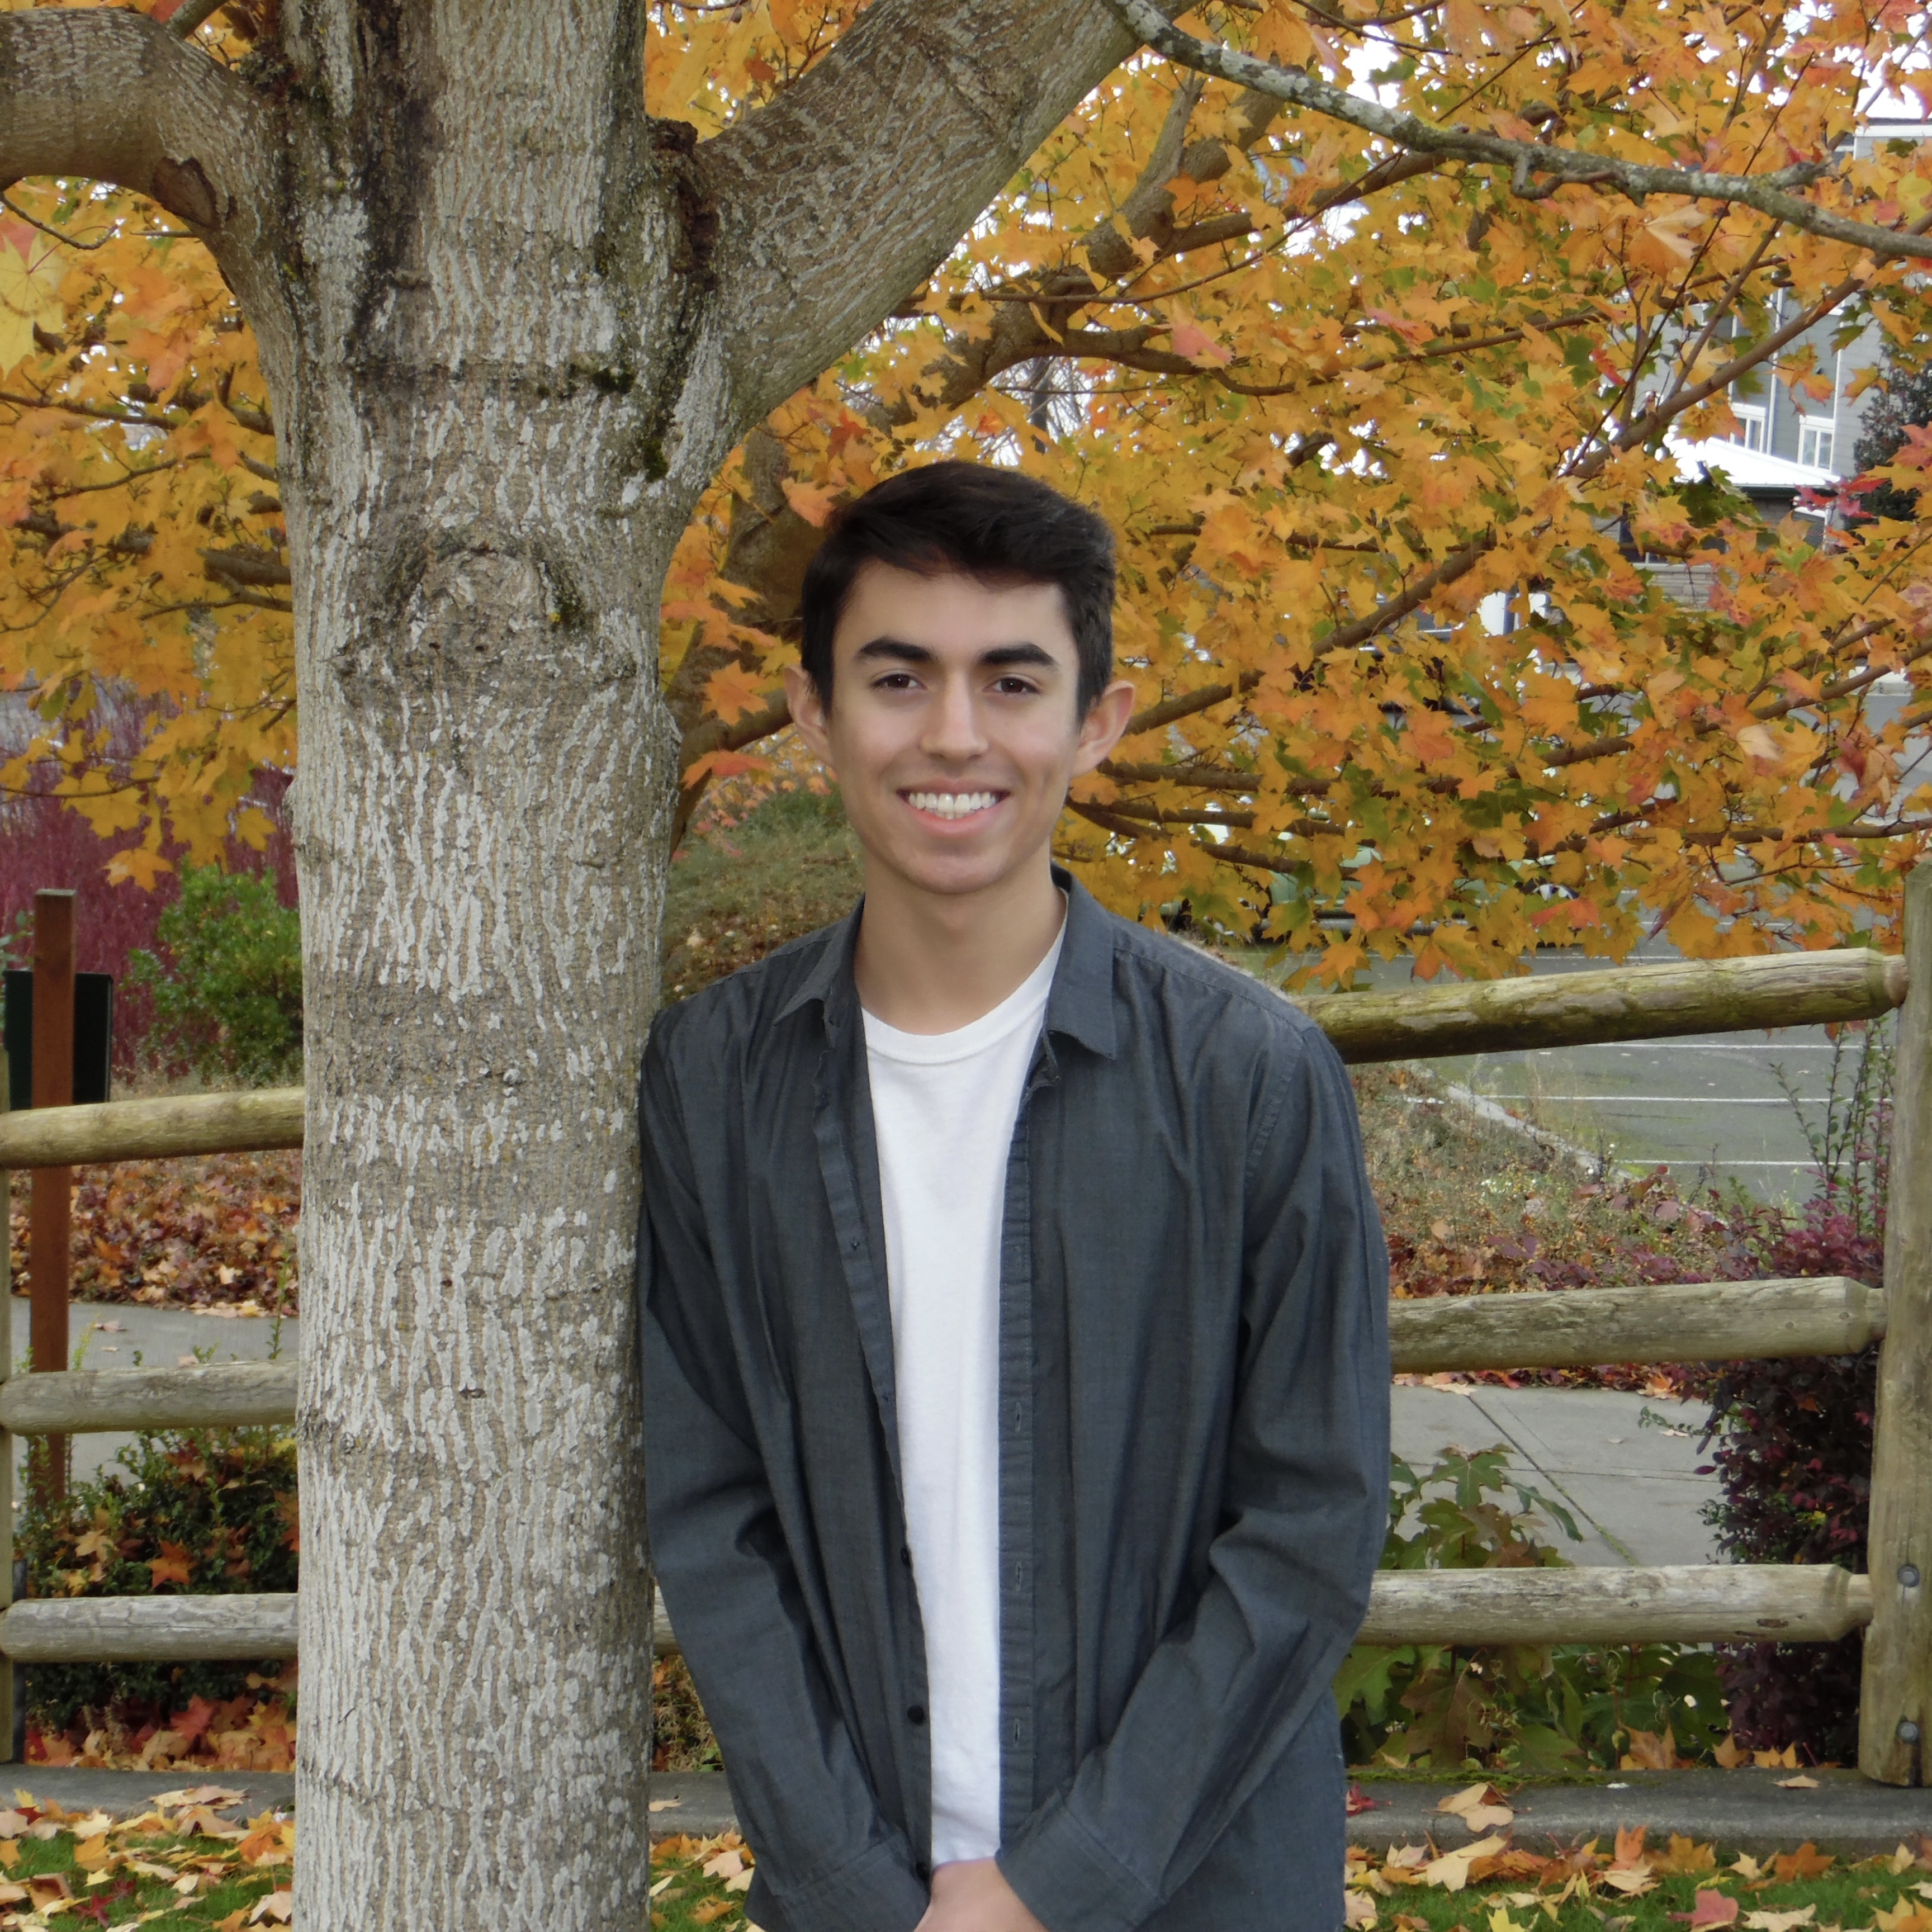
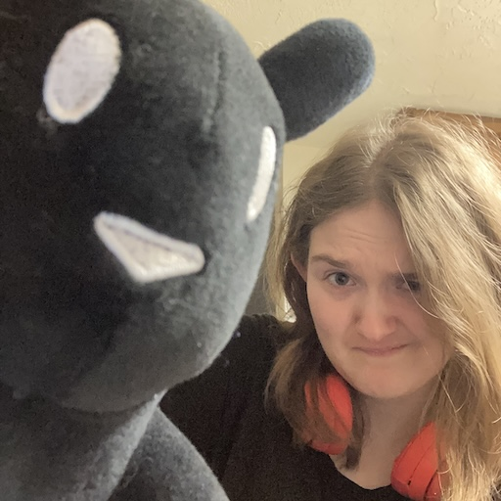
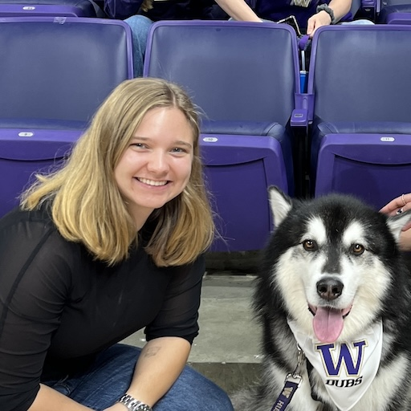
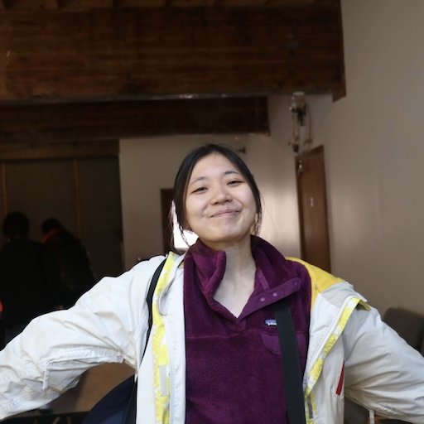
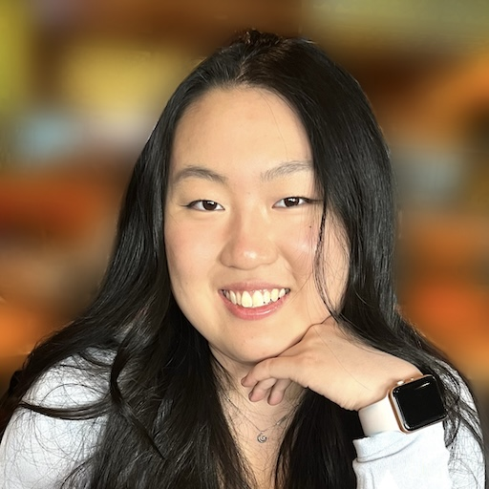
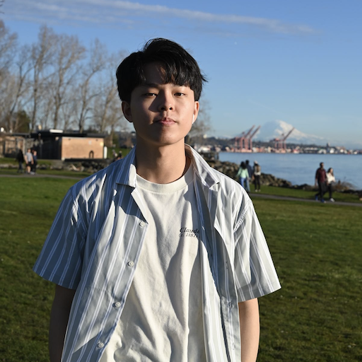
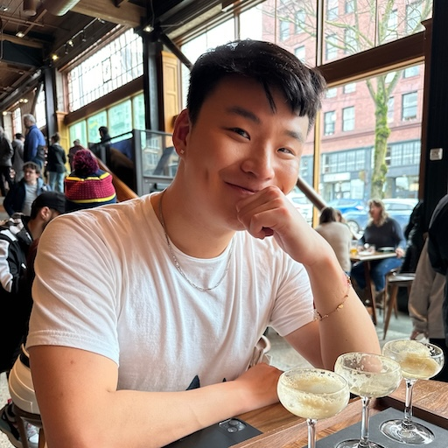
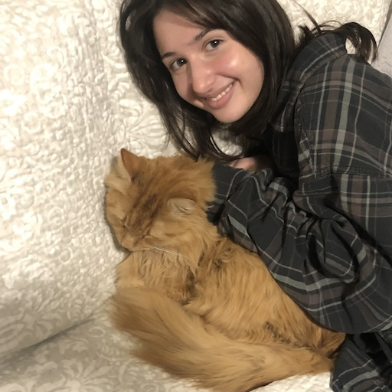
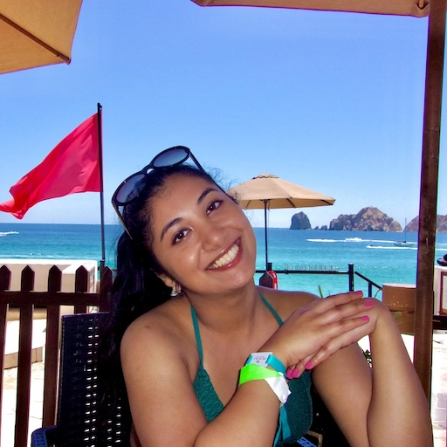
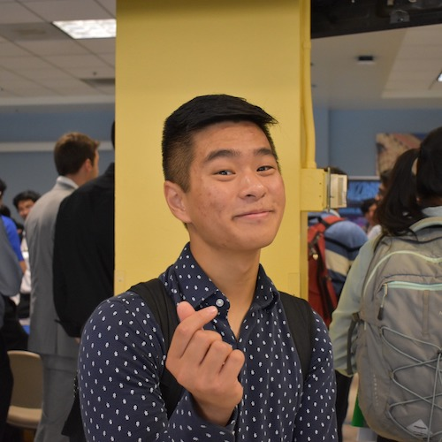
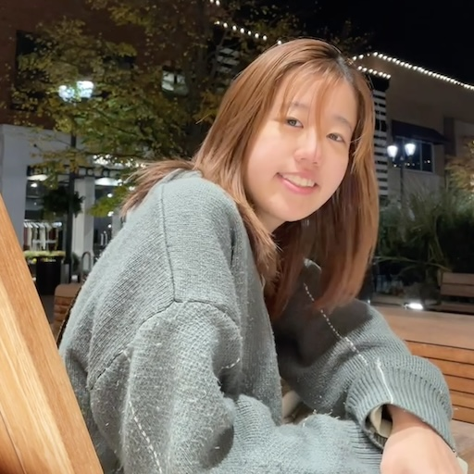

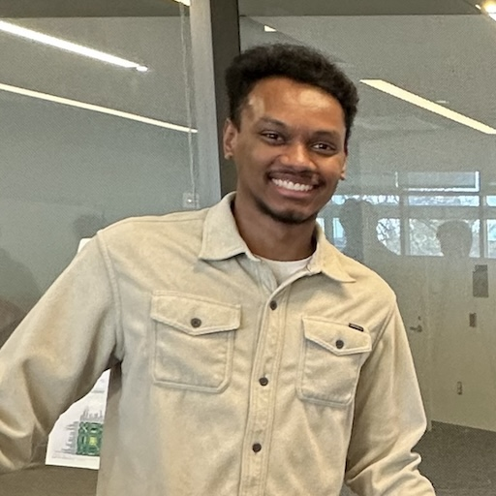



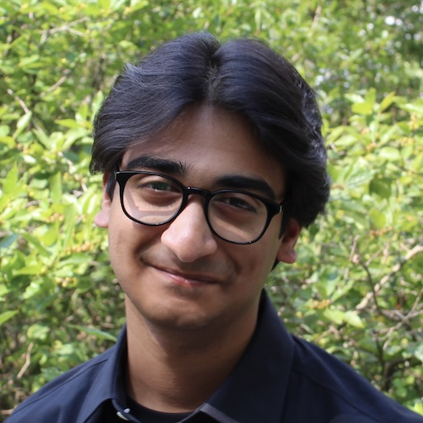
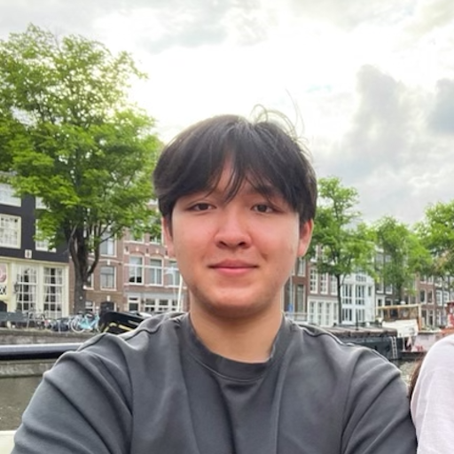

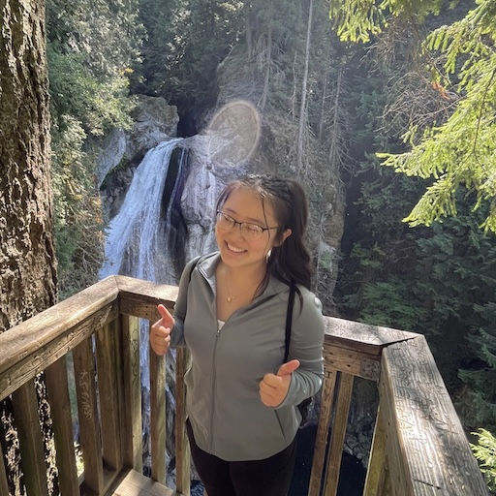
Thank your lovely TAs!!!!!!

Slide 13
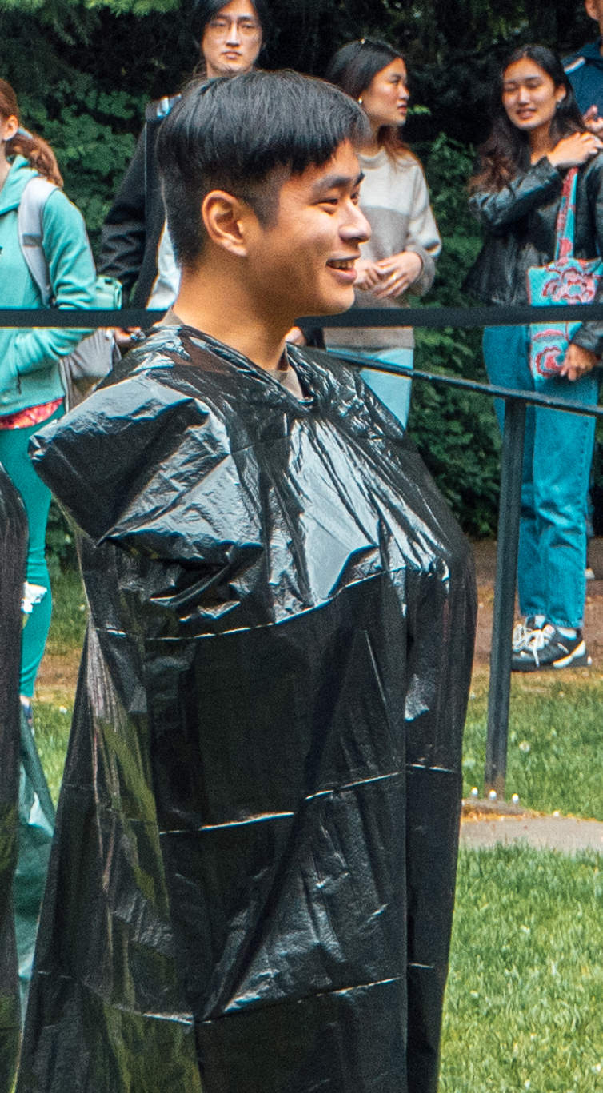
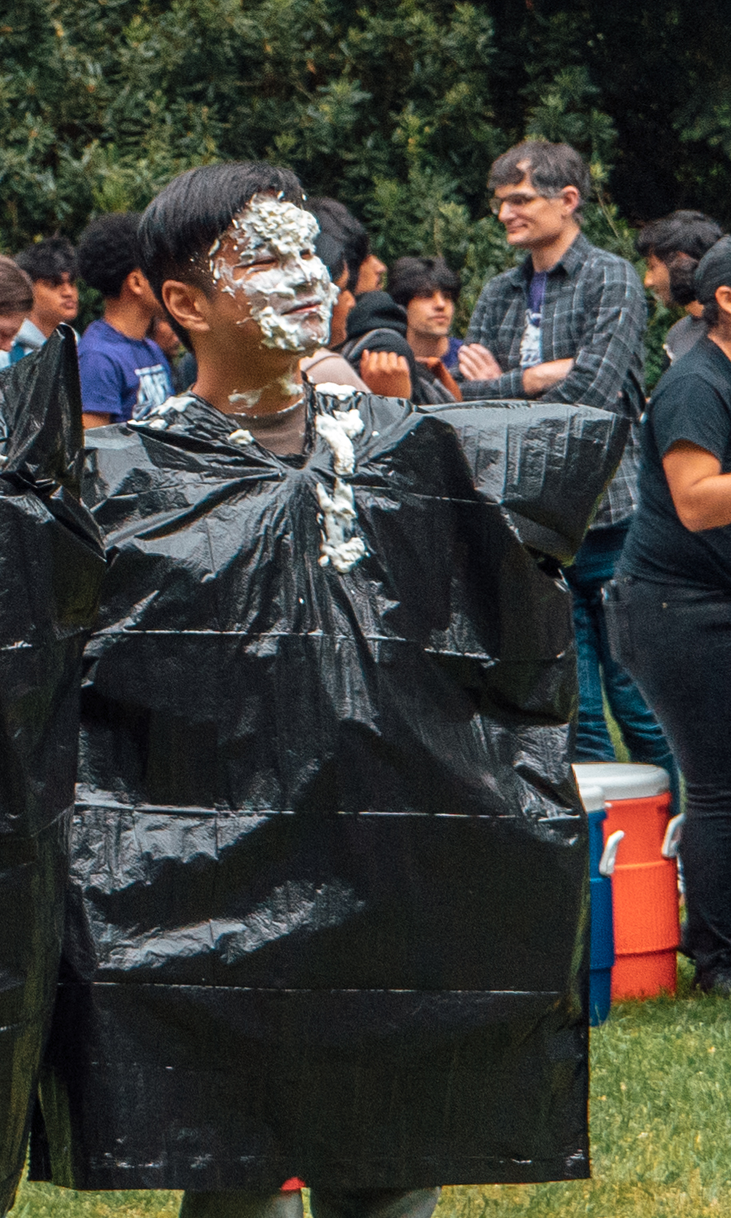
Thank you!
Ask Me (Almost) Anything!
sli.do #cse121-19

