Slide 1
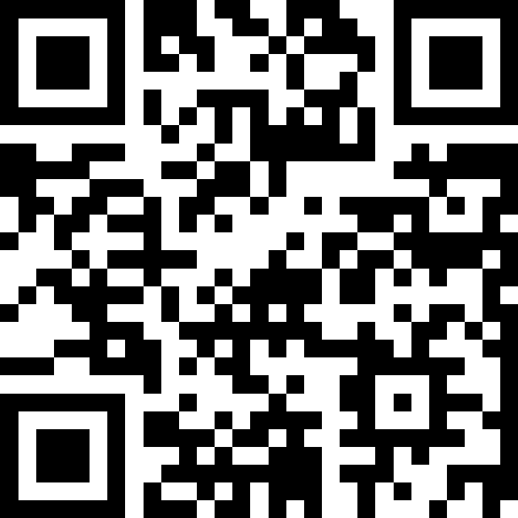
Final Exam Review
BEFORE WE START
Talk to your neighbors:
What was your favorite topic from the course?
LEC 16
Music: ♣️CSE 121 25su Lecture Tunes ♣️
Instructor:
Hannah Swoffer
TAs:
Abby
Hannah
Julia
Merav
Trey

Slide 2
Announcements, Reminders (general)
R7 due Thu, August 21st at 11:59pm – all assignments eligible
Extra resub due Friday, August 22nd at 5:00 PM – all assignments eligible
  Emails were sent to those who have completed 9 PSWs
Today is the last day for IPL & instructor office hours
Final Exam: Friday, August 22nd from 12:00 - 1:00pm in JHN 075
  Review the Exam page of website (with policies & resources)
Gumball meetup TODAY from 2:30 - 4:00pm near Drumheller Fountain!!

Slide 3
Evaluations and Awards
Please give us feedback!
Course Evals are due Friday, August 22nd at 11:59 PM
TA Evals are due Sunday, August 24th at 11:59 PM
Bob Bandes TA award nominations open!
thought your TA was the goat? write them a nomination!
fun fact: some of our faculty won the award when they were TAs!

Slide 4
Future Courses
More 12X!
or “What can I do next?”
Course | Overview
CSE 122 | Data structures, object-oriented programming
CSE 123 | More OOP, recursion
Non-majors
Course | Overview
CSE 154 | Intro. to web programming (several languages)
CSE 160 | Intro programming, data analysis (Python)
CSE 163 | Intermediate programming, data analysis (Python)
CSE 180 | Introduction to data science (Python)
CSE 373 | Data structures and algorithms (in Java)
CSE 374 | Low-level programming and tools (C/C++)
CSE 412 | Intro to Data Visualization
CSE 416 | Intro. to Machine Learning
CSE 493E | Accessibility
Majors
Course | Overview
CSE 311 | Mathematical foundations
CSE 331 | Software design/implementation
CSE 340 | Interaction programming (mobile apps)
CSE 341 | Programming languages (!!)
CSE 351 | Hardware / Software Interface
Other tech-related majors:
Informatics, ACMS, HCDE, Electrical & Computer Engineering, …
See: https://www.cs.washington.edu/academics/ugrad/current-students and https://www.cs.washington.edu/academics/ugrad/nonmajor-options/nonmajor-courses

Slide 5
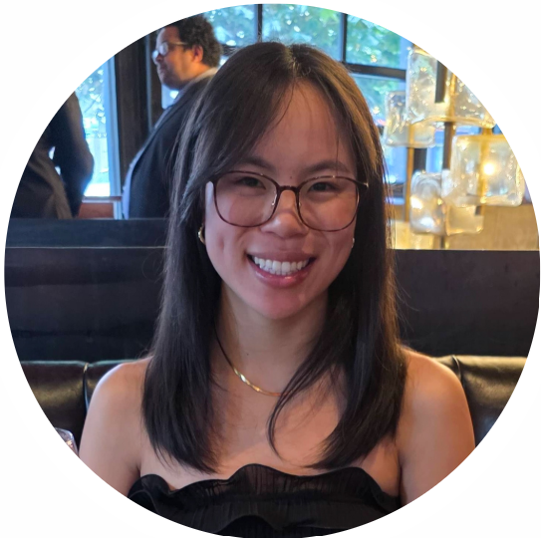
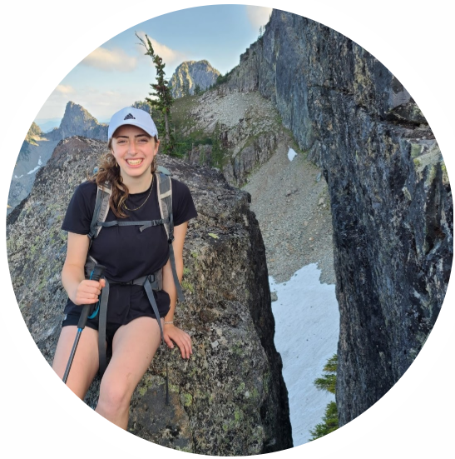
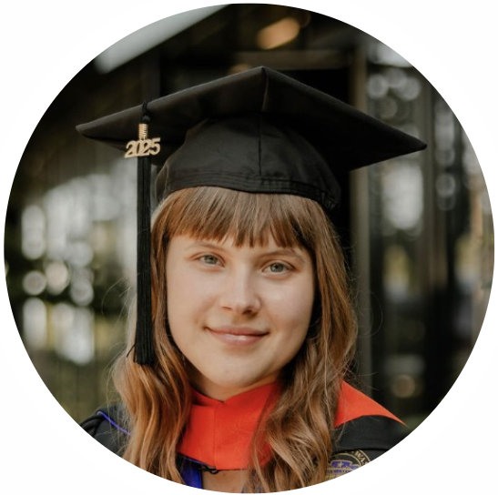
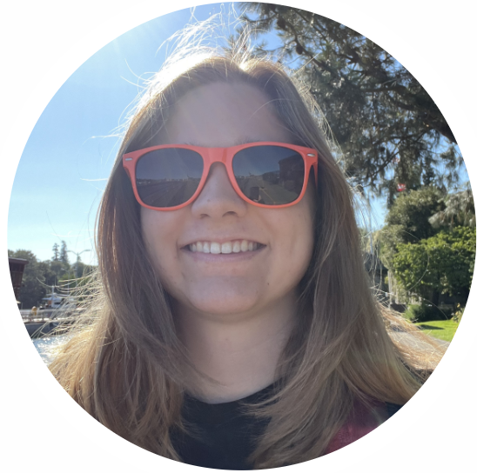
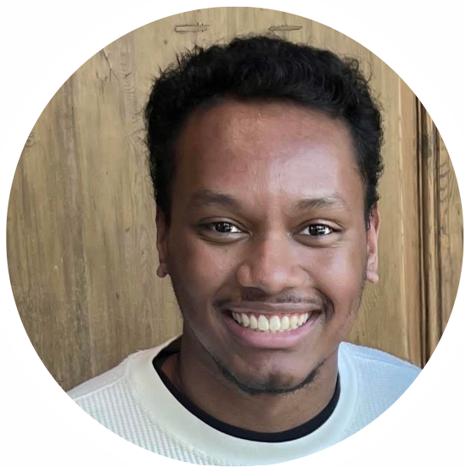
Thank your lovely TAs!

Slide 6
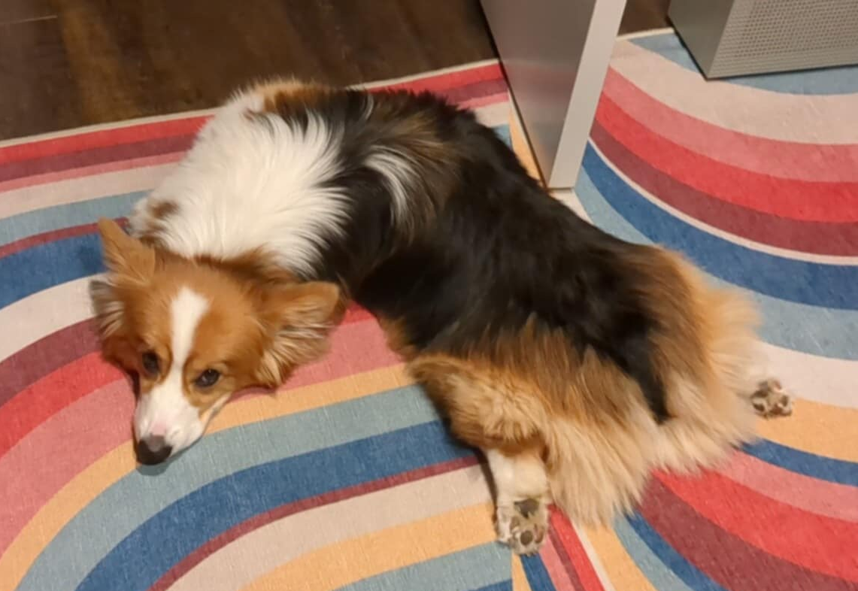
Thank you!

Slide 7
In-Class Exam Review
Mini-exam overview
  This mini-final does not necessarily reflect the difficulty and length of the actual final
  Opportunity to try exam-style problems on paper
3 problems
  Code comprehension
  Debugging
  Programming
Task for today:
  Work through each problem (one at a time) independently
  Then, your lovely TAs will walk through their solutions and thought processes for each problem

