Slide 1
2D Arrays
BEFORE WE START
Talk to your neighbors:
What’s left on your 2024-25 academic year bucket list?
LEC 14
Music: ♣️CSE 121 25su Lecture Tunes ♣️
Instructor:
Hannah Swoffer
TAs:
Abby
Hannah
Julia
Merav
Trey

Slide 2
Announcements, Reminders
C3 due tonight
P3 will be released later today, due Wednesday, August 20th
R6 will be released later today, due Tuesday, August 19th
  Eligible: C2, P2, C3
Quiz 2 is tomorrow
  Reference sheet linked from the Quiz 2 Practice Quizzes post
  Conditionals, while Loops, User Input (Scanner), Arrays
Quiz 2 Practice Quizzes released; very helpful resources for the quiz

Slide 3

Announcements, Reminders
In the future
  Gumball meetup on Wednesday, August 20th from 2:30-4:00 PM near Drumheller Fountain
  Final exam on Friday, August 22nd from 12:00-1:00 PM during lecture

Slide 4
Announcements, Reminders
PSW extra resubmission
  If you’ve attended 9 sections, you will receive an email on Tuesday, August 19th with a link to R8
  Due Friday, August 22nd at 5:00 PM
  Check Canvas to see how many you’ve completed
  Details about the PSW → Extra Resub posted on Ed!
2D Array section
  Since Quiz 2 is tomorrow, the 2D array section won’t happen until Tuesday, August 19th but P3 relies heavily on 2D arrays
  Therefore, this section will release at 1:30pm today with walkthrough videos filmed by the TAs and I that explain the problems
  Details in the 2D Array Section / P3 Ed Post

Slide 5
Reference Mystery: think
public static void main(String[] args) {
int x = 0;
int[] a = new int[4];
x++;
mystery(x, a);
System.out.println(x + " " + Arrays.toString(a));
x++;
mystery(x, a);
System.out.println(x + " " + Arrays.toString(a));
}
public static void mystery(int x, int[] a) {
x++;
a[x]++;
System.out.println(x + " " + Arrays.toString(a));
}
Four lines of output are produced by this code. What would those four lines be?

Slide 6
Reference Mystery: pair
public static void main(String[] args) {
int x = 0;
int[] a = new int[4];
x++;
mystery(x, a);
System.out.println(x + " " + Arrays.toString(a));
x++;
mystery(x, a);
System.out.println(x + " " + Arrays.toString(a));
}
public static void mystery(int x, int[] a) {
x++;
a[x]++;
System.out.println(x + " " + Arrays.toString(a));
}
Four lines of output are produced by this code. What would those four lines be?

Slide 7

PCM Review: 2D Arrays
An array of arrays!
The type of each individual element is another array!
Your first example of “nested data structures”
There will be more if you take CSE 122!
int[][]
double[][]
String[][]
boolean[][]
char[][]

Slide 8
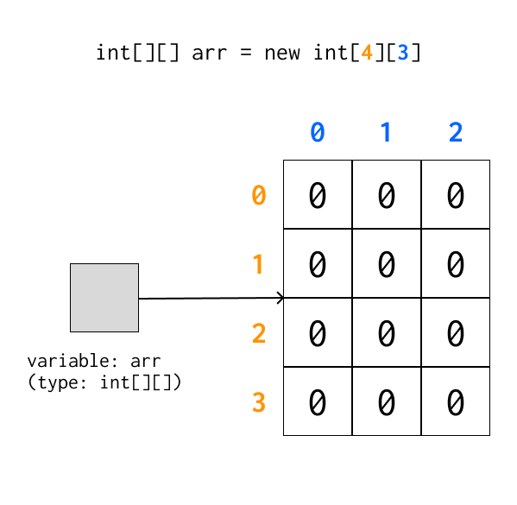
PCM Review: 2D Arrays as Rows and Columns
Can think of the two dimensions as “rows” and “columns”.
Individual elements are row-first, then column (“row-major”)
arr[2][1]

Slide 9
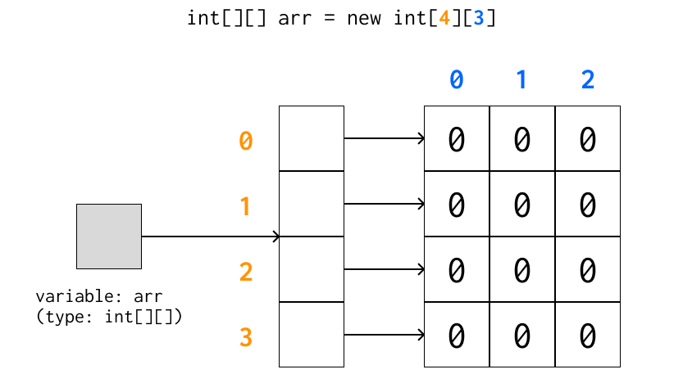
A more accurate view (reference semantics)

Slide 10
PCM Review: 2D Array Traversals
for each row…
for (int i = 0; i < list.length; i++) {
for (int j = 0; j < list[i].length; j++) {
// do something with list[i][j]
}
}
for each element within a row…

Slide 11
Arrays Utility Class (and methods)
Method | Description
Arrays.toString(array); | Returns a String representing the array, such as "[10, 30, -25, 17]"
Arrays.equals(array1, array2); | Returns true if the two arrays contain the same elements in the same order
Arrays.deepToString(array); | Returns a String representing the array; if the array contains other arrays as elements, the String represents their contents, and so on. For example, "[[99, 151], [30, 5]]"
Arrays.deepEquals(array1, array2); | Returns true if the two arrays contain the same elements in the same order; if the array(s) contain other arrays as elements, their contents are tested for equality, and so on.

Slide 12
Applications of 2D Arrays
Matrices
  Useful in so many applications in math, engineering, and statistics
  Fundamental to machine learning & AI
  P3 is one real-life application of this! (bioinformatics)
Board games
  e.g. chess, checkers, tic-tac-toe, sudoku
Tabular or grid-like data
  e.g. scorekeeping, gradebook, census data
Image processing

Slide 13
matrixAdd
23 | 96 | 18 | 4 | 64
45 | 40 | 18 | 44 | 34
92 | 13 | 77 | 71 | 12
93 | 169 | 84 | 83 | 103
136 | 115 | 91 | 143 | 81
119 | 77 | 98 | 105 | 13
70 | 73 | 66 | 79 | 39
91 | 75 | 73 | 99 | 47
27 | 64 | 21 | 34 | 1

Slide 14
matrixAdd: first row
23 | 96 | 18 | 4 | 64
45 | 40 | 18 | 44 | 34
92 | 13 | 77 | 71 | 12
i: 0
j: 0
93 | 169 | 84 | 83 | 103
136 | 115 | 91 | 143 | 81
119 | 77 | 98 | 105 | 13
70 | 73 | 66 | 79 | 39
91 | 75 | 73 | 99 | 47
27 | 64 | 21 | 34 | 1

Slide 15
matrixAdd: 0,0
23 | 96 | 18 | 4 | 64
45 | 40 | 18 | 44 | 34
92 | 13 | 77 | 71 | 12
i: 0
j: 0
93
70 | 73 | 66 | 79 | 39
91 | 75 | 73 | 99 | 47
27 | 64 | 21 | 34 | 1

Slide 16
matrixAdd: 0,1
23 | 96 | 18 | 4 | 64
45 | 40 | 18 | 44 | 34
92 | 13 | 77 | 71 | 12
i: 0
j: 1
93 | 169
70 | 73 | 66 | 79 | 39
91 | 75 | 73 | 99 | 47
27 | 64 | 21 | 34 | 1

Slide 17
matrixAdd: 0,2
23 | 96 | 18 | 4 | 64
45 | 40 | 18 | 44 | 34
92 | 13 | 77 | 71 | 12
i: 0
j: 2
93 | 169 | 84
70 | 73 | 66 | 79 | 39
91 | 75 | 73 | 99 | 47
27 | 64 | 21 | 34 | 1

Slide 18
matrixAdd: 0,3
23 | 96 | 18 | 4 | 64
45 | 40 | 18 | 44 | 34
92 | 13 | 77 | 71 | 12
i: 0
j: 3
93 | 169 | 84 | 83
70 | 73 | 66 | 79 | 39
91 | 75 | 73 | 99 | 47
27 | 64 | 21 | 34 | 1

Slide 19
matrixAdd: 0,4
23 | 96 | 18 | 4 | 64
45 | 40 | 18 | 44 | 34
92 | 13 | 77 | 71 | 12
i: 0
j: 4
93 | 169 | 84 | 83 | 103
70 | 73 | 66 | 79 | 39
91 | 75 | 73 | 99 | 47
27 | 64 | 21 | 34 | 1

Slide 20
matrixAdd: 1,0
23 | 96 | 18 | 4 | 64
45 | 40 | 18 | 44 | 34
92 | 13 | 77 | 71 | 12
i: 1
j: 0
93 | 169 | 84 | 83 | 103
136
70 | 73 | 66 | 79 | 39
91 | 75 | 73 | 99 | 47
27 | 64 | 21 | 34 | 1

Slide 21
matrixAdd: 1,1
23 | 96 | 18 | 4 | 64
45 | 40 | 18 | 44 | 34
92 | 13 | 77 | 71 | 12
i: 1
j: 1
93 | 169 | 84 | 83 | 103
136 | 115
70 | 73 | 66 | 79 | 39
91 | 75 | 73 | 99 | 47
27 | 64 | 21 | 34 | 1

Slide 22
matrixAdd: 1,2
23 | 96 | 18 | 4 | 64
45 | 40 | 18 | 44 | 34
92 | 13 | 77 | 71 | 12
i: 1
j: 2
93 | 169 | 84 | 83 | 103
136 | 115 | 91
70 | 73 | 66 | 79 | 39
91 | 75 | 73 | 99 | 47
27 | 64 | 21 | 34 | 1

Slide 23
matrixAdd: 1,3
23 | 96 | 18 | 4 | 64
45 | 40 | 18 | 44 | 34
92 | 13 | 77 | 71 | 12
i: 1
j: 3
93 | 169 | 84 | 83 | 103
136 | 115 | 91 | 143
70 | 73 | 66 | 79 | 39
91 | 75 | 73 | 99 | 47
27 | 64 | 21 | 34 | 1

Slide 24
matrixAdd: 1,4
23 | 96 | 18 | 4 | 64
45 | 40 | 18 | 44 | 34
92 | 13 | 77 | 71 | 12
i: 1
j: 4
93 | 169 | 84 | 83 | 103
136 | 115 | 91 | 143 | 81
70 | 73 | 66 | 79 | 39
91 | 75 | 73 | 99 | 47
27 | 64 | 21 | 34 | 1

Slide 25
matrixAdd: 2,0
23 | 96 | 18 | 4 | 64
45 | 40 | 18 | 44 | 34
92 | 13 | 77 | 71 | 12
i: 2
j: 0
93 | 169 | 84 | 83 | 103
136 | 115 | 91 | 143 | 81
119
70 | 73 | 66 | 79 | 39
91 | 75 | 73 | 99 | 47
27 | 64 | 21 | 34 | 1

Slide 26
matrixAdd: 2,1
23 | 96 | 18 | 4 | 64
45 | 40 | 18 | 44 | 34
92 | 13 | 77 | 71 | 12
i: 2
j: 1
93 | 169 | 84 | 83 | 103
136 | 115 | 91 | 143 | 81
119 | 77
70 | 73 | 66 | 79 | 39
91 | 75 | 73 | 99 | 47
27 | 64 | 21 | 34 | 1

Slide 27
matrixAdd: 2,2
23 | 96 | 18 | 4 | 64
45 | 40 | 18 | 44 | 34
92 | 13 | 77 | 71 | 12
i: 2
j: 2
93 | 169 | 84 | 83 | 103
136 | 115 | 91 | 143 | 81
119 | 77 | 98
70 | 73 | 66 | 79 | 39
91 | 75 | 73 | 99 | 47
27 | 64 | 21 | 34 | 1

Slide 28
matrixAdd: 2,3
23 | 96 | 18 | 4 | 64
45 | 40 | 18 | 44 | 34
92 | 13 | 77 | 71 | 12
i: 2
j: 3
93 | 169 | 84 | 83 | 103
136 | 115 | 91 | 143 | 81
119 | 77 | 98 | 105
70 | 73 | 66 | 79 | 39
91 | 75 | 73 | 99 | 47
27 | 64 | 21 | 34 | 1

Slide 29
matrixAdd: 2,4
23 | 96 | 18 | 4 | 64
45 | 40 | 18 | 44 | 34
92 | 13 | 77 | 71 | 12
i: 2
j: 4
93 | 169 | 84 | 83 | 103
136 | 115 | 91 | 143 | 81
119 | 77 | 98 | 105 | 13
70 | 73 | 66 | 79 | 39
91 | 75 | 73 | 99 | 47
27 | 64 | 21 | 34 | 1

Slide 30
matrixAdd: finished!
23 | 96 | 18 | 4 | 64
45 | 40 | 18 | 44 | 34
92 | 13 | 77 | 71 | 12
93 | 169 | 84 | 83 | 103
136 | 115 | 91 | 143 | 81
119 | 77 | 98 | 105 | 13
70 | 73 | 66 | 79 | 39
91 | 75 | 73 | 99 | 47
27 | 64 | 21 | 34 | 1

Slide 31
readData: processing input
How many days' data would you like to input? 3
Next day's data:
Temperature in Seattle? 44
Temperature in Tacoma? 40
Temperature in Bothell? 43
Next day's data:
Temperature in Seattle? 42
Temperature in Tacoma? 40
Temperature in Bothell? 44
Next day's data:
Temperature in Seattle? 42
Temperature in Tacoma? 41
Temperature in Bothell? 43
...

Slide 32
readData: days
How many days' data would you like to input? 3
Next day's data:
Temperature in Seattle?
Temperature in Tacoma?
Temperature in Bothell?
Next day's data:
Temperature in Seattle?
Temperature in Tacoma?
Temperature in Bothell?
Next day's data:
Temperature in Seattle?
Temperature in Tacoma?
Temperature in Bothell?
...
 | Seattle | Tacoma | Bothell
1
2
3

Slide 33
readData: 1, Seattle
How many days' data would you like to input? 3
Next day's data:
Temperature in Seattle? 44
Temperature in Tacoma?
Temperature in Bothell?
Next day's data:
Temperature in Seattle?
Temperature in Tacoma?
Temperature in Bothell?
Next day's data:
Temperature in Seattle?
Temperature in Tacoma?
Temperature in Bothell?
...
 | Seattle | Tacoma | Bothell
1 | 44
2
3

Slide 34
readData: 1, Tacoma
How many days' data would you like to input? 3
Next day's data:
Temperature in Seattle? 44
Temperature in Tacoma? 40
Temperature in Bothell?
Next day's data:
Temperature in Seattle?
Temperature in Tacoma?
Temperature in Bothell?
Next day's data:
Temperature in Seattle?
Temperature in Tacoma?
Temperature in Bothell?
...
 | Seattle | Tacoma | Bothell
1 | 44 | 40
2
3

Slide 35
readData: 1, Bothell
How many days' data would you like to input? 3
Next day's data:
Temperature in Seattle? 44
Temperature in Tacoma? 40
Temperature in Bothell? 43
Next day's data:
Temperature in Seattle?
Temperature in Tacoma?
Temperature in Bothell?
Next day's data:
Temperature in Seattle?
Temperature in Tacoma?
Temperature in Bothell?
...
 | Seattle | Tacoma | Bothell
1 | 44 | 40 | 43
2
3

Slide 36
readData: 2, Seattle
How many days' data would you like to input? 3
Next day's data:
Temperature in Seattle? 44
Temperature in Tacoma? 40
Temperature in Bothell? 43
Next day's data:
Temperature in Seattle? 42
Temperature in Tacoma?
Temperature in Bothell?
Next day's data:
Temperature in Seattle?
Temperature in Tacoma?
Temperature in Bothell?
...
 | Seattle | Tacoma | Bothell
1 | 44 | 40 | 43
2 | 42
3

Slide 37
readData: 2, Tacoma
How many days' data would you like to input? 3
Next day's data:
Temperature in Seattle? 44
Temperature in Tacoma? 40
Temperature in Bothell? 43
Next day's data:
Temperature in Seattle? 42
Temperature in Tacoma? 40
Temperature in Bothell?
Next day's data:
Temperature in Seattle?
Temperature in Tacoma?
Temperature in Bothell?
...
 | Seattle | Tacoma | Bothell
1 | 44 | 40 | 43
2 | 42 | 40
3

Slide 38
readData: 2, Bothell
How many days' data would you like to input? 3
Next day's data:
Temperature in Seattle? 44
Temperature in Tacoma? 40
Temperature in Bothell? 43
Next day's data:
Temperature in Seattle? 42
Temperature in Tacoma? 40
Temperature in Bothell? 44
Next day's data:
Temperature in Seattle?
Temperature in Tacoma?
Temperature in Bothell?
...
 | Seattle | Tacoma | Bothell
1 | 44 | 40 | 43
2 | 42 | 40 | 44
3

Slide 39
readData: 2, Seattle
How many days' data would you like to input? 3
Next day's data:
Temperature in Seattle? 44
Temperature in Tacoma? 40
Temperature in Bothell? 43
Next day's data:
Temperature in Seattle? 42
Temperature in Tacoma? 40
Temperature in Bothell? 44
Next day's data:
Temperature in Seattle? 42
Temperature in Tacoma?
Temperature in Bothell?
...
 | Seattle | Tacoma | Bothell
1 | 44 | 40 | 43
2 | 42 | 40 | 44
3 | 42

Slide 40
readData: 2, Tacoma
How many days' data would you like to input? 3
Next day's data:
Temperature in Seattle? 44
Temperature in Tacoma? 40
Temperature in Bothell? 43
Next day's data:
Temperature in Seattle? 42
Temperature in Tacoma? 40
Temperature in Bothell? 44
Next day's data:
Temperature in Seattle? 42
Temperature in Tacoma? 41
Temperature in Bothell?
...
 | Seattle | Tacoma | Bothell
1 | 44 | 40 | 43
2 | 42 | 40 | 44
3 | 42 | 41

Slide 41
readData: 2, Bothell
How many days' data would you like to input? 3
Next day's data:
Temperature in Seattle? 44
Temperature in Tacoma? 40
Temperature in Bothell? 43
Next day's data:
Temperature in Seattle? 42
Temperature in Tacoma? 40
Temperature in Bothell? 44
Next day's data:
Temperature in Seattle? 42
Temperature in Tacoma? 41
Temperature in Bothell? 43
...
 | Seattle | Tacoma | Bothell
1 | 44 | 40 | 43
2 | 42 | 40 | 44
3 | 42 | 41 | 43

Slide 42
computeAverages
How many days' data would you like to input? 3
…
The average values for each location were [42.666666666666664, 40.333333333333336, 43.333333333333336]
 | Seattle | Tacoma | Bothell
1 | 44 | 40 | 43
2 | 42 | 40 | 44
3 | 42 | 41 | 43
42.667 | 40.333 | 43.333
Average of Seattle temperatures
(44 + 42 + 42) / 3

