Slide 1
While Loops
BEFORE WE START
Talk to your neighbors:
What’s your favorite spot
on the ave?
LEC 10
Music: ♣️CSE 121 25su Lecture Tunes ♣️
Instructor:
Hannah Swoffer
TAs:
Abby
Hannah
Julia
Merav
Trey

Slide 2
Agenda
Mid-Quarter Lecture Feedback
Announcements, Reminders
While loop review
Code Examples!

Slide 3
Mid-Quarter Lecture Feedback
Please take 10 mins to fill out this survey
TAs and I will leave the room
My goal: make lecture as beneficial as I can for you all
Link to form: https://forms.gle/iatNF5brTJ7mHSqg7
  Can also be found in the Ed post titled “25su Mid-Quarter Lecture Feedback Tomorrow During Class”

Slide 4
Agenda
Mid-Quarter Lecture Feedback
Announcements, Reminders
While loop review
Code Examples!

Slide 5
Announcements, Reminders
P2 released this morning; due Tuesday, August 5th
R4 releases later today; due Tuesday, August 5th
  Eligible: C1, P1, C2
  Note: C1 is cycling out of eligibility for resubmission
Quiz reminders:
  Quiz 0 feedback released last Friday!
  Quiz 1: TOMORROW Thursday, July 31st
    Practice quizzes are very helpful study resources
    Sick? Do not come to your quiz.
    Instead, email me, before the start of your quiz section.

Slide 6
Agenda
Mid-Quarter Lecture Feedback
Announcements, Reminders
While loop review
Code Examples!

Slide 7
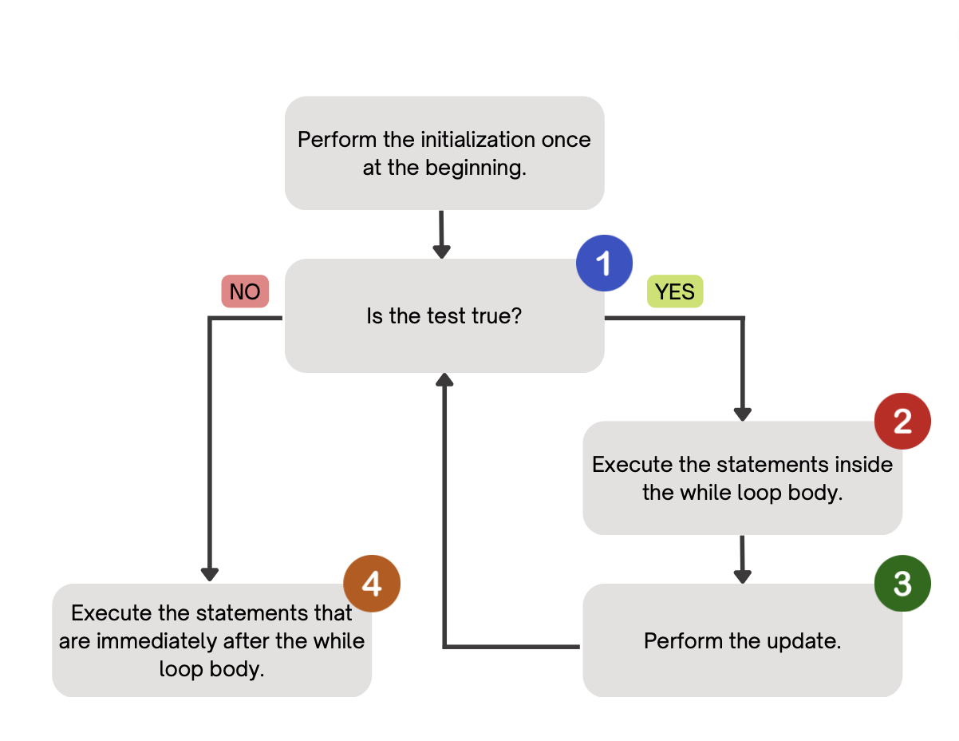
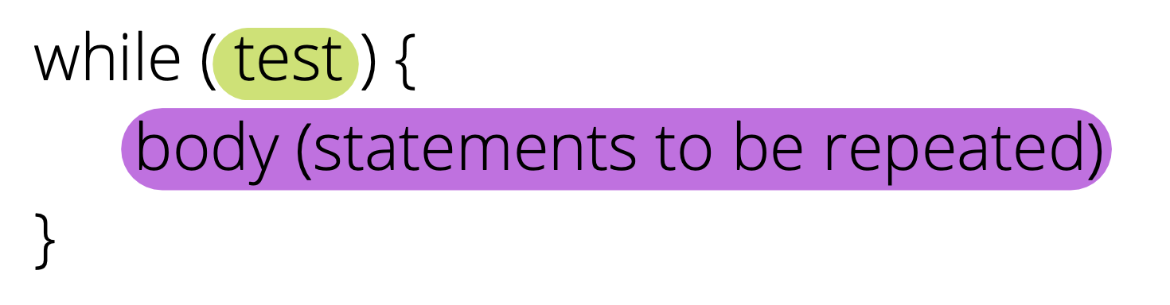
PCM Review: while loops
Repeatedly executes its body as long as the logical test is true.

Slide 8
for loops are while loops?
for (int i = 0; i < bigYikes; i++) {
// ...
}
int i = 0;
while (i < bigYikes) {
// ...
i++;
}

Slide 9
for loops are while loops! (almost*)
for (int i = 0; i < bigYikes; i++) {
// ...
}
int i = 0;
while (i < bigYikes) {
// ...
i++;
}
*as a technical note, these aren’t exactly the same – there are some minor technical details that are different, most notably the scope of i is different in the two loops

Slide 10
for loops vs. while loops ⚔️
For loops and while loops are quite similar! This is the first (but certainly not the last) time where you need to decide which to use!
There’s not always a “correct” answer, but some advice:
is the condition definite or indefinite
Describing the problem!
  “I will do __ X times” or “for each __ I will __” – sounds like for!
  “I will do __ until” or “while __ is true, I will” – sounds like while!
it’s okay to change your mind after you try one approach!

Slide 11
Agenda
Mid-Quarter Lecture Feedback
Announcements, Reminders
While loop review
Code Examples!

Slide 12
Think Pair Share: mystery (think)
public static void mystery(Random randy, int lucky) {
int roll = -1; // "priming" the loop
int x = -1;
while (roll != lucky) {
roll = randy.nextInt(20) + 1;
if (x < roll) {
x = roll;
}
}
System.out.println("x: "+ x);
System.out.println("lucky number: " + roll);
}
How would you describe what the variable x calculates?
The largest value rolled
The smallest value rolled
The last value rolled
The first value rolled
The sum of all values rolled

Slide 13
Think Pair Share: mystery (pair)
public static void mystery(Random randy, int lucky) {
int roll = -1; // "priming" the loop
int x = -1;
while (roll != lucky) {
roll = randy.nextInt(20) + 1;
if (x < roll) {
x = roll;
}
}
System.out.println("x: "+ x);
System.out.println("lucky number: " + roll);
}
How would you describe what the variable x calculates?
The largest value rolled
The smallest value rolled
The last value rolled
The first value rolled
The sum of all values rolled

