Slide 1
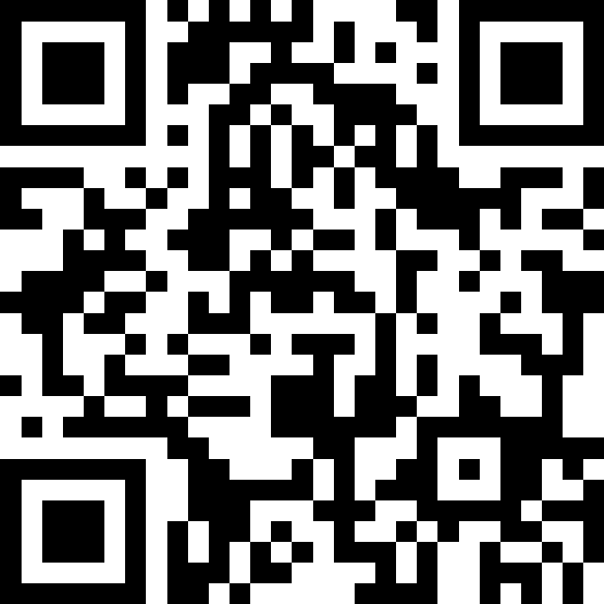
Printing, Strings, and Variables
BEFORE WE START
Talk to your neighbors:
What’s your favourite YouTube or Twitch channel to watch?
LEC 00
Music: 121 25wi lecture playlist ❄️
Instructor:
Matt Wang
TAs:
Ailsa Alice Chloë Christopher
Ethan Hanna Hannah Hibbah
Janvi Judy Julia Kelsey
Lucas Luke Maitreyi Merav
Ruslana Samrutha Sam Shayna
Sushma Vivian

Slide 2
Announcements, Reminders
Check out website for links to all activities & materials
Creative Project 0 will be out tonight, due Wednesday, Jan 15th
Please do the intro survey by Sunday, Jan 12th
gives us valuable insight!
part of “post-section work” (will explain in a moment!)
important that Google Forms works in CSE 121
New Ed tool: Sandbox (write all the code you want!)
Matt has office hours today at 1:30! (in CSE 464 and on Zoom)

Slide 3
Aside: office hours as a resource!
The IPL (TA office hours) will open on Monday (Jan 13) at 12:30 PM.
one of the best parts of the course!
but, TAs are instructed to not just give you the answer!
why not? you wouldn’t be learning!
e.g. “my code doesn’t work” versus “I tried X, expected Y, but got Z. Thoughts on what to try next?”
also true for Matt’s office hours too ;)
Expect an announcement on Ed with a detailed schedule soon!

Slide 4
Assessment
Why assessment?
Our goal: you gain proficiency of the concepts and skills we teach
We assess your proficiency by asking you to apply these concepts and skills on tasks
By necessity, we are assessing your work as a proxy for proficiency

Slide 5
Resubmissions
Learning takes time and doesn’t always happen on the first try!
Each week, one previous assignment or project can be resubmitted
Must be accompanied by reflection explaining your change(s)
Grade on resubmission replaces original grade
Assignments eligible for only 3 “cycles” after feedback released
We’ll discuss more after our first assignment is graded. See syllabus!

Slide 6
Post-Section Work (PSW)
A “nudge” system: on section days with no quiz, you’ll have a light homework problem and/or set of reflection questions due at midnight.
graded on effort (and intentionally short)
in quiz section, will do the problem & leave time to reflect
your reflections are very helpful to your TAs!
If you complete 12/16 post-section works, you’ll get an extra resub!
no direct grade impact, think of it as optional/extra credit
first PSW is intro survey (w/ special due date, Sunday)

Slide 7
Grading Scheme
Grades should reflect proficiency in course objectives.
All assignments, quizzes, and exams are graded with an “E/S/N” grade:
E (Excellent)
S (Satisfactory)
N (Not Yet)

Slide 8
Grading Assessments
E/S/N (or ESN) grades per assessment type:
Programming Assignments: 4 ESN grades (4 assignments, 16 total)
Creative Projects: 1 ESN grade (4 projects, 4 total)
Quizzes: 3 ESN grades (3 quizzes, 9 total)
Final Exam: 6 ESN grades
We will also ignore your lowest 2 quiz/final exam grades.

Slide 9
Course Grades
We provide a “minimum grade guarantee” for translating to a numeric grade, but not a direct formula.
Much more on this in the syllabus! (and over the next few weeks)
Minimum Grade | Requirements
Total ESN available | 33
3.5 | 27 Es and 3 additional S+
3.0 | 22 Es and 5 additional S+
2.5 | 17 Es and 7 additional S+
2.0 | 21 S+
1.5 | 14 S+
0.7 | 8 S+

Slide 10
Collaboration Policy
When we assess your work in this class, we need to know that it’s yours. Unless specified otherwise, all graded work must be completed individually.
Some rules to highlight:
do not share your own solution code or view solution code from any source – including (but not limited to) other students, tutors, or the internet
do not use AI tools (e.g. ChatGPT) on graded work in any capacity
See syllabus for more details (this is very important to understand).

Slide 11
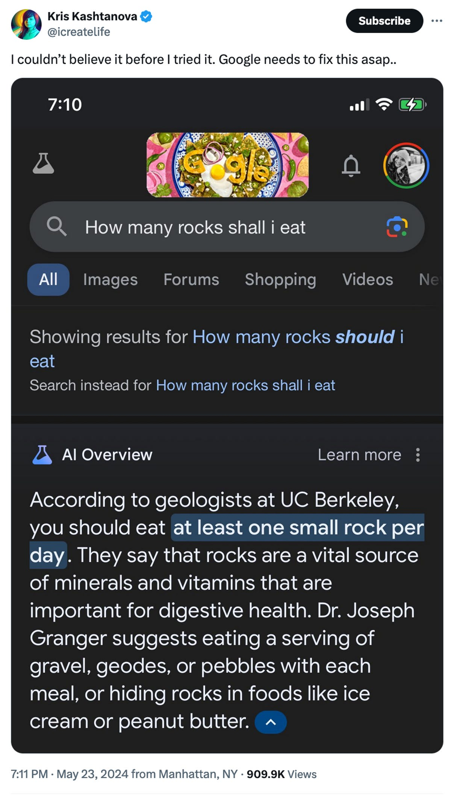
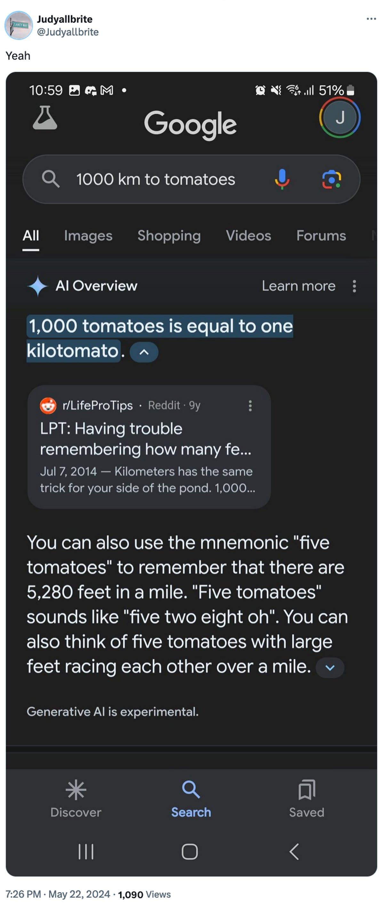
AI gone wrong?
Courtesy “Glue in Pizza? Eat Rocks? Google’s AI Search Is Mocked for Bizarre Answers” by Ian Sherr for CNET. May 24, 2024

Slide 12
Just a bit more on AI…
With generative AI tools, there’s a few things going on:
making sure that your assessed work is yours
just the same as other interactive resources
making sure that you’re learning correct information
hard for you to judge if you’re a beginner!
potential environmental & ethical concerns
outside of scope of 121, but important!
Happy to talk more about this if you’d like! (e.g. in office hours)

Slide 13
Closing the Loop: Inclusive Learning
In the most reductive/short summary, I saw five big buckets:
small group environments!
environments that encourage asking questions (and vulnerability)
genuine and respectful engagement in conversation
teachers who care and are enthusiastic
getting to know others in your community (e.g. your peers)
For more, see my “End of Week 0” Ed post!

Slide 14
Think Pair Share: different hello worlds (think)
1
2
3
4
5
6
How many lines of output would the following code produce?
System.out.println("hello");
System.out.print("moi");
System.out.print("bonjour");
System.out.println("pryvit");
System.out.print("nihao");
System.out.println("hola");

Slide 15
Think Pair Share: different hello worlds (Pair)
1
2
3
4
5
6
How many lines of output would the following code produce?
System.out.println("hello");
System.out.print("moi");
System.out.print("bonjour");
System.out.println("pryvit");
System.out.print("nihao");
System.out.println("hola");

Slide 16
Escape sequences
escape sequence: a special sequence of characters used to represent certain special characters in a String.
\" to produce " in a String
\\ to produce \ in a String
\n to produce a new line character (or line break) in a String
note: in our class, we will ask you not to use this
and many more!

Slide 17
What’s in a (variable) name or String?
Switch over to Ed and do some experiments (with a partner), then report back on sli.do.
What types of characters are “allowed” in Strings?
What types of characters are “allowed” in variable names?
sli.do #cse121

Slide 18
Food for Thought!
This is the beginning of a very interesting rabbit hole!
(but also, a decision made by the Java designers)
Whether or not you program for a career, you will also make decisions like these!
for example, what’s a “valid name”?
a theme we’ll revisit (and something to continuously reflect on!)

Slide 19
Creative Project 0 (“C0”): Hello Bugs?! (1/2)
By release date of assignment, all the relevant content will be covered.
e.g. C0 is just about printing, strings, and escape characters
Assignments are partially about “does your program work”, but also:
tests your ability to read a specification
is graded on code quality
includes a graded reflection (don’t leave this to the last minute)
some metacognition, some societal impact & ethics content

Slide 20
Creative Project 0 (“C0”): Hello Bugs?! (2/2)
This specific assignment…
has two parts: “Basic Task” and “Creative Extension” (do both!)
has an optional set of code quality slides (to help you practice)
intentional gentle onboarding to computer programming
is not meant to be time-consuming or stressful
but also, not representative of all assignments (or programs)
We look forward to seeing your bugs!!

Slide 21
Announcements, Reminders (again)
Check out website for links to all activities & materials
Creative Project 0 will be out tonight, due Wednesday, Jan 15th
Please do the intro survey by Sunday, Jan 12th
gives us valuable insight!
part of “post-section work” (will explain in a moment!)
important that Google Forms works in CSE 121
New Ed tool: Sandbox (write all the code you want!)
Matt has office hours today at 1:30! (in CSE 464 and on Zoom)

