Slide 1
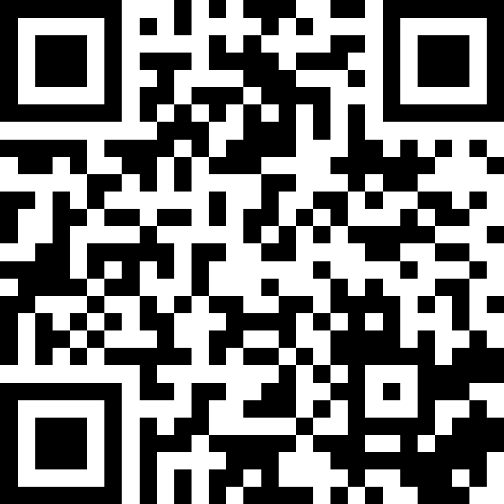
Welcome!
BEFORE WE START
Talk to your neighbors:
Introduce yourself! What is your name? Major? What did you do over winter break?
LEC 00
Music: 121 25wi lecture playlist ❄️
Instructor:
Matt Wang
TAs:
Ailsa Alice Chloë Christopher
Ethan Hanna Hannah Hibbah
Janvi Judy Julia Kelsey
Lucas Luke Maitreyi Merav
Ruslana Samrutha Sam Shayna
Sushma Vivian

Slide 2
Lecture Outline
Today:
Introductions!
About this course
Our learning model
Tools
Our first program!
On Friday:
Assessment and grading
Collaboration
More programming :)

Slide 3
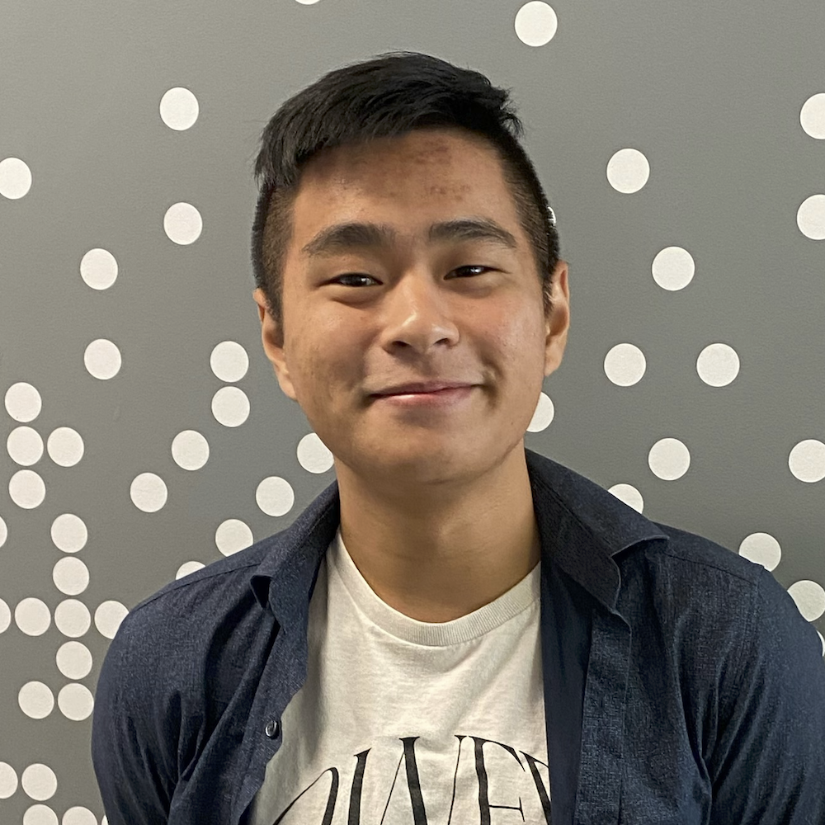
Hi, I’m Matt! (he/him)
new-ish Assistant Teaching Professor in CSE
grew up in Toronto (and sometimes, Tokyo)
went to UCLA!
BS & MS in Computer Science
BS in Math-Economics
CS interests: CS Education, “open-source”, programming languages, accessibility
non-CS interests: reading, music, video games, & winter sports!

Slide 4
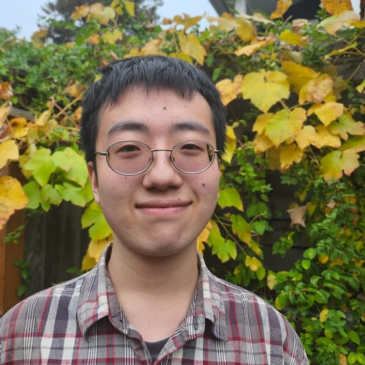
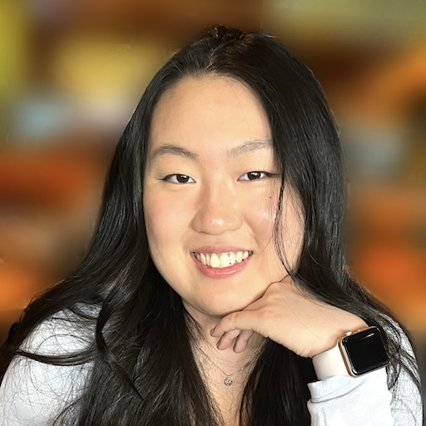
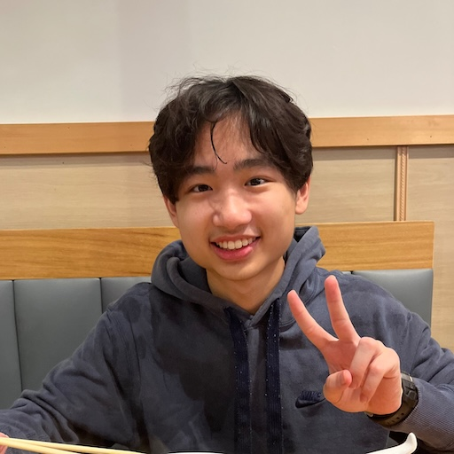
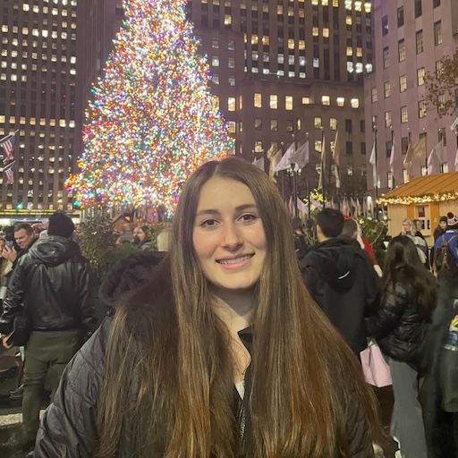
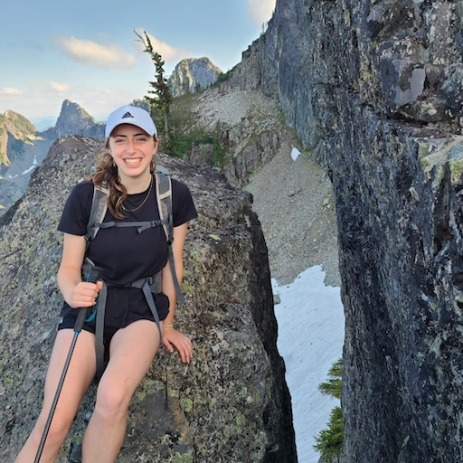
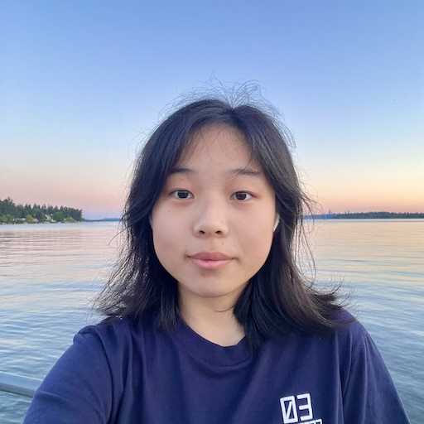
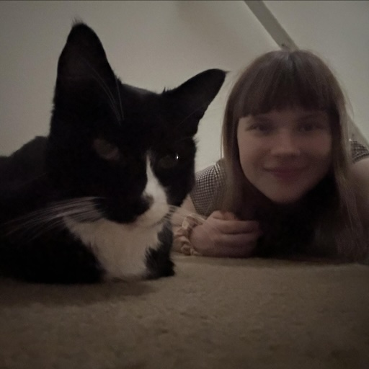
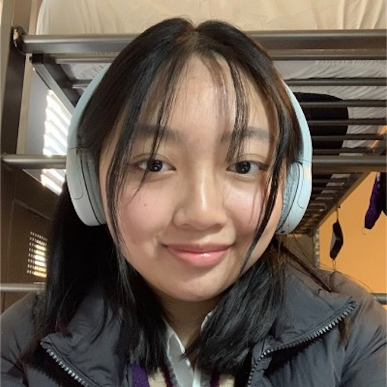
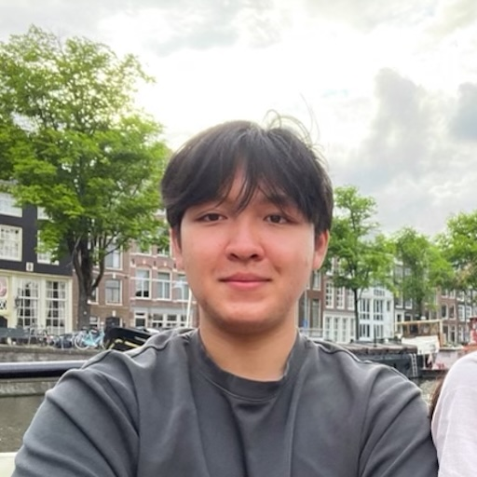
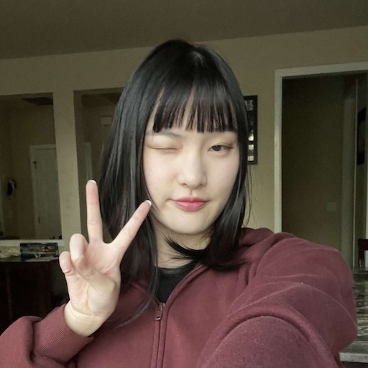
Meet your 22 awesome TAs!

Slide 5
Y’all! (the students)
~ 411 students registered for this course!
wide range of backgrounds, interests, and goals
almost none are CSE majors
everyone is new to programming
strength in numbers!!
411 of you >>> 23 of us
have a question? Almost certain that others do too – please ask!
we’re a learning community!
one focus of quiz section tomorrow: building that community

Slide 6
12x community standards
We watched the 12x community standards video in class!

Slide 7
Think-Pair-Share: Inclusive Environments
CSE 121 will have many think-pair-share activities. Let’s practice! Today’s think:
“What was an experience you had that made you feel welcome or included in a learning environment?”
think on your own, in silence for about ~ 30 seconds
pair with your neighbor about it (and introduce yourself!!)
share in sli.do & in class (I’ll take a few volunteers from both)
later, I’ll go through all responses and summarize :)

Slide 8
Learning Objectives
or, “What will I learn in this class?”
Bottom line: Intro to Programming, part 1
Not quite:
“How do computers work?”
“Intro to Java”
“All you need to program”
Math!
Learning objectives:
Computational Thinking
Code Comprehension
Code Writing
Communication
Testing
Debugging
Ethics & Societal Impact

Slide 9
Other Similar Courses
Course | Good choice if…
CSE 121 (this is us!) | You’ve never programmed before AND You are, or want to be in a major such as CS, CE, ECE, Info, etc. that requires Java programming
CSE 122 | You’ve done some programming (roughly one course worth) in any programming language AND You are, or want to be in a major such as CS, CE, ECE, Info, etc. that requires Java programming
CSE 123 | You’ve taken CSE 122 (or equivalent) AND You are, or want to be in a major such as CS, CE, ECE, Info, etc. that requires Java programming
CSE 143X | You have programmed quite a bit before, but not in Java OR You have lots of extra time to put into learning and tend to pick things up quickly
CSE 160 | You’ve never programmed before AND You’re interested in data science and analysis OR You’d rather learn Python than Java* OR You are, or want to be in a major such as Physics, Bio, Stat, etc. where your primary goal is analyzing data through programming (rather than building software)
Also see: guided self-placement test and CSE page on introductory courses for more info.

Slide 10
Course Components
Meetings
LECTURES
(x20)
SECTIONS
(x16)
We’re here!
Introduce concepts, practice ideas, discuss applications.
Pre-class materials to prepare for class each day. Due before class.
Held in person
More practice, reviews, applications
TA advice, how to be an effective student
Preparation for quizzes / exams
Post-section work done at section or on your own. Due day of section.
Graded Assessments
PROGRAMMING ASSIGNMENTS
(x4)
CREATIVE PROJECTS
(x4)
QUIZZES
(x3)
EXAM
(x1)
Structured assignments
Programming in Java
Applying & implementing course concepts
More open-ended assignments
Explore new ideas and applications
Taken in quiz section
45 minutes on computer
Culminating exam
Tuesday March 18th
12:30 – 2:20 PM

Slide 11
How did you learn how to ride a bike?

Slide 12
How Learning Works
Learning requires active participation.
It’s not as simple as listening to someone talk at you!
Requires deliberate practice in learning by doing
Involves productive struggle
Benefits from collaboration
Does not work well if you cram everything!

Slide 13
Learning in CSE 121: Consistent Practice
Consistent, incremental practice works!
Gradual scale of difficulty (and grading)
Ungraded (but frequent; >2x /week)
pre-class work
lecture activities
quiz section problems*
*extra resub – we’ll explain Friday! (or see syllabus)
Graded (but infrequent; 1/week)
creative projects (4)
programming assignments (4)
quizzes (3)
final exam (1)

Slide 14
Learning in CSE 121: Metacognition
Metacognition: understanding how you think (and got to a solution).
“what problem-solving approaches do I use?”
“how did I rule out alternative solutions?”
“why am I stuck right now? what will unblock me?”
“are my study habits working for me?”
Metacognition is a key CS (and life!) skill; it’s built into our course:
relatively frequent, graded reflections
semi-structured “nudges” (e.g. extra resub from post-section work)
tight feedback loops

Slide 15
Learning in CSE 121: Live Support Systems
Programming is hard! We want to give you collaborative support!
Introductory Programming Lab (TA Office Hours) – starting Week 2
> 40 hours/week (and highly rated in the class!)
face-to-face help from TAs on any course questions
Instructor Office Hours (in-person & Zoom) – starting today!
I don’t byte (most of the time)
Great for things from lecture, personal questions, or just saying hi

Slide 16
Learning in CSE 121: Async Support Systems
Ed Board
Best for content and logistics questions – 411 of you >> 23 of us!!
Encourage public posts, except for things about your graded work
Answer other students’ questions – great way to learn!
Email
Best for personal circumstances and/or private questions
If unsure, always feel free to email Matt at mxw@cs.washington.edu
May politely ask you to post on Ed instead!
For emails, please use your UW email (protecting student privacy!)

Slide 17
The World Around CSE 121 & Reaching Out
Our goal is to give you a great CSE 121 experience!
But, we recognize that CSE 121 doesn’t exist in a vacuum – there’s a lot going on in the world that can impact your education.
We’ve designed course policies for maximum flexibility: resubmissions, dropping quiz/exam problems, asynchronous help & lecture recording.
Please reach out ASAP if you’re struggling or have circumstances that require extra support. We’re happy to help – we just need to know!

Slide 18
Help Us Improve!
This is a relatively new course! We’re always looking for feedback on how to improve the class for you and for future students.
we really value your feedback!
let us know what’s working and what isn’t working for you!
Several feedback mechanisms:
built into the class (e.g. reflections, mid-quarter feedback sessions)
post on discussion board (can be public/private)
note: anonymous is anonymous to other students, not to staff
use CSE’s Anonymous Feedback Tool (also on website)

Slide 19
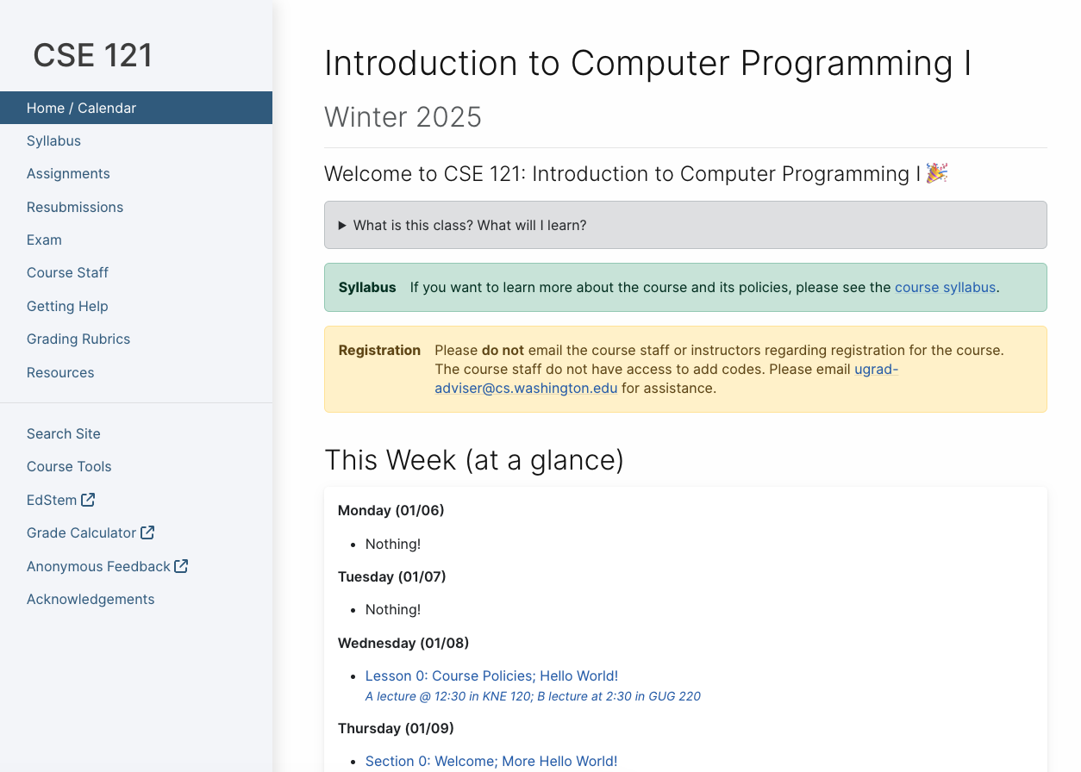
Course Website
cs.uw.edu/121
Primary source of course information (not Canvas)
Calendar will contain links to (almost) all resources
Please review syllabus ASAP
Let’s go on a website tour :)

Slide 20
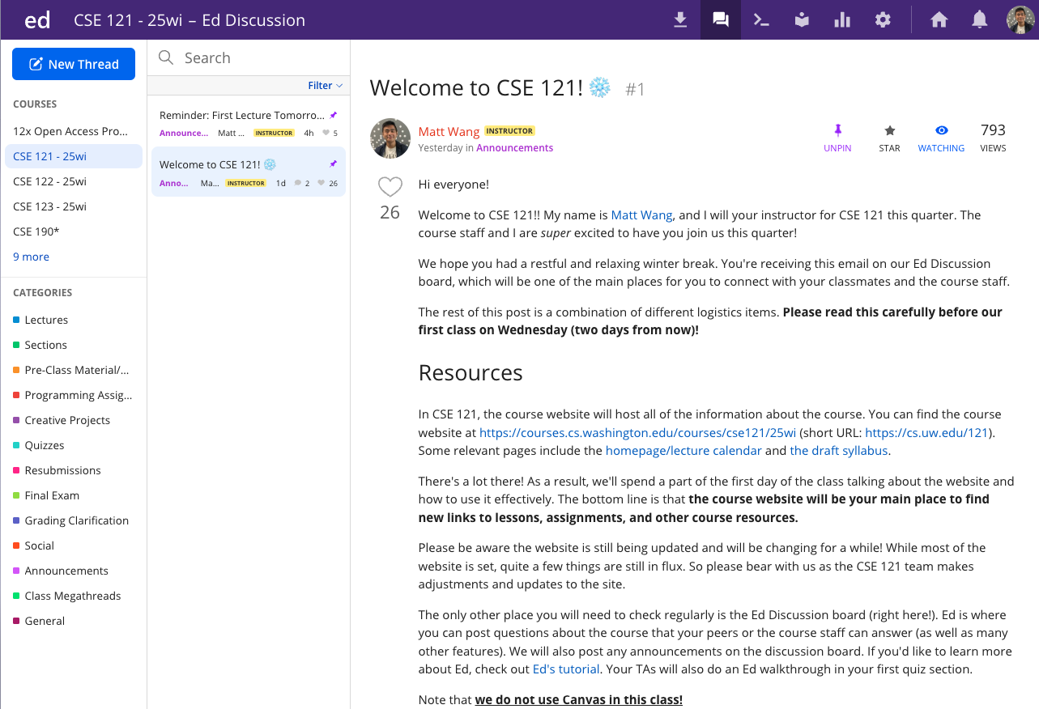
Ed
Our online learning platform
Lessons, sections, quizzes
Place to ask questions
Also, where we’ll code!
Intro and walkthrough in Section 0

Slide 21
Some Other Course Tools
Sli.do
Ask questions in class
Live activities (ungraded)
No account needed
Canvas
Panopto lecture recordings (also linked from website)
Some grades*

Slide 22
Switching to Ed: Our First Program!*
*note: in almost all cases, slides are not comprehensive. reviewing the slides will not cover all the content in lecture!

Slide 23
“Homework” for Next Time
First assignment will be released Friday, but there are some things to do in the meantime.
TODOs this week:
Fill out the introductory survey (this is Thursday’s post-section work)
Go meet your TA and classmates in Thursday’s quiz section
Complete the pre-class material for Friday (see website/calendar)
Check over syllabus details on website

