Slide 1
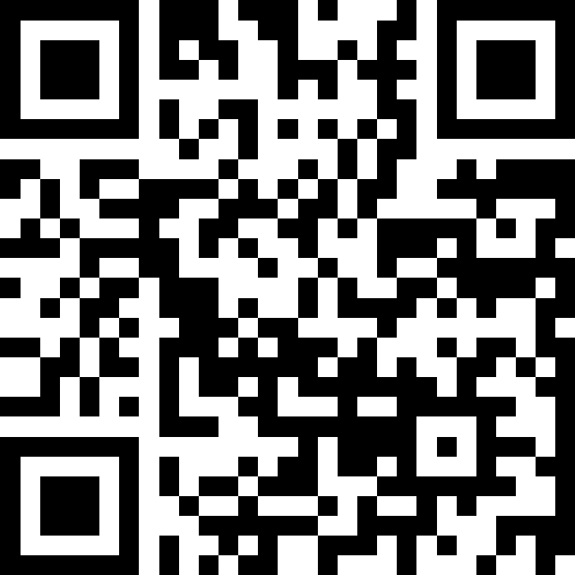
Conditionals
BEFORE WE START
LEC 09
Talk to your neighbors:
How are you doing? (like, actually)
Music: ❄️ CSE 121 26wi Lecture Tunes ❄️
Instructor:
Miya Natsuhara
TAs:
Amogh
William
Johnathan
Anant
Reese
Hayden
Aki
Spencer
Savannah
Tamsyn
Anum
Abdul
Janvi
Navya
Ruslana
Sam
Ethan
Jessica
Paul
Carson
Shayna
Jesse
Minh
Cayden

Slide 2
Announcements, Reminders
C2 released, due Thursday, Feb 12th
R2 out yesterday, due Thursday, Feb 12th
  this is the last time C0 is eligible for resubmission
  "Re-resubmissions" post
Quiz reminders:
  Quiz 0 grades – we're working on it!
  Quiz 1 is on Thursday, Feb 19th

Slide 3
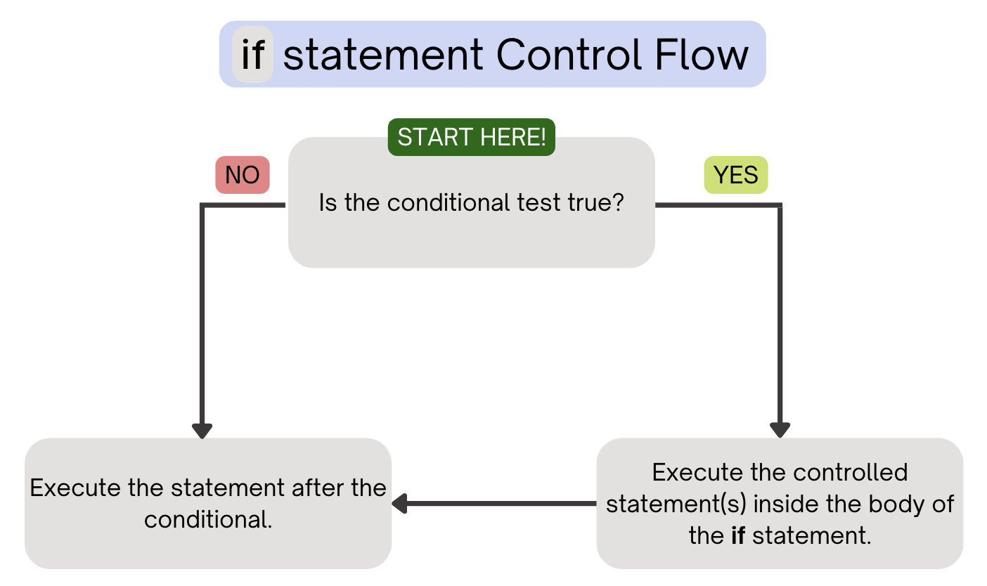
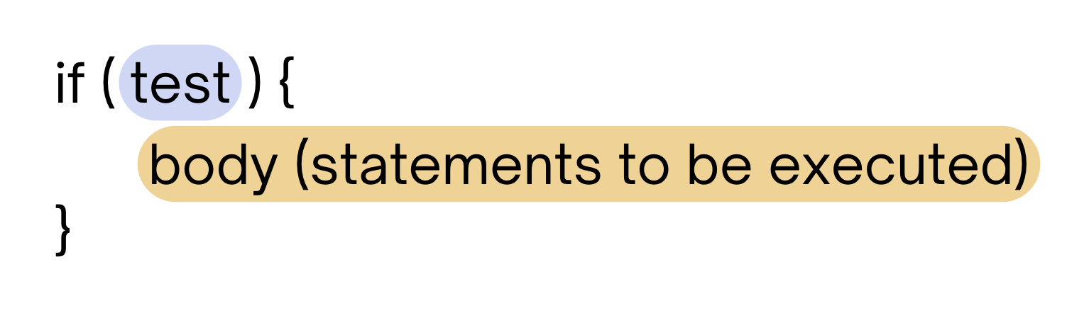
PCM Review: if Statements
Executes a block of statements if and only if the test is true

Slide 4
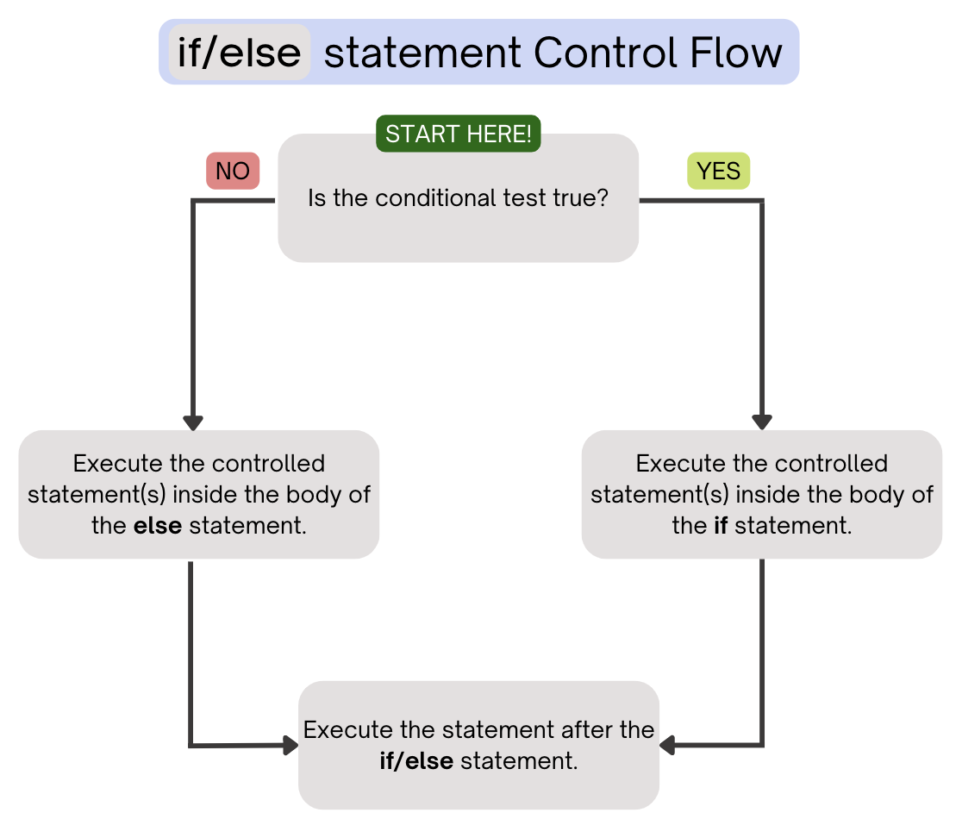
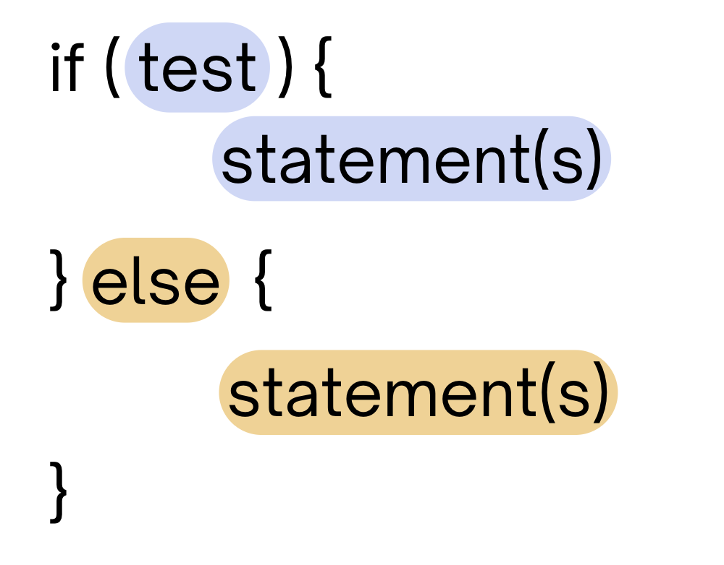
PCM Review: if-else
If the test is true: execute block of statements
If false, execute other block of statements

Slide 5
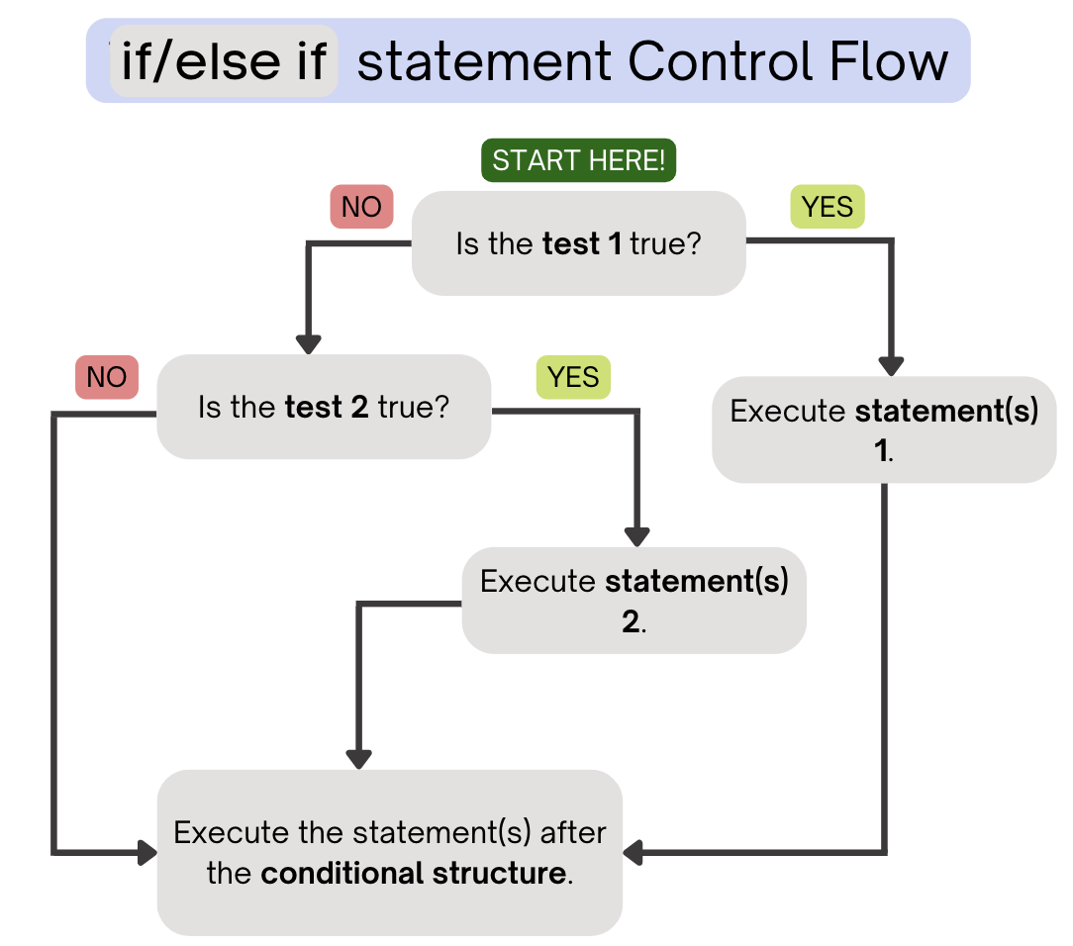
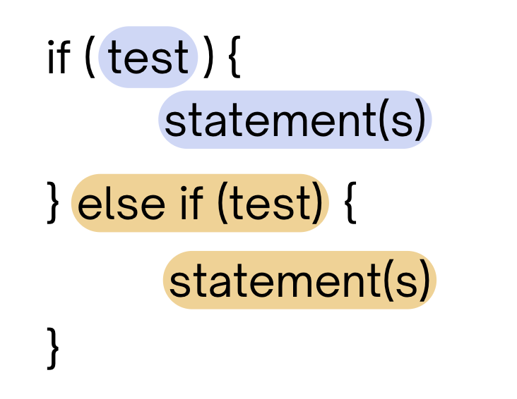
PCM Review: if-else if
If the first test is true, execute that block
If not, proceed to the next test, and repeat
If none were true, don’t execute any blocks
Note After entering an if /else if
block, skip all remaining blocks.

Slide 6
Think Pair Share: Odds and Evens (Think)
public static void main(String[] args) {
for (int i = 1; i <= 3; i++) {
System.out.print(mystery(i));
}
}
public static String mystery(int n) {
String response = "even ";
if (n % 2 == 1) {
response = "odd ";
} else if (n == 1) {
response = "one ";
}
return response;
}
What does this program output?
A. odd even odd
B. one even odd
C. one even even
D. even even even

Slide 7
Think Pair Share: Odds and Evens (Pair)
public static void main(String[] args) {
for (int i = 1; i <= 3; i++) {
System.out.print(mystery(i));
}
}
public static String mystery(int n) {
String response = "even ";
if (n % 2 == 1) {
response = "odd ";
} else if (n == 1) {
response = "one ";
}
return response;
}
What does this program output?
A. odd even odd
B. one even odd
C. one even even
D. even even even

Slide 8
“Useless” Conditionals
public static void main(String[] args) {
for (int i = 1; i <= 3; i++) {
System.out.print(mystery(i));
}
}
public static String mystery(int n) {
String response = "even ";
if (n % 2 == 1) {
response = "odd ";
} else if (n == 1) {
response = "one ";
}
return response;
}
This else if statement never runs!

Slide 9
Common Problem-Solving Strategies
Analogy – Is this similar to another problem you've seen?
Brainstorming – Consider steps to solve problem before jumping into code
  Try to do an example "by hand”, then outline steps
Solve sub-problems – Is there a smaller part of the problem to solve?
Debugging – Does your solution behave correctly?
  What is it doing?
  What do you expect it to do?
  What area of your code controls that part of the output?
Iterative Development – Can we start by solving a different problem that is easier?

