Slide 1
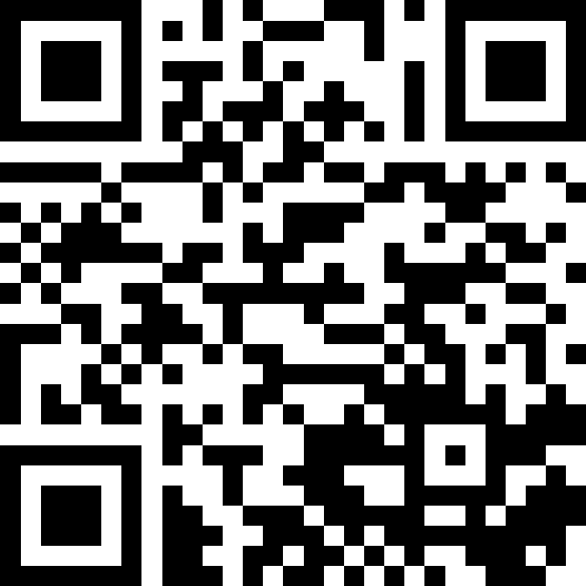
Strings, char, and Variables
BEFORE WE START
LEC 03
Talk to your neighbors:
What is your favorite emoji? 😀
Respond on sli.do!
Music: ❄️ CSE 121 26wi Lecture Tunes ❄️
Instructor:
Miya Natsuhara
TAs:
Amogh
William
Johnathan
Anant
Reese
Hayden
Aki
Spencer
Savannah
Tamsyn
Anum
Abdul
Janvi
Navya
Ruslana
Sam
Ethan
Jessica
Paul
Carson
Shayna
Jesse
Minh
Cayden

Slide 2
Agenda
Announcements, Reminders
C0 Reflection Recap
Casting, More Variables and Operators!
Strings and Characters Review
code example!

Slide 3

Announcements, Reminders
P0: Cornbear’s Café released!
due Tuesday, January 20th
Expect C0 grades ~ 1 week from submission (we’ll announce on Ed)
shortly after, your first resubmission cycle will open!

Slide 4
Agenda
Announcements, Reminders
C0 Reflection Recap
Casting, More Variables and Operators!
Strings and Characters Review
code example!

Slide 5
On Accessibility…
Great engagement with the C0 reflection! Some themes:
It was inspiring and eye-opening to learn how blind programmers code
“I was impressed throughout the video at his pace with the screenreader. When he talked about certain window changes making a world of difference for his productivity, it gave me pause.”
Little ‘quality of life’ changes can make a big difference!
"how a small change in making the debugger’s local window readable by the screen reader allowed her to change how she worked independently. It shows that accessibility isn’t about limiting capability, but also the fact that you can remove unnecessary barriers."
Accessibility matters because…
“technology shapes who is able to learn, work, and [participate] in creating digital tools. Technology should be served to everyone.”

Slide 6
Is C0 Accessible?
Probably not…or at least not yet.
When looking at ASCII art:
"Hearing the characters read line by line would not communicate the intended image or creativity. This project helped me realize that just because something is “text” does not automatically make it accessible."
"No, because in my experience, this assignment involved lots of trial and error with writing a line, seeing how it looked after the code was run, and seeing that the art was off"
"Even though we included a caption at the end to make it more accessible, it does not provide enough information."
Some ideas for improvement:
Incorporating auditory elements
Making a tactile version of the ASCII art

Slide 7
So, What?
Broadly speaking: the digital world is inaccessible
but that’s changing!
and we have the power to change it!
In CSE 121, we don’t have the full knowledge yet to make accessible ASCII art (or Java programs, applications, video games, websites, …)
However, we encourage you to:
think about accessibility when you make things with computers
keep on learning more! UW is a global leader in digital accessibility
e.g. at UW: CSE 493E: Accessibility, CREATE, AccessComputing

Slide 8
Agenda
Announcements, Reminders
C0 Reflection Recap
Casting, More Variables and Operators!
Strings and Characters Review
code example!

Slide 9
PCM: Variables
Recall: Variables allow us to give a name to a specific value
3 parts: declaration, initialization, usage
Example:
Declaration: int x;
Initialization: x = 30;
Or all in one line: int x = 30;
String bestBoy = "gumball";
System.out.println(bestBoy);

Slide 10
PCM: Casting
Java will do some type conversions for us
E.g., int to double, double to String, int to String
BUT some conversions Java won't do for us…
Nonsensical conversions (e.g., "Gumball" to int)
Conversions that are "lossy" (e.g., double to int)
We can ask Java to typecast for us
double x = 8.83;
int xInt = (int) x;

Slide 11
New: Manipulating Variables
They’re made to be manipulated, modified, and re-used!
int myFavoriteNumber = 7;
int tripleFavNum = myFavoriteNumber * 3;
myFavoriteNumber = myFavoriteNumber + 3;
Note! This doesn’t really make any mathematical sense. That’s because in Java, = is assignment, not equality!

Slide 12
New Operator: +=
myFavoriteNumber = myFavoriteNumber + 3;
This pattern is so common, we have a shorthand for it!
myFavoriteNumber += 3;
This works for both numeric addition and string concatenation!

Slide 13
More Shorthand Operators
The shorthands -=, *=, /=, and %= exist too!
myFavoriteNumber /= 3;
Should this work for integers? Doubles? Strings?

Slide 14
Even Shorter Shorthands
There are even shorter operators for “incrementing” and “decrementing”!
myFavoriteNumber++; // myFavoriteNumber += 1;
myFavoriteNumber--; // myFavoriteNumber -= 1;
Should this work for integers? Doubles? Strings?

Slide 15
Think Pair Share: A, B, C Variables (Think)
What values do a, b, and c hold after this code is executed?
int a = 10;
int b = 30;
int c = a + b;
c -= 10;
a = b + 5;
b /= 2;
10, 30, 40
35, 15, 30
35, 15.5, 30
20, 15, 30

Slide 16
Think Pair Share: A, B, C Variables (Pair)
What values do a, b, and c hold after this code is executed?
int a = 10;
int b = 30;
int c = a + b;
c -= 10;
a = b + 5;
b /= 2;
10, 30, 40
35, 15, 30
35, 15.5, 30
20, 15, 30

Slide 17
Agenda
Announcements, Reminders
C0 Reflection Recap
Typecasting
Casting, More Variables and Operators!
Strings and Characters Review
code example!

Slide 18
PCM: Strings & chars
Recall: String literals are a sequence of characters that are strung together, begin and end with ""
Use zero-based indexing
A char represents a single character
Begin and end with single quotes ( ' )
Strings are made up of chars!
g | u | m | b | a | l | l
0 | 1 | 2 | 3 | 4 | 5 | 6
char letter = 'g';
char anotherLetter = 'b';

Slide 19
PCM: String Methods
Usage: <string_variable>.<method>(…)
Method | Description
length() | Returns the length of the string.
charAt(i) | Returns the character at index i of the string
indexOf(s) | Returns the index of the first occurrence of s in the string; returns -1 if s doesn't appear in the string
substring(i, j) or substring(i) | Returns the characters in this string from i (inclusive) to j (exclusive); if j is omitted, goes until the end of the string
contains(s) | Returns whether or not the string contains s
equals(s) | Returns whether or not the string is equal to s (case-sensitive)
equalsIgnoreCase(s) | Returns whether or not the string is equal to s ignoring case
toUpperCase() | Returns an uppercase version of the string
toLowerCase() | Returns a lowercase version of the string

Slide 20
Think Pair Share: A, B, C Variables (Think)
Suppose s contains the String "bubble gum". Which statement would result in s containing "Gumball" instead?
s.substring(7) + "ball";
s = s.substring(7, 9) + "ball";
s = s.charAt(7).toUpperCase() + "ball";
s = s.substring(7, 8).toUpperCase() + s.substring(8) + "ball";
b | u | b | b | l | e |  | g | u | m
0 | 1 | 2 | 3 | 4 | 5 | 6 | 7 | 8 | 9

Slide 21
Think Pair Share: A, B, C Variables (Pair)
Suppose s contains the String "bubble gum". Which statement would result in s containing "Gumball" instead?
s.substring(7) + "ball";
s = s.substring(7, 9) + "ball";
s = s.charAt(7).toUpperCase() + "ball";
s = s.substring(7, 8).toUpperCase() + s.substring(8) + "ball";
b | u | b | b | l | e |  | g | u | m
0 | 1 | 2 | 3 | 4 | 5 | 6 | 7 | 8 | 9

Slide 22
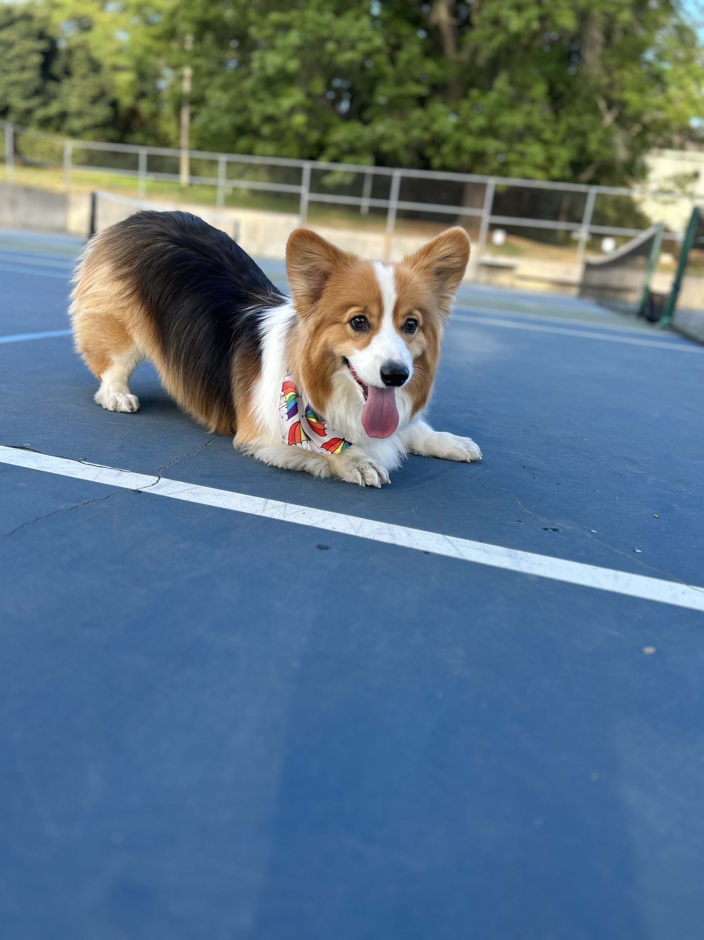
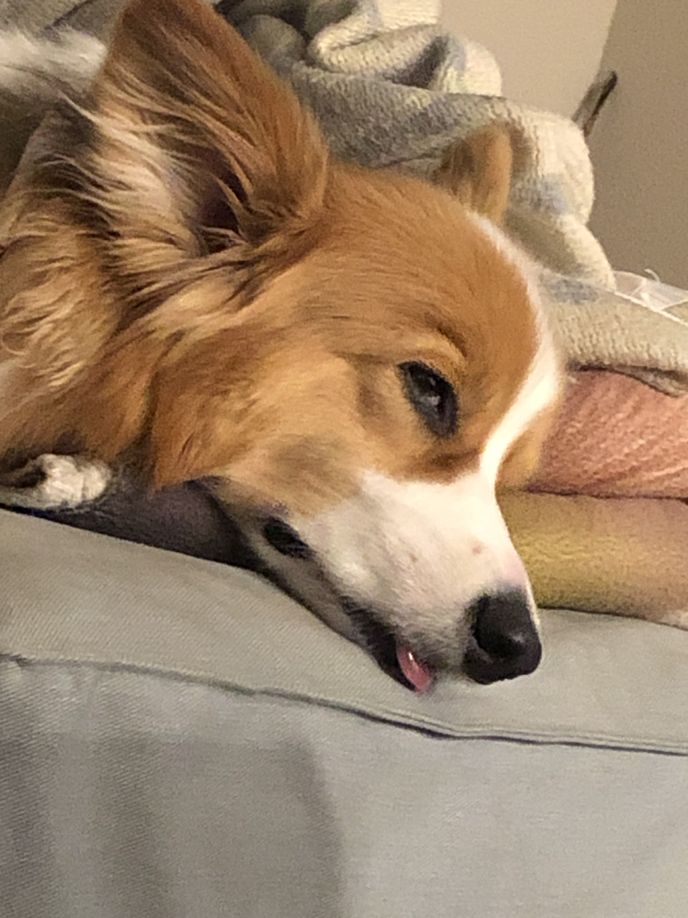


Aside: Gumball

