Slide 1
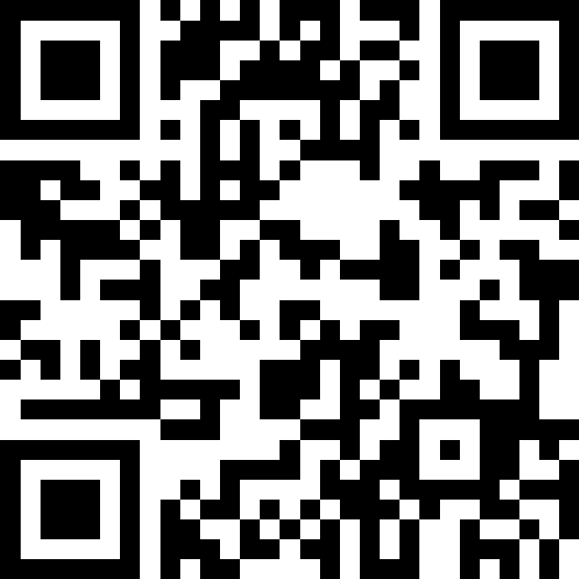
Datatypes and Expressions
BEFORE WE START
LEC 02
Talk to your neighbors:
What’s your favorite song right now?
Respond on sli.do!
Music: ❄️ CSE 121 26wi Lecture Tunes ❄️
Instructor:
Miya Natsuhara
TAs:
Amogh
William
Johnathan
Anant
Reese
Hayden
Aki
Spencer
Savannah
Tamsyn
Anum
Abdul
Janvi
Navya
Ruslana
Sam
Ethan
Jessica
Paul
Carson
Shayna
Jesse
Minh
Cayden

Slide 2
Agenda
Announcements, Reminders
Intro Survey Recap
Datatypes and Expressions Review
Expressions Practice
Combining Variables and Expressions

Slide 3
Announcements, Reminders
Creative Project 0 due tonight by 11:59 PM
Programming Assignment 0 releases later today
  due Tuesday, January 20th at 11:59 PM
  now on regular “cadence” (Wed release, due following Tue)
IPL is open! Schedule & instructions on website.
If you joined late, welcome!
  Check out the course website and lecture recordings
  Resubmissions are your friend!
Section credit and Pre-Section Work details

Slide 4
Agenda
Announcements, Reminders
Intro Survey Recap
Datatypes and Expressions Review
Expressions Practice
Combining Variables and Expressions

Slide 5
Intro Survey – things we’re excited for!
“Learning programming” / “Learning how to code”
“Meeting more people!” / "working with my peers"
“Learning something challenging”
"making interactive programs like little games"
"Learning the basics so computer science is less intimidating"

Slide 6
Intro Survey – things we’re nervous about
"failing" / "not knowing what to do and not feeling confident" / "coding isn't my strength"
  Everyone struggles ("coming naturally" is a myth)
  Remember, we don't expect you to get it perfect the first time! (Resubmissions)
"that I am less experienced than everyone else"
  This class is made for students with no prior experience at all! You're in the right place!
"keeping pace while balancing [a busy schedule]" / "falling behind"
  Utilize support systems (section, IPL, Ed, resubs, etc.)
"final exam" / "quizzes"
  We'll have more information and practice materials!
"making friends to study with"
  Remember last week there were lots of folks who wanted to meet other people and learn together! Let's create that welcoming environment ☺

Slide 7
Agenda
Announcements, Reminders
Intro Survey Recap
Datatypes and Expressions Review
Expressions Practice
Combining Variables and Expressions

Slide 8
PCM: Datatypes & Expressions
Programming is about data; we tell Java what type of data we have!
Datatypes (so far): int, double, String, boolean
  note: only String is capitalized!
All values in a (Java) program have a type!
  some are “obvious”, e.g. 42 or "hello world"
    aside: these are called “literals”
  some are more complicated expressions!

Slide 9
PCM: Operators
We learned a ton of operators!
Numerical:
+ Addition
- Subtraction
* Multiplication
/ Division (tricky!)
% Modulo (or “mod”)
<, >, <=, >=, ==, != Relational
Strings:
+ Concatenation (not addition!)
Booleans:
! Logical Not
&& Logical And
|| Logical Or
== and != Relational

Slide 10
PCM: Precedence
Operators have precedence (an order of operations).
In Math:
Parentheses
Exponent
Multiplication
Division
Addition
Subtraction
In Java:
Parentheses
Logical not
Multiplication, Modulo, Division
Addition (and concatenation), Subtraction
Relational operators
Equality operators
Logical AND
Logical OR

Slide 11
Expressions in “little steps”
5 + 2 * 4
1 + 2 / 3
6 * 5 % 7
8
0
30
13
1
2

Slide 12
PCM: Conversions
When mixing types in an expression, Java will convert one type to the other and then perform the operation “normally”.
Some conversions are straightforward:
ints can be converted to doubles (add .0)
ints and doubles can be converted to Strings (add "")
So, Java does these for you! (is this good? controversial!)

Slide 13
New: Conversions (Gone Wrong!!)
Other conversions are “lossy”, because you lose data.
e.g. to make 3.14 an int, you’d probably pick either 3 or 4 – but either one loses data
Java won’t do this automatically for you – you need to “ask”.
  called a type cast: you’ll see this in Friday’s PCM + in P0
Some conversions don’t make sense.
how would you convert "Beyoncé" to an int? double?
Java really doesn’t let you do these…

Slide 14
What does this expression evaluate to?
2 + 2 + "hello" + 3 * 5 + 10 a. "22hello3510" b. "22hello1510" c. "4hello1510" d. "4hello25" e. This will cause an error

Slide 15
What does this expression evaluate to?
2 + 2 + "hello" + 3 * 5 + 10 a. "22hello3510" b. "22hello1510" c. "4hello1510" d. "4hello25" e. This will cause an error

Slide 16
Expression example with mixing types
2 + 2 + "hello" + 3 * 5 + 10
" "
15
4
" "
" "
"4hello"
"4hello15"
"4hello1510"

Slide 17
Agenda
Announcements, Reminders
Intro Survey Recap
Datatypes and Expressions Review
Expressions Practice
Combining Variables and Expressions
a

Slide 18
Work on Expressions and Types Practice (1)
On the Ed lesson for today, and on your handout
Work with folks around you!
TAs & I will walk around and help!
5 * 3 + 1.0
8 / 3 * 2.0
8.0 / 3 * 2
"Hello" + "world"
1 + "2" + 3
1 + 2 + "3"
1 + "2" + (3 + 4)

Slide 19
Part 1 Walkthrough

Slide 20
Part 1 Walkthrough (steps)
"Hello" + "world"
"Helloworld"
5 * 3 + 1.0
8 / 3 * 2.0
8.0 / 3 * 2
.0
.0
2
15
.0
2.666…
.0
16.0
4.0
5.333…
1 + "2" + 3
1 + 2 + "3"
1 + "2" + (3 + 4)
" "
" "
" "
" "
"12"
" "
"12"
7
3
"123"
"33"
"127"

Slide 21
Work on Expressions and Types Practice (2)
On the Ed lesson for today, and on your handout
Work with folks around you!
TAs & I will walk around and help!
5 * 3 < 12
10 % 3 == 10 / 3
5 < 9 || (7 != 7)
!(1 + 2 == 3 && 10 % 4 > 2)

Slide 22
Part 2 Walkthrough

Slide 23
Part 2 Walkthrough (1)
5 * 3 < 12
10 % 3 == 10 / 3
5 < 9 || (7 != 7)
15
1
false
1 == 10 / 3
15 < 12
5 < 9 || false
false
3
1 == 3
true
true || false
false
true

Slide 24
Part 2 Walkthrough (2)
!(1 + 2 == 3 && 10 % 4 > 2)
!(1 + 2 == 3 && 2 > 2)
!( 3 == 3 && 2 > 2)
!( 3 == 3 && false )
!( true && false )
!( false )
true

Slide 25
Agenda
Announcements, Reminders
Intro Survey Recap
Datatypes and Expressions Review
Expressions Practice
Combining Variables and Expressions

Slide 26
Ed time :)
Applying what we learned to variables!

Slide 27
What’s in a (variable) name or String?
Switch over to Ed and do some experiments (with a partner), then report back on sli.do.
What types of characters are “allowed” in Strings?
What types of characters are “allowed” in variable names?
sli.do #cse121

Slide 28
Food for Thought!
This is the beginning of a very interesting rabbit hole!
(but also, a decision made by the Java designers)
Whether or not you program for a career,
you will also make decisions like these!
for example, what’s a “valid name”?
a theme we’ll revisit (and something to continuously reflect on!)

