Slide 1
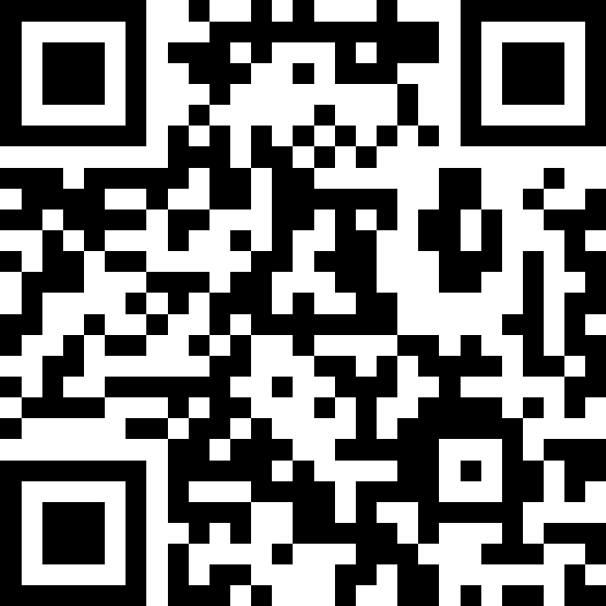
Victory Lap!
BEFORE WE START
LEC 19
Talk to your neighbors:
What is your go-to end-of-finals celebration?
Music: ❄️ CSE 121 26wi Lecture Tunes ❄️
Instructors:
Miya Natsuhara
TAs:
Amogh
William
Johnathan
Anant
Reese
Hayden
Aki
Spencer
Savannah
Tamsyn
Anum
Abdul
Janvi
Navya
Ruslana
Sam
Ethan
Jessica
Paul
Carson
Shayna
Jesse
Minh
Cayden
Notes:
Slido qr code: https://app.sli.do/event/k62kDRPcZurGYpUnPYEr2i

Slide 2
Announcements, Reminders
R7 (and R-Extra) due Thursday, March 19th
all assignments are eligible for resubmission!
Today is the last day for IPL and instructor office hours
Final Exam: Wednesday, March 18th from 12:30 - 2:20pm
review the Exam page of website (with policies & resources)
TA-led review session: Monday, March 16th from 4:30-7:00pm in CSE2 G20
Gumball & friends visit on Monday, March 16th from 2:00pm-3:30pm around Drumheller Fountain / Rainier Vista

Slide 3
Evaluations and Awards
Please give us feedback!
Course Evaluations are due Sunday, March 15th at 11:59 PM
Lecture A Eval
Lecture B Eval
TA Evaluations are also due Sunday, March 15th at 11:59 PM
Bob Bandes TA Award nominations open!
thought your TA was goated? write them a nomination!
fun fact: some of our faculty won the award when they were TAs!

Slide 4
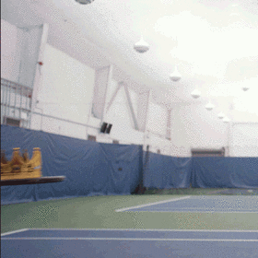

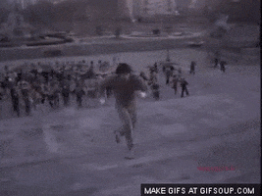




You Made It!

Slide 5
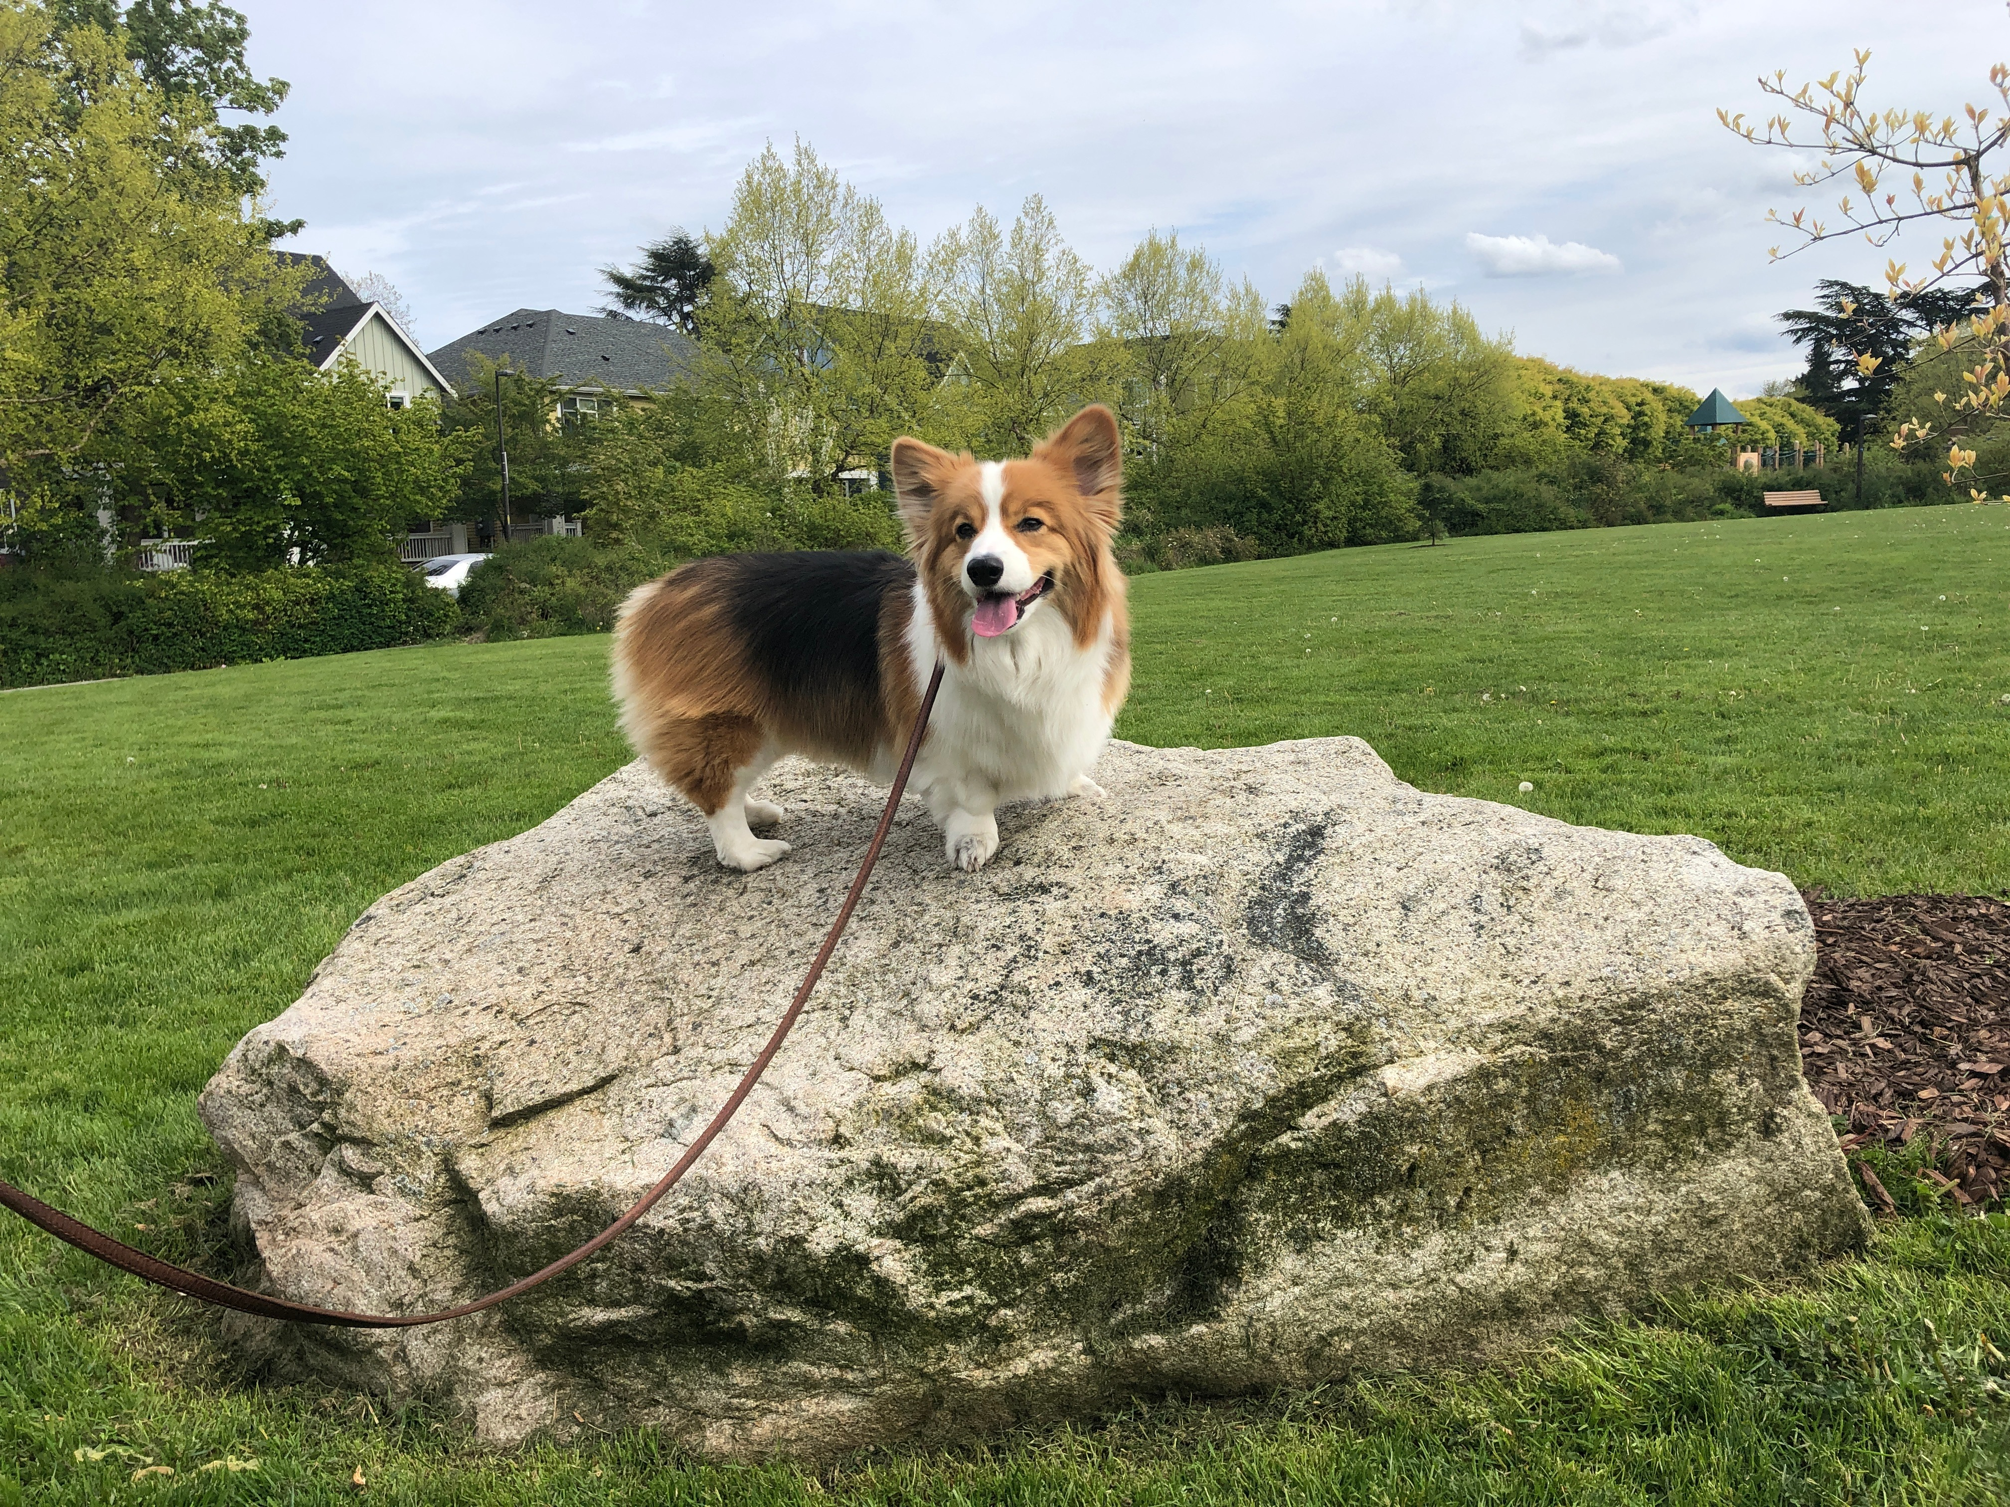
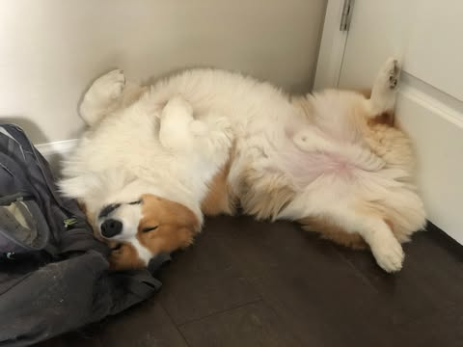
You Made It!

Slide 6
Applications of Computer Science
or “What can I do with what I learned?” – outside of just “write code”:
Help deaf & hard-of-hearing people identify sounds
Develop a programming language that celebrates the world’s languages
Build battery-free robots & put them on insects (and... track murder hornets?)
Detect and prevent toxicity online & recognize disinformation
Computational knitting & carpentry
Create an interactive atlas of millions of refugee experiences
Fix Olympic badminton & identify cheating in chess
and so much more!

Slide 7
… including our assignments! (1/2)
Computational Biology & Medicine (P2, P3)
in CSE: Chris Thachuk, Linda Shapiro, Sara Mostafavi, Su-In Lee, Luis Ceze
Computational Art (C0, C1)
UW CSE has many unique intersections of CS + art!
“Cultural-Centric Computational Embroidery” (CSE + iSchool)
“Computational Illusion Knitting”, “How to Knit Objects Weird”
“WasteBanned: Supporting zero waste fashion design”

Slide 8
… including our assignments! (2/2)
Games & Graphics (C1, C3)
at UW: many labs in CSE and iSchool’s GAMER group
fun fact: Foldit is a crowd-sourced game for protein folding
David Baker shared last year’s Nobel Prize in Chemistry, in part for this!!
Social Computing (P1)
at UW: Amy Zhang’s Social Futures Lab + so much of iSchool
Computer Security (C2)
in CSE: Franzi Roesner, David Kohlbrenner, Nirvan Tyagi
and many side quests (in lecture, section, PCM): accessibility (e.g. UW CREATE), weather forecasting, chatbots, and lots of math

Slide 9
Future Courses
More 12X!
or “What can I do next?”
Course | Overview
CSE 122 | Data structures, object-oriented programming
CSE 123 | More OOP, recursion
Non-majors
Course | Overview
CSE 154 | Intro to web programming (several languages)
CSE 160 | Intro programming, data analysis (Python)
CSE 163 | Intermediate programming, data analysis (Python)
CSE 180 | Introduction to data science (Python)
CSE 373 | Data structures and algorithms (in Java)
CSE 374 | Low-level programming and tools (C/C++)
CSE 412 | Intro to Data Visualization
CSE 416 | Intro. to Machine Learning
CSE 493E | Accessibility
Majors
Course | Overview
CSE 311 | Mathematical foundations
CSE 331 | Software design/implementation
CSE 340 | Interaction programming (mobile apps)
CSE 341 | Programming languages
CSE 351 | Hardware / Software Interface
CSE 480 | Social impacts of computing
Related majors: Informatics, ACMS, HCDE, ECE, …
See: https://www.cs.washington.edu/academics/ugrad/current-students and https://www.cs.washington.edu/academics/ugrad/nonmajor-options/nonmajor-courses

Slide 10
Generalizing beyond Computer Science
Some of you said, ”I’m glad I took this class, but no more CS for me”
That’s totally valid!
Some lessons from this class that could apply more broadly:
how to break big problems into smaller subproblems
how to isolate what part of a system is broken
attention to detail
understanding basics of how software works
how to learn (and reflect) effectively

Slide 11
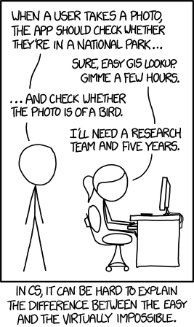
Frequently Asked Questions
How can I get better at programming?
Practice!
How can I learn to X?
Classes, books, videos, or self-learn!
CS (as a field) has lots of free resources :)
What should I do next?
Anything you’re interested in!
but: hard to tell what’s easy and what’s hard
Should I learn another language? Which one?
That depends – what do you want to do?

Slide 12
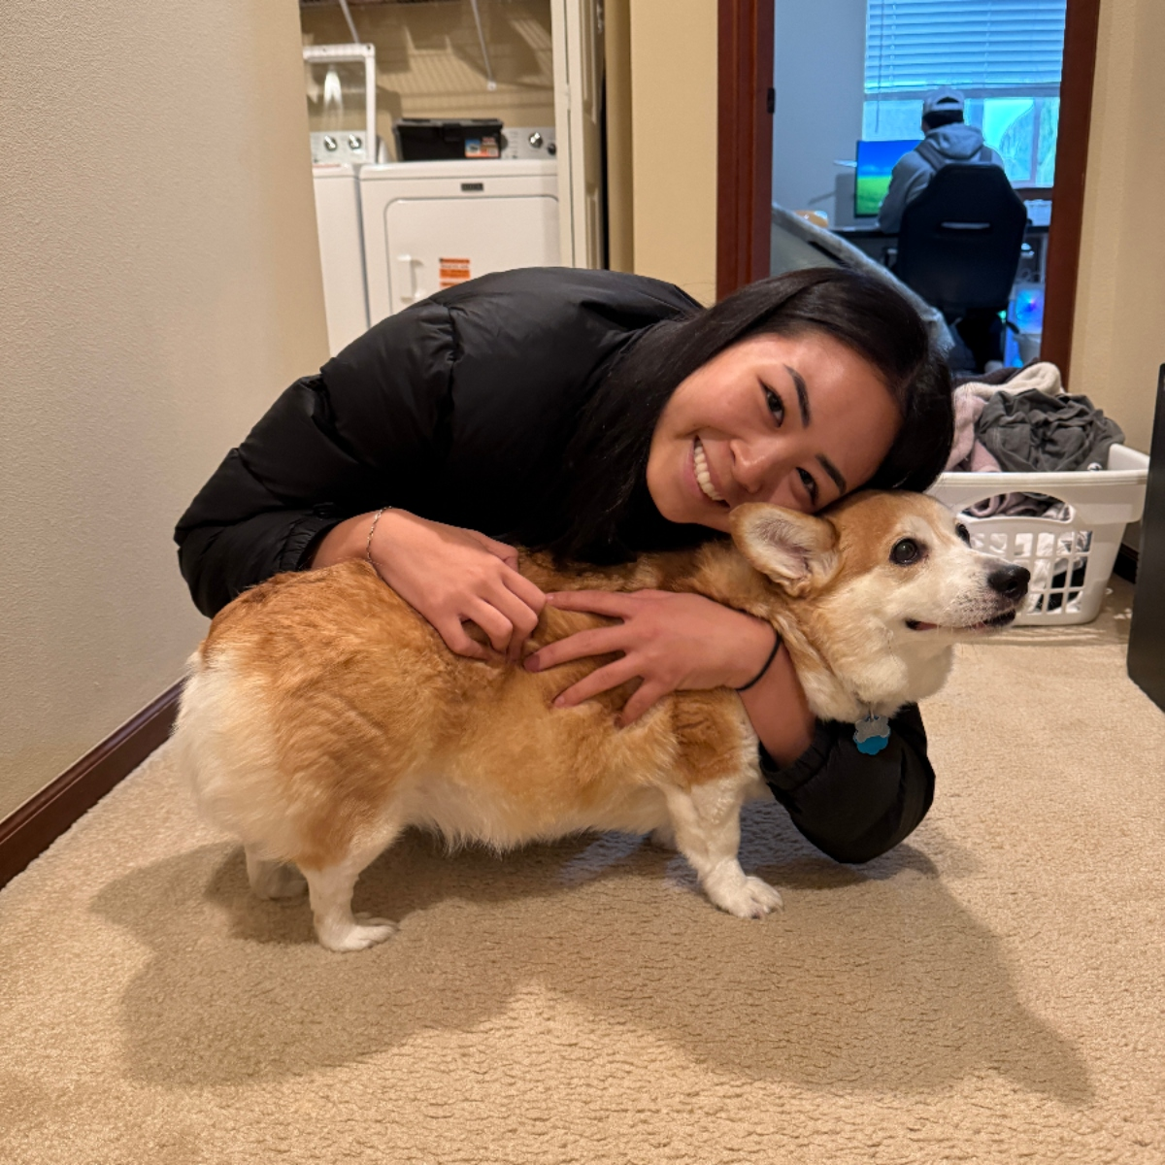
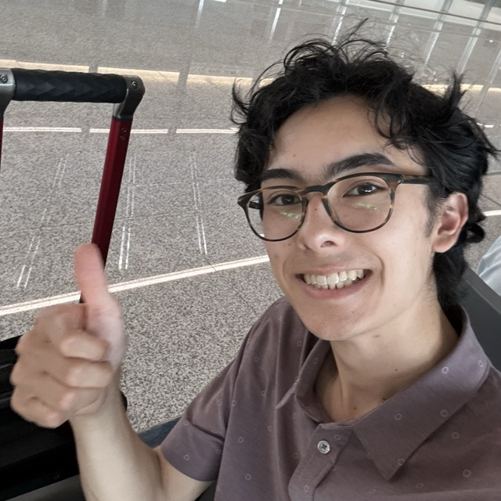
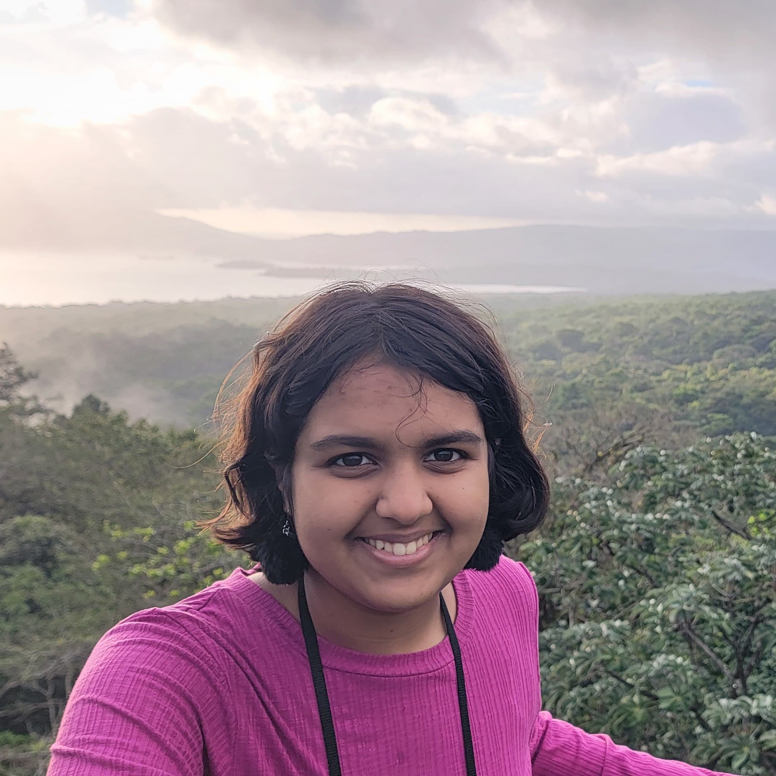
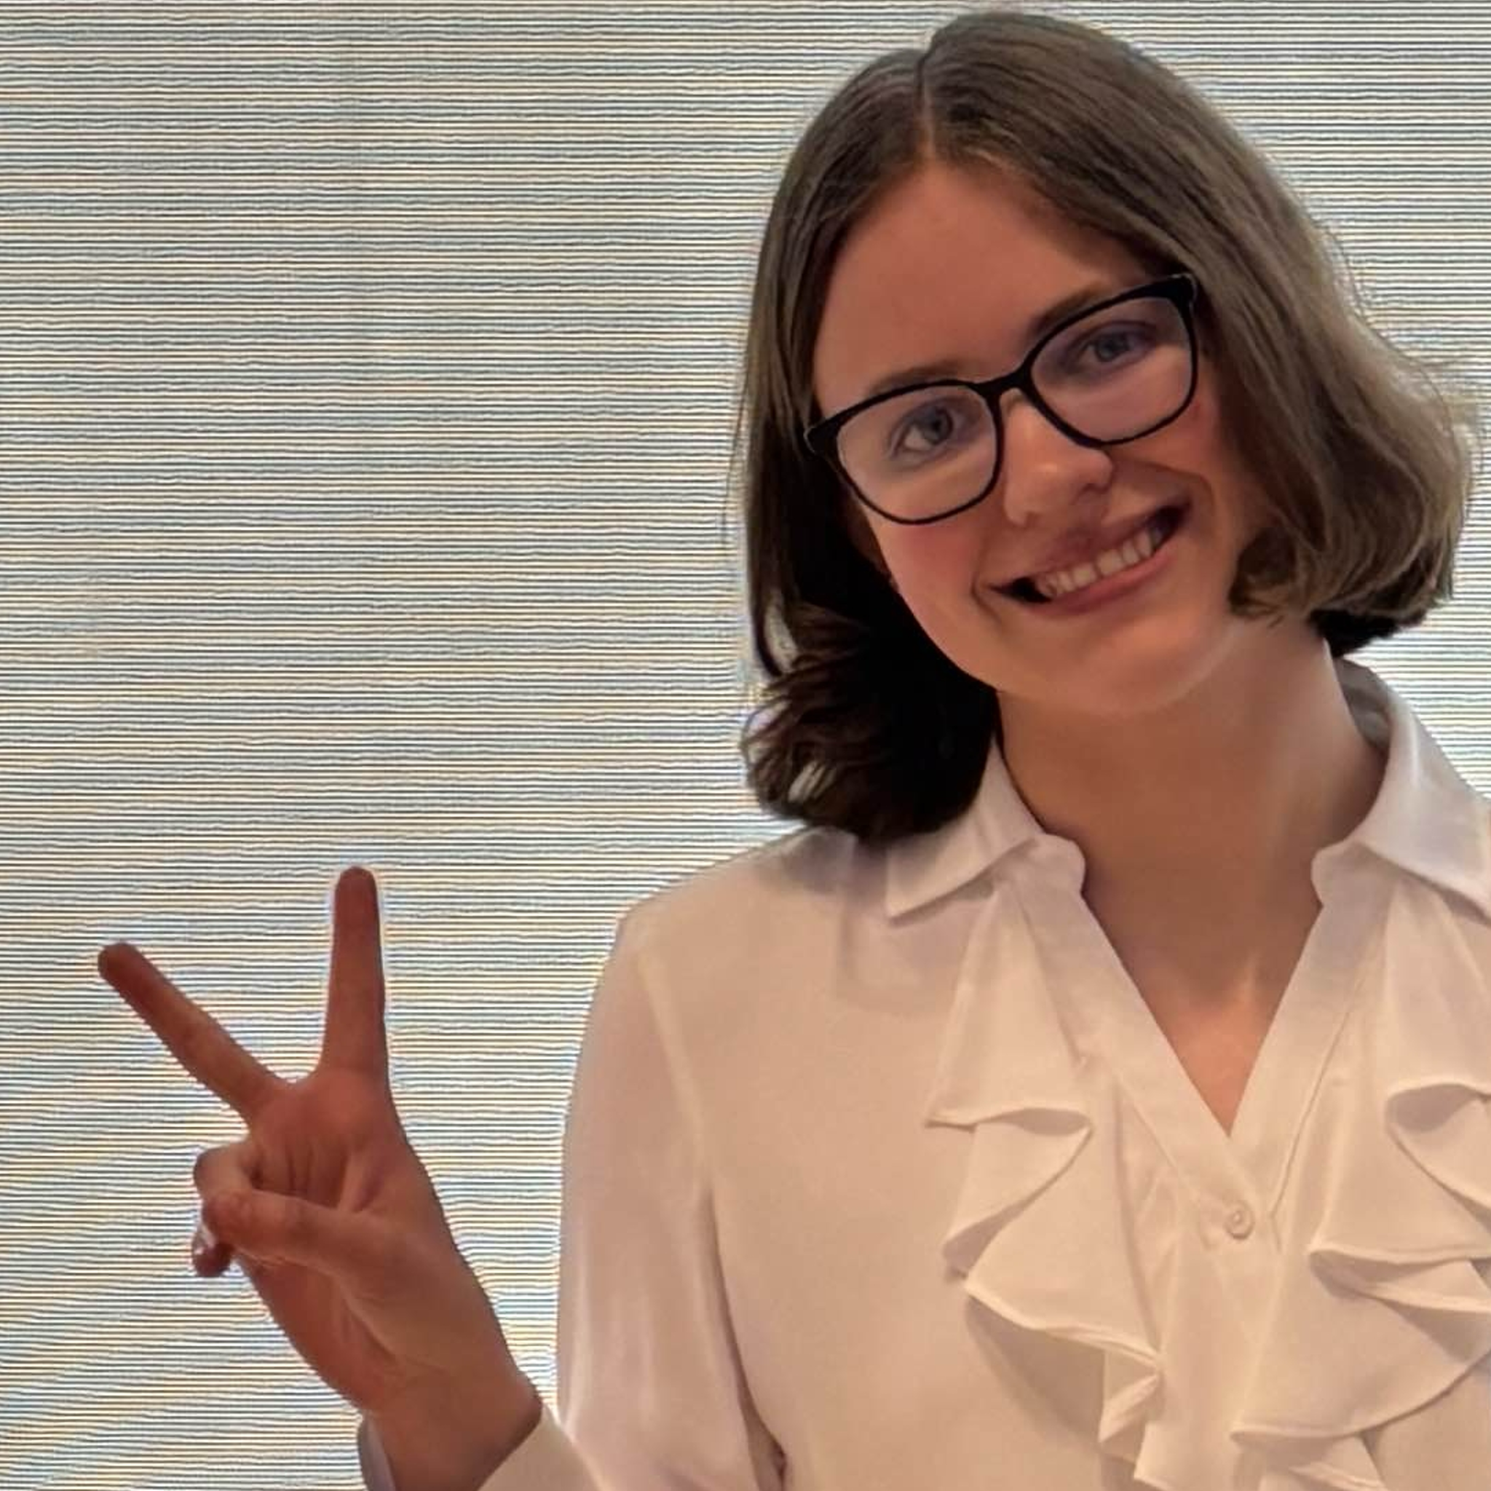
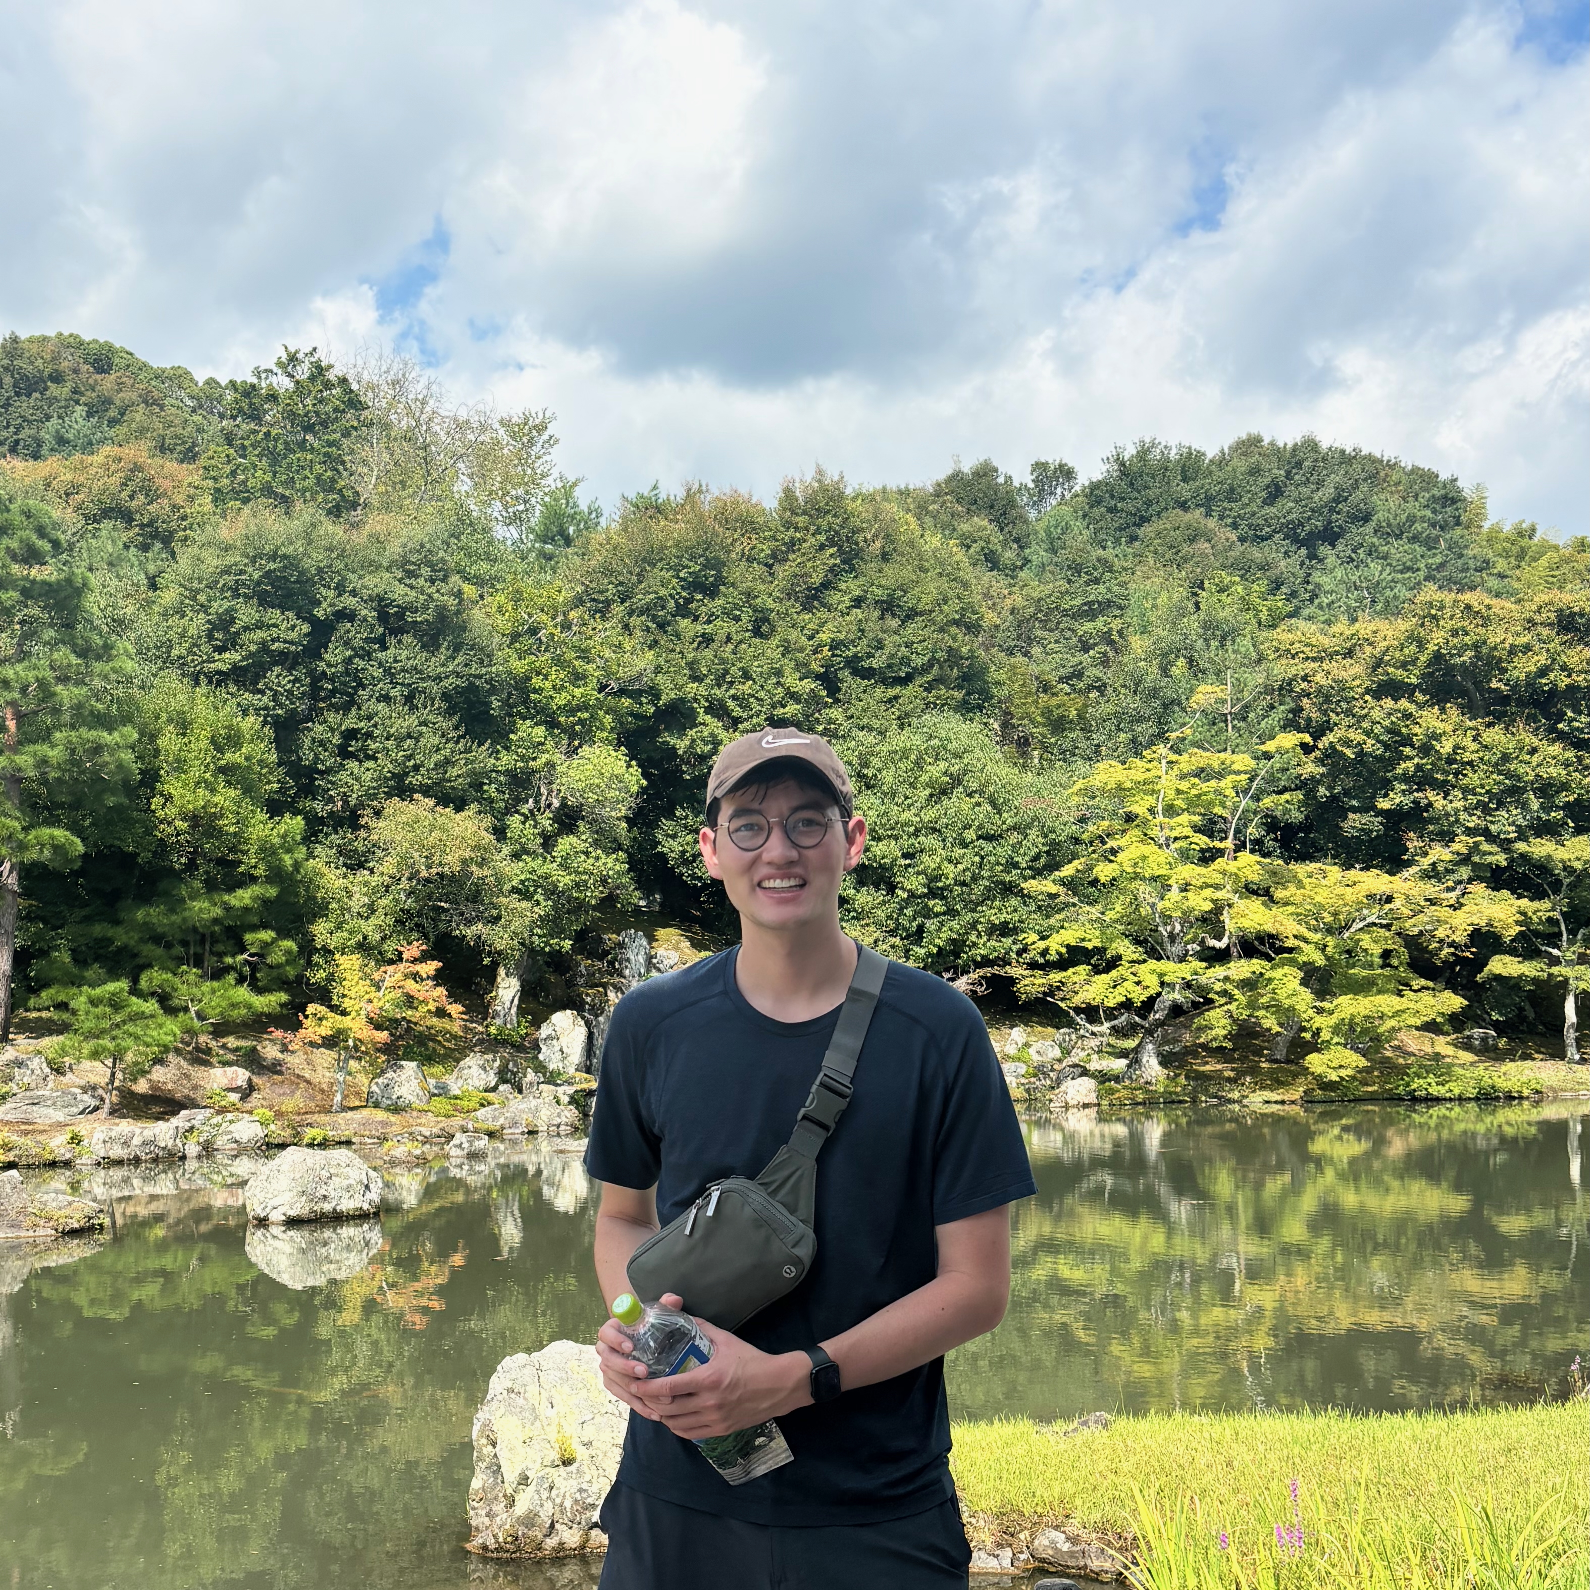
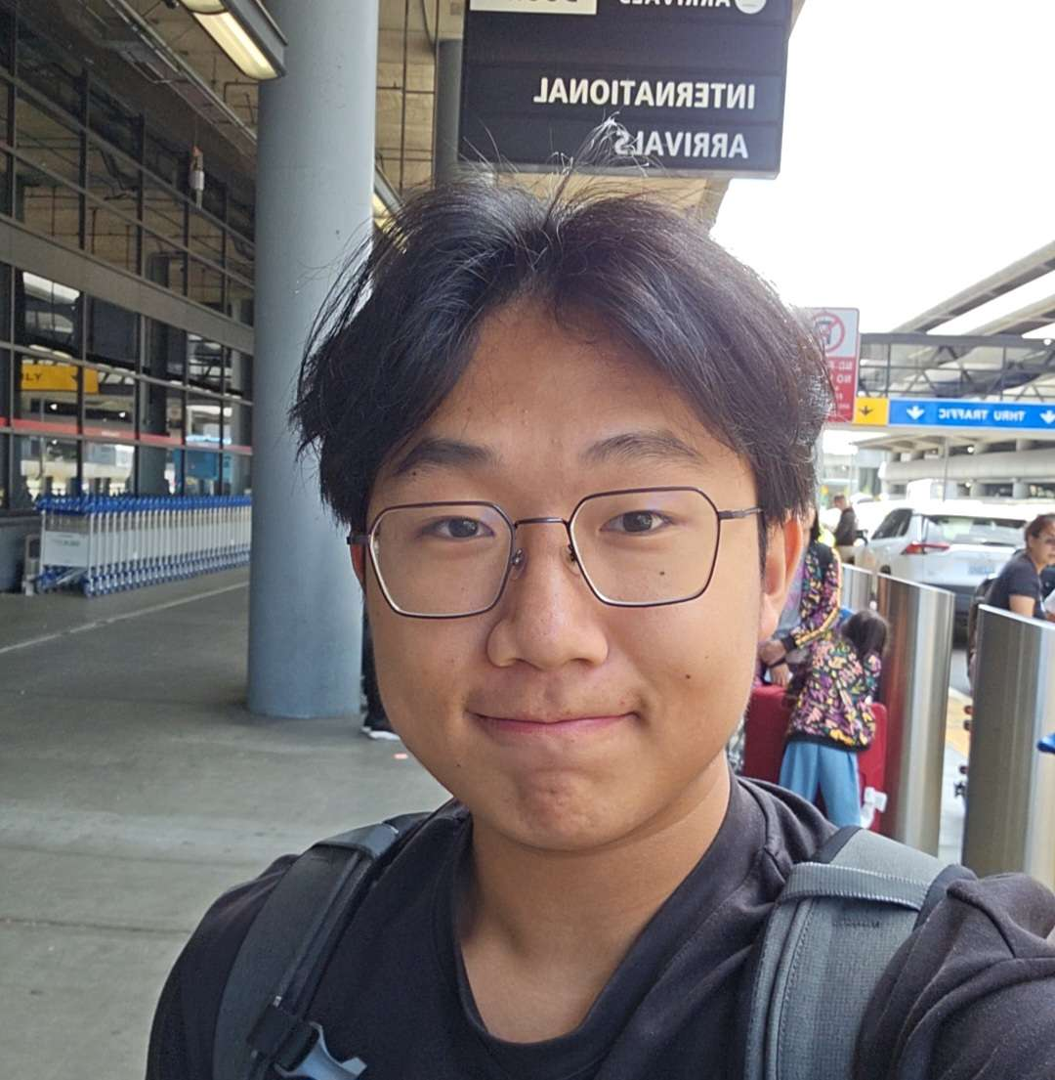
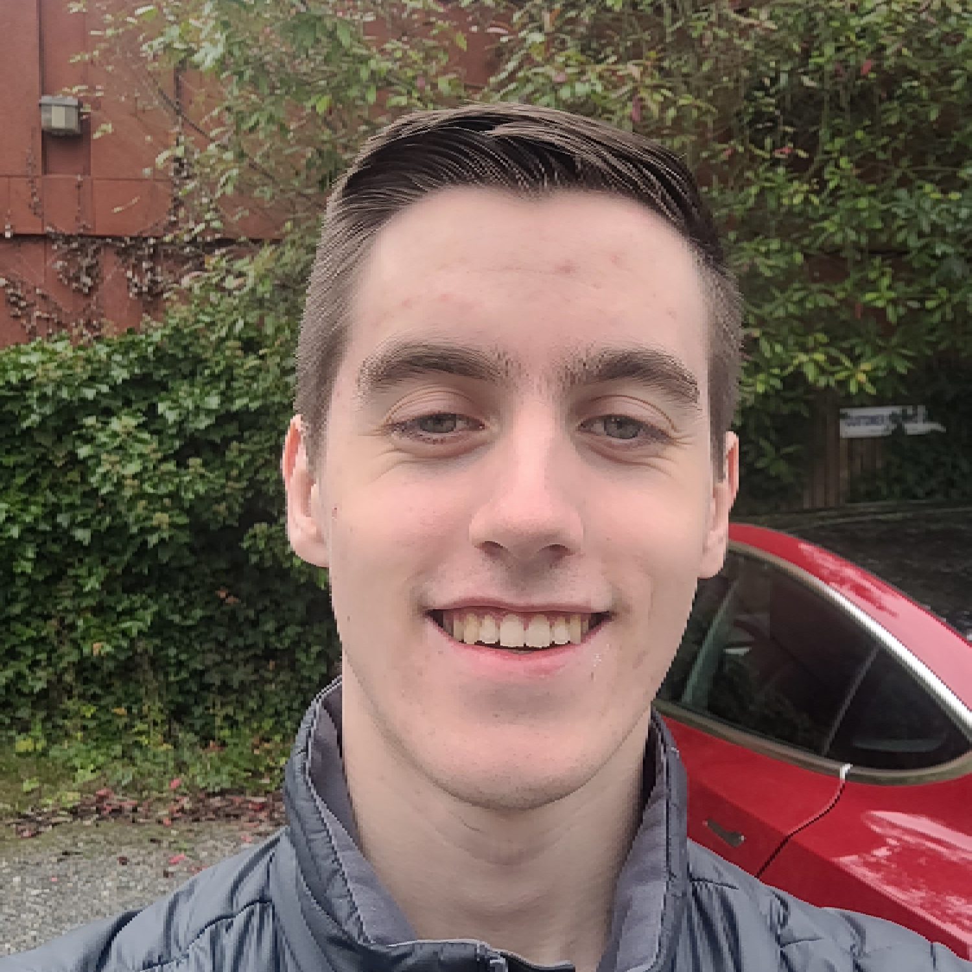
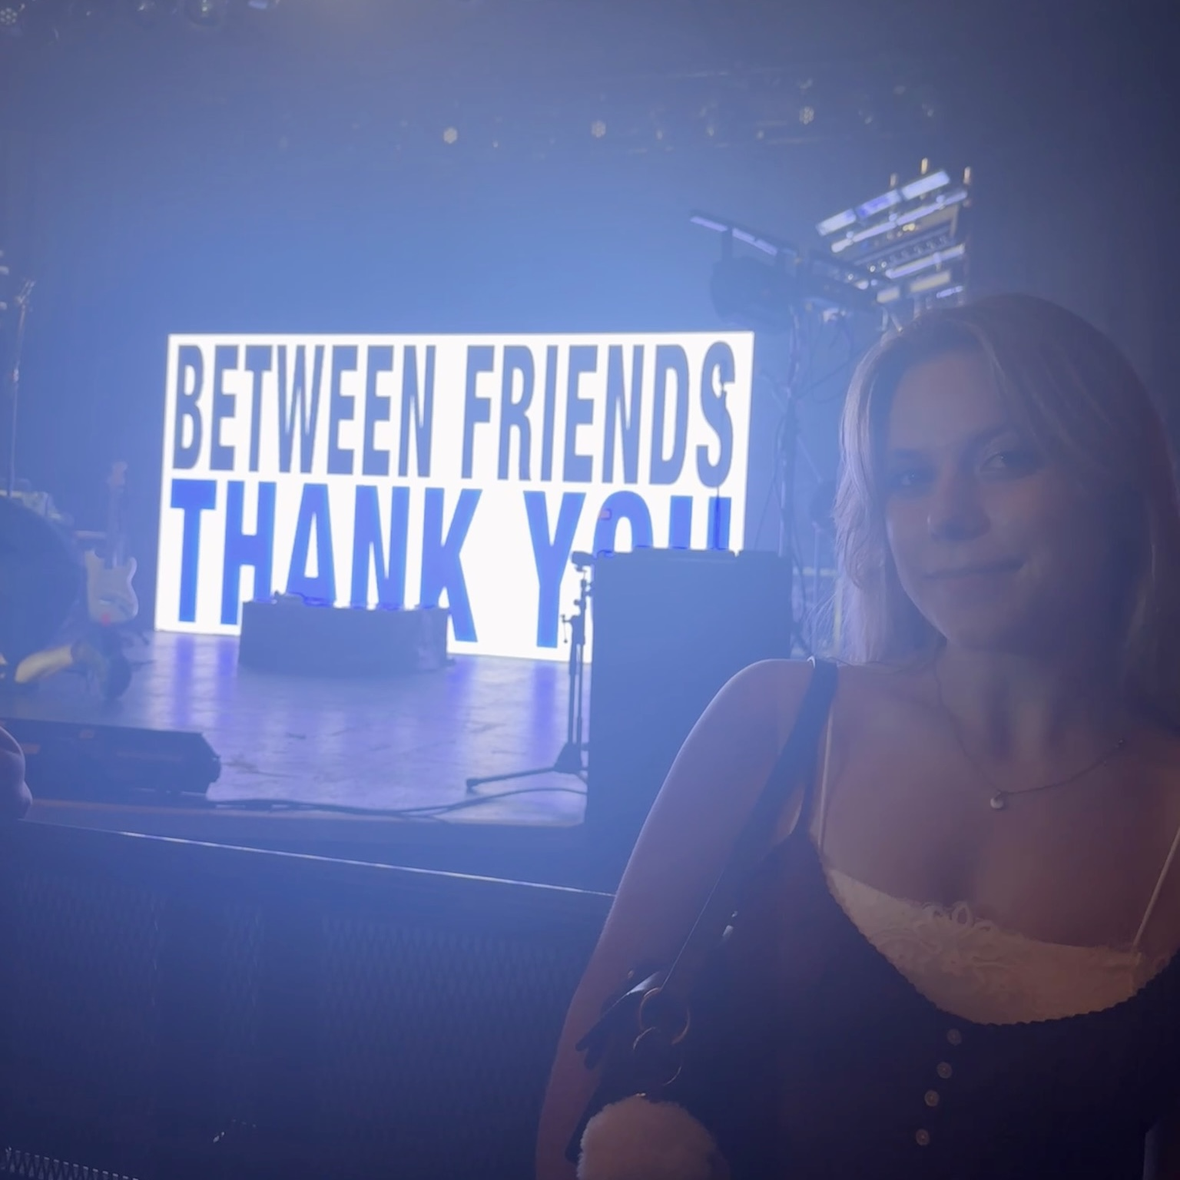
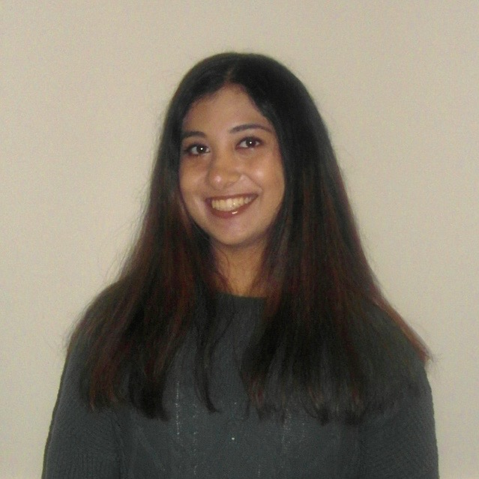
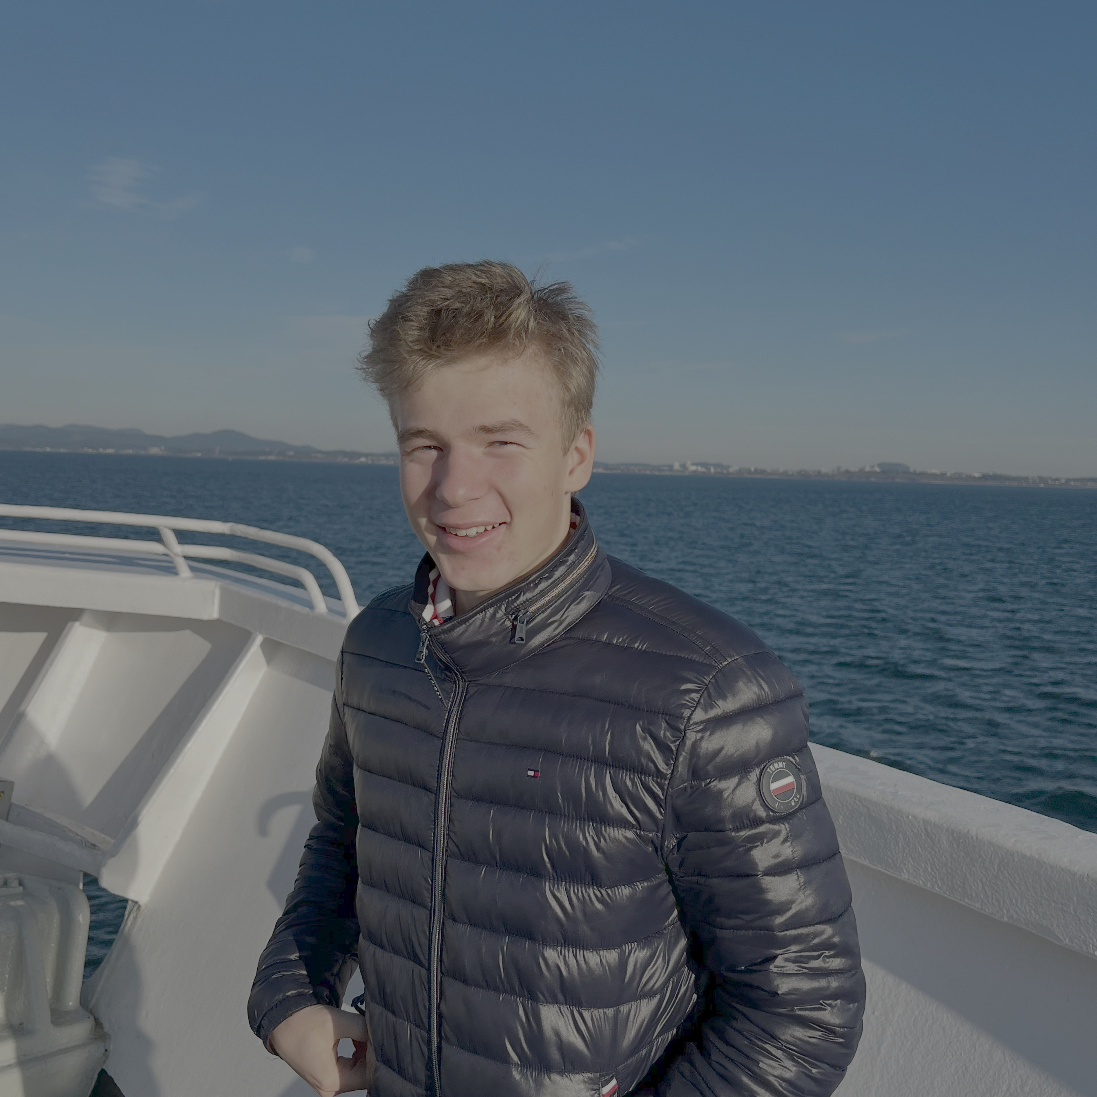
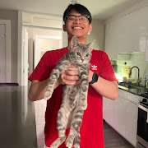
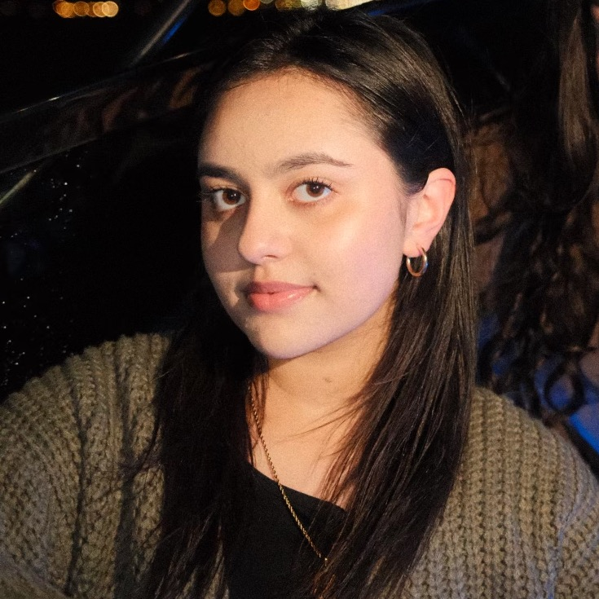
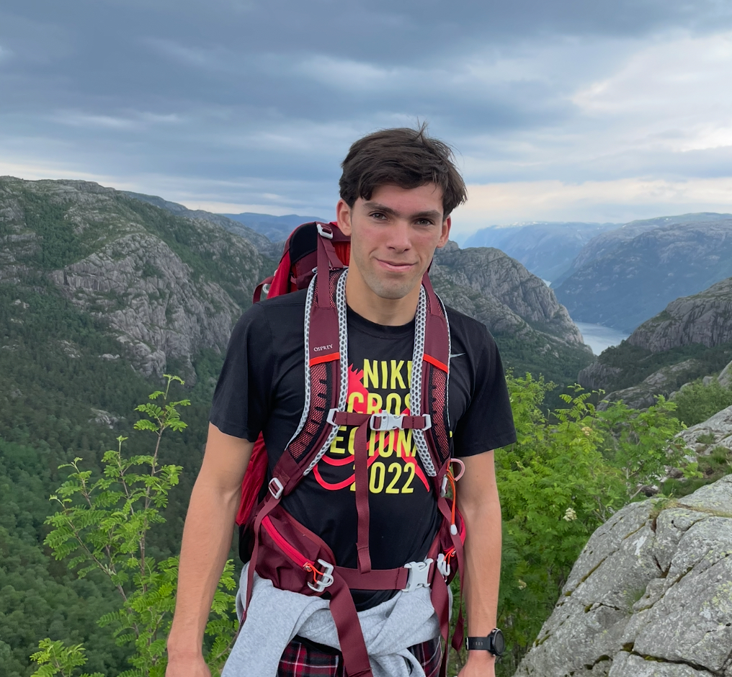
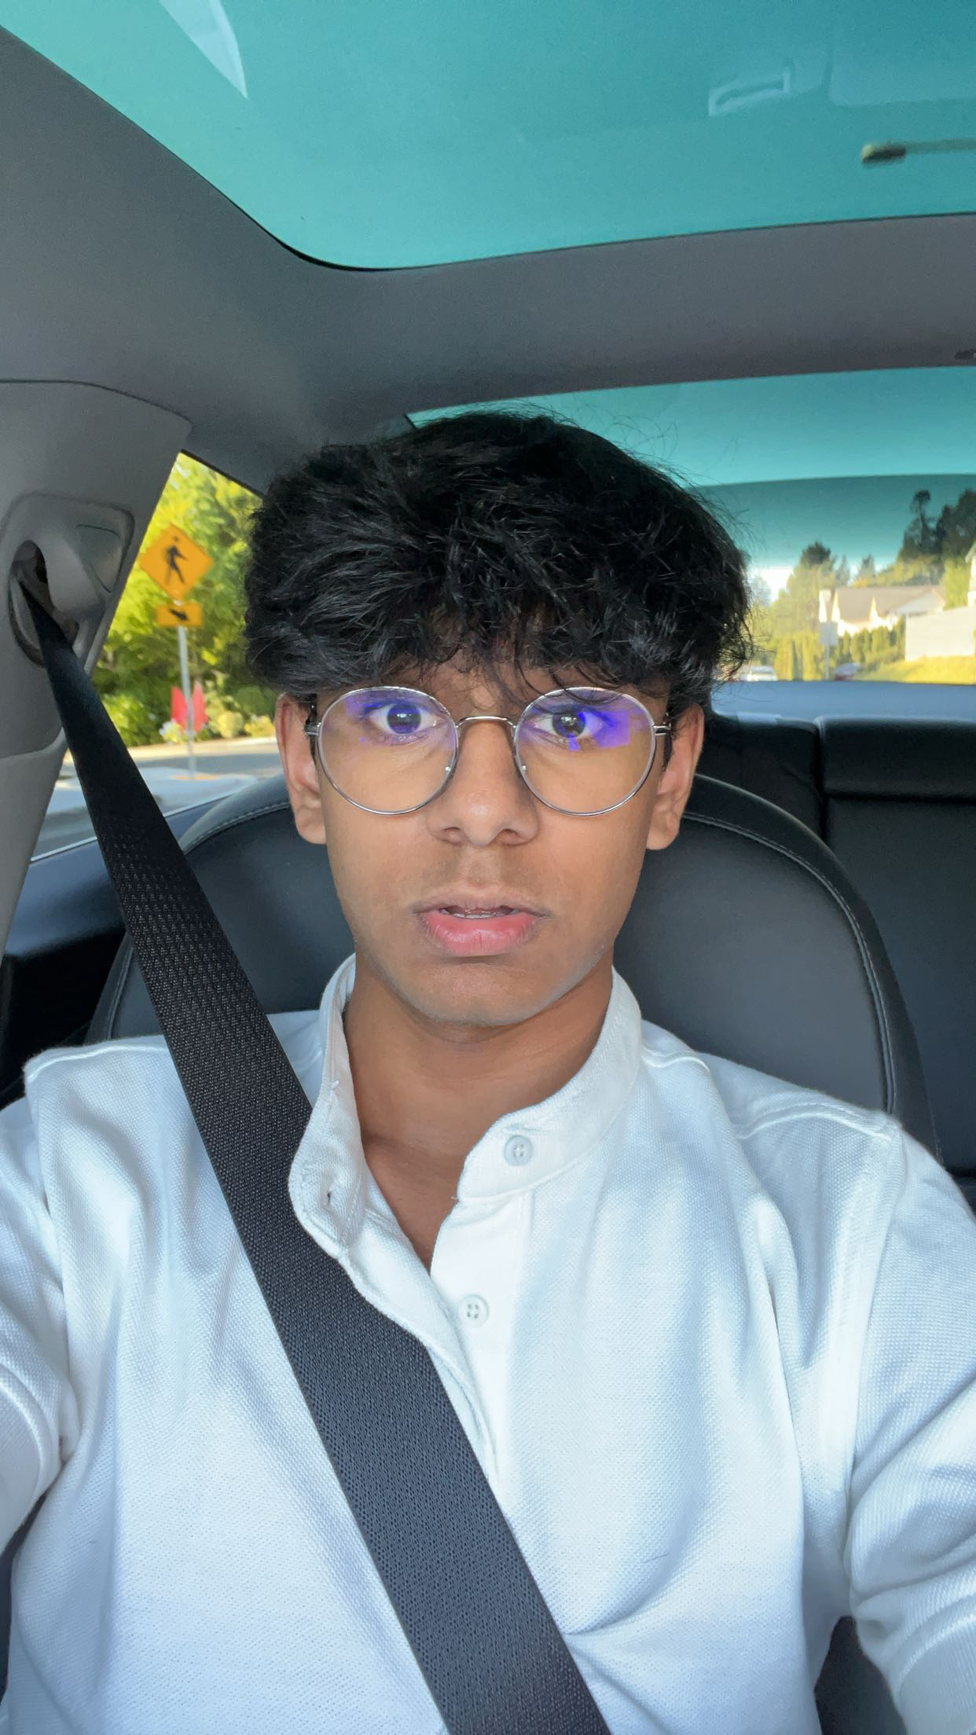
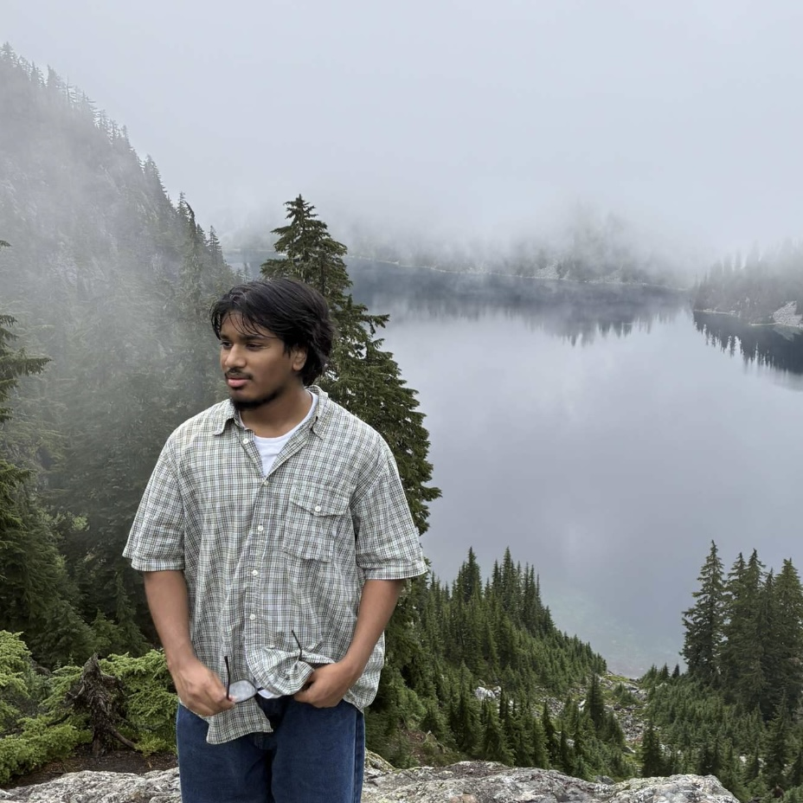
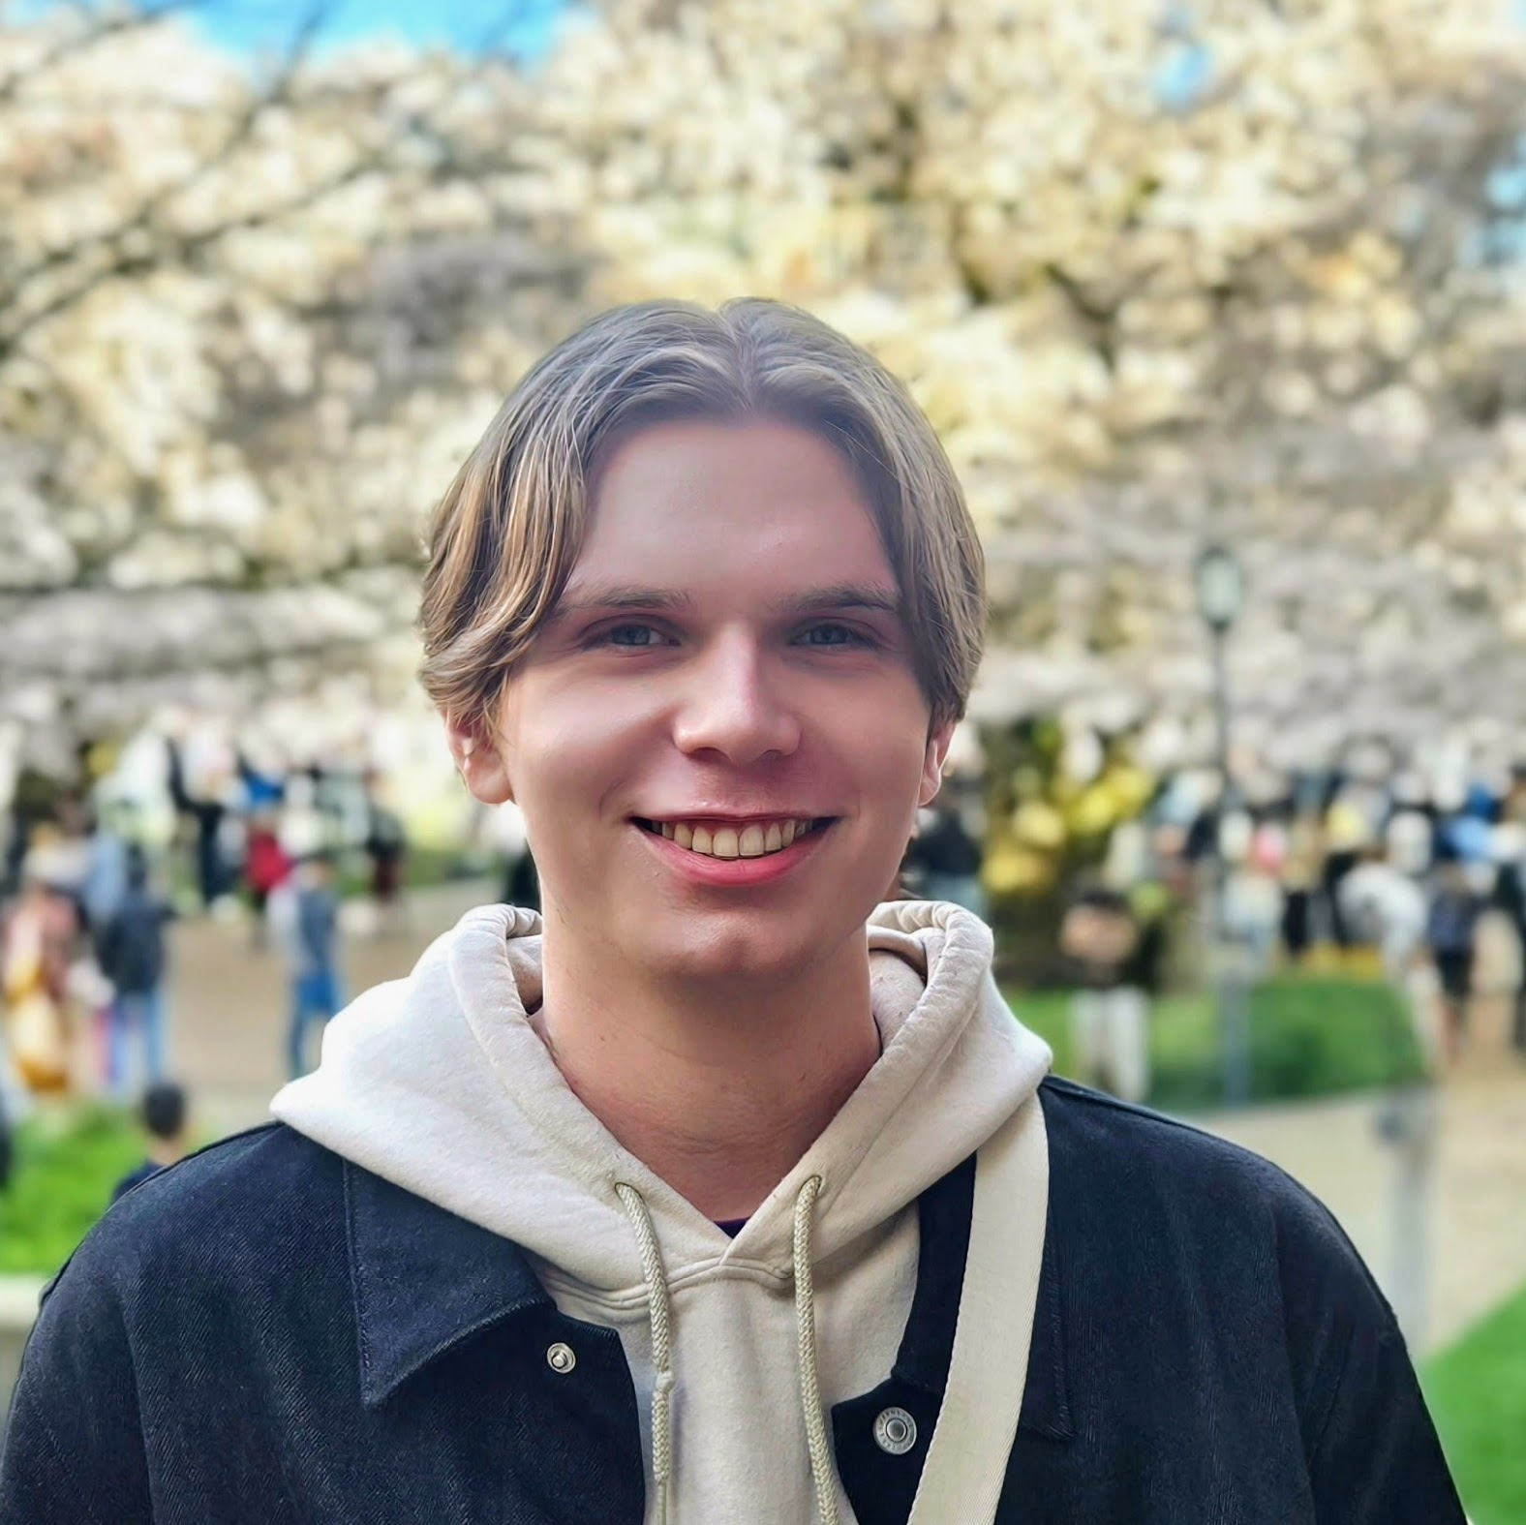
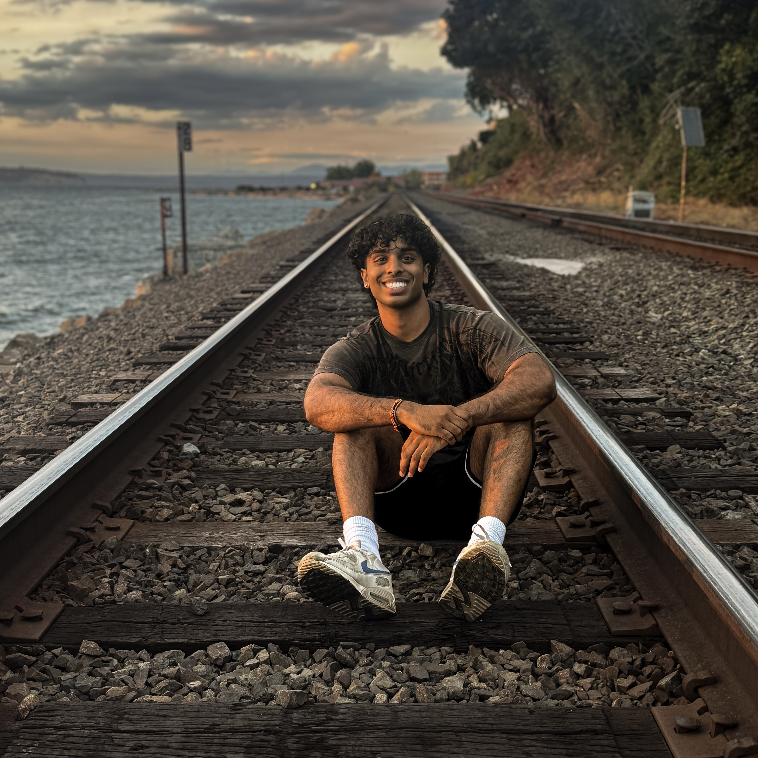
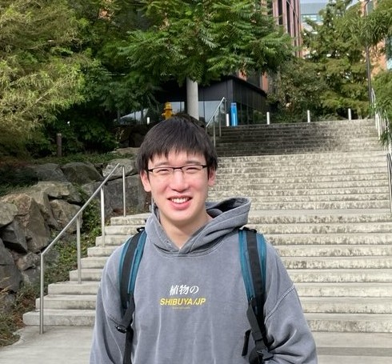
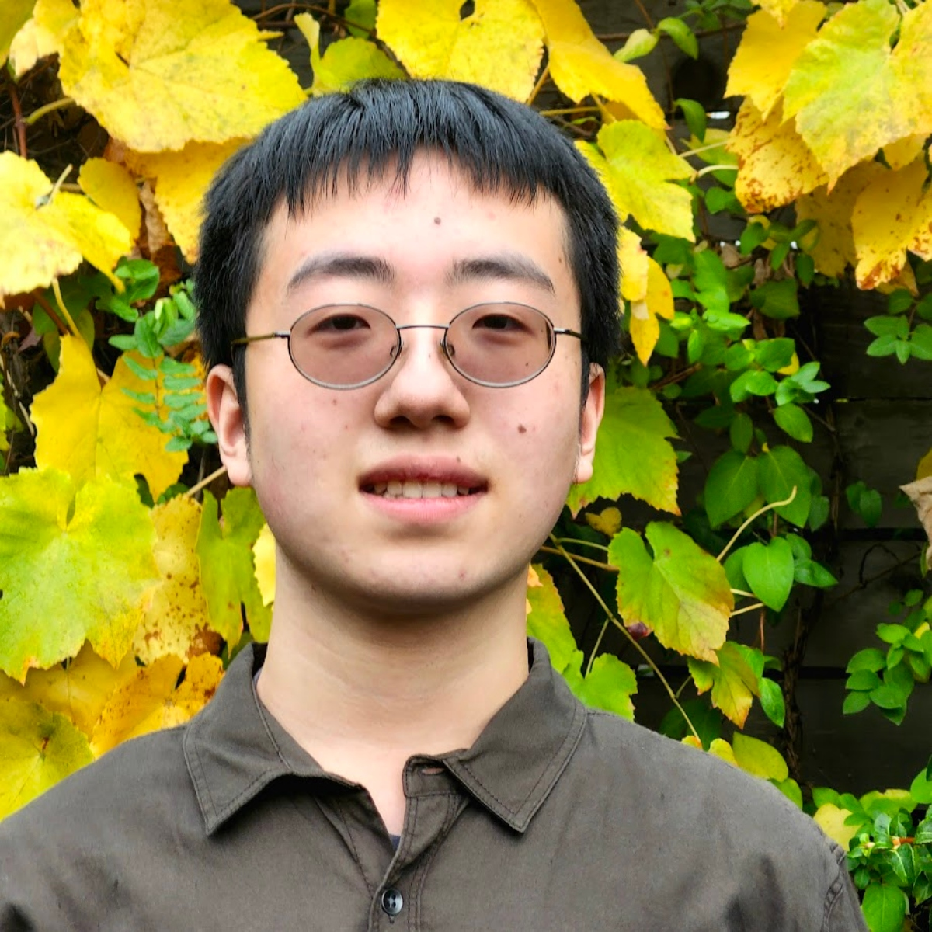
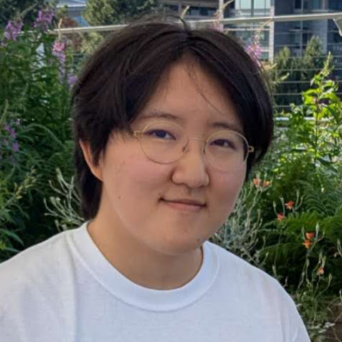
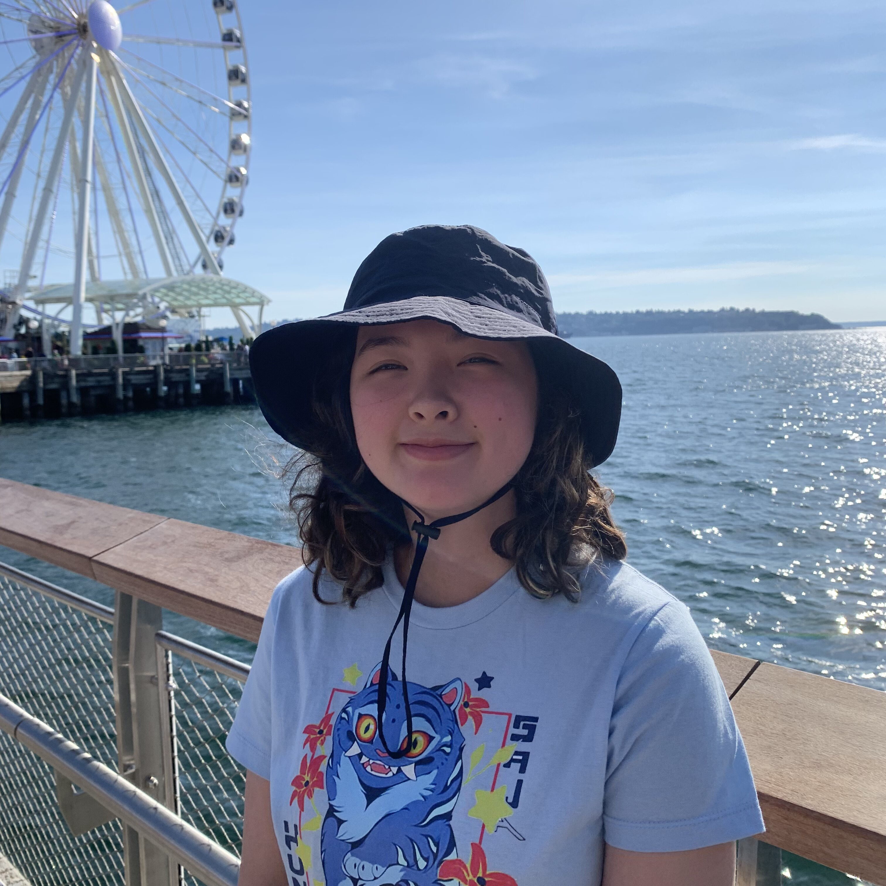
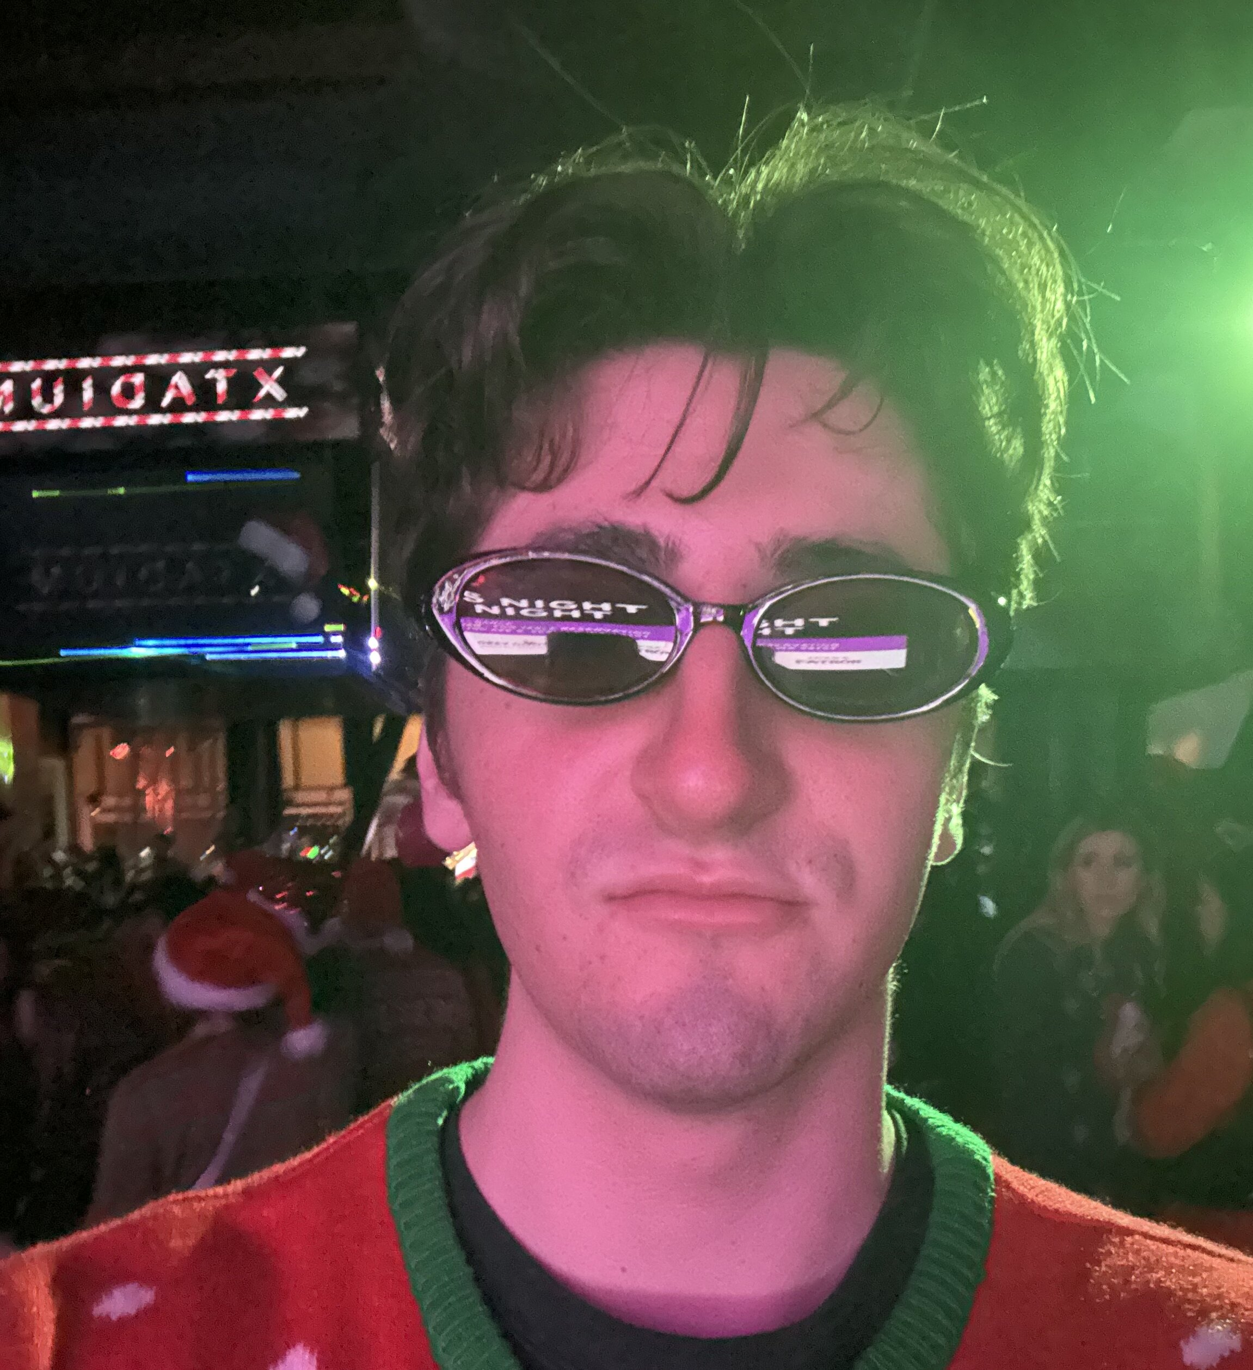
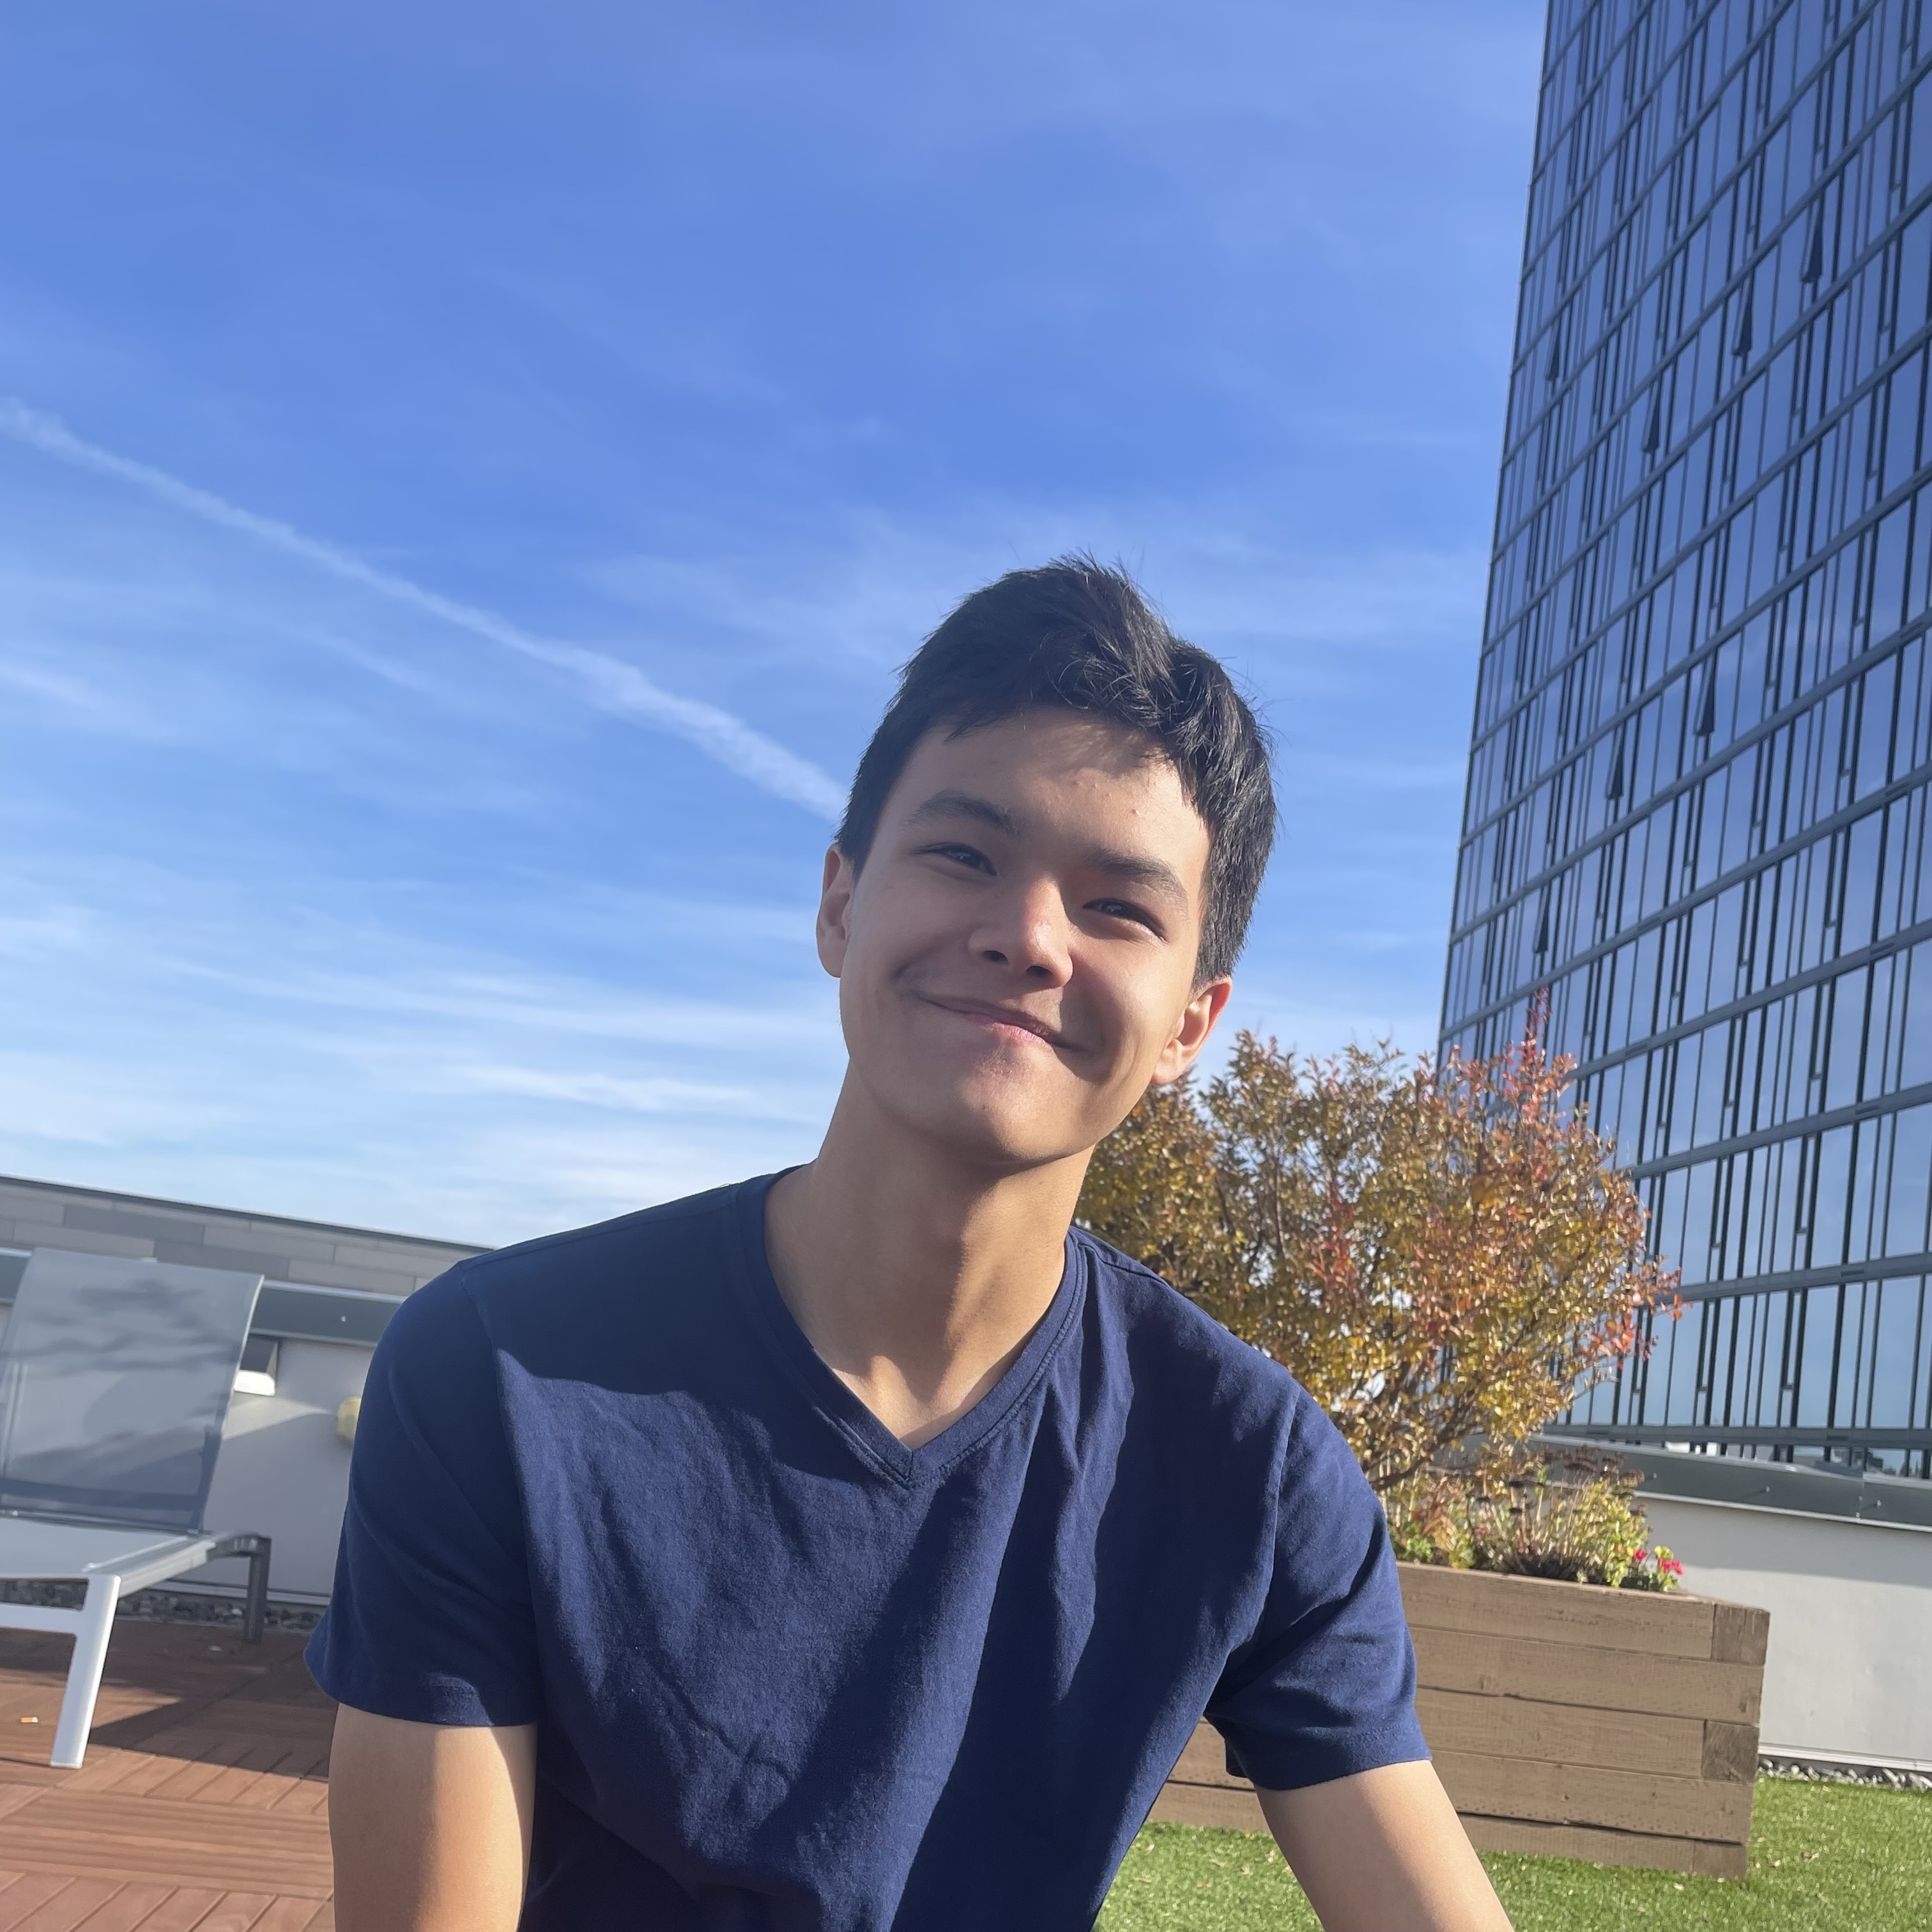
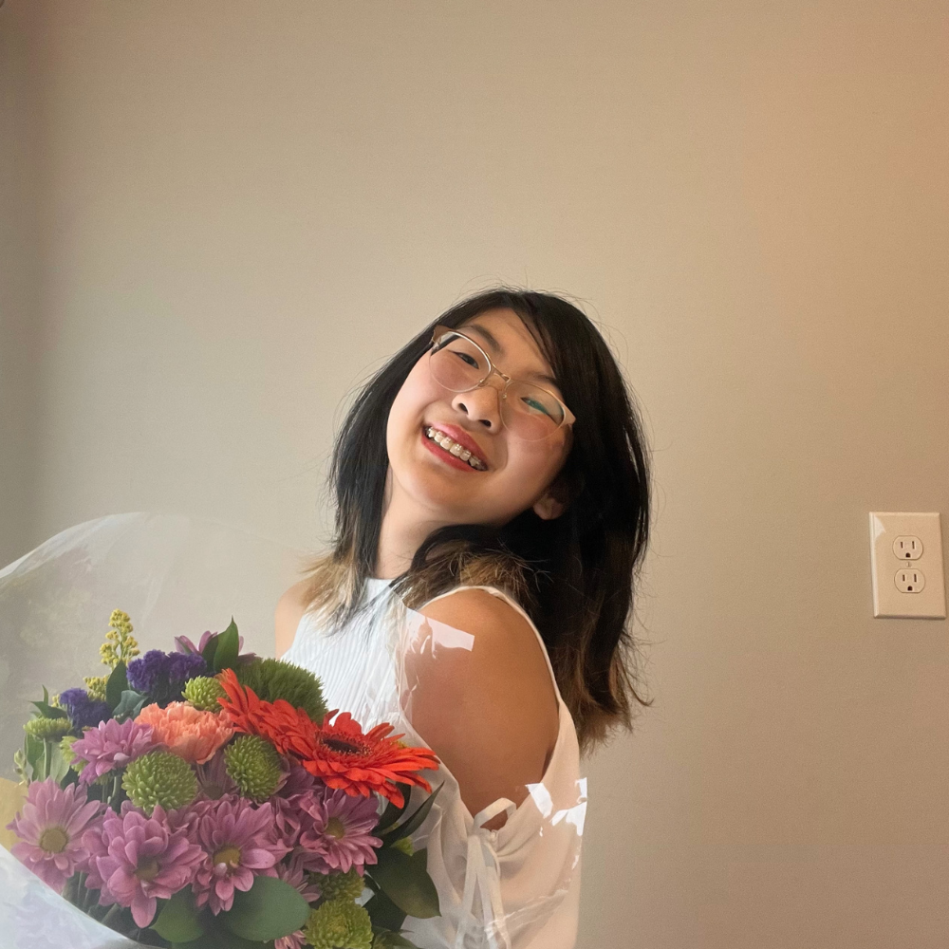
Thank your fabulous TAs!
Notes:
Brett

Slide 13
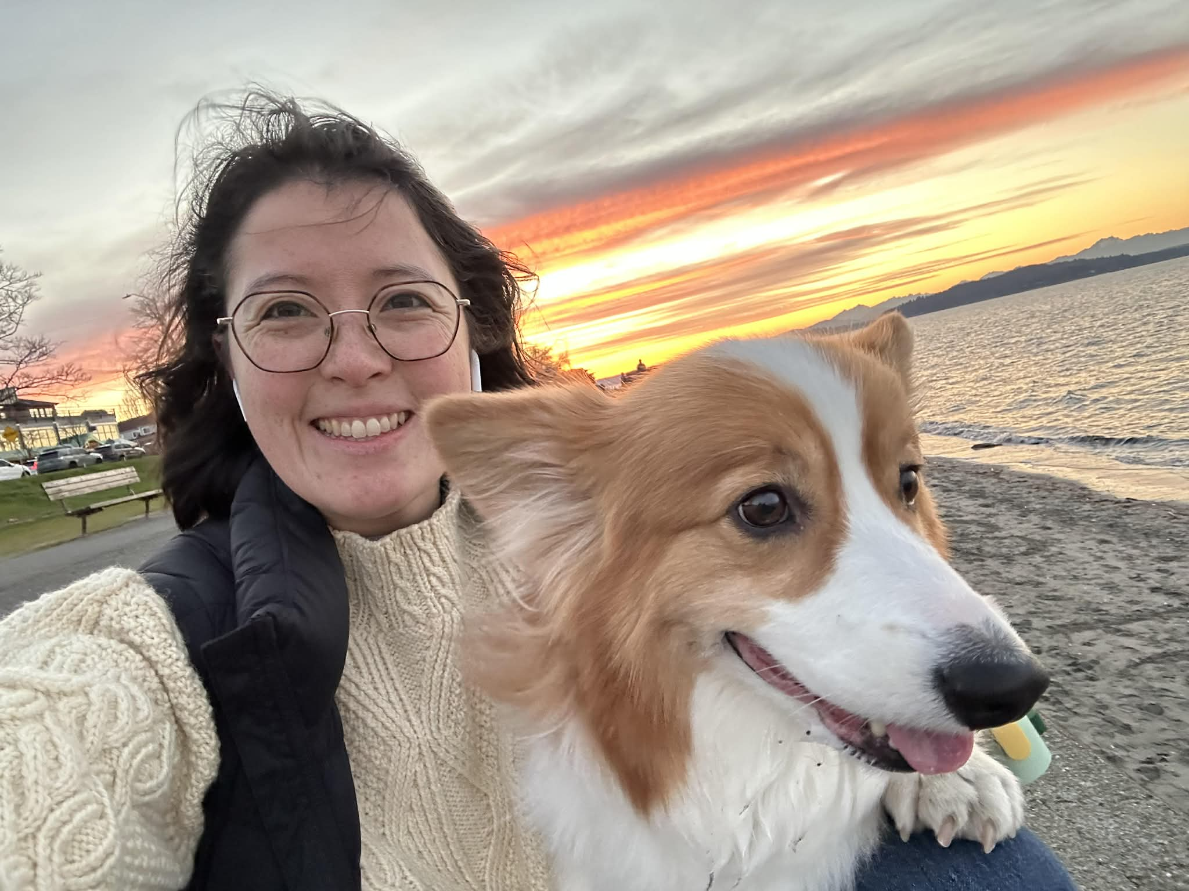
Thank you!
Ask Me (Almost) Anything!
sli.do #cse121
Notes:
Slido qr code: https://app.sli.do/event/k62kDRPcZurGYpUnPYEr2i

