Slide 1

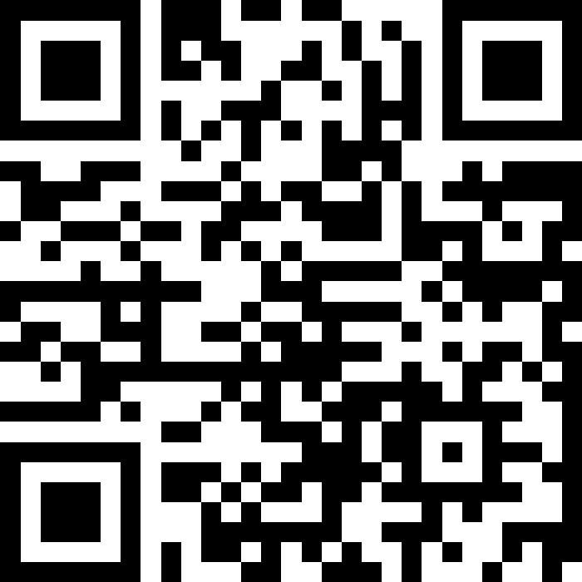
Final Exam Review
BEFORE WE START
LEC 18
Talk to your neighbors:
What will you miss from winter? What are you excited to leave behind?
Music: ❄️ CSE 121 26wi Lecture Tunes ❄️
Instructors:
TAs:
Amogh
William
Johnathan
Anant
Reese
Hayden
Aki
Spencer
Savannah
Tamsyn
Anum
Abdul
Janvi
Navya
Ruslana
Sam
Ethan
Jessica
Paul
Carson
Shayna
Jesse
Minh
Cayden

Slide 2

Announcements, Reminders (general)
R6 due Thursday, March 12th
R-EXTRA released Friday, March 13th
Contact your TA if your section credit on Gradescope looks wrong
R7 and R-EXTRA close Thursday, March 19th
IPL closes Friday, March 13th
Final Exam: Wednesday, March 18th from 12:30 - 2:20pm
Review the Exam page of website (with policies & resources)
TA-led review session: Monday, March 16th from 4:30-7:00pm in CSE2 G20
This will be very similar to today’s lecture but with a full practice exam

Slide 3
In-Class Exam Review
Mini-exam overview
This mini-final does not reflect the difficulty and length of the actual final
Opportunity to try exam-style problems on paper
3 problems
Code comprehension
Debugging
Programming
Task for today:
Work through each problem (one at a time) independently or with peers
Then, your lovely TAs will walk through their solutions and thought processes for each problem

Slide 4
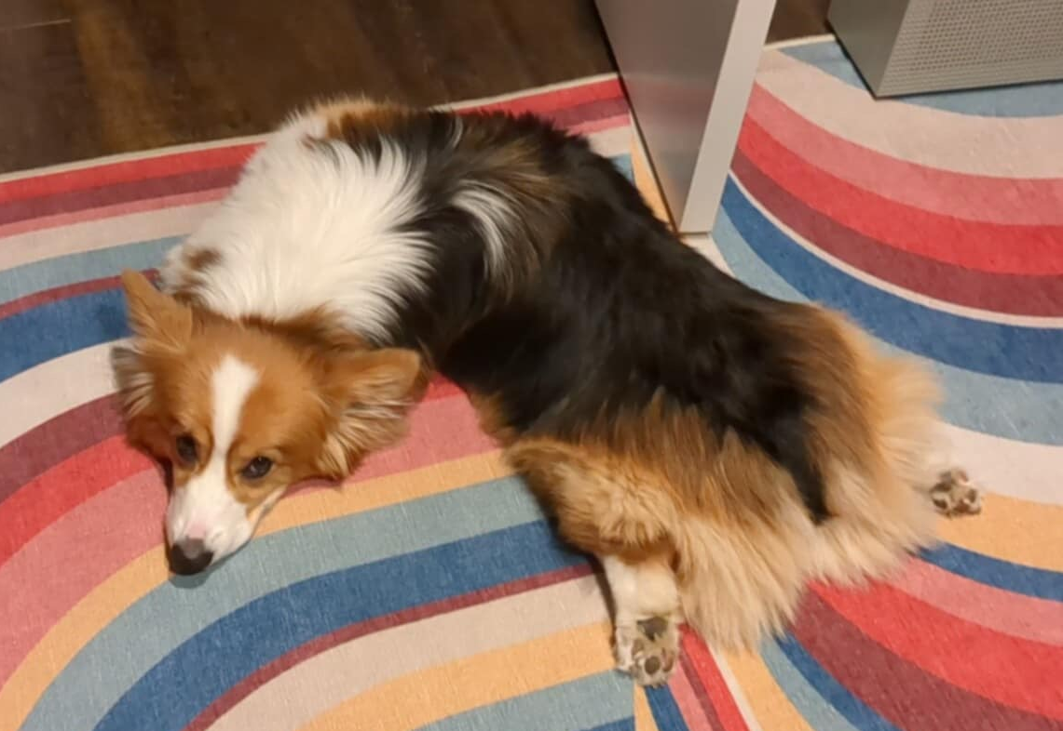
Best of luck on the exam!

