Slide 1
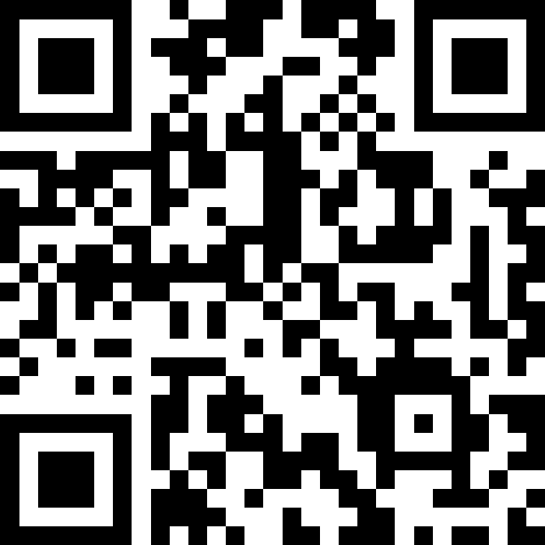
User Input (Scanner)
BEFORE WE START
LEC 11
Talk to your neighbors:
(In honor of Friday the 13th) what's your favorite spooky movie?
Music: ❄️ CSE 121 26wi Lecture Tunes ❄️
Instructor:
Miya Natsuhara
TAs:
Amogh
William
Johnathan
Anant
Reese
Hayden
Aki
Spencer
Savannah
Tamsyn
Anum
Abdul
Janvi
Navya
Ruslana
Sam
Ethan
Jessica
Paul
Carson
Shayna
Jesse
Minh
Cayden

Slide 2
Announcements, Reminders
P2 due Tuesday, February 24th
R3 out yesterday and due Thursday, February 19th
P0, C1, P1, C2 eligible
last opportunity to resubmit P0
Quiz 1 is Thursday, February 19th, in your registered quiz section
Resources posted on Ed today!
for loops, nested for loops, Random, Math, methods, parameters, returns, conditionals, while loops
Monday (Feb 16) is a university holiday (Presidents' Day)
IPL will be closed
Miya's office hours cancelled
I'm out of town for a conference next week, but you will be in good hands!
Matt Wang will be teaching on Wednesday
Hayden Feeney will be teaching on Friday

Slide 3
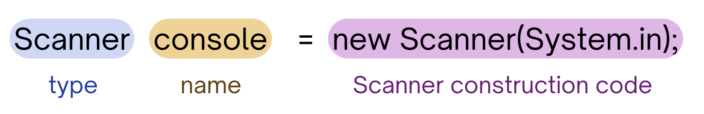
PCM Review: Scanner
An object that we can use to read in input
In the java.util “package”!
Methods | Description
nextInt() | Reads the next token from the user as an int and returns it.
nextDouble() | Reads the next token from the user as a double and returns it.
next() | Reads the next token from the user as a String and returns it.
nextLine() | Reads an entire line from the user as a String and returns it.

Slide 4
PCM Review: Tokens
A unit of user input, as read by the Scanner
Tokens are separated by whitespace (spaces, tabs, new lines)
23 John Smith
42.0 "Hello world" $2.50 " 19

Slide 5
PCM Review: InputMismatchException
Exceptions are errors that occur while a program is running that stops the program from running.
There are different types of exceptions that can occur, and the name of the exception can help you understand what caused the error!
An InputMismatchException occurs when the Scanner tries to read input in as a specific type, but the input cannot be interpreted as that type.
(e.g., trying to read in "hello" as an int)

Slide 6
Think Pair Share: Cornbear (Think)
When calling the following method, which of these user inputs would not cause an error? (choose multiple)
public static void cornbear() {
Scanner console = new Scanner(System.in);
int amt = console.nextInt();
String firstName = console.next();
String secondName = console.next();
double price = console.nextDouble();
}
6 Gumball’s Treats $12.48
3 Sesame Latte 16.47
2 The Hunger Games 21.98
4 Gumballs 900.24
2 Grammy Awards 90095

Slide 7
Think Pair Share: Cornbear (Pair)
When calling the following method, which of these user inputs would not cause an error? (choose multiple)
public static void cornbear() {
Scanner console = new Scanner(System.in);
int amt = console.nextInt();
String firstName = console.next();
String secondName = console.next();
double price = console.nextDouble();
}
6 Gumball’s Treats $12.48
3 Sesame Latte 16.47
2 The Hunger Games 21.98
4 Gumballs 900.24
2 Grammy Awards 90095

Slide 8
Reminder (again): Fencepost Pattern
Some task where one piece is repeated n times, and another piece is repeated n-1 times and they alternate
g-u-m-b-a-l-l

Slide 9
Fencepost Pattern … for User Input?
Some task where one piece is repeated n times, and another piece is repeated n-1 times and they alternate
What is your name?
Enter your age…
What is your name?
Enter your age…
What is your name?
...

