Slide 1
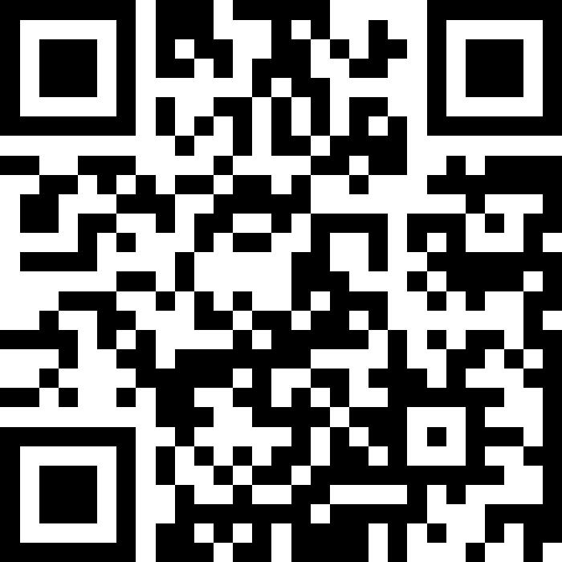
While Loops
BEFORE WE START
LEC 10
Talk to your neighbors:
What’s your favorite spot on the Ave?
Music: ❄️ CSE 121 26wi Lecture Tunes ❄️
Instructor:
Miya Natsuhara
TAs:
Amogh
William
Johnathan
Anant
Reese
Hayden
Aki
Spencer
Savannah
Tamsyn
Anum
Abdul
Janvi
Navya
Ruslana
Sam
Ethan
Jessica
Paul
Carson
Shayna
Jesse
Minh
Cayden

Slide 2
Agenda
Announcements, Reminders
while loop review
Flipping coins!

Slide 3
Announcements, Reminders
C2 due Thursday, February 12th
R2 due Thursday, February 12th
Eligible: C0, P0, C1, P1
Note: C0 is cycling out of eligibility for resubmission
P2 out soon, due Tuesday, February 24th
Quiz reminders:
Quiz 0 feedback coming this week!
Quiz 1: Thursday, February 19th

Slide 4
Agenda
Announcements, Reminders
while loop review
Flipping coins!

Slide 5
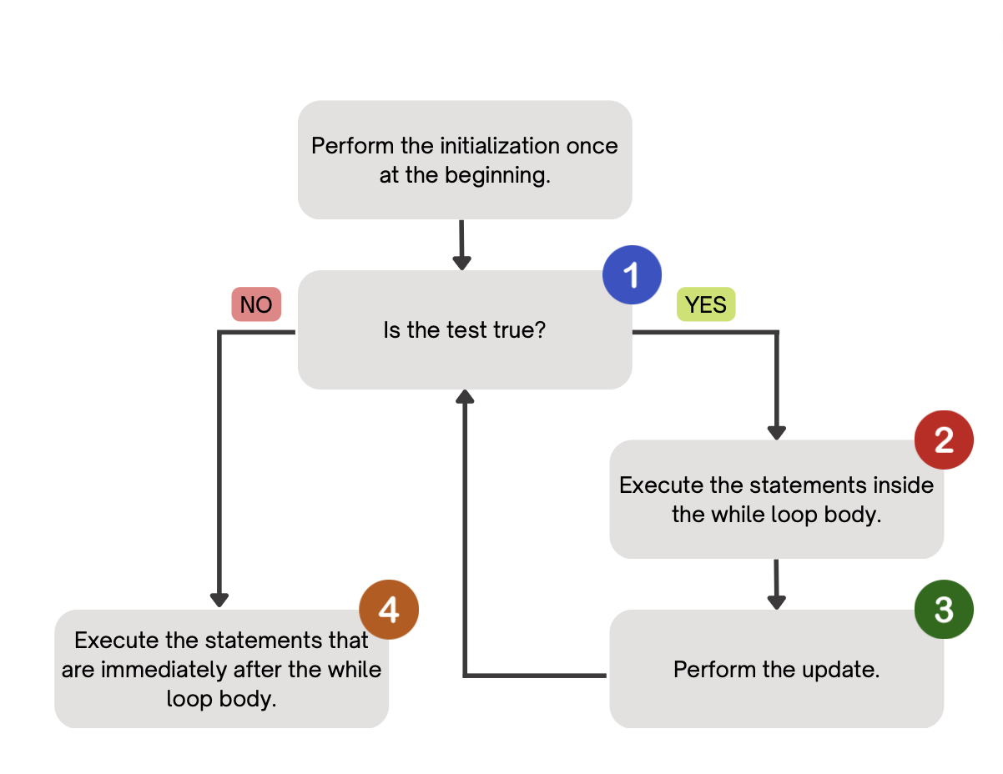
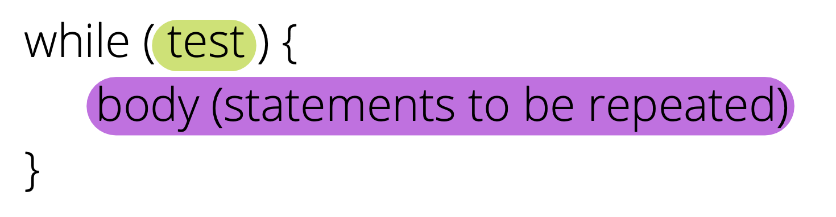
PCM Review: while loops
Repeatedly executes its body as long as the logical test is true.

Slide 6
Think Pair Share: mystery (think)
public static void mystery(Random randy, int lucky) {
int roll = -1; // "priming" the loop
int x = -1;
while (roll != lucky) {
roll = randy.nextInt(20) + 1;
if (x < roll) {
x = roll;
}
}
System.out.println("Lucky number " + x);
}
How would you describe what the variable x calculates?
The largest value rolled
The smallest value rolled
The first value rolled
The last value rolled
The sum of all values rolled

Slide 7
Think Pair Share: mystery (pair)
public static void mystery(Random randy, int lucky) {
int roll = -1; // "priming" the loop
int x = -1;
while (roll != lucky) {
roll = randy.nextInt(20) + 1;
if (x < roll) {
x = roll;
}
}
System.out.println("Lucky number " + x);
}
How would you describe what the variable x calculates?
The largest value rolled
The smallest value rolled
The first value rolled
The last value rolled
The sum of all values rolled

Slide 8
for loops are while loops?
for (int i = 0; i < bigYikes; i++) {
// ...
}
int i = 0;
while (i < bigYikes) {
// ...
i++;
}

Slide 9
for loops are while loops! (almost*)
for (int i = 0; i < bigYikes; i++) {
// ...
}
int i = 0;
while (i < bigYikes) {
// ...
i++;
}
*as a technical note, these aren’t exactly the same – there are some minor technical details that are different, most notably the scope of i is different in the two loops

Slide 10
for loops vs. while loops ⚔️
For loops and while loops are quite similar! This is the first (but certainly not the last) time where you need to decide which to use!
There’s not always a “correct” answer, but some advice:
is the condition definite or indefinite
Describing the problem!
“I will do __ X times” or “for each __ I will __” – sounds like for!
“I will do __ until” or “while __ is true, I will” – sounds like while!
it’s okay to change your mind after you try one approach!

Slide 11
Agenda
Announcements, Reminders
while loop review
Flipping coins!

