Slide 1

Conditionals
BEFORE WE START
LEC 09
Talk to your neighbors:
What’s something new you did recently? Or something new you’d like to try?
Instructor:
Hayden Feeney
TAs:
Anisha
Cayden
Savannah
Tamsyn
William

Slide 2
Announcements, Reminders
C2 released, due Thursday, July 30th
R2 out yesterday, due Thursday, July 30th
  the last time C0 is eligible for resubmission!
  "Re-resubmissions" post
Quiz reminders:
  Quiz 0 grades – we're working on it!
  Quiz 1 is on Thursday, July 30th

Slide 3
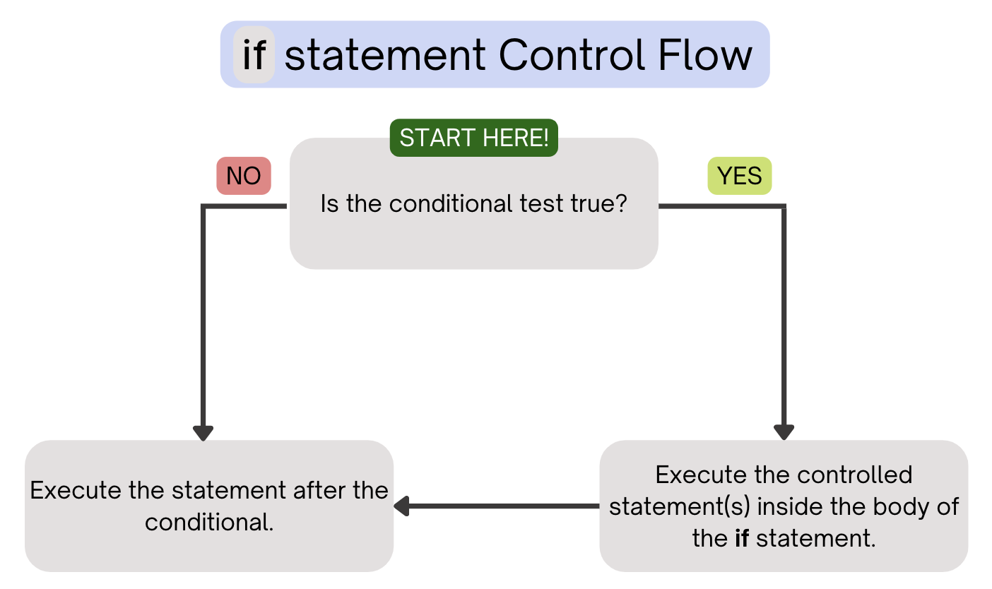
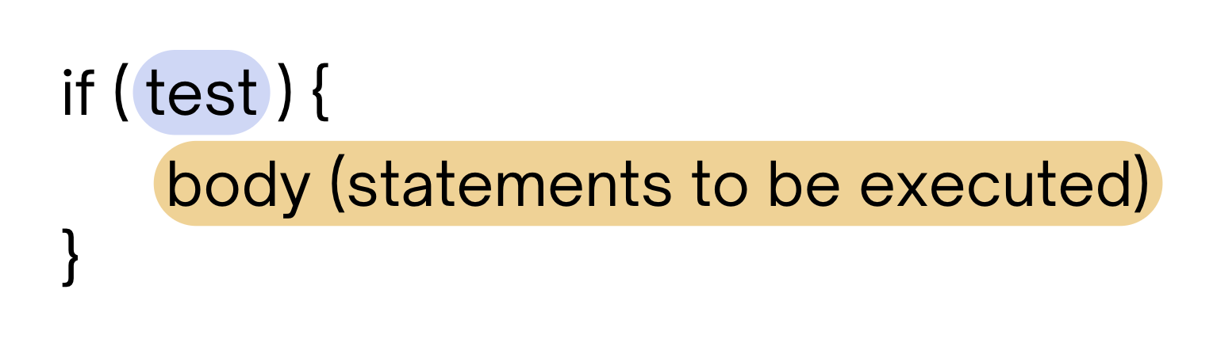
PCM Review: if Statements
Executes a block of statements if and only if the test is true

Slide 4
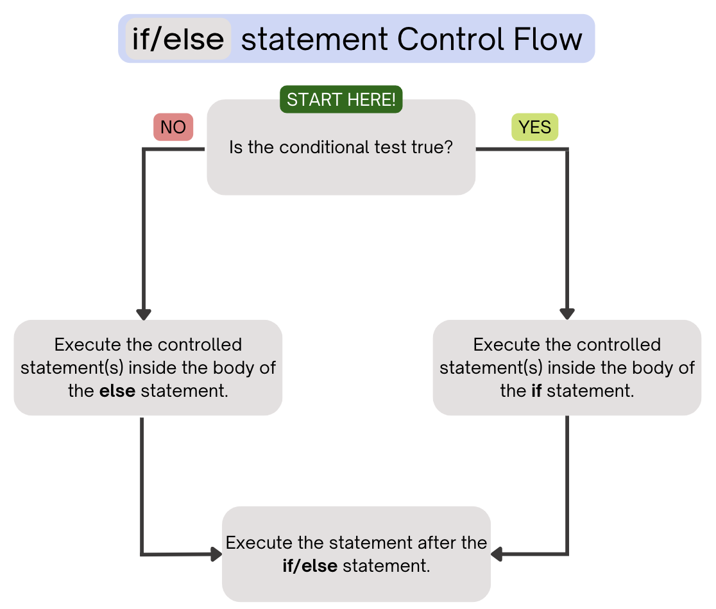
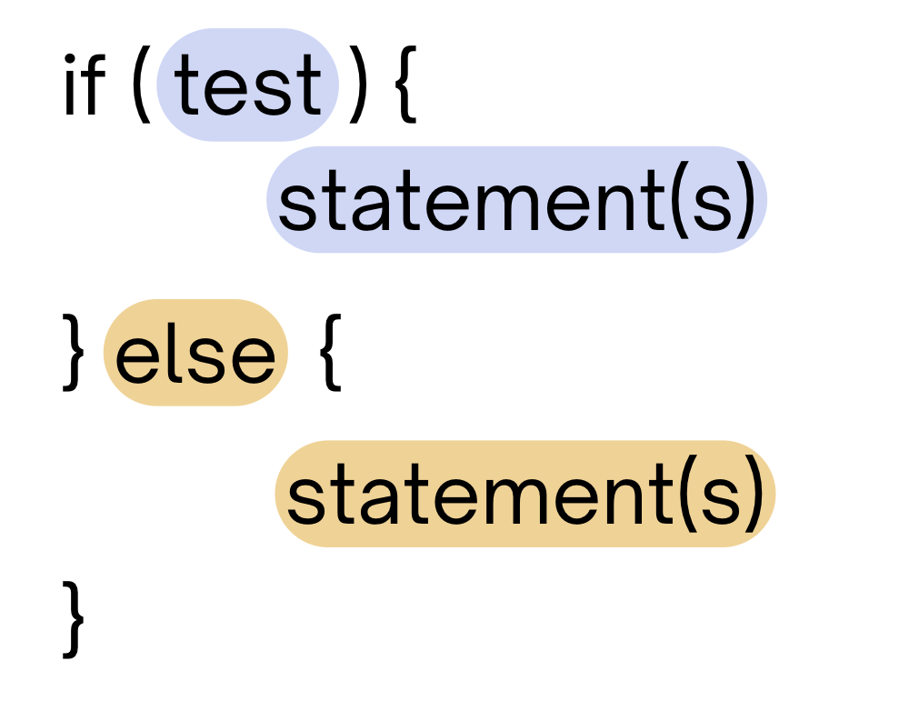
PCM Review: if-else
If the test is true: execute block of statements
If false, execute other block of statements

Slide 5
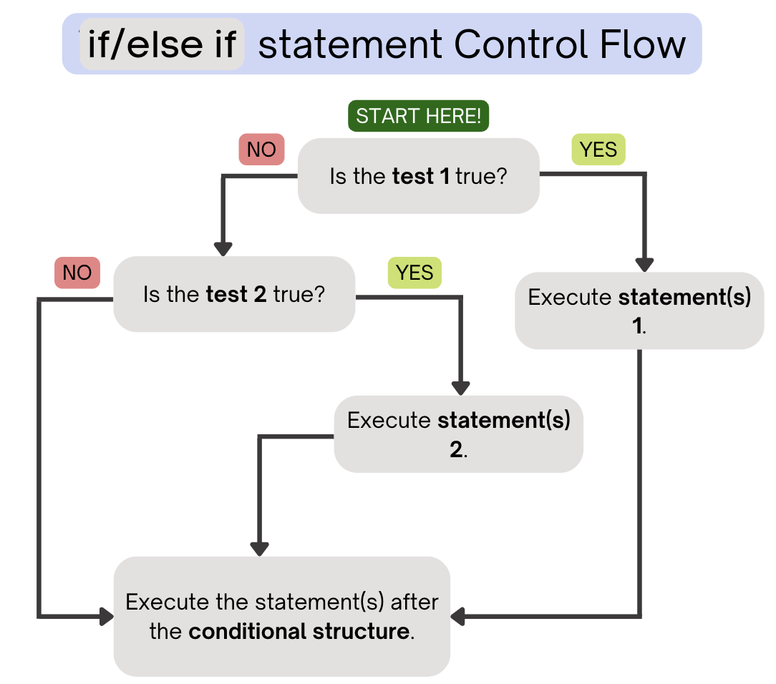
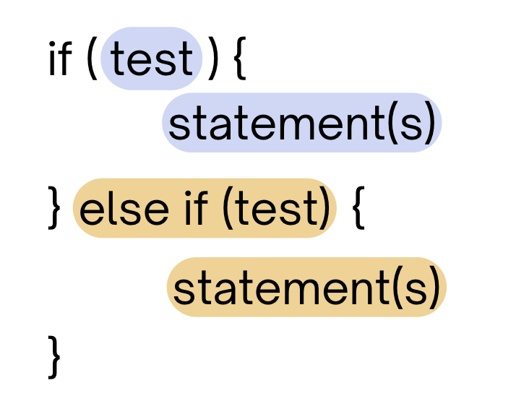
PCM Review: if-else if
If the first test is true, execute that block
If not, proceed to the next test, and repeat
If none were true, don’t execute any blocks
Note After entering an if /else if
block, skip all remaining blocks.

Slide 6
Reminder: Boolean Operators!
! (NOT)
&& (AND)
|| (OR)
relational: <, >, <=, >=, ==, !=
Very common with conditionals
if (day.equals("Wed") || day.equals("Fri")) {
return "121 lecture!";
} else if (day.equals("Tue") || day.equals("Thu")) {
return "121 quiz section!";
} else {
return "no 121!";
}

Slide 7
Think Pair Share: Odds and Evens (Think)
public static void main(String[] args) {
for (int i = 1; i <= 3; i++) {
System.out.print(mystery(i));
}
}
public static String mystery(int n) {
String response = "even ";
if (n % 2 == 1) {
response = "odd ";
} else if (n == 1) {
response = "one ";
}
return response;
}
What does this program output?
A. odd even odd
B. one even odd
C. one even even
D. even even even

Slide 8
Think Pair Share: Odds and Evens (Pair)
public static void main(String[] args) {
for (int i = 1; i <= 3; i++) {
System.out.print(mystery(i));
}
}
public static String mystery(int n) {
String response = "even ";
if (n % 2 == 1) {
response = "odd ";
} else if (n == 1) {
response = "one ";
}
return response;
}
What does this program output?
A. odd even odd
B. one even odd
C. one even even
D. even even even

Slide 9
“Useless” Conditionals
public static void main(String[] args) {
for (int i = 1; i <= 3; i++) {
System.out.print(mystery(i));
}
}
public static String mystery(int n) {
String response = "even ";
if (n % 2 == 1) {
response = "odd ";
} else if (n == 1) {
response = "one ";
}
return response;
}
This else if statement never runs!

Slide 10
Think Pair Share: count (think)
public static int mystery(int num1, int num2) {
int count = 0;
if (num1 == 7) {
count++;
if (num2 < 4) {
count++;
}
}
if (num1 + num2 == 10) {
count++;
} else if (num1 - 2 + num2 == 8) {
count++;
} else {
count++;
}
return count;
}
If num1 is 7 and num2 is 3, what does this method return?
A. 2
B. 3
C. 4
D. 5

Slide 11
Think Pair Share: count (think)
public static int mystery(int num1, int num2) {
int count = 0;
if (num1 == 7) {
count++;
if (num2 < 4) {
count++;
}
}
if (num1 + num2 == 10) {
count++;
} else if (num1 - 2 + num2 == 8) {
count++;
} else {
count++;
}
return count;
}
If num1 is 7 and num2 is 3, what does this method return?
A. 2
B. 3
C. 4
D. 5

