Slide 1
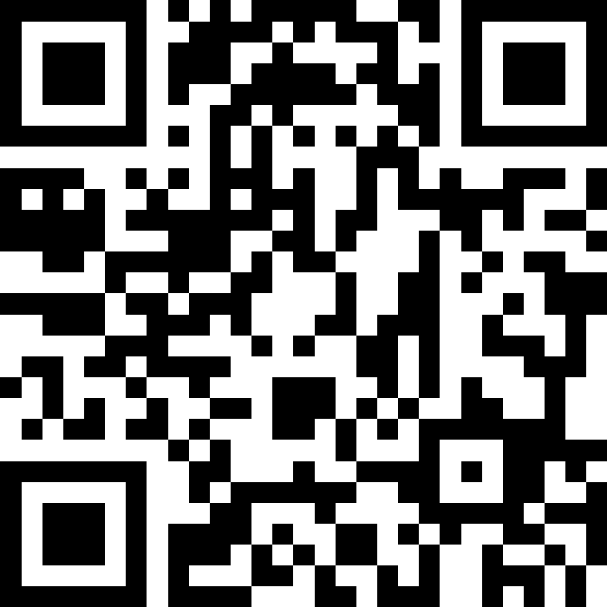
String methods, char, More Variables
BEFORE WE START
LEC 02
Talk to your neighbors:
What is your favorite emoji? 😀
Respond on sli.do!
Instructor:
Hayden Feeney
TAs:
Anisha
Cayden
Savannah
Tamsyn
William

Slide 2
Agenda (1/5)
Announcements, Reminders (now)
C0 Reflection Recap
Datatypes and Expressions Review
Casting, More Variables and Operators!
Strings and Characters Review
  code example!

Slide 3
Announcements, Reminders
C0 due tonight
  Expect C0 grades ~ 1 week from submission (we’ll announce on Ed)
  shortly after, your first resubmission cycle will open!
P0: Cornbear’s Café releases tonight!
  due Tuesday, July 7th
No lecture this Friday! (university holiday)

Slide 4
Agenda (2/5)
Announcements, Reminders
Intro Survey, C0 Reflection Recap (now)
Datatypes and Expressions Review
Casting, More Variables and Operators!
Strings and Characters Review
  code example!

Slide 5
Intro survey responses
What we’re excited about:
“To learn something completely new to me - I have no programming experience”
“Chatting with my peers and honestly just figuring out how to code.”
“To learn and build confidence in a new skill I've previously struggled with, hopefully open some creative doors for future projects.”

Slide 6
Intro survey responses
What we’re nervous about:
“The fact that I have never taken a computer science course”
“I'm a bit worried I'll get in over my head and get stuck on the projects and fall behind.”
“theres noone to ask for help”
Resources for help:
Ed
IPL
Instructor office hours
Email Hayden at hbfeeney@cs.washington.edu

Slide 7
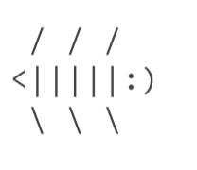
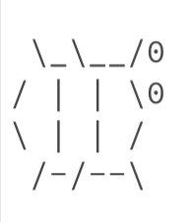

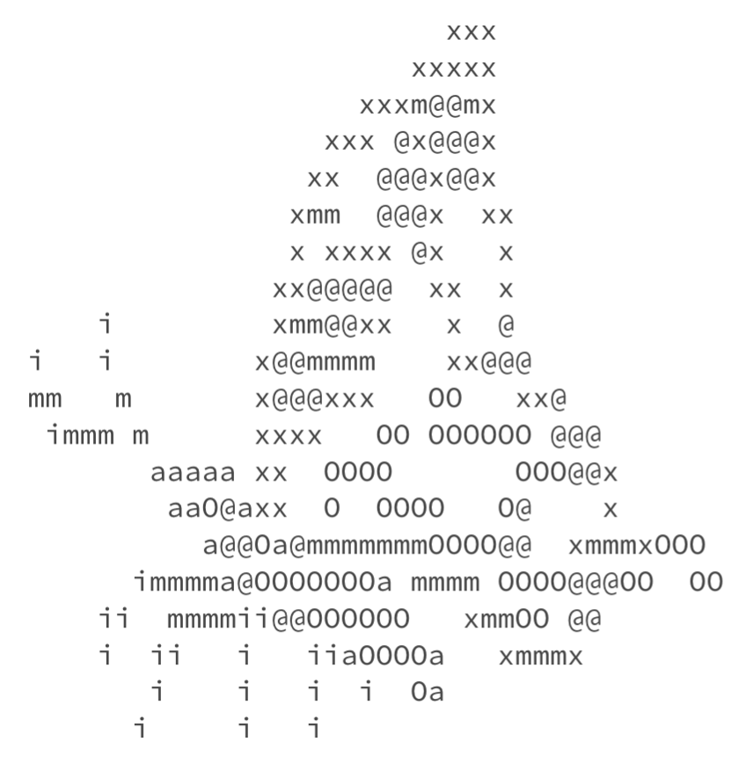
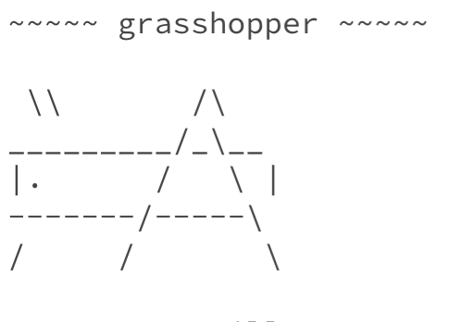
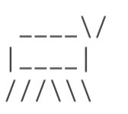
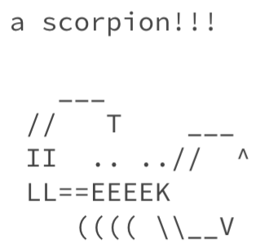
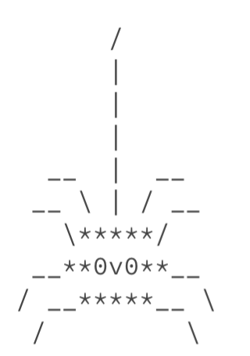
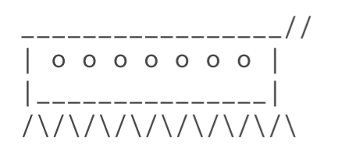
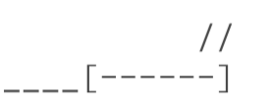
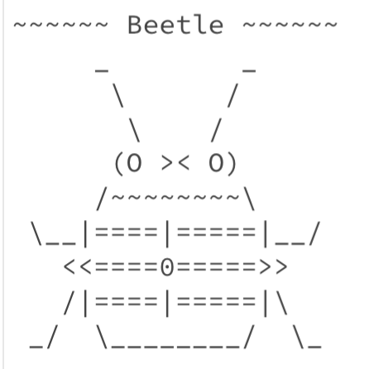
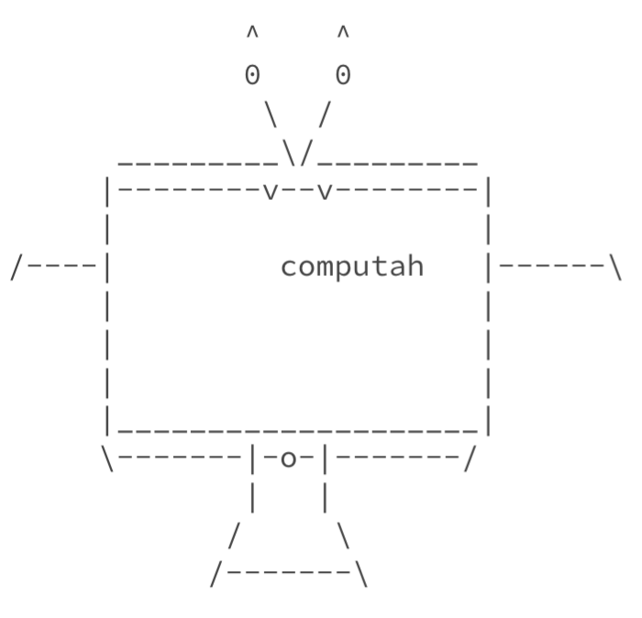
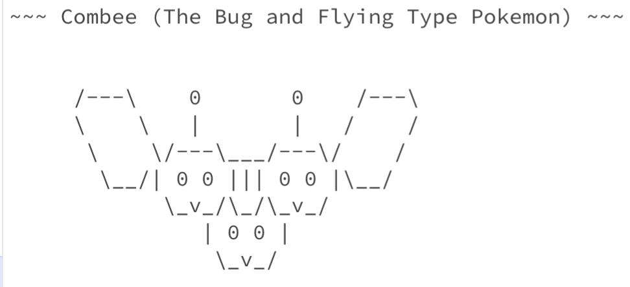
Bugs!

Slide 8
On Accessibility… (1/2)
Great engagement with the C0 reflection! Some themes:
Suprise!
“I was really surprised how the speaker was able to understand the speaking tool that he uses to code at such high speeds. I wouldn't have been able to decipher anything that the speaking tool was saying, so it's really impressive that he is able to code efficiently using this tool.”
Programming as problem solving, not just typing
“…programming is more about problem-solving than about just looking at the screen and understanding it immediately.”

Slide 9
On Accessibility… (2/2)
Accessibility matters because…
  “…having accessibility in computer science helps create inclusivity and an equal opportunity to learn and participate in technology”
  “When we stop perceiving people within disabled communities as incompetent, is when we are able to create means for creating pathways so every person that wants to code is able to do so. ”
  “…fixes for blind users, like better keyboard navigation, end up helping everyone.”

Slide 10
Is C0 Accessible?
Probably not…or at least not yet.
When looking at ASCII art:
“…the slashes and symbols aren't screen reader-friendly, as it's just gonna read what's on each line rather than make sense of the whole image.”

Slide 11
So, What?
Broadly speaking: the digital world is inaccessible
but, that’s changing!
and we have the power to change it!
In CSE 121, we don’t have the full knowledge yet to make accessible ASCII art (or Java programs, applications, video games, websites, …)
However, we encourage you to:
think about accessibility when you make things with computers
keep on learning more! UW is a global leader in digital accessibility
e.g. at UW: CSE 443E: Accessibility, EDSPE 304, CREATE, HuskyADAPT

Slide 12
Agenda (3/5)
Announcements, Reminders
Intro Survey, C0 Reflection Recap
Datatypes and Expressions Review (now)
Casting, More Variables and Operators
Strings and Characters Review
  code example!

Slide 13

Think Pair Share: Datatypes Review (Think)
What does this expression evaluate to? Be sure to indicate the type of the resulting value (e.g. 7.0 rather than 7 for a double, String in quotes).
2 % 5 + (26 % 6) - 5 / 2 + " corgi " + 1.2 + 1
"4 corgi 1.21" B. "2 corgi 2.2"
C. "2 corgi 1.21" D. "4 corgi 2.2"

Slide 14
Think Pair Share: Datatypes Review (Pair)
What does this expression evaluate to? Be sure to indicate the type of the resulting value (e.g. 7.0 rather than 7 for a double, String in quotes).
2 % 5 + (26 % 6) - 5 / 2 + " corgi " + 1.2 + 1
"4 corgi 1.21" B. "2 corgi 2.2"
C. "2 corgi 1.21" D. "4 corgi 2.2"

Slide 15
Worked Out Think-Pair-Share Example
" "
" "
2 % 5 + (26 % 6) - 5 / 2 + " corgi " + 1.2 + 1
2
2
2
4
" "
2
"2 corgi "
"2 corgi 1.2"
"2 corgi 1.21"

Slide 16
Agenda (4/5)
Announcements, Reminders
Intro Survey, C0 Reflection Recap
Datatypes and Expressions Review
Casting, More Variables and Operators! (now)
Strings and Characters Review
  code example!

Slide 17
PCM: Variables
Recall: Variables allow us to give a name to a specific value
  3 parts: declaration, initialization, usage
  Example:
Declaration: int x;
Initialization: x = 30;
Or all in one line: int x = 30;
String bestBoy = "gumball";
System.out.println(bestBoy);

Slide 18
PCM: Casting
Java will do some type conversions for us
  E.g., int to double, double to String, int to String
BUT some conversions Java won't do for us…
  Nonsensical conversions (e.g., "Gumball" to int)
  Conversions that are "lossy" (e.g., double to int)
    We can ask Java to typecast for us
double x = 8.83;
int xInt = (int) x;

Slide 19
New: Manipulating Variables
They’re made to be manipulated, modified, and re-used!
  int myFavoriteNumber = 7;
  int tripleFavNum = myFavoriteNumber * 3;
  myFavoriteNumber = myFavoriteNumber + 3;
Note! This doesn’t really make any mathematical sense. That’s because in Java, = is assignment, not equality!

Slide 20
New Operator: +=
myFavoriteNumber = myFavoriteNumber + 3;
This pattern is so common, we have a shorthand for it!
myFavoriteNumber += 3;
This works for both numeric addition and string concatenation!

Slide 21
More Shorthand Operators
The shorthands -=, *=, /=, and %= exist too!
myFavoriteNumber /= 3;
Should this work for integers? Doubles? Strings?

Slide 22
Even Shorter Shorthands
There are even shorter operators for “incrementing” and “decrementing”!
myFavoriteNumber++; // myFavoriteNumber += 1;
myFavoriteNumber--; // myFavoriteNumber -= 1;
Should this work for integers? Doubles? Strings?

Slide 23
Think Pair Share: A, B, C Variables (Think)
What values do a, b, and c hold after this code is executed?
int a = 10;
int b = 30;
int c = a + b;
c -= 10;
a = b + 5;
b /= 2;
10, 30, 40
35, 15, 30
35, 15.5, 30
20, 15, 30

Slide 24
Think Pair Share: A, B, C Variables (Pair)
What values do a, b, and c hold after this code is executed?
int a = 10;
int b = 30;
int c = a + b;
c -= 10;
a = b + 5;
b /= 2;
10, 30, 40
35, 15, 30
35, 15.5, 30
20, 15, 30

Slide 25
Agenda (5/5)
Announcements, Reminders
Intro Survey, C0 Reflection Recap
Typecasting
Casting, More Variables and Operators!
Strings and Characters Review (now)
  code example!

Slide 26
PCM: Strings & chars
Recall: String literals are a sequence of characters that are strung together, begin and end with ""
  Use zero-based indexing
A char represents a single character
  Begin and end with single quotes ( ' )
  Strings are made up of chars!
g | u | m | b | a | l | l
0 | 1 | 2 | 3 | 4 | 5 | 6
char letter = 'g';
char anotherLetter = 'b';

Slide 27
PCM: String Methods
Usage: <string_variable>.<method>(…)
Method | Description
length() | Returns the length of the string.
charAt(i) | Returns the character at index i of the string
indexOf(s) | Returns the index of the first occurrence of s in the string; returns -1 if s doesn't appear in the string
substring(i, j) or substring(i) | Returns the characters in this string from i (inclusive) to j (exclusive); if j is omitted, goes until the end of the string
contains(s) | Returns whether or not the string contains s
equals(s) | Returns whether or not the string is equal to s (case-sensitive)
equalsIgnoreCase(s) | Returns whether or not the string is equal to s ignoring case
toUpperCase() | Returns an uppercase version of the string
toLowerCase() | Returns a lowercase version of the string

Slide 28
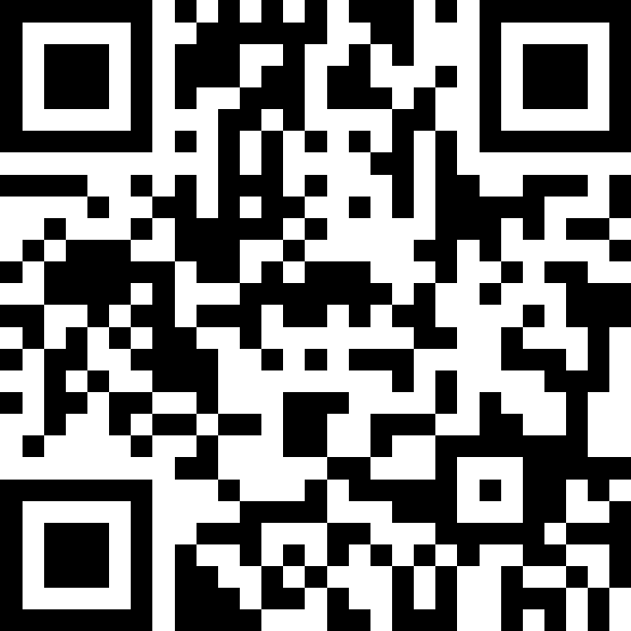
Think Pair Share: Gumball (Think)
Suppose s contains the String "bubble gum".
Which statement would result in s containing "Gumball" instead?
s.substring(7) + "ball";
s = s.substring(7, 9) + "ball";
s = s.charAt(7).toUpperCase() + "ball";
s = s.substring(7, 8).toUpperCase()
+ s.substring(8) + "ball";
b | u | b | b | l | e |  | g | u | m
0 | 1 | 2 | 3 | 4 | 5 | 6 | 7 | 8 | 9

Slide 29
Think Pair Share: Gumball (Pair)
Suppose s contains the String "bubble gum".
Which statement would result in s containing "Gumball" instead?
s.substring(7) + "ball";
s = s.substring(7, 9) + "ball";
s = s.charAt(7).toUpperCase() + "ball";
s = s.substring(7, 8).toUpperCase()
+ s.substring(8) + "ball";
b | u | b | b | l | e |  | g | u | m
0 | 1 | 2 | 3 | 4 | 5 | 6 | 7 | 8 | 9

Slide 30
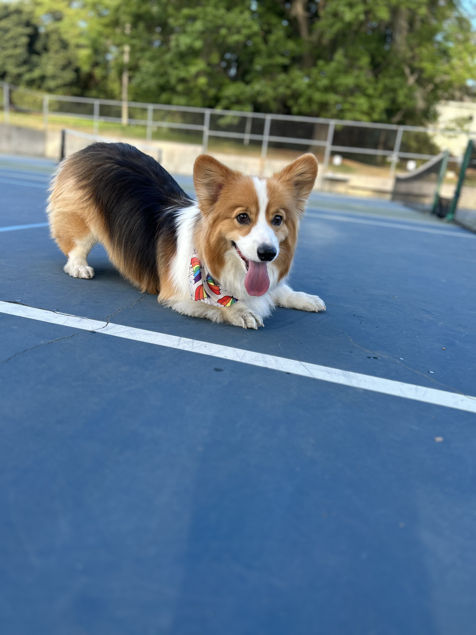
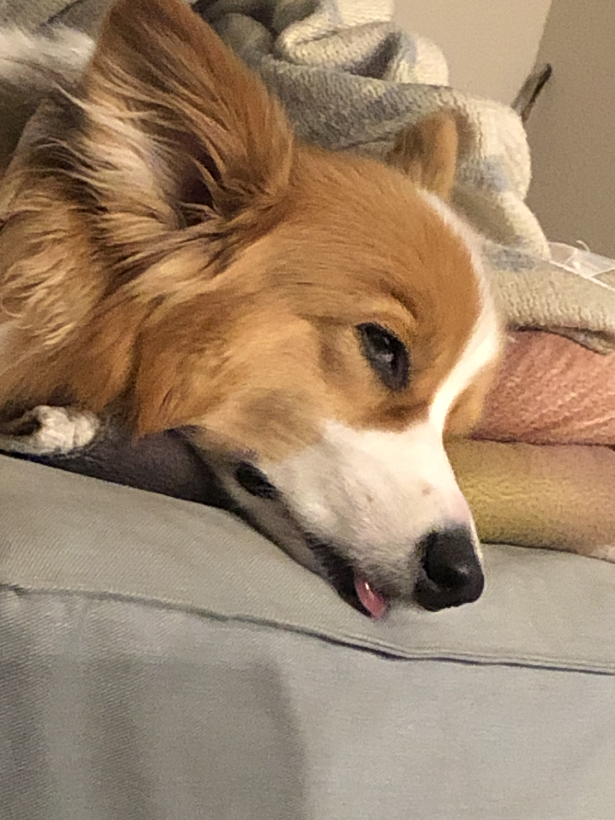

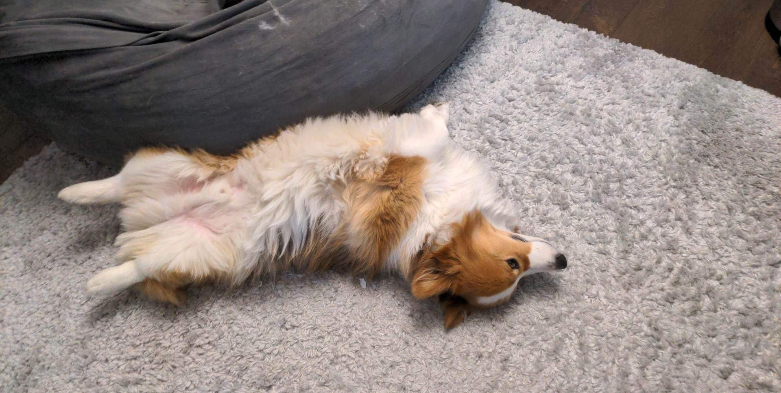
Aside: Gumball

