Slide 1
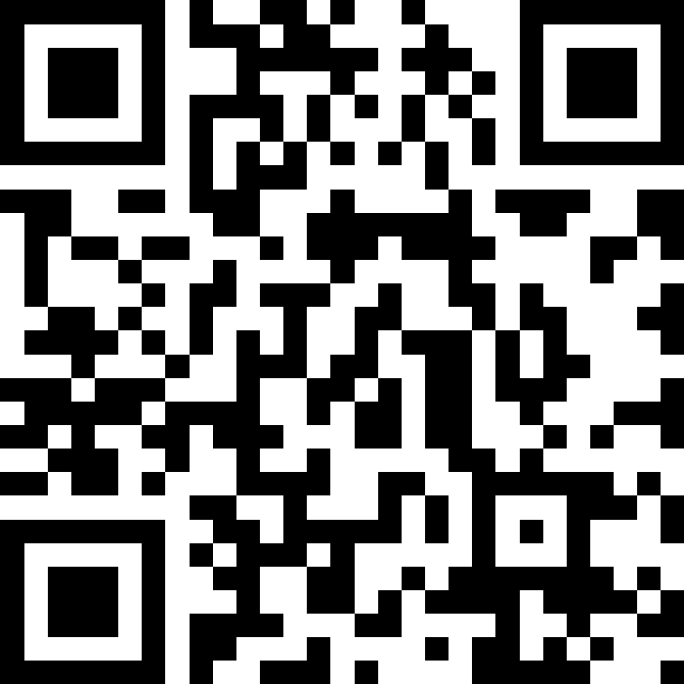
Victory Lap!
(+ exam review)
BEFORE WE START
LEC 16
Talk to your neighbors:
What is your go-to end-of-finals celebration?
Instructors:
Hayden Feeney
TAs:
Anisha
Cayden
Savannah
Tamsyn
William

Slide 2
Announcements, Reminders
P3 due Friday, August 21st
R5 due tomorrow, August 20th
R6 (and R-Extra) due Saturday, August 22nd
  all assignments are eligible for resubmission!
  R-Extra email has gone out!
Tomorrow is the last day for IPL
Final Exam: Friday, August 21st from 12:00– 1:00 PM, in SIG 134 (this room)
  Review the Exam page of website (with policies & resources)
  Can’t make it? Email me ASAP

Slide 3
Evaluations and Awards
Please give us feedback!
Course Evaluations are due Sunday, August 23rd at 11:59 PM
TA Evaluations are due Sunday, August 23rd at 11:59 PM
We read every piece of feedback!
Bob Bandes TA Award nominations open!
  thought your TA was goated? write them a nomination!
  fun fact: some of our faculty won the award when they were TAs!

Slide 4
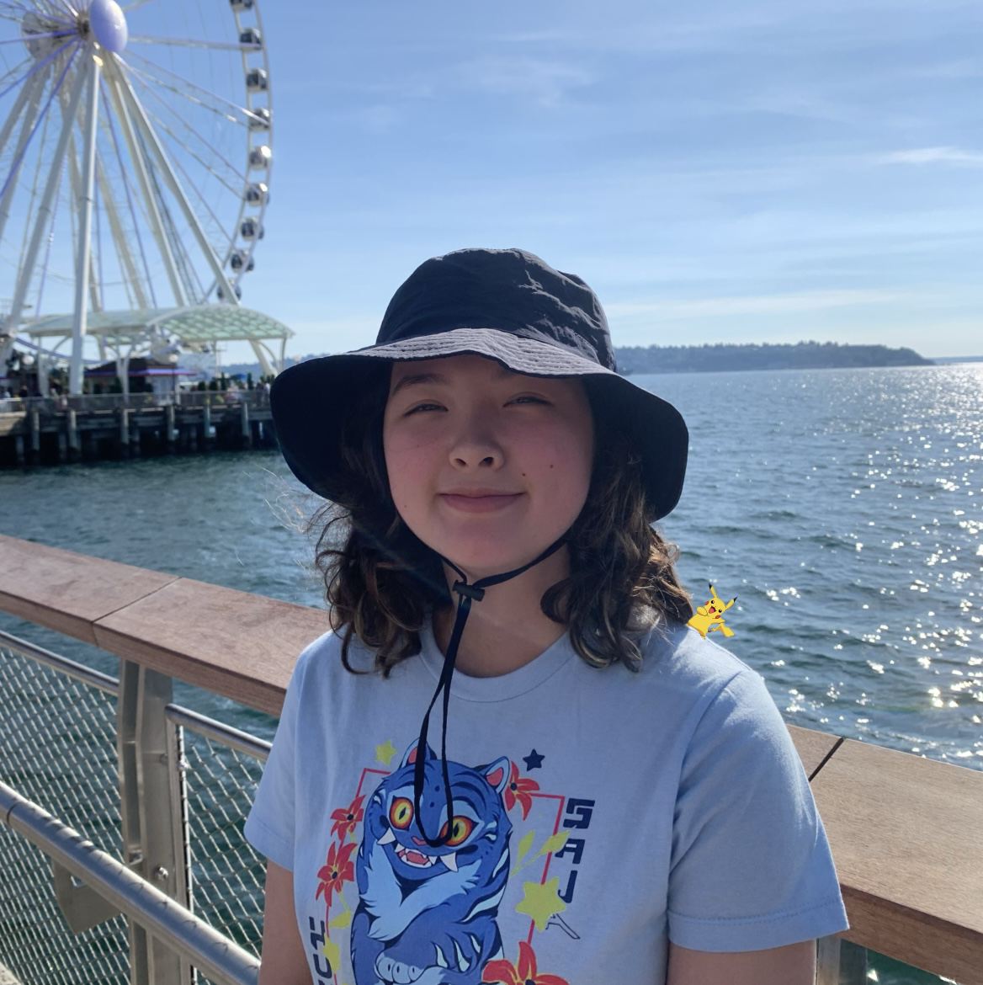
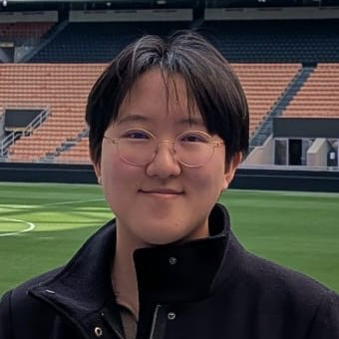
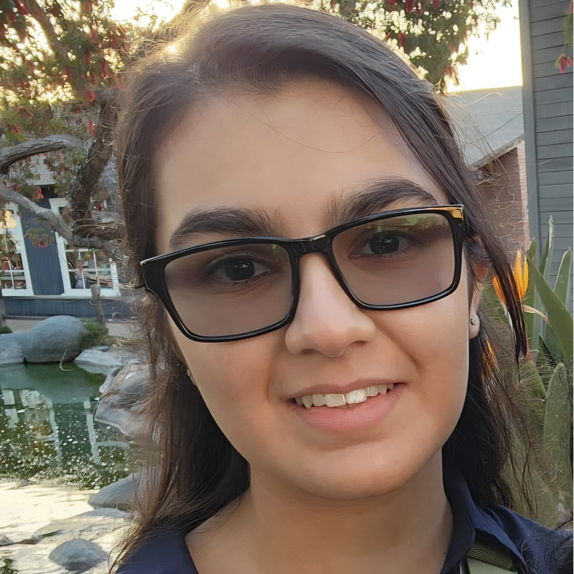
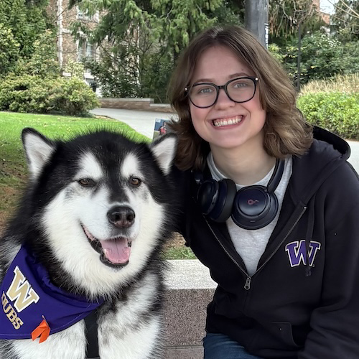
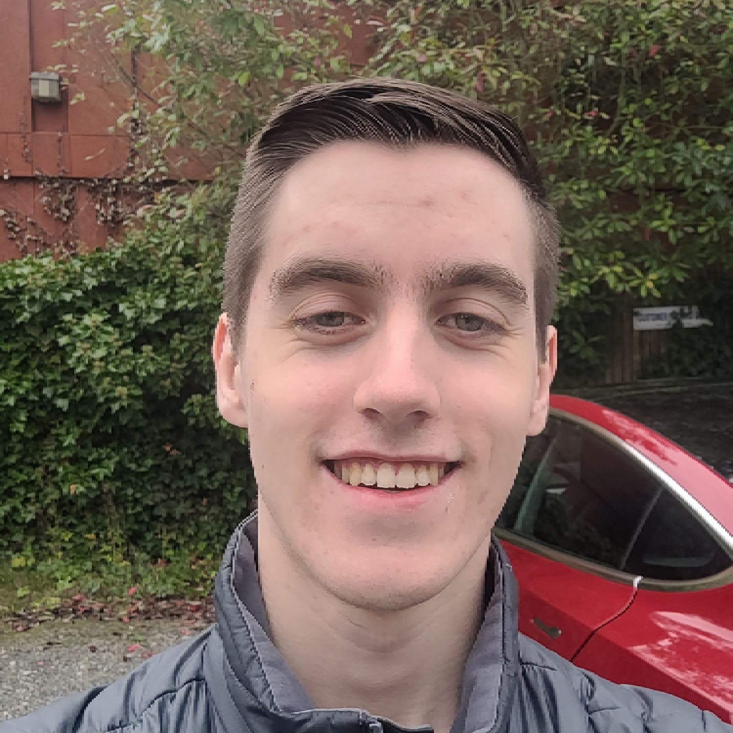

Thank your fabulous TAs!

Slide 5
What is String[] args?
Live demo in class ☺
Note: this is not tested material!

Slide 6
Future Courses
More 12X!
or “What can I do next?”
Course | Overview
CSE 122 | Data structures, object-oriented programming
CSE 123 | More OOP, recursion
Non-majors
Course | Overview
CSE 154 | Intro to web programming (several languages)
CSE 160 | Intro programming, data analysis (Python)
CSE 163 | Intermediate programming, data analysis (Python)
CSE 180 | Introduction to data science (Python)
CSE 373 | Data structures and algorithms (in Java)
CSE 374 | Low-level programming and tools (C/C++)
CSE 412 | Intro to Data Visualization
CSE 416 | Intro. to Machine Learning
CSE 493E | Accessibility
Majors
Course | Overview
CSE 311 | Mathematical foundations
CSE 331 | Software design/implementation
CSE 340 | Interaction programming (apps)
CSE 341 | Programming languages
CSE 351 | Hardware / Software Interface
CSE 480 | Social impacts of computing
Related majors: Informatics, ACMS, HCDE, ECE, …
See: https://www.cs.washington.edu/academics/ugrad/current-students and https://www.cs.washington.edu/academics/ugrad/nonmajor-options/nonmajor-courses

Slide 7
Summer Break Project: Tic Tac Toe
Build your own Tic Tac Toe game + “AI”!
How would you represent a Tic Tac Toe game in Java?
(hint: arrays will be very, very helpful!)
Write a method that tells you if a Tic Tac Toe game is won.
Write a method that gets input from the user and “makes” a move.
Wrap it all up – into a nice two-player game!

Slide 8
Summer Break Project: Tic Tac Toe++
Make some “AI” that…
just makes a random valid move (you should be able to beat this!)
tries to make a “good” move (~ some if statements)
never loses
  Tic Tac Toe is a “solved game”: a perfect player will never lose.
Or, extend this idea to other grid-based games!
similar-ish: connect four, checkers, battleship
much harder: sudoku, chess, go, othello

Slide 9
In-Class Exam Review
Mini-exam overview
  This mini-final does not reflect the difficulty and length of the actual final
  Opportunity to practice exam-style problems on paper
3 problems
  Code Comprehension
  Debugging
  Programming
Task for today:
  Work through each problem (one at a time) independently or with peers
  Afterwards, we’ll walk through our solutions & thought processes
  Problems & key also on Ed (look after class!)

