Slide 1
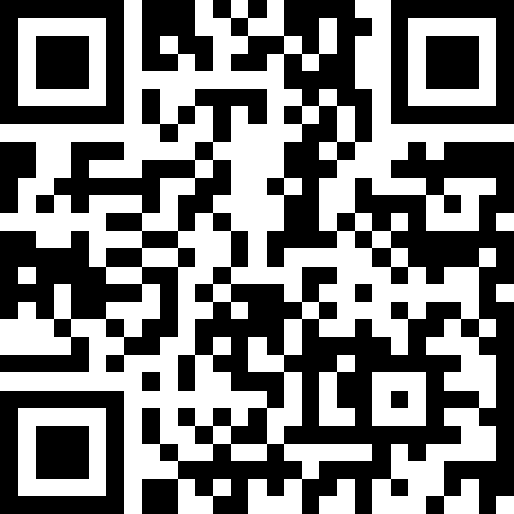
Reference Semantics
BEFORE WE START
LEC 14
Talk to your neighbors:
What’s your favorite sport or competition to watch?
Instructors:
Hayden Feeney
TAs:
Anisha
Cayden
Savannah
Tamsyn
William

Slide 2
Announcements, Reminders
C3 releases today, due Thursday, August 13th
R4 due next Thursday, August 13th (eligible: C1, P1, C2, P2)
  C1 cycling out of eligibility after R4
Quiz 2 on Thursday, August 13th
  Conditionals, while loops, User Input (Scanner), Arrays
  can’t make it? email Hayden before your quiz!
Final exam on Friday, August 21st in class!
  Details on final exam page
  More details to come!

Slide 3
Think Pair Share: arrayMystery (think)
What would the array arr store at the end of this arrayMystery method if {-20, 20, 26, 32, 50, 3} was passed in?
public static void arrayMystery(int[] arr) {
for (int i = arr.length - 1; i >= 1; i--) {
if (arr[i] > arr[i - 1] + 10) {
arr[i - 1] = arr[i - 1] + 5;
}
}
}
{-20, 20, 26, 32, 50, 3}
{-15, 25, 31, 37, 55, 8}
{-15, 25, 31, 37, 50, 3}
{-15, 20, 26, 37, 50, 3}

Slide 4
Think Pair Share: arrayMystery (Pair)
What would the array arr store at the end of this arrayMystery method if {-20, 20, 26, 32, 50, 3} was passed in?
public static void arrayMystery(int[] arr) {
for (int i = arr.length - 1; i >= 1; i--) {
if (arr[i] > arr[i - 1] + 10) {
arr[i - 1] = arr[i - 1] + 5;
}
}
}
{-20, 20, 26, 32, 50, 3}
{-15, 25, 31, 37, 55, 8}
{-15, 25, 31, 37, 50, 3}
{-15, 20, 26, 37, 50, 3}

Slide 5
Tracing through arrayMystery
i
{-20, 20, 26, 32, 50, 3}
public static void arrayMystery(int[] a) {
for (int i = a.length - 1; i >= 1; i--) {
if (a[i] > a[i - 1] + 10) {
a[i - 1] = a[i - 1] + 5;
}
}
}
a

Slide 6
PCM Review: Value Semantics vs. Reference Semantics
Value Semantics
Applies when working with primitive types
Variables/parameters hold a copy of the actual value
Reference Semantics
Applies when working with objects
Variables/parameters hold a reference to the object
int a = 3;
int[] list1 = {4, 8, 15};
3
4
8
15
int a
int[] list1

Slide 7
PCM Review: Value Semantics (setup)
int a
Applies when working with primitive types
Variables/parameters hold a copy of the actual value
3
int b
int a = 3;
int b = a;
a = 99;

Slide 8
PCM Review: Value Semantics
int a
Applies when working with primitive types
Variables/parameters hold a copy of the actual value
3
99
int b
3
int a = 3;
int b = a;
a = 99;

Slide 9
PCM Review: Reference Semantics (setup)
int[] list1
Applies when working with objects
  Including arrays!
Variables/parameters hold a reference to the object
4
int[] list1 = {4, 8, 15};
int[] list2 = list1;
list1[0] = 99;
int[] list2

Slide 10
PCM Review: Reference Semantics
Applies when working with objects
  Including arrays!
Variables/parameters hold a reference to the object
99
int[] list1
4
8
15
int[] list1 = {4, 8, 15};
int[] list2 = list1;
list1[0] = 99;
int[] list2

Slide 11
Value Semantics & Methods
boolean test = true;
flipValue(test);
public static void flipValue(boolean b) {
b = !b;
}

Slide 12
Reference Semantics & Methods
boolean[] tests = {true, false, false, false};
flipValues(tests);
public static void flipValues(boolean[] b) {
for (int i = 0; i < b.length; i++) {
b[i] = !b[i];
}
}

Slide 13
PCM Review: null
null is the absence of a reference!
sort of the “zero” for references
default value for object types (e.g. Random, Scanner, and String)
A NullPointerException is an error that happens
when you ask null to “do something”, which includes:
calling .toUpperCase() on null? NullPointerException!
calling .nextInt() on null? NullPointerException!
many, many more

Slide 14
PCM Review: avoiding NullPointerException
if (strs[i] != null) {
System.out.println(strs[i].toUpperCase());
} else {
System.out.println("element " + i + " is null.");
}

