Slide 1

Arrays
BEFORE WE START
LEC 13
Talk to your neighbors:
What is your favorite potato-based dish? (e.g. fries, aloo gobhi, gnocchi)
Instructors:
Hayden Feeney
TAs:
Anisha
Cayden
Savannah
Tamsyn
William

Slide 2
Announcements, Reminders
P2 due tomorrow, Thursday August 6th
R3 due tomorrow, Thursday, August 6th (eligible: P0, C1, P1, C2)
Quiz 2 next week, Thursday, August 13th
  Includes everything through today’s lecture
  Can’t make it? Email Hayden before your quiz!
Quiz 1 grades released before Quiz 2
Final Exam is in two weeks, Friday, August 21st

Slide 3
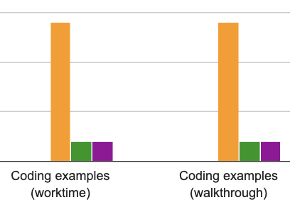
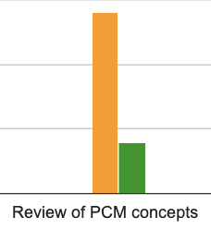
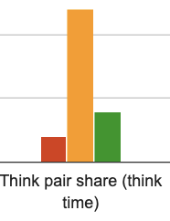
Lecture feedback (1/2)

Slide 4
Lecture feedback (2/2)
Think Pair Share (TPS)
  Belief: most learning happens during the share portion!
  Difficult when people don’t share
    2 things helping you learn:
      Try to explain your reasoning
      Trying to ask a question
Collaboration, discussion, questions
  Slight preference towards less, questions slowing down class
  During pauses, the brain learns a lot!

Slide 5
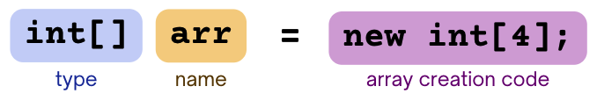
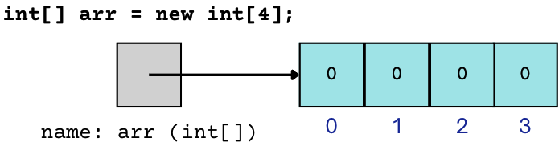
PCM Review: Arrays
New data structure that stores multiple items, in order
Elements must all be the same type
Zero-based indexing (like Strings!)

Slide 6
Recall: Variables and “Mental Models”
type
name
value
myNum
int myNum = 2;
2
int
CODE
THINK

Slide 7
The Mental Model for Arrays
type
name
value
arr
int[] arr = {2,0,6};
2
0
6
int[]
CODE
THINK

Slide 8
Arrays vs Strings
Unlike Strings…
refer to individual elements via bracket notation (e.g. arr[3])
must decide (and fix) size when created
arr.length to get arr’s length
  no parentheses. this is called a “field”, not a method.
  (more on this in CSE 122!)
Arrays.toString(arr) to get a nice String version
  if not: “gobbledygook” (printing the “reference”)
  requires import.java.util.*;

Slide 9
PCM Review: Array Traversal Pattern
for (int i = 0; i < arr.length; i++) {
// do something with arr[i]
}

Slide 10
Think Pair Share: Array Length (Think)
Which of these expressions gives us the last element of an array arr?
arr[arr.length()]
arr[length()]
arr[arr.length]
arr[arr.length() - 1]
arr[arr.length - 1]

Slide 11
Think Pair Share: Array Length (Pair)
Which of these expressions gives us the last element of an array arr?
arr[arr.length()]
arr[length()]
arr[arr.length]
arr[arr.length() - 1]
arr[arr.length - 1]

