Slide 1
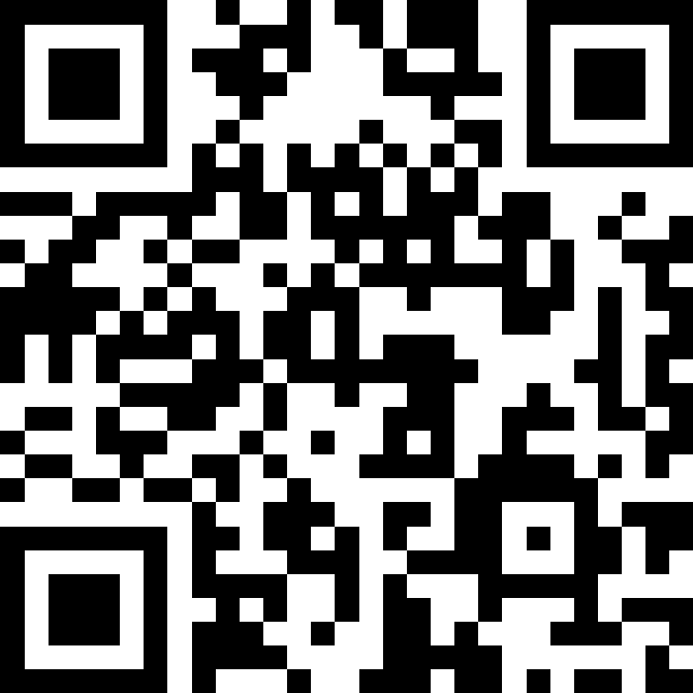
Printing, Strings, Variables, Datatypes, Expressions
BEFORE WE START
LEC 01
Talk to your neighbors:
What is your favorite handheld food?
Respond on sli.do!
Instructor:
Hayden Feeney
TAs:
Anisha
Cayden
Savannah
Tamsyn
William

Slide 2
Agenda (1/7)
Announcements, Reminders
HelloWorld Review
Printing, Strings, Variables Review
Variables Example
Datatypes and Expressions Review
Expressions Practice
C0 Overview

Slide 3
Announcements, Reminders
Links to all materials and activities are available on the website
Creative Project 0 (C0) will be released tonight
  due Wednesday, July 1st
Fill out the welcome survey by tonight at 11:59 PM
  gives us valuable insight!
  important that Google Forms works in CSE 121
  Google Forms troubleshooting guide on website
New Ed tool: Sandbox (write all the code you want!)
First PCM is much longer than future PCMs

Slide 4
Aside: TA Office Hours!
The IPL (TA office hours) will open on Monday (June 29) at 1:30 PM.
one of the best parts of the course!
but, TAs are instructed to not just give you the answer!
  why not? you wouldn’t be learning!
  e.g. “my code doesn’t work” versus
  “I tried X, expected Y, but got Z. Thoughts on what to try next?”
  also true for instructor office hours ;)
Expect an announcement on Ed with a detailed schedule soon!

Slide 5
Agenda (2/7)
Announcements, Reminders
HelloWorld Review
Printing, Strings, Variables Review
Variables Example
Datatypes and Expressions Review
Expressions Practice
C0 Overview

Slide 6
Code Quality
"Programs are meant to be read by humans and only incidentally for computers to execute." –Abelson & Sussman, SICP
Code is about communication. Writing code with good code quality is important to communicate effectively.
Different organizations have different standards for code quality.
Doesn't mean that any one standard is wrong! (e.g., APA, MLA, Chicago, IEEE, …)
Consistency is very helpful within a project
See our Code Quality Guide for the standards we will all use in CSE 121

Slide 7
Agenda (3/7)
Announcements, Reminders
HelloWorld Review
Printing, Strings, Variables Review
Variables Example
Datatypes and Expressions Review
Expressions Practice
C0 Overview

Slide 8
PCM: Printing, Strings
System.out.print(…)
  Prints the given text to the console
System.out.println(…)
  Prints the given text to the console, and then moves to the next line
String literals: a sequence of characters that are strung together, begin and end with ""
  Example: "hello"

Slide 9
Think Pair Share: Hello (around the) World (Think)
How many lines of output would the following code produce?
System.out.println("hello");
System.out.print("bonjour");
System.out.println("pryvit");
System.out.print("nihao");
System.out.println("hola");
System.out.print("namaste");
1
2
3
4
5
6

Slide 10
Think Pair Share: Hello (around the) World (Pair)
How many lines of output would the following code produce?
System.out.println("hello");
System.out.print("bonjour");
System.out.println("pryvit");
System.out.print("nihao");
System.out.println("hola");
System.out.print("namaste");
1
2
3
4
5
6

Slide 11
Escape sequences
Escape sequence: a special sequence of characters used to represent certain special characters in a String.
\" to produce " in a String
\\ to produce \ in a String
\n to produce a new line character (or line break) in a String
  note: in our class, we will ask you not to use this
and many more!

Slide 12
PCM: Variables
Variables allow us to give a name to a specific value
  3 parts: declaration, initialization, usage
  Example:
String food = "burrito";
System.out.println(food); // prints burrito

Slide 13
Agenda (4/7)
Announcements, Reminders
HelloWorld Review
Printing, Strings, Variables Review
Variables Example
Datatypes and Expressions Review
Expressions Practice
C0 Overview

Slide 14
Agenda (5/7)
Announcements, Reminders
HelloWorld Review
Printing, Strings, Variables Review
Variables Example
Datatypes and Expressions Review
Expressions Practice
C0 Overview

Slide 15
PCM: Data Types & Expressions
Programming is about data; we tell Java what type of data we have!
Data types (so far): int, double, String, boolean
  note: only String is capitalized!
All values in a (Java) program have a type!
  some are “obvious”, e.g. 42 or "hello world"
    aside: these are called “literals”
  some are more complicated expressions!

Slide 16
PCM: Operators
We learned a ton of operators!
Numerical:
+ Addition
- Subtraction
* Multiplication
/ Division (tricky!)
% Modulo (or “mod”)
<, >, <=, >=, ==, != Relational
Strings:
+ Concatenation (not addition!)
Booleans:
! Logical Not
&& Logical And
|| Logical Or
== and != Relational

Slide 17
PCM: Precedence
Operators have precedence (an order of operations).
In Math:
Parentheses
Exponent
Multiplication
Division
Addition
Subtraction
In Java:
Parentheses
Logical not
Multiplication, Modulo, Division
Addition (and concatenation), Subtraction
Relational operators
Equality operators
Logical AND
Logical OR

Slide 18
Expressions in “little steps”
5 + 2 * 4
1 + 2 / 3
6 * 5 % 7
8
0
30
13
1
2

Slide 19
PCM: Conversions
When mixing types in an expression, Java will convert one type to the other and then perform the operation “normally”.
Some conversions are straightforward:
ints can be converted to doubles (add .0)
ints and doubles can be converted to Strings (add "")
So, Java does these for you!

Slide 20
New: Conversions (Gone Wrong!!)
Other conversions are “lossy”, because you lose data.
e.g. to make 3.14 an int, you’d probably pick either 3 or 4 – but either one loses data
Java won’t do this automatically for you – you need to “ask”.
  called a type cast: you’ll see this in Wednesday’s PCM + in P0
Some conversions don’t make sense.
how would you convert "Beyoncé" to an int? double?
Java really doesn’t let you do these…

Slide 21
Expression example with mixing types
2 + 2 + "hello" + 3 * 5 + 10
" "
15
4
" "
" "
"4hello"
"4hello15"
"4hello1510"

Slide 22
Agenda (6/7)
Announcements, Reminders
HelloWorld Review
Printing, Strings, Variables Review
Variables Example
Datatypes and Expressions Review
Expressions Practice
C0 Overview

Slide 23
Work on Expressions and Types Practice (1)
Ed lesson linked from course calendar
Work with folks around you!
TAs & I will walk around and help!
5 * 3 + 1.0
8 / 3 * 2.0
8.0 / 3 * 2
"Hello" + "world"
1 + "2" + 3
1 + 2 + "3"
1 + "2" + (3 + 4)

Slide 24
Part 1 Walkthrough (steps)
"Hello" + "world"
"Helloworld"
5 * 3 + 1.0
8 / 3 * 2.0
8.0 / 3 * 2
.0
.0
2
15
.0
2.666…
.0
16.0
4.0
5.333…
1 + "2" + 3
1 + 2 + "3"
1 + "2" + (3 + 4)
" "
" "
" "
" "
"12"
" "
"12"
7
3
"123"
"33"
"127"

Slide 25
Work on Expressions and Types Practice (2)
On the Ed lesson for today, and on your handout
Work with folks around you!
TAs & I will walk around and help!
5 * 3 < 12
10 % 3 == 10 / 3
5 < 9 || (7 != 7)
!(1 + 2 == 3 && 10 % 4 > 2)

Slide 26
Part 2 Walkthrough (1)
5 * 3 < 12
10 % 3 == 10 / 3
5 < 9 || (7 != 7)
15
1
false
1 == 10 / 3
15 < 12
5 < 9 || false
false
3
1 == 3
true
true || false
false
true

Slide 27
Part 2 Walkthrough (2)
!(1 + 2 == 3 && 10 % 4 > 2)
!(1 + 2 == 3 && 2 > 2)
!( 3 == 3 && 2 > 2)
!( 3 == 3 && false )
!( true && false )
!( false )
true

Slide 28
Agenda (7/7)
Announcements, Reminders
HelloWorld Review
Printing, Strings, Variables Review
Variables Example
Datatypes and Expressions Review
Expressions Practice
C0 Overview

Slide 29
Creative Project 0 (“C0”): Hello Bugs?! (1/2)
By release date of assignment, all the relevant content will be covered.
e.g. C0 is just about printing, strings, and escape characters
Assignments are partially about “does your program work”, but also:
test your ability to read a specification
are graded on code quality
include a graded reflection (don’t leave this to the last minute)
  some metacognition, some societal impact & ethics content

Slide 30
Creative Project 0 (“C0”): Hello Bugs?! (2/2)
This specific assignment…
has two parts: “Basic Task” and “Creative Extension” (do both!)
has an optional set of code quality slides (to help you practice)
intentionally gentle onboarding to computer programming
  is not meant to be time-consuming or stressful
  but also, not representative of all assignments (or programs)
We look forward to seeing your bugs!!

