Slide 1

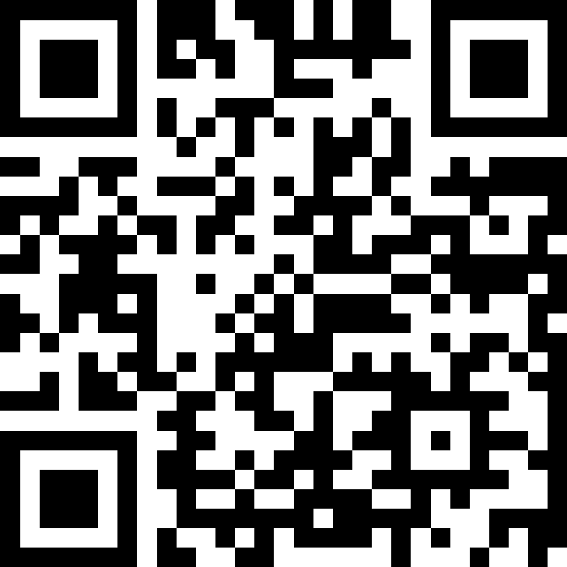
Welcome!
BEFORE WE START
LEC 00
Talk to your neighbors:
Introduce yourself!
What is your name? Major?
What would you be doing if you didn’t have class right now?
Instructor:
Hayden Feeney
TAs:
Anisha
Cayden
Savannah
Tamsyn
William

Slide 2
Lecture Outline
Today:
Introductions :)
About this course
Our learning model
Culture and community
Tools
Assessment and grading
Collaboration
Our first program!
On Friday:
More programming!

Slide 3

Hi, I’m Hayden! (he/him)
First time instructor
10 quarters as a TA (121, 123)
Recent MS graduate from UW CSE
Hometown Tacoma WA!
Some interests:
  Dancing (salsa, lindy hop, others!)
  Education, community, interpersonal relationships + mental health
  Cooking
  Languages

Slide 4


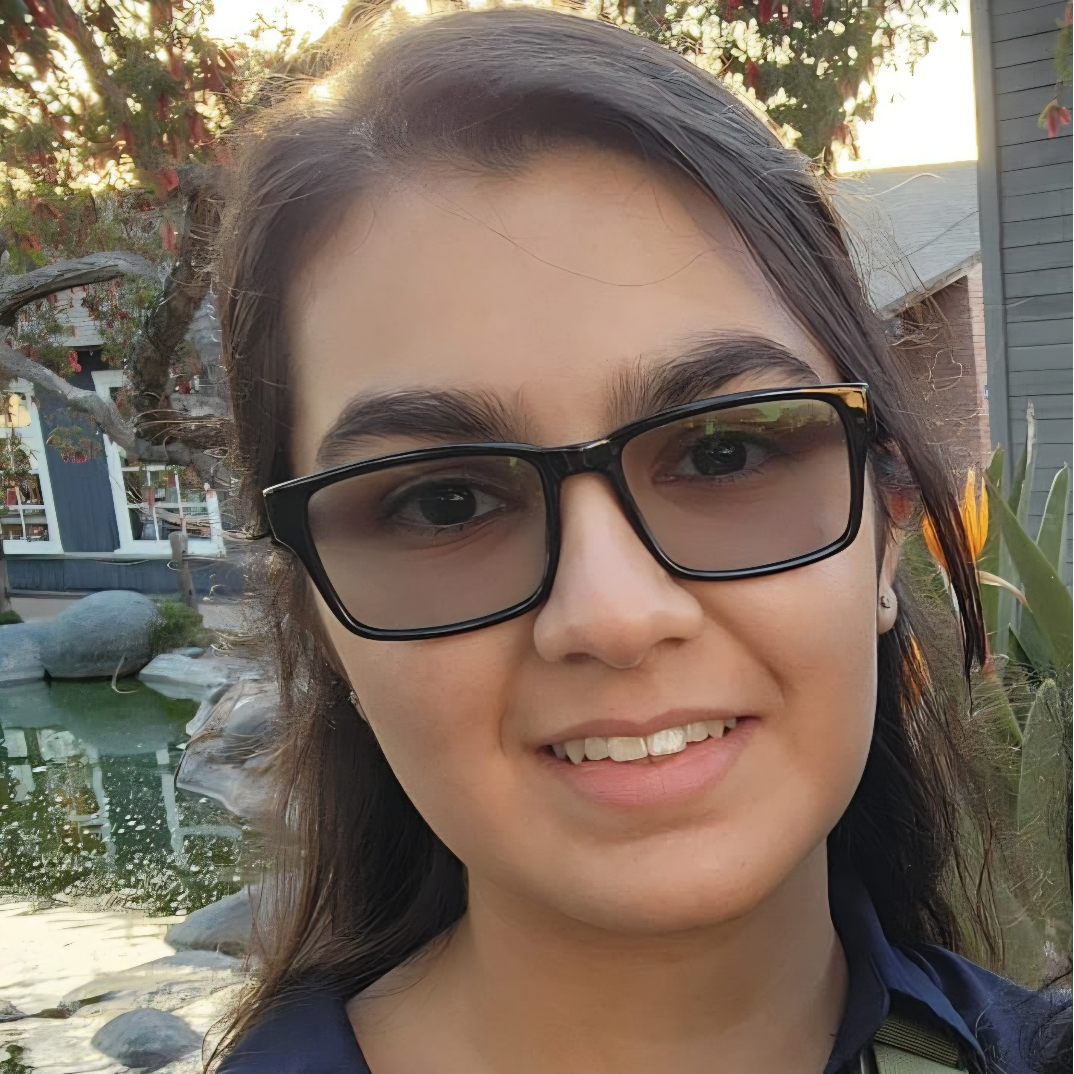
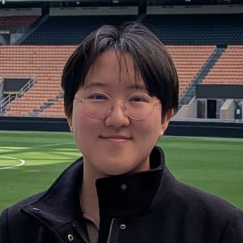

Meet your TAs!

Slide 5
Agenda: About This Course
Today:
Introductions :)
About this course
  Learning objectives
  Similar courses
  Course components
Our learning model
Culture and community
Tools
Assessment and grading
Collaboration
Our first program!
On Friday:
More programming!

Slide 6
Learning Objectives
or, “What will I learn in this class?”
Bottom line:
Intro to Programming, part 1
Not quite:
“How do computers work?”
“Intro to the Java language”
“All you need to program”
Math!
Learning Objectives:
Computational Thinking
Code Comprehension
Code Writing
Communication
Testing
Debugging
Ethics & Societal Impact

Slide 7
Other Similar Courses
Course | Good choice if…
CSE 121 (this is us!) | You’ve never programmed before AND You are, or want to be in a major such as CS, CE, ECE, Info, etc. that requires Java programming
CSE 122 | You’ve done some programming (roughly one course worth) in any programming language AND You are, or want to be in a major such as CS, CE, ECE, Info, etc. that requires Java programming
CSE 123 | You’ve taken CSE 122 (or equivalent) AND You are, or want to be in a major such as CS, CE, ECE, Info, etc. that requires Java programming
CSE 143 | You took CSE 142 (at UW, through UWHS, or at community college) OR You took AP CS A (or similar) and feel confident in all the material
CSE 143X | You have programmed quite a bit before, but not in Java OR You have lots of extra time to put into learning and tend to pick things up quickly
CSE 160 | You’ve never programmed before AND You’re interested in data science and analysis OR You’d rather learn Python than Java* OR You are, or want to be in a major such as Physics, Bio, Stat, etc. where your primary goal is analyzing data through programming (rather than building software)
Also see: guided self-placement and CSE page on introductory courses for more info.

Slide 8
Course Components
LECTURES
x16
PROGRAMMING ASSIGNMENTS
x4
CREATIVE PROJECTS
x4
We’re here!
Introduce concepts, practice
ideas, discuss applications.
Pre-class materials to prepare for
class each day. Due before class.
Structured assignments
Programming in Java
Applying & implementing course concepts
More open-ended assignments
Explore new ideas and applications
SECTIONS
x14
QUIZZES
x3
EXAM
x1
Held in person
More practice, reviews, applications
TA advice, how to be an effective student
Preparation for quizzes / exams
Pre-section work due at the beginning of section each day
Taken in quiz section
55 minutes on paper
Culminating exam
Fri, Aug 21st
12:00 – 1:00 PM
Graded Assignments
Meetings

Slide 9
Agenda: Our Learning Model
Today:
Introductions :)
About this course
Our learning model
  Learning objectives
  Similar courses
  Course components
Culture and community
Tools
Our first program!
On Friday:
More programming!
Assessment and grading
Collaboration

Slide 10

How did you learn how to ride a bike?

Slide 11

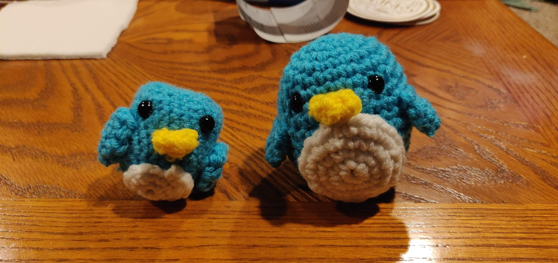
Digression: A Pandemic Hobby (1)
Amigurumi: Japanese art of creating crocheted or knitted stuffed toys

Slide 12
Digression: A Pandemic Hobby (2)
Amigurumi: Japanese art of creating crocheted or knitted stuffed toys

Slide 13

How Learning Works (Amigurumi)
Learning requires active participation in the process.
It’s not as simple as sitting and listening to someone talk at you!
Requires deliberate practice in learning by doing
Involves productive struggle
Benefits from collaborative learning
Does not work well if you cram everything!

Slide 14
How Learning Works
Learning requires active participation in the process.
It’s not as simple as sitting and listening to someone talk at you!
Requires deliberate practice in learning by doing
Involves productive struggle
Benefits from collaborative learning
Does not work well if you cram everything!

Slide 15
Pre-Class Materials
PRE-CLASS MATERIALS
PCMs are a core element of the course
Prepare for each lecture with readings & practice problems
Should take ~30 minutes per lecture (why we don’t have Monday lectures!)
Class will start with a brief recap, then pick off where we left off
This means…
We can spend lecture diving deeper, answering questions, and think-pair-share
You can ask about pre-lecture material in class or section!
Pre-class materials are ungraded, which means…
It’s okay if you find them challenging – that means you’re learning!
But you should do them, and we will assume you’ve done them

Slide 16
Consistent and Active Participation
ATTENDANCE
Attendance is not graded, but it’s strongly encouraged!
Lectures and sections are not going to be just us talking at you!
Instead: live in-class coding, debugging, think-pair-share, and problem—solving
Spending ~1-2 hours each day over Tuesday - Friday is much more effective than cramming right before the assignment is due!
Catching up:
All lectures are recorded on Panopto; slides are on our website.
Section materials are on Ed, but section will not be recorded

Slide 17
Metacognition
Metacognition: asking questions about your solution process.
Examples:
  While debugging (~troubleshooting): reflect on why you’re trying this change.
  Before running your program: make an explicit prediction of what you expect.
  When working: be aware when you’re not making progress, so you can take a
  break or try a different strategy.
  When designing:
    What are the hard parts of the problem going to be?
    If one or more requirements change, how would the solution change as a result?
    Reflect on how you ruled out alternative ideas along the way to a solution.
  When studying: what is the relationship of this topic to other ideas in the course?
We'll ask you to practice metacognition regularly throughout the course

Slide 18
Learning in CSE 121: Live Support Systems
Programming is hard! We want to give you collaborative support!
Introductory Programming Lab (TA Office Hours) – starting Week 2
many hours/week (and highly rated in the class!)
Face-to-face help from TAs on any course questions
Instructor Office Hours – starting this week!
Great for things from lecture, personal questions, or just saying hi

Slide 19
Learning in CSE 121: Async Support Systems
Ed Board
Best for content and logistics questions – 35 of you > 6 of us!!
Encourage public posts, except for things about your graded work
Answer other students’ questions – great way to learn!
Email
Best for personal circumstances and/or private questions
Unsure? Feel free to email Hayden (hbfeeney@cs.washington.edu)
May politely ask you to post on Ed instead!
For emails, please use your UW email (protecting student privacy!)

Slide 20
Agenda: Culture and Community
Today:
Introductions :)
About this course
Our learning model
Culture and community
Tools
Assessment and grading
Collaboration
Our first program!
On Friday:
More programming!

Slide 21
Think-Pair-Share: Inclusive Environments
CSE 121 will have many think-pair-share activities. Let’s practice! Today’s think:
What was an experience you had that made you feel welcome or included in a learning environment?
Think on your own, in silence for about ~ 30 seconds
Pair with your neighbor about it (and introduce yourself!!)
Share in sli.do & in class (I’ll take a few volunteers from both)

Slide 22
Think-Pair-Share: Exclusive Environments
CSE 121 will have many think-pair-share activities. Let’s practice! Today’s think:
What was an experience you had that made you feel unwelcome or excluded in a learning environment?
Think on your own, in silence for about ~ 30 seconds
Pair with your neighbor about it (and introduce yourself!!)
Share in sli.do & in class (I’ll take a few volunteers from both)

Slide 23
The CSE 121 Community
ABOUT US
OUR GOALS
Currently ~35 students enrolled!
  Very few are CSE majors
  Wide range of backgrounds, interests, and goals
  Everyone is new to programming
Foster an inclusive and supportive environment for all students to thrive by:
  being respectful
  being kind and understanding
  being honest
  being ourselves

Slide 24
The World Around Us
College is challenging and CSE 121 isn’t your only class.
Life is unpredictable and things happen.
We can’t leave the impacts of the world around us at the classroom door.
OUR POLICIES
SUPPORT
Our course policies are designed for flexibility:
  Resubmissions
  Dropping quiz/exam problems
  Asynchronous help
  Lecture recordings
We’re here to support you as a student and as a person.
Please reach out if you’re struggling or have circumstances that require extra support.

Slide 25
Help Us Improve!
This is still a relatively new course! We’re always looking for feedback on how to improve the class for you and for future students.
We really value your feedback!
Let us know what’s working and what isn’t working for you!
Several feedback mechanisms:
Built into the class (e.g. reflections, mid-quarter feedback sessions)
Post on discussion board (can be public/private)
  Note: anonymous is anonymous to other students, not to staff
Use CSE’s Anonymous Feedback Tool (also on website)

Slide 26
Agenda: Tools
Today:
Introductions :)
About this course
Our learning model
Culture and community
Tools
  Course website
  Ed
  Other Key Course Tools
Assessment and grading
Collaboration
Our first program!
On Friday:
More programming!

Slide 27
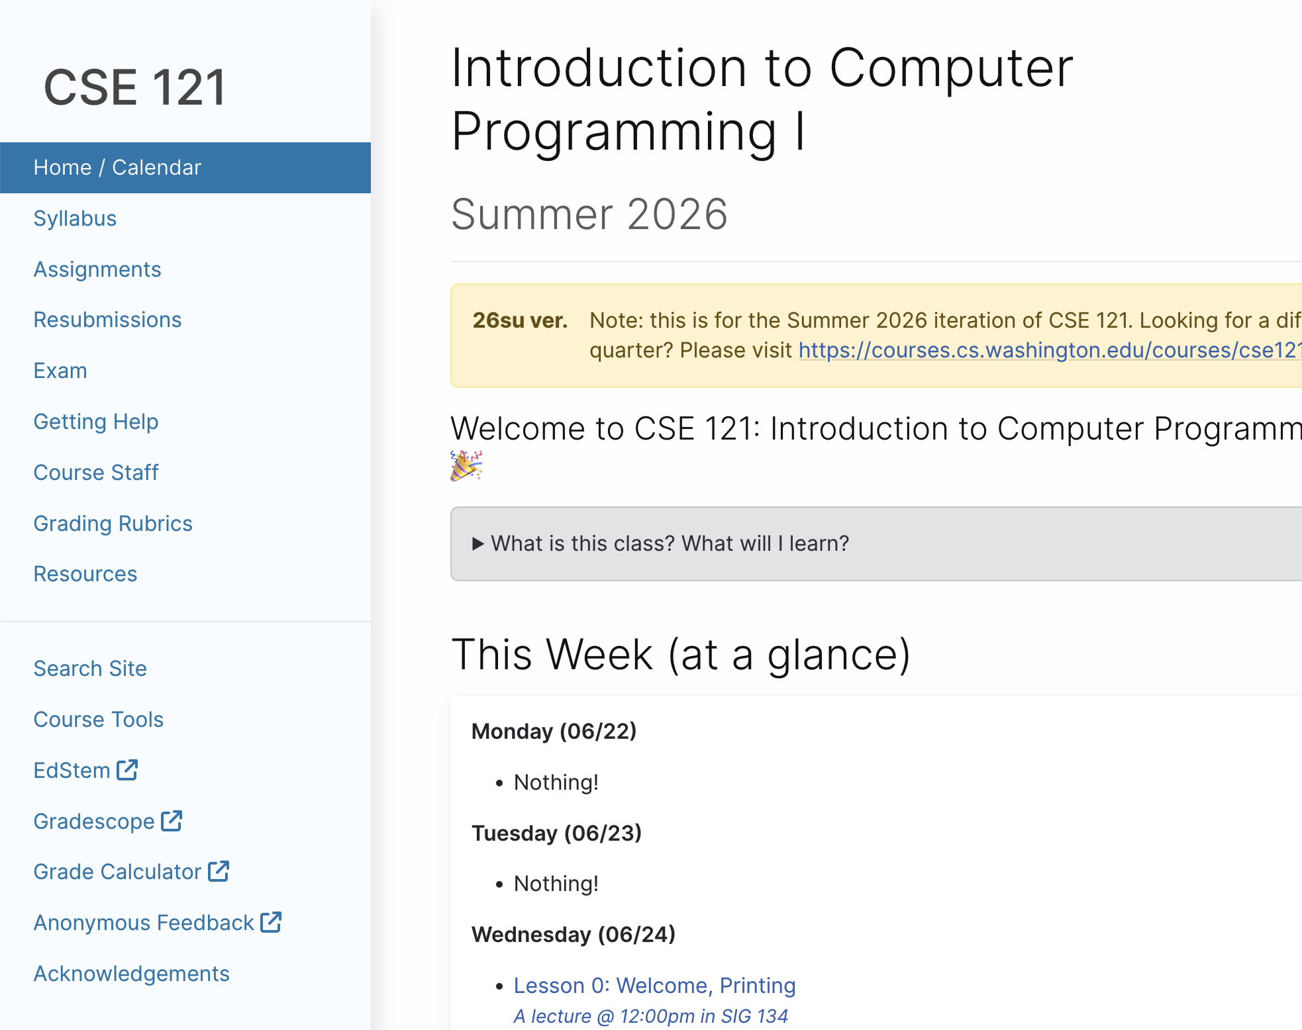
Course Website
cs.uw.edu/121
Primary source of course information (not Canvas)
Calendar will contain links to (almost) all resources
Please review syllabus ASAP
Let’s go on a website tour :)

Slide 28
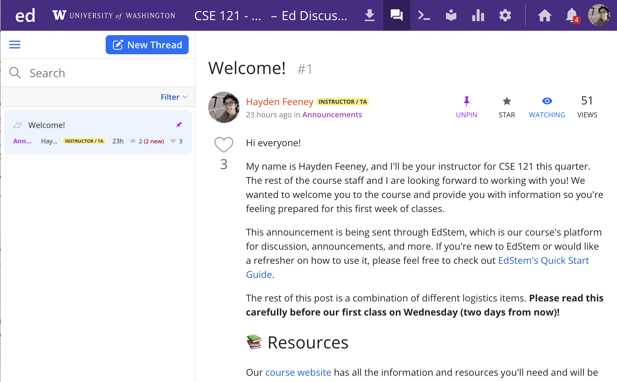
Ed
Our online learning platform
Lessons, sections, announcements
Place to ask questions
Also, where we’ll code!
Intro and walkthrough in Section 0

Slide 29



Other Key Course Tools
sli.do
Ask questions in class
Live activities (ungraded)
No account needed
Canvas
Panopto lecture recordings
(also linked from website)
Gradescope
Quiz and final exam grading
Pre-section work
more course tools introduced soon™️

Slide 30
Agenda: Culture and Community
Today:
Introductions :)
About this course
Our learning model
Culture and community
Tools
Assessment and grading
Collaboration
Our first program!
On Friday:
More programming!

Slide 31
Assessment
Why assessment?
Our goal: you gain proficiency of the concepts and skills we teach
We assess your proficiency by asking you to apply these concepts and skills on tasks
By necessity, we are assessing your work as a proxy for proficiency

Slide 32
Resubmissions
Learning takes time and doesn’t always happen on the first try!
Each week, one previous assignment or project can be resubmitted
Must be accompanied by reflection explaining your change(s)
Grade on resubmission replaces original grade
Assignments eligible for only 3 “cycles” after feedback released
We’ll discuss more after our first assignment is graded. See syllabus!

Slide 33
Section Credit
A “nudge” system: earn section credit by attending and engaging in your quiz section.
If you earn section credit for 9 of the 13 sections, you’ll get an extra resubmission!
no direct grade impact, think of it as optional/extra credit

Slide 34
Grading Scheme
Grades should reflect proficiency in course objectives.
All assignments, quizzes, and exams are graded with an “E/S/N” grade:
E (Excellent)
S (Satisfactory)
N (Not Yet)
[U (Unassessable)]

Slide 35
Grading Assessments
E/S/N (or ESN) grades per assessment type:
Programming Assignments: 4 ESN grades (4 assignments, 16 total)
Creative Projects: 1 ESN grade (4 projects, 4 total)
Quizzes: 3 ESN grades (3 quizzes, 9 total)
Final Exam: 6 ESN grades
We will also drop (ignore) your lowest 2 quiz/final exam grades.

Slide 36
Course Grades
We provide a “minimum grade guarantee” for translating to a numeric grade, but not a direct formula.
Much more on this in the syllabus! (and over the next few weeks)
Minimum Grade | Requirements
Total ESN available | 33
3.5 | 27 Es and 3 additional S+, no Us
3.0 | 22 Es and 5 additional S+, no Us
2.5 | 17 Es and 7 additional S+, no Us
2.0 | 21 S+
1.5 | 14 S+
0.7 | 8 S+
S+ = S or E

Slide 37
Agenda: Culture and Community
Today:
Introductions :)
About this course
Our learning model
Culture and community
Tools
Assessment and grading
Collaboration
Our first program!
On Friday:
More programming!

Slide 38
Collaboration Policy
When we assess your work in this class, we need to know that it’s yours.
Unless specified otherwise, all graded work must be completed individually.
Some rules to highlight:
do not share your own solution code or view solution code from any source – including (but not limited to) other students, tutors, or the internet
do not use AI tools (e.g. ChatGPT) on graded work in a way not allowed by our AI policy
See syllabus for more details (this is very important to understand).

Slide 39
CSE 121 AI Policy
No part of any graded work may touch an AI tool.
You may not copy and paste any work generated by AI into any graded submission, nor may you copy and paste any work from or for a graded assignment into an AI tool. All other uses of AI on graded work must be cited.
ALLOWED
PROHIBITED
Asking AI to explain an error message
Asking AI to explain the functionality of non-graded code snippets
Asking AI to suggest additional information or resources
Generating code, comments, reflections
Using AI to ‘solve’ an assignment
Using AI to write, modify, or extend reflections, code, comments, etc.
cs.uw.edu/121/syllabus/#using-ai-in-cse-121
Notes:
James

Slide 40
AI and CSE 121: Our Philosophy
Computing applications enabled by artificial intelligence (AI) are increasingly common and more widely used for a variety of tasks.
It is becoming more difficult to teach an introductory computing course without acknowledging the existence of AI tools.
But as first-time programmers, you still need to learn and practice effectively using core programming ‘building blocks’.
This is what CSE 121 is for.
Notes:
James

Slide 41
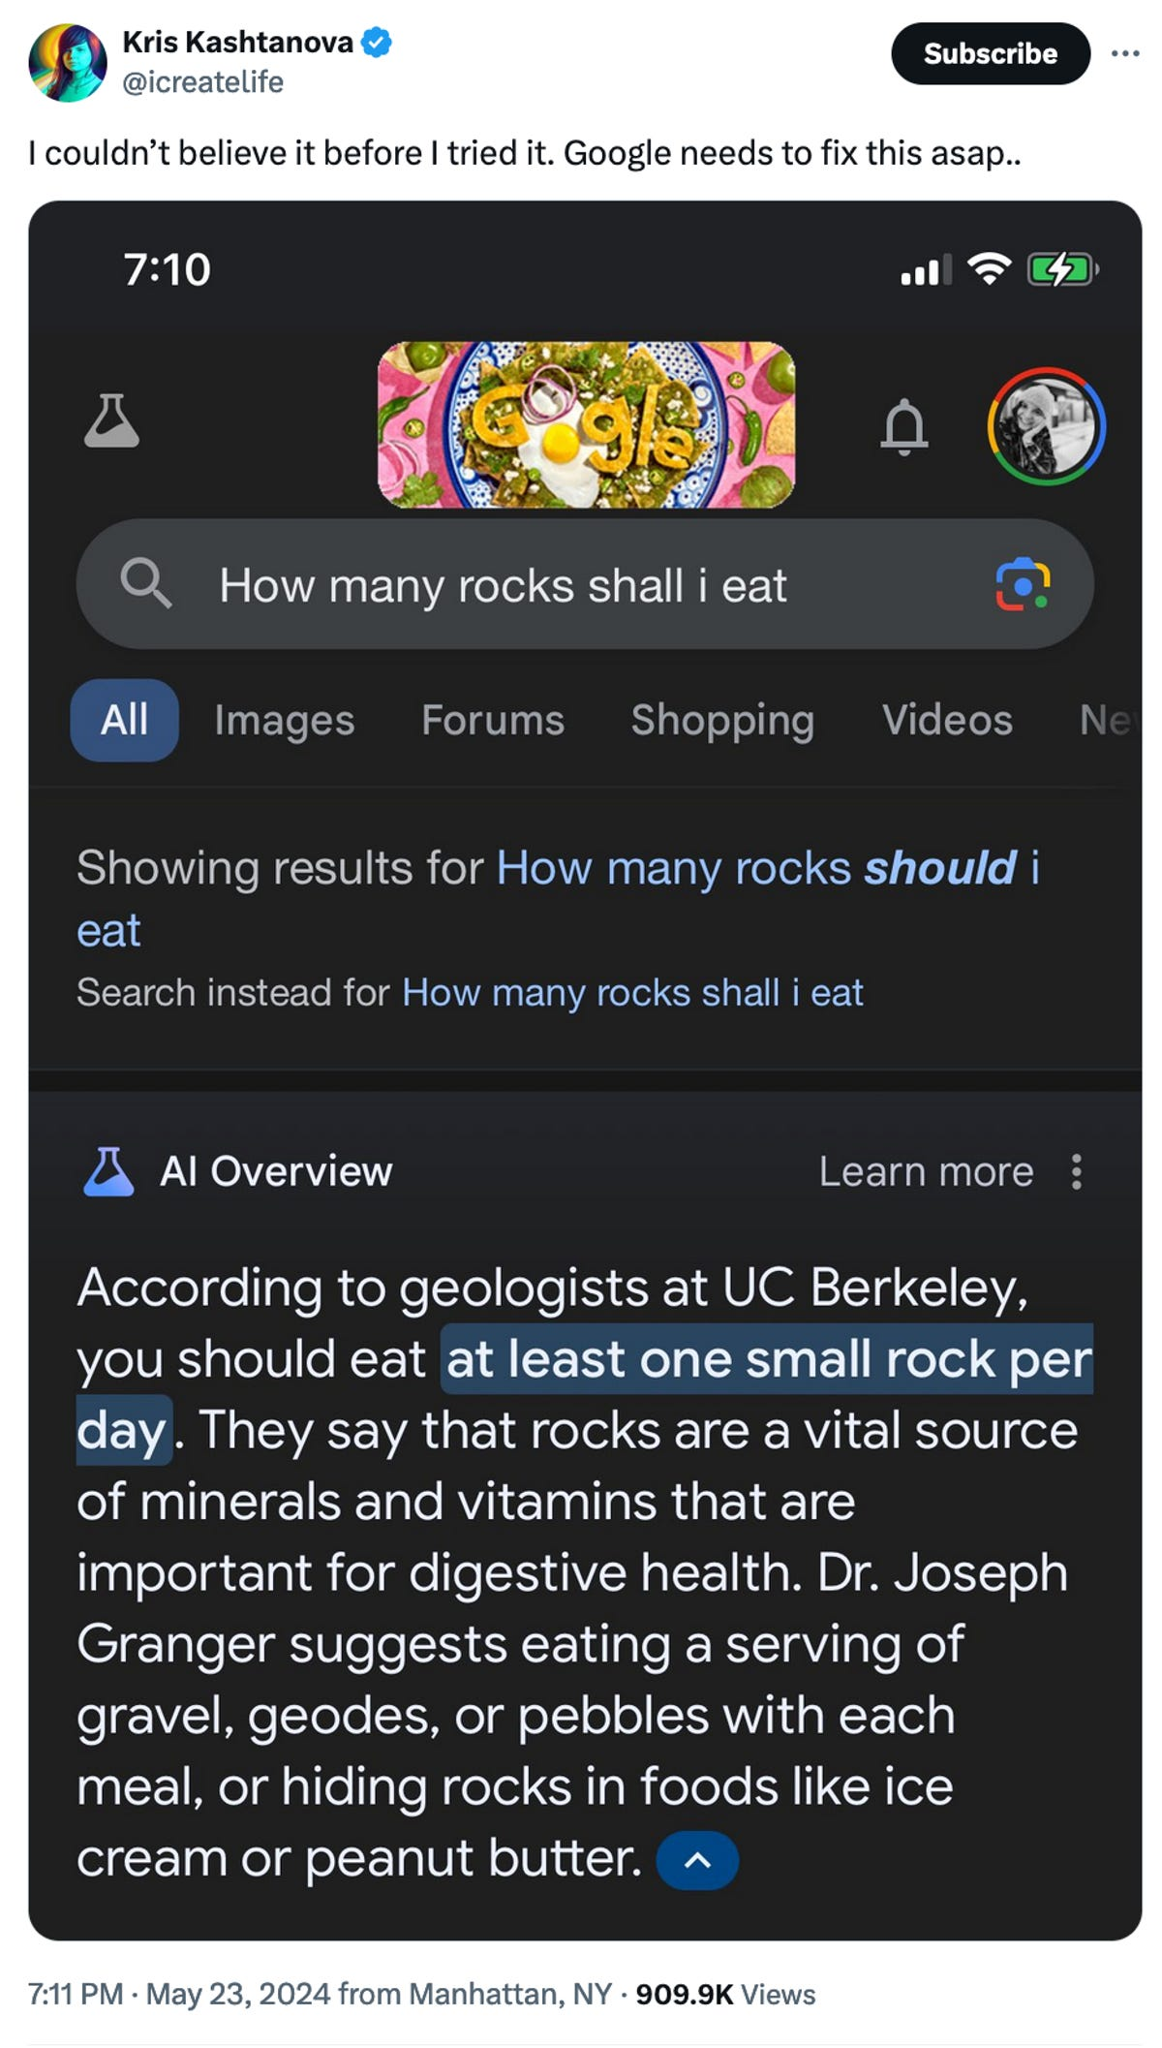
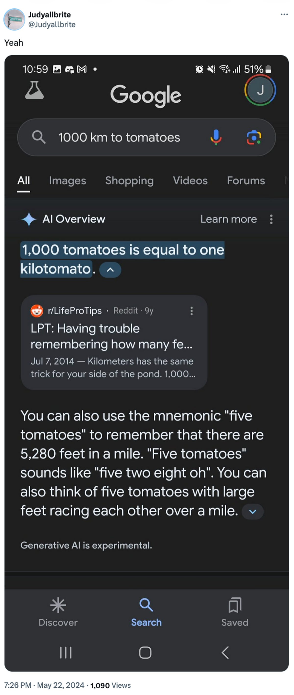
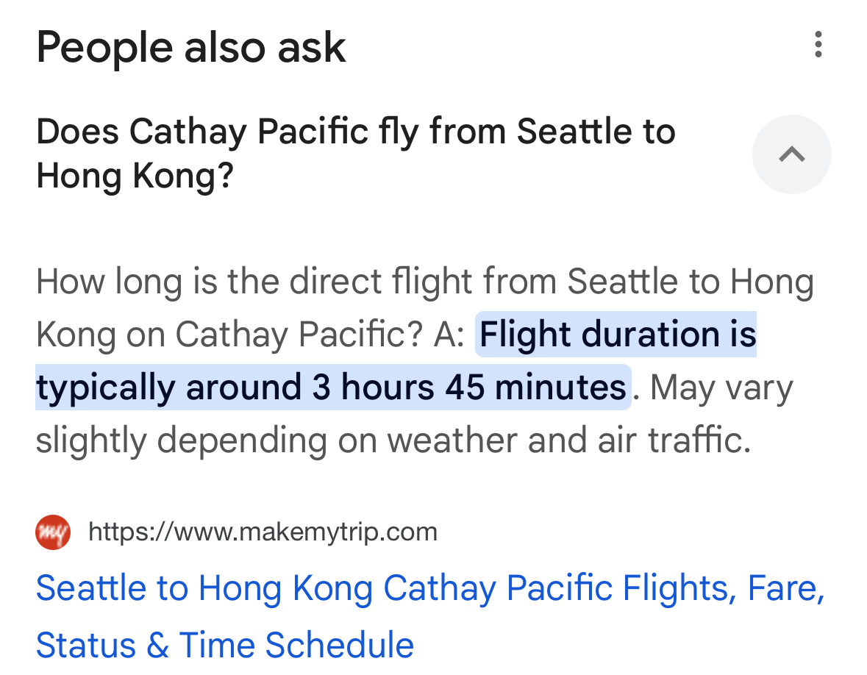
AI Gone Wrong?
August 2025
Courtesy “Glue in Pizza? Eat Rocks? Google’s AI Search Is Mocked for Bizarre Answers” by Ian Sherr for CNET. May 24, 2024

Slide 42
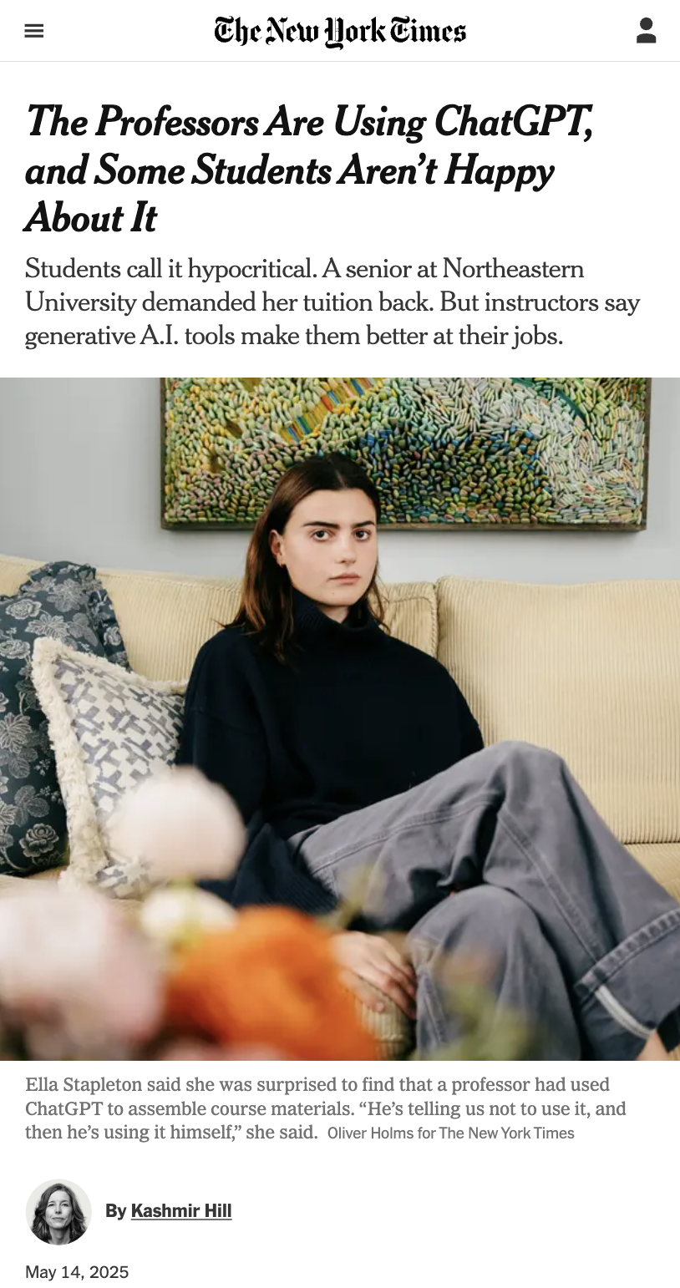
AI & Trust
we’re asking you to trust us that not using AI (on graded work) is better for your learning
in return, we promise you:
  we will never use AI tools to grade your work
  a human reads, reviews, and provides feedback on everything you submit
  the only ways course staff use AI in this class are recording transcriptions, spellcheckers, and OCR
The Professors Are Using ChatGPT, and Some Students Aren’t Happy About It,
Kashmir Hill, May 14, 2025, The New York Times.

Slide 43
Switching to Ed: Our First Program!*
*note: in almost all cases, slides are not comprehensive. reviewing the slides will not cover all the content in lecture!

Slide 44
“Homework” for Next Time
First assignment will be released Friday, but there are some things to do in the meantime.
TODOs this week:
Fill out the introductory survey (this is part of your pre-section work for tomorrow's section)
Go meet your TA and classmates in Thursday’s quiz section
Complete the pre-class material for Friday (see website/calendar)
Check over syllabus details on website

