Slide 1
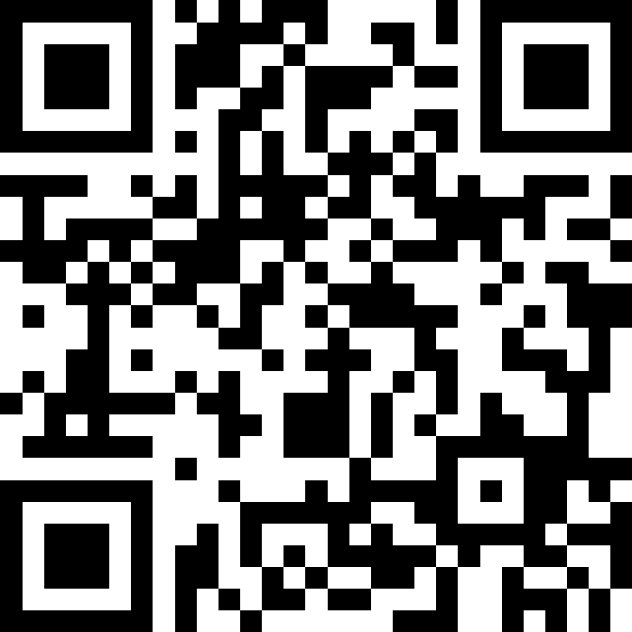
Methods, Parameters,
Scope (revisited)
BEFORE WE START
LEC 07
Talk to your neighbors:
Is cereal a soup? Why?
Music: 🌻 CSE 121 26sp Lecture Tunes 🌻
Instructor:
Matt Wang
TAs:
Abdul
Dalton
Johnathan
Ruslana
Tamsyn
Amogh
Ethan
Minh
Sam
TJ
Anant
Hayden
Navya
Savannah
Trey
Anum
Jesse
Paul
Spencer
Cayden
Jessica
Reese
Shayna

Slide 2
Agenda
Announcements, Reminders
Closing the loop on C1
Methods & Parameters Review
Programming with Methods & Parameters

Slide 3
Announcements, Reminders
P1 is out, due next Tuesday, April 28th
  start early!!
R1 released yesterday, due Thursday, April 30th
Quiz 0 was yesterday
  grades will be out before Quiz 1

Slide 4
Awesome ASCII Art:
Diverse Drawings
Task 1: This is a Moorish idol, which is a tropical fish.
*
*
* *
* * * * *
* * * * * 0 *
* * * * *
* *
*
*
Task 1: I drew a picture of a planet using the basic println method.
* ._------_ +
-==_ _ -=_ .
. ===-- ---===
_== ___--_-
* --_____-- .
Task 1: ASCII art of a tree
^
^^^
^^^^^
^^^^^^^
[ ]
Task 1: ASCII art of a lighthouse in the sea.
~~~~/\~~~~
~~~/==\~~~
~~~|[]|~~~
~~=\\===~~
~~==\\==~~
~~===\\=~~
~~\===\\~~
Task 1: A face that looks hauntingly like Voldemort.
________
/ \
/ ___)(___ \
| <O>||<O> |
| /..\ |
\ ____ /
\______/
Task 1: A donut!
********
**************
******* *******
****** ******
******* *******
**************
********
Task 1: A tabby cat!
^ ||| ^
~( ^ * ^ )~
( _ o o _ )
Task 1: one baby penguin facing right
__
( 0>
/ \
| V |
\ /
---=
Task 1: pig peaking over its pen!
^ -- ^
(* *)
|------|

Slide 5
Awesome ASCII Art:
Square Dancing
Creative Option 1: 25 diamond men square dancing.
/\ /\ /\ /\ /\
/MM\ /MM\ /MM\ /MM\ /MM\
/ .. \ / .. \ / .. \ / .. \ / .. \
\ -- / \ -- / \ -- / \ -- / \ -- /
\ / \ / \ / \ / \ /
\/ \/ \/ \/ \/
/\ /\ /\ /\ /\
/MM\ /MM\ /MM\ /MM\ /MM\
/ .. \ / .. \ / .. \ / .. \ / .. \
\ -- / \ -- / \ -- / \ -- / \ -- /
\ / \ / \ / \ / \ /
\/ \/ \/ \/ \/
/\ /\ /\ /\ /\
/MM\ /MM\ /MM\ /MM\ /MM\
/ .. \ / .. \ / .. \ / .. \ / .. \
\ -- / \ -- / \ -- / \ -- / \ -- /
\ / \ / \ / \ / \ /
\/ \/ \/ \/ \/
/\ /\ /\ /\ /\
/MM\ /MM\ /MM\ /MM\ /MM\
/ .. \ / .. \ / .. \ / .. \ / .. \
\ -- / \ -- / \ -- / \ -- / \ -- /
\ / \ / \ / \ / \ /
\/ \/ \/ \/ \/
/\ /\ /\ /\ /\
/MM\ /MM\ /MM\ /MM\ /MM\
/ .. \ / .. \ / .. \ / .. \ / .. \
\ -- / \ -- / \ -- / \ -- / \ -- /
\ / \ / \ / \ / \ /
\/ \/ \/ \/ \/

Slide 6
Awesome ASCII Art:
Scary Sharks
Creative Option 2: random length shark
_
/ \
,,============================___ /|
/" 0 ------------------ '''==' |
'-__ /// ___ |
'''==========================='''" \|
\\

Slide 7
Awesome ASCII Art:
Educating Eighths!
Creative Option 2: Several eighth-notes in a line, along with some fun music facts
---- ---- ---- ---- ---- ---- ---- ----
| | | | | | | | | | | | | | | |
(@)) (@) (@)) (@) (@)) (@) (@)) (@) (@)) (@) (@)) (@) (@)) (@) (@)) (@)
Did you know? There are 2 eighth-notes in a quarter note. You have 8 eight notes, which equals 4.0 quarter notes!
In 4/4 time, there are 4 quarter notes in a measure. 4.0 quarter notes equals 1.0 full measures!

Slide 8
Closing Loop on C1’s Reflection – ASCII alts
Class consensus: writing alt text is hard!
  generally: hard to know what to include!
  balance being concise with being descriptive enough.
  what if the alt text relies on knowing what something “looks like”?
  (also: what if your grader needed alt text?)
nobody is born knowing how to write alt text; it takes practice!
  for example: we’re trying to train our TAs to write alt text too!
  want to learn more? check out optional resources in C1’s reflection!

Slide 9
Closing Loop on C1’s Reflection – Q2
Q2: […] Jake discusses how deciding on alt text for other people's headshots made him feel "judgey". Specifically, he says:
  Because I was looking at people's avatars, and going, you do not deserve an alt, because it's just you. Like, you're not doing a thing, it's just a head shot or whatever.
The 121 course staff disagrees with his approach to writing alt text for others, particularly that some headshots do not "deserve" alt text.

Slide 10
Closing Loop on C1’s Reflection – Q2 answers!
“I think that leaving it up to his own judgement is a flawed process. There are things in people's headshots that some people using screen reader might find important that Jake might not.”
“it's never okay to think that people don't "deserve" an alt text”
How could we avoid this? Two main suggestions:
by writing alt text for everyone
by asking people to write their own alt text
  something for you to consider – e.g., for your club’s Instagram!

Slide 11
Closing Loop on C1’s Reflection – alts IRL
We asked you where alt text might appear in your life.
Many great answers!
on Instagram (Instagram supports alt text for photos)
on Canvas (Canvas supports alt text for images)
in design software like PowerPoint (alt text in MS Office),
Canva (alt text in Canva), or Figma* (Figma’s accessibility mode)
many others (Webtoons, Discord, Tumblr, Pinterest, new sites, Valorant, broadcast sports, album covers, Reddit, memes!)
and in different contexts (classes, jobs, RSOs, etc.)

Slide 12
Case Study: Watching Sports
“I watch a lot of sports, which is a good example of constantly moving and changing images. Various camera angles, different views, graphics and stats, and score displays are just some of the components visible on the screen. From my research, I found that alt text is not widely implemented for live broadcasts, because this would require the description to change in real time as the live event unfolds.”

Slide 13
Alt text is not always right!
in many cases, concise alt text is not enough
  for information-dense content: video, a poster for an RSO, a complicated physics graph, or a flowchart
  for interactive content: video games, Solidworks, Figma
so, there are alternatives
  by adding more structure: captions, tables, or web pages
  by using audio (e.g., “audio descriptions”, “sonification”)
  by creating alternate interaction techniques
this topic will return… in C3!

Slide 14
PCM: Methods
Writing our own methods allows us to define our own commands!
(naming conventions for methods are same as variables: camelCased)
public static void myMethod() {
/***
Your code here
**/
}

Slide 15
Think Pair Share: Hello Goodbye (Think)
public class HelloGoodbye {
public static void main(String[] args) {
welcome();
hello();
goodbye();
}
public static void hello() {
System.out.print("Hello! ");
glad();
}
public static void goodbye() {
System.out.println("Goodbye!");
}
public static void welcome() {
System.out.print("Welcome! ");
glad();
}
public static void glad() {
System.out.println("Glad you're here.");
}
}
What is the output of this program?
A. C.
Welcome! Glad you’re here.
Hello! Glad you’re here.
Goodbye!
Welcome! Hello! Goodbye!
B.
D.
Welcome!
Glad you're here.
Hello!
Glad you're here.
Goodbye!
Welcome!
Hello!
Goodbye!

Slide 16
PCM: Parameters
Definition: a value passed to a method by its caller. “Like” a variable!
  public static void myMethod(String musicalAct) {
  System.out.print(musicalAct + " is the best!");
  ...
  }
Calling a method with a parameter…
  myMethod("Laufey"); // prints: Laufey is the best!

Slide 17
PCM: Scope, Redux
Our scope rules also apply to methods and parameters!
general rule: from its declaration to the next closing brace, }
a variable declared in a method only exists in that method!
public static void example(int n) {
System.out.println("hello");
int x = 3;
for (int i = 1; i <= n; i++) {
System.out.print(x);
}
}
n's scope
x's scope
i's scope

Slide 18
Think Pair Share: Count (Think)
What will be the last
line of output from this code?
public static final int COUNT = 7;
public static void main(String[] args) {
int count = 5;
line(count);
System.out.println("COUNT is: " + COUNT);
System.out.println("count is: " + count);
}
public static void line(int count) {
for (int i = 1; i <= count; i++) {
System.out.print("*");
}
count++;
System.out.println();
}
A. count is: 1
B. count is: 5
C. count is: 6
D. count is: 7

Slide 19
Walkthrough: Counting Counts
public static final int COUNT = 7;
public static void main(String[] args) {
int count = 5;
line(count);
System.out.println("COUNT is: " + COUNT);
System.out.println("count is: " + count);
}
public static void line(int count) {
for (int i = 1; i <= count; i++) {
System.out.print("*");
}
count++;
System.out.println();
}
5
count
5
COUNT
7
count
6
5

Slide 20
PCM: Refactoring Line
line(5);
line(10);
public static void line(int numStars) {
for (int i = 1; i <= numStars; i++) {
System.out.print("*");
}
}
public static void lineOf5() {
for (int i = 1; i <= 5; i++) {
System.out.print("*");
}
}
public static void lineOf10() {
for (int i = 1; i <= 10; i++) {
System.out.print("*");
}
}

Slide 21
New: Method Comments
Each method you write (except main) should have a short comment!
// Takes in a Random object as a parameter.
// Uses the Random object to generate an addition problem
// where the operands are in the range 1-10 (inclusive),
// and prints the result, rounded to two decimal places.
public static void addTwoRandomNumbers(Random randy) {
int num1 = randy.nextInt(10) + 1;
int num2 = randy.nextInt(10) + 1;
int sum = num1 + num2;
...
}

