Slide 1

for Loops
BEFORE WE START
LEC 04
Talk to your neighbors:
What’s your favorite TV show right now?
Respond on sli.do!
Music: 🌻 CSE 121 26sp Lecture Tunes 🌻
Instructor:
Matt Wang
TAs:
Abdul
Dalton
Johnathan
Ruslana
Tamsyn
Amogh
Ethan
Minh
Sam
TJ
Anant
Hayden
Navya
Savannah
Trey
Anum
Jesse
Paul
Spencer
Cayden
Jessica
Reese
Shayna

Slide 2
Announcements, Reminders
Feedback for C0 released this morning!
  Please view your feedback – crucial part of learning process
  For regrades (not resubs), please make a private Ed post
  Use the minimum grade calculator to track your grades!
C1 releasing later today, due Tuesday, April 14th
Quiz 0 is next Thursday, April 23rd (in your registered quiz section)
  Can’t make it? Email Matt ASAP (mxw@cs.washington.edu)
Resubmission Cycle 0 (R0) opening tomorrow, due Thursday, April 23rd

Slide 3
Reminder: Resubmissions (or “resubs”)
Each week, you may resubmit one Programming Assignment or Creative Project with no penalty. The grade of your resubmission will completely replace your previous grade.
This is a huge opportunity: you get to resubmit your work after we grade it and give you feedback! Please take advantage of this :)
If you miss an assignment and/or only finish it late – use a resub!

Slide 4
Resub Logistics
Some logistics:
There are 8* total resub cycles this quarter (and 8 assignments)
Assignments eligible to resubmit for 3 cycles after feedback is out
To resubmit:
Make and submit your changes
Set the submission you want graded as “Final”
Submit a Google Form, with a reflection, to confirm your resub
  You must submit the form before the deadline for resub to count

Slide 5
Think Pair Share: bubblegum to Gumball (Think)
Suppose s contains the String "bubble gum".
Which statement would result in s containing "Gumball" instead?
s.substring(7) + "ball";
s = s.substring(7, 9) + "ball";
s = s.charAt(7).toUpperCase() + "ball";
s = s.substring(7, 8).toUpperCase()
+ s.substring(8) + "ball";
b | u | b | b | l | e |  | g | u | m
0 | 1 | 2 | 3 | 4 | 5 | 6 | 7 | 8 | 9

Slide 6
Think Pair Share: bubblegum to Gumball (Pair)
Suppose s contains the String "bubble gum".
Which statement would result in s containing "Gumball" instead?
s.substring(7) + "ball";
s = s.substring(7, 9) + "ball";
s = s.charAt(7).toUpperCase() + "ball";
s = s.substring(7, 8).toUpperCase()
+ s.substring(8) + "ball";
b | u | b | b | l | e |  | g | u | m
0 | 1 | 2 | 3 | 4 | 5 | 6 | 7 | 8 | 9

Slide 7
Chaining methods in expressions
b | u | b | b | l | e |  | g | u | m
0 | 1 | 2 | 3 | 4 | 5 | 6 | 7 | 8 | 9
s.substring(7, 8).toUpperCase() + s.substring(8) + "ball"
"g".toUpperCase() + s.substring(8) + "ball"
"G" + s.substring(8) + "ball"
"G" + "um" + "ball"

Slide 8
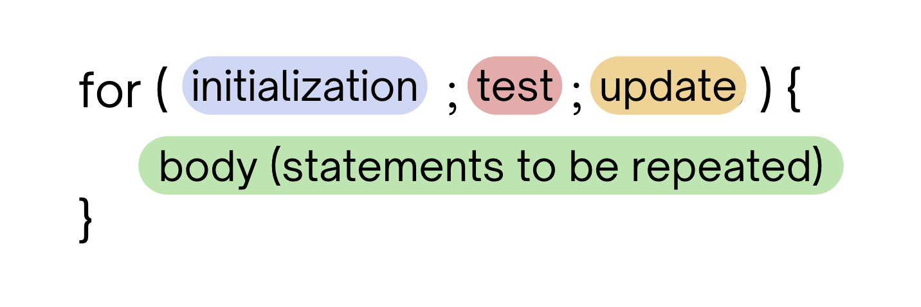
PCM Review: for loops!
For loops are our first control structure: a syntax structure that controls the execution of other statements.

Slide 9
PCM Review: for loops (example)
for (int counter = 1; counter <= 5; counter++) {
System.out.println("I love CSE 121!");
}

Slide 10
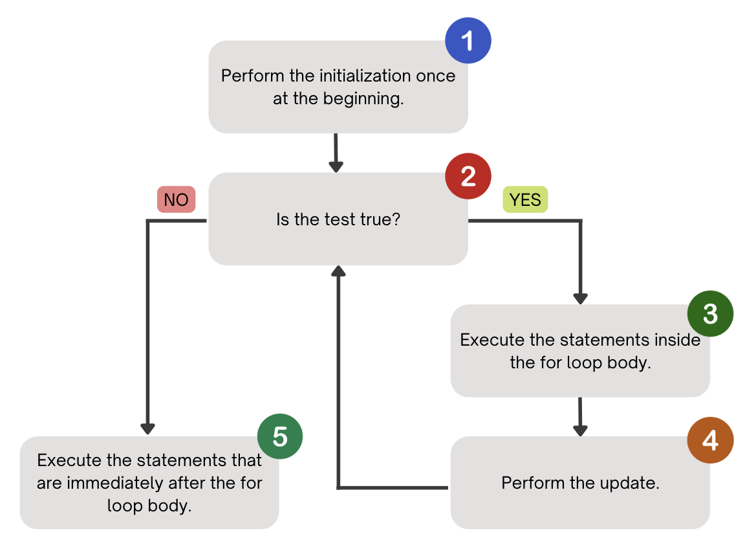
PCM Review: for loops (a helpful flowchart)

Slide 11
Tracing through a for loop
counter
1
2
4
1
2
3
4
5
6
for (int counter = 1; counter <= 5; counter++) {
System.out.println("I love CSE 121!");
}
3
5
I love CSE 121!
I love CSE 121!
I love CSE 121!
I love CSE 121!
I love CSE 121!

Slide 12
Think Pair Share: squared loops (Think)
What output does the following code produce?
for (int i = 1; i <= 7; i++) {
System.out.println(i + " squared = " + i * i);
}
A.
i squared = i * i
i squared = i * i
i squared = i * i
i squared = i * i
i squared = i * i
i squared = i * i
B.
i squared = i * i
i squared = i * i
i squared = i * i
i squared = i * i
i squared = i * i
i squared = i * i
i squared = i * i
C.
1 squared = 1
2 squared = 4
3 squared = 9
4 squared = 16
5 squared = 25
6 squared = 36
D.
1 squared = 1
2 squared = 4
3 squared = 9
4 squared = 16
5 squared = 25
6 squared = 36
7 squared = 49

Slide 13
Think Pair Share: squared loops (Pair)
What output does the following code produce?
for (int i = 1; i <= 7; i++) {
System.out.println(i + " squared = " + i * i);
}
A.
i squared = i * i
i squared = i * i
i squared = i * i
i squared = i * i
i squared = i * i
i squared = i * i
B.
i squared = i * i
i squared = i * i
i squared = i * i
i squared = i * i
i squared = i * i
i squared = i * i
i squared = i * i
C.
1 squared = 1
2 squared = 4
3 squared = 9
4 squared = 16
5 squared = 25
6 squared = 36
D.
1 squared = 1
2 squared = 4
3 squared = 9
4 squared = 16
5 squared = 25
6 squared = 36
7 squared = 49

Slide 14
PCM Review: String Traversals
// For some String s
for (int i = 0; i < s.length(); i++) {
// do something with s.charAt(i)
}
b | u | b | b | l | e |  | g | u | m
0 | 1 | 2 | 3 | 4 | 5 | 6 | 7 | 8 | 9

Slide 15
Go Huskies?
h-u-s-k-i-e-s

Slide 16
The Fencepost Pattern
Some task where one piece is repeated n times, and another piece is repeated n-1 times and they alternate
h-u-s-k-i-e-s

