Slide 1
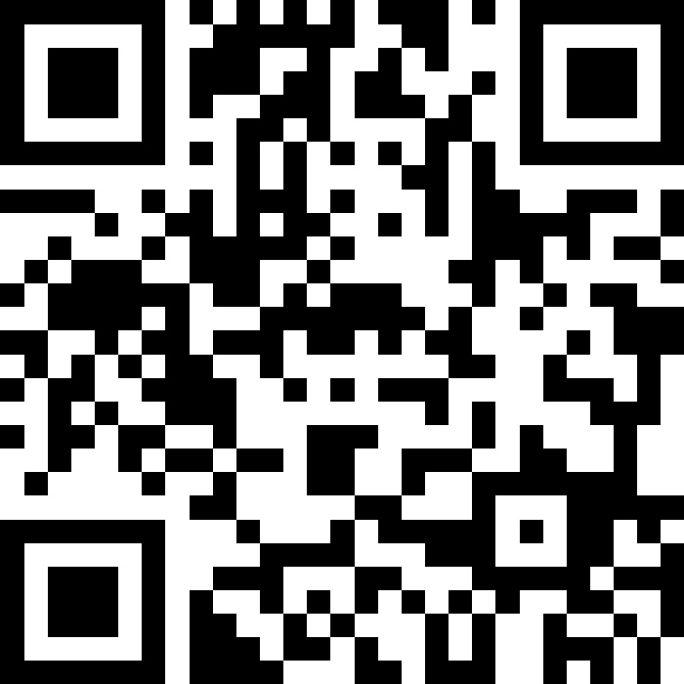
Strings, char, and Variables
BEFORE WE START
LEC 03
Talk to your neighbors:
What is your favorite emoji? 😀
Respond on sli.do!
Music: 🌻 CSE 121 26sp Lecture Tunes 🌻
Instructor:
Matt Wang
TAs:
Abdul
Dalton
Johnathan
Ruslana
Tamsyn
Amogh
Ethan
Minh
Sam
TJ
Anant
Hayden
Navya
Savannah
Trey
Anum
Jesse
Paul
Spencer
Cayden
Jessica
Reese
Shayna

Slide 2
Agenda (1/4)
Announcements, Reminders (now)
C0 Reflection Recap
Casting, More Variables and Operators!
Strings and Characters Review
code example!

Slide 3

Announcements, Reminders
P0: Cornbear’s Café released!
due Tuesday, April 14th
Expect C0 grades ~ 1 week from submission (we’ll announce on Ed)
shortly after, your first resubmission cycle will open!
Ed Shortcuts page! (and search bar)
next Wednesday: guest lecture from Hayden!

Slide 4
Agenda (2/4)
Announcements, Reminders
C0 Reflection Recap (now)
Casting, More Variables and Operators!
Strings and Characters Review
code example!

Slide 5
Bountiful Butterflies
-------------
| Butterfly |
-------------
/\ |\
/ \ | \
/ \ | \
| \\/| \
\ /00| /
/--|[--]\--\
/ / [--] \ \
\ / [-] \ /
// \\
0 0
A Sad Butterfly
\ /
\___/
_______|00 |_______
\ | ^ | /
\ | | /
\ | | /
/ | | \
/ | | \
/______|___|______\
~~~~~~ Butterfly ~~~~~~
/""""""\ \ / /""""""\
\ \ ( ) / /
> || <
/ || \
\,,,,,,,,/V\,,,,,,,,/
-Butterfly-
_ __
| | \ _*
| | \ / _*
| | \|/
\ | |
\_\___/
Butterfly
.-.
\ |.-.
\_|_/
`
_* *_
(_\|/_)
(/|\)
a butterfly!
Butterfly
_ " _
( \ | / )
(/|\)
Butterfly (\o/)
(/|\)

Slide 6
Buggy Bugs
BUGA BU BUGA
GABUGA BUGA BUGA
BUGABUGABUABUGABUGA BUGABUGA BUGA BUGABU
BUGABUGABUGABUGABUGABUGABUGABUGABUGA
BUGA BUGABUGABUGABUGABUGABUGABUGA
BUGABUGABUGABUGABUGABUGABUGABUGABUGABUGA
BUGA ABUGABUGABUGABUGABUGABUGABUGA
BUGABUGABUGABUGABUGABUGABUGABUGABUGA
BUGABUGABUABUGABUGA BUGABUGA BUGA BUGABU
GABUGA BUGA BUGA
BUGA BU BUGA
Caption: This is a 3 horned beatle. The body is
made up of the words "BUGA", and their are 3 legs
on each side of the beatle.
BUG> BUG> BUG>
BUG BUG BUG
BUG BUG BUG BUGBUG
BUG BUG BUG BUG BUG>
BUGBUGBUGBUGBUGBUGBUG
BUGBUGBUGBUGBUGBUGBUGBUGBUG>
BUGBUGBUGI<3BUGBUGBUGBUG
BUGBUGBUGBUGBUGBUGBUGBUGBUG>
BUGBUGBUGBUGBUGBUGBUG
BUG BUG BUG BUG BUG>
BUG BUG BUG BUGBUG
BUG BUG BUG
BUG> BUG> BUG>
Caption: […] and a crawling bug
~~~~~ Mega Bug ~~~~~
Bug Bug. Bug
BugBugBugBugBug
Bug Bug. Bug

Slide 7
Story Time!
A four eyed alien appears. But a snake wants to eat it.
o|o|o|o <________
-|______|- < o \____
| | | | | <
< /------
<------
But wait! The ants are protecting the alien!
. . . . . .
. o|o|o|o . <________
. -|______|- . < o \____
. | | | | | . <
. . . . . . < /------
<------
The snake is rebuffed and the alien is saved!It celebrates with the ants:
o|o|o|o
\|______|/
()()()()
. . . . .
. . . . . . . .
. . . .

Slide 8
Lisan Al-Ghaib???
Watch out! I spot a Shai-Hulud (the sandworm from Dune)
~~~~~~~~~~~~~~~~~~
O O
~~~~~~~~~~~~~~~~~~
How did it get here all the way from Arrakis? Phew, I think this is a regular worm
____________
| :)
------------
How cute!
Caption: ASCII art figures of […], a sandworm from the movie franchise "Dune", and a regular worm.

Slide 9
On Accessibility… (1/3)
Great engagement with the C0 reflection! Some themes:
It was inspiring (and eye-opening!) to learn how blind programmers code
“I had never considered how a blind person would code.”
“I found the reading of the screen window fascinating and quite unbelievable.”
“Hearing the screen reader talk at that fast rate is very challenging and overwhelming for most people to understand.”
Small changes can make a big difference!
“[…] the speaker focused on the little changes that can make visual code more accessible to a wider audience. Also, his call to action to other computer scientists to make these changes as it can make platforms and apps for accessible to a wider audience.

Slide 10
On Accessibility… (2/3)
Accessibility matters because…
“As our world is becoming ‘digital-first,’ ensuring software accessibility is no longer optional.”
“[…] technology should be usable by everyone, regardless of ability. If tools and software aren’t designed with accessibility in mind, they exclude talented people and limit innovation..”
“Accessibility is not only important for the users, to make sure everybody has access to the technology despite what their physical ability may be, but also for those developing the software, to make sure we don't have "one kind of person" working to create the resources that will be used by all. “

Slide 11
On Accessibility… (3/3)
Some also pointed out broader interpretations of accessibility:
“[…] accessibility in computer science can be viewed through a gender scope. Growing up, I never got into coding or computer science because as a girl, I had been socially conditioned to subconsciously believe it just wasn't for me. Now that I'm older, I know that women are directly addressing this accessibility gap through programs like "Girls Who Code" to provide an educational platform for groups that have been traditionally excluded from computer science.”

Slide 12
Is C0 Accessible?
Probably not…or at least not yet.
When looking at ASCII art:
“hearing an array of backslashes, underscores, and parenthesis won't make a clear design”
"You can't really gather much about the art from 'drawing of bumblebee, and mosquito’."
"Even with a caption, the creative part of the assignment is still built around a sighted interpretation. A blind developer could technically write the characters but they would not have equal access to understanding or appreciating the output."
Some ideas for improvement:
Additional audio “signals” for certain parts of the project
Making a tactile version of the ASCII art (e.g., braille)
AI?

Slide 13
So, What?
Broadly speaking: the digital world is inaccessible
but, that’s changing!
and we have the power to change it!
In CSE 121, we don’t have the full knowledge yet to make accessible ASCII art (or Java programs, applications, video games, websites, …)
However, we encourage you to:
think about accessibility when you make things with computers
keep on learning more! UW is a global leader in digital accessibility
e.g. at UW: CSE 443E: Accessibility, EDSPE 304, CREATE, HuskyADAPT

Slide 14
Agenda (3/4)
Announcements, Reminders
C0 Reflection Recap
Casting, More Variables and Operators! (now)
Strings and Characters Review
code example!

Slide 15
PCM: Variables
Recall: Variables allow us to give a name to a specific value
3 parts: declaration, initialization, usage
Example:
Declaration: int x;
Initialization: x = 30;
Or all in one line: int x = 30;
String bestBoy = "gumball";
System.out.println(bestBoy);

Slide 16
PCM: Casting
Java will do some type conversions for us
E.g., int to double, double to String, int to String
BUT some conversions Java won't do for us…
Nonsensical conversions (e.g., "Gumball" to int)
Conversions that are "lossy" (e.g., double to int)
We can ask Java to typecast for us
double x = 8.83;
int xInt = (int) x;

Slide 17
New: Manipulating Variables
They’re made to be manipulated, modified, and re-used!
int myFavoriteNumber = 7;
int tripleFavNum = myFavoriteNumber * 3;
myFavoriteNumber = myFavoriteNumber + 3;
Note! This doesn’t really make any mathematical sense. That’s because in Java, = is assignment, not equality!

Slide 18
New Operator: +=
myFavoriteNumber = myFavoriteNumber + 3;
This pattern is so common, we have a shorthand for it!
myFavoriteNumber += 3;
This works for both numeric addition and string concatenation!

Slide 19
More Shorthand Operators
The shorthands -=, *=, /=, and %= exist too!
myFavoriteNumber /= 3;
Should this work for integers? Doubles? Strings?

Slide 20
Even Shorter Shorthands
There are even shorter operators for “incrementing” and “decrementing”!
myFavoriteNumber++; // myFavoriteNumber += 1;
myFavoriteNumber--; // myFavoriteNumber -= 1;
Should this work for integers? Doubles? Strings?

Slide 21
Think Pair Share: A, B, C Variables (Think)
What values do a, b, and c hold after this code is executed?
int a = 10;
int b = 30;
int c = a + b;
c -= 10;
a = b + 5;
b /= 2;
10, 30, 40
35, 15, 30
35, 15.5, 30
20, 15, 30

Slide 22
Think Pair Share: A, B, C Variables (Pair)
What values do a, b, and c hold after this code is executed?
int a = 10;
int b = 30;
int c = a + b;
c -= 10;
a = b + 5;
b /= 2;
10, 30, 40
35, 15, 30
35, 15.5, 30
20, 15, 30

Slide 23
Agenda (4/4)
Announcements, Reminders
C0 Reflection Recap
Typecasting
Casting, More Variables and Operators!
Strings and Characters Review (now)
code example!

Slide 24
PCM: Strings & chars
Recall: String literals are a sequence of characters that are strung together, begin and end with ""
Use zero-based indexing
A char represents a single character
Begin and end with single quotes ( ' )
Strings are made up of chars!
g | u | m | b | a | l | l
0 | 1 | 2 | 3 | 4 | 5 | 6
char letter = 'g';
char anotherLetter = 'b';

Slide 25
PCM: String Methods
Usage: <string_variable>.<method>(…)
Method | Description
length() | Returns the length of the string.
charAt(i) | Returns the character at index i of the string
indexOf(s) | Returns the index of the first occurrence of s in the string; returns -1 if s doesn't appear in the string
substring(i, j) or substring(i) | Returns the characters in this string from i (inclusive) to j (exclusive); if j is omitted, goes until the end of the string
contains(s) | Returns whether or not the string contains s
equals(s) | Returns whether or not the string is equal to s (case-sensitive)
equalsIgnoreCase(s) | Returns whether or not the string is equal to s ignoring case
toUpperCase() | Returns an uppercase version of the string
toLowerCase() | Returns a lowercase version of the string

Slide 26
Think Pair Share: Gumball (Think)
Suppose s contains the String "bubble gum". Which statement would result in s containing "Gumball" instead?
s.substring(7) + "ball";
s = s.substring(7, 9) + "ball";
s = s.charAt(7).toUpperCase() + "ball";
s = s.substring(7, 8).toUpperCase() + s.substring(8) + "ball";
b | u | b | b | l | e |  | g | u | m
0 | 1 | 2 | 3 | 4 | 5 | 6 | 7 | 8 | 9

Slide 27
Think Pair Share: Gumball (Pair)
Suppose s contains the String "bubble gum". Which statement would result in s containing "Gumball" instead?
s.substring(7) + "ball";
s = s.substring(7, 9) + "ball";
s = s.charAt(7).toUpperCase() + "ball";
s = s.substring(7, 8).toUpperCase() + s.substring(8) + "ball";
b | u | b | b | l | e |  | g | u | m
0 | 1 | 2 | 3 | 4 | 5 | 6 | 7 | 8 | 9

Slide 28
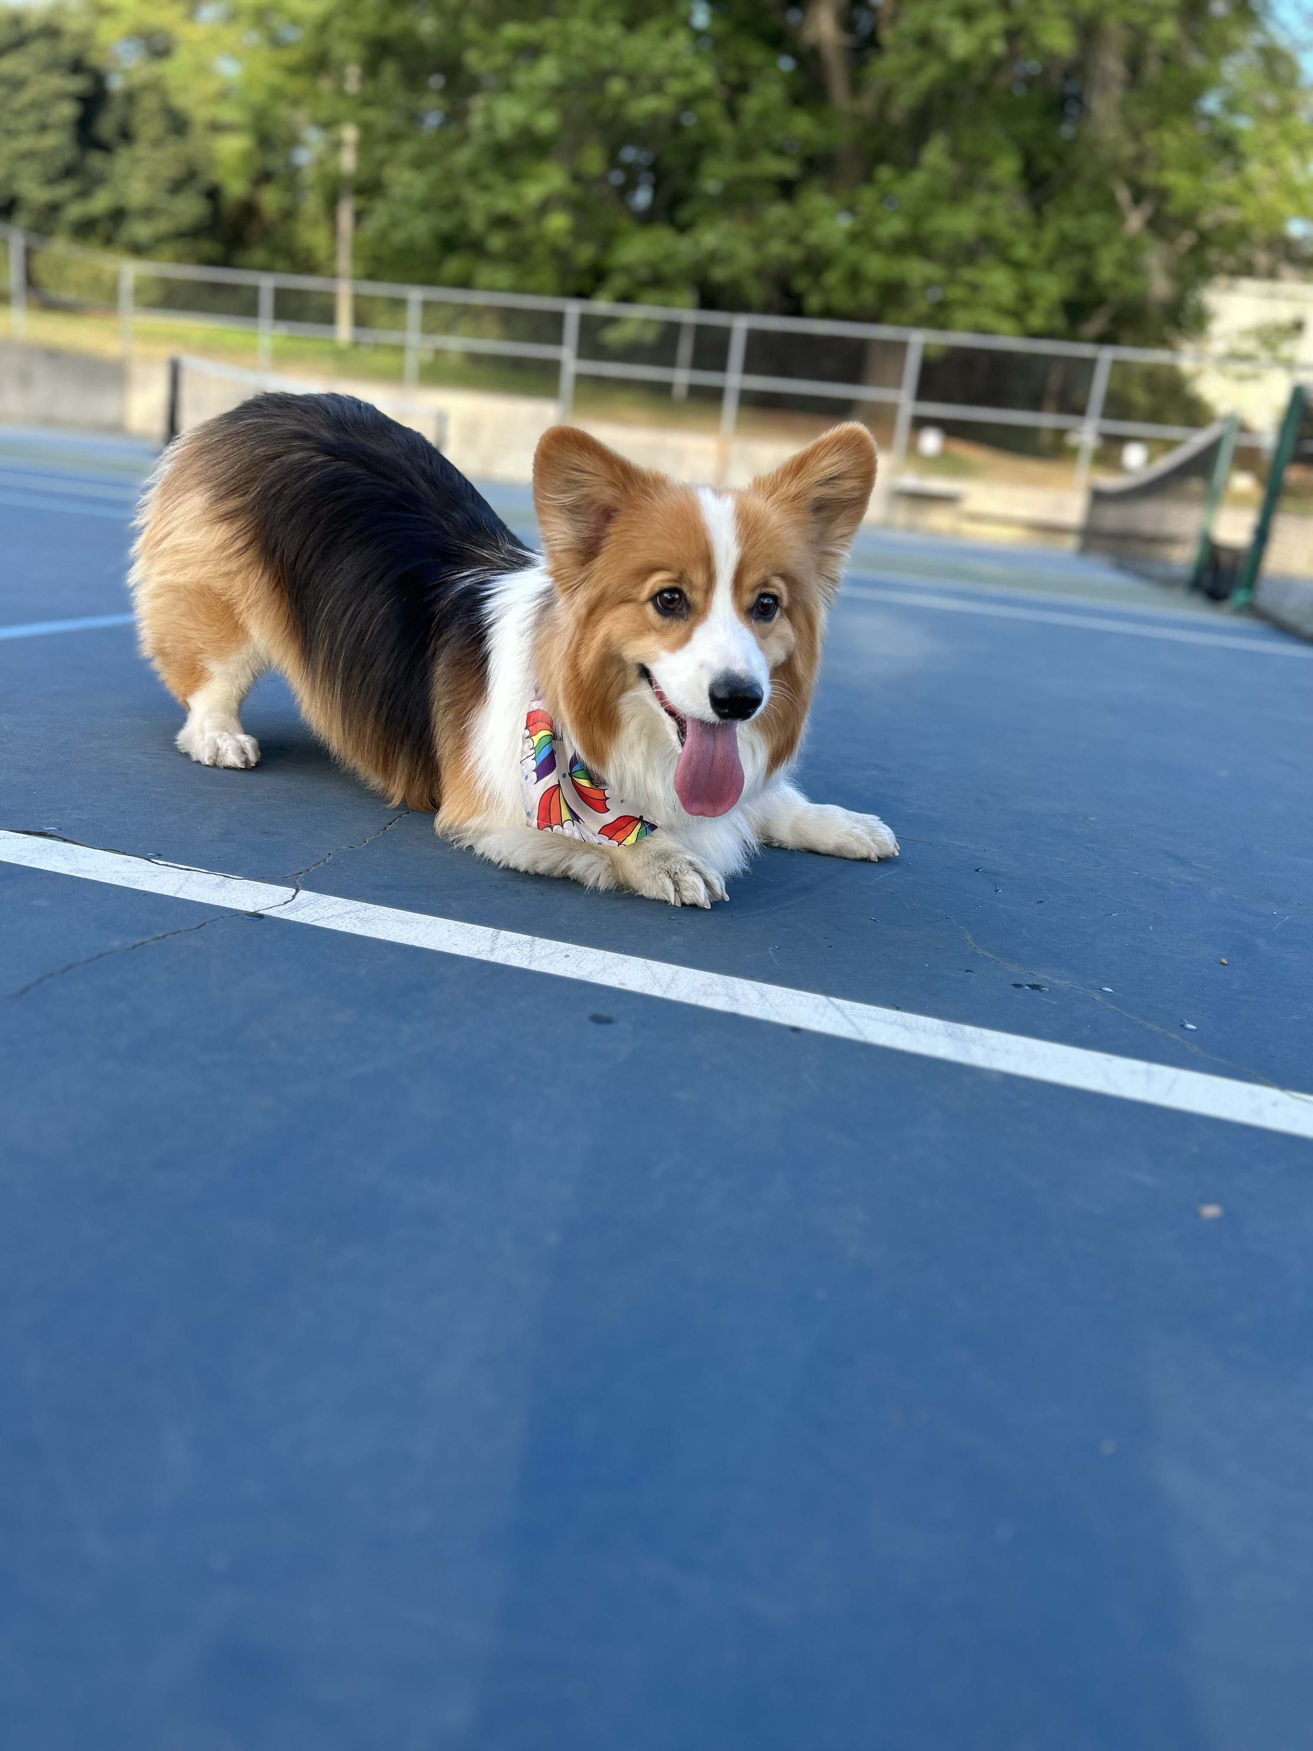
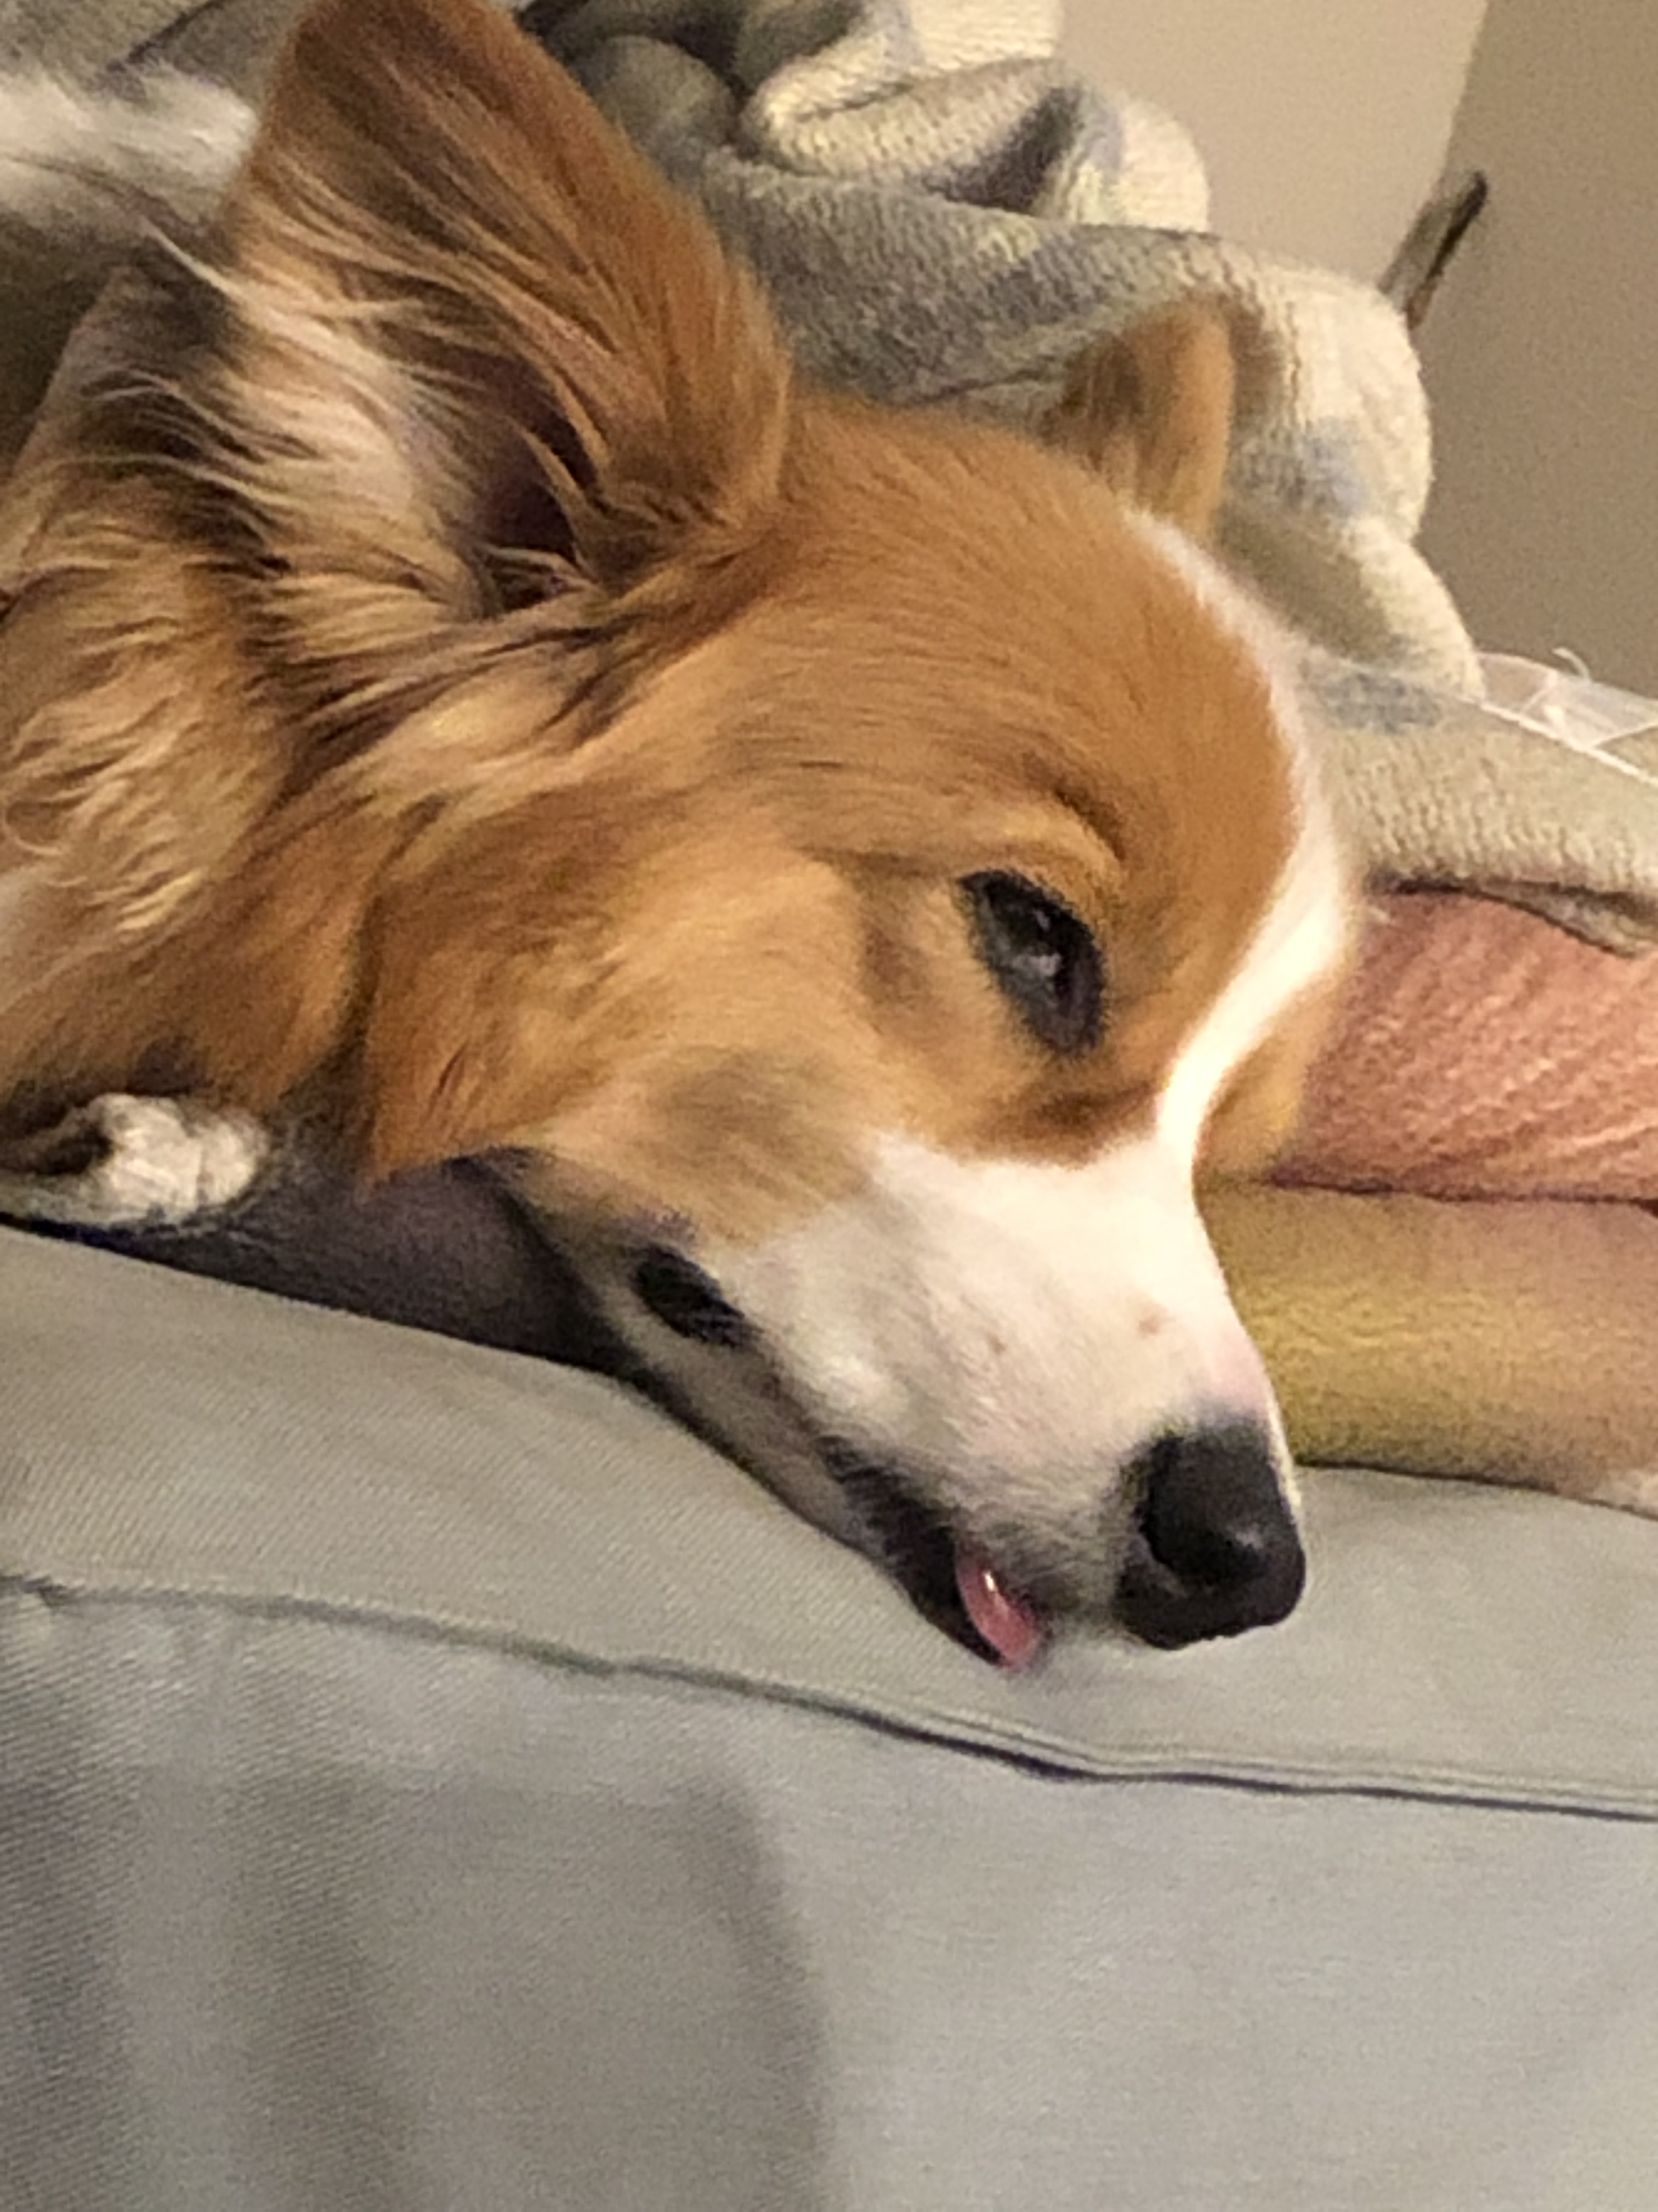

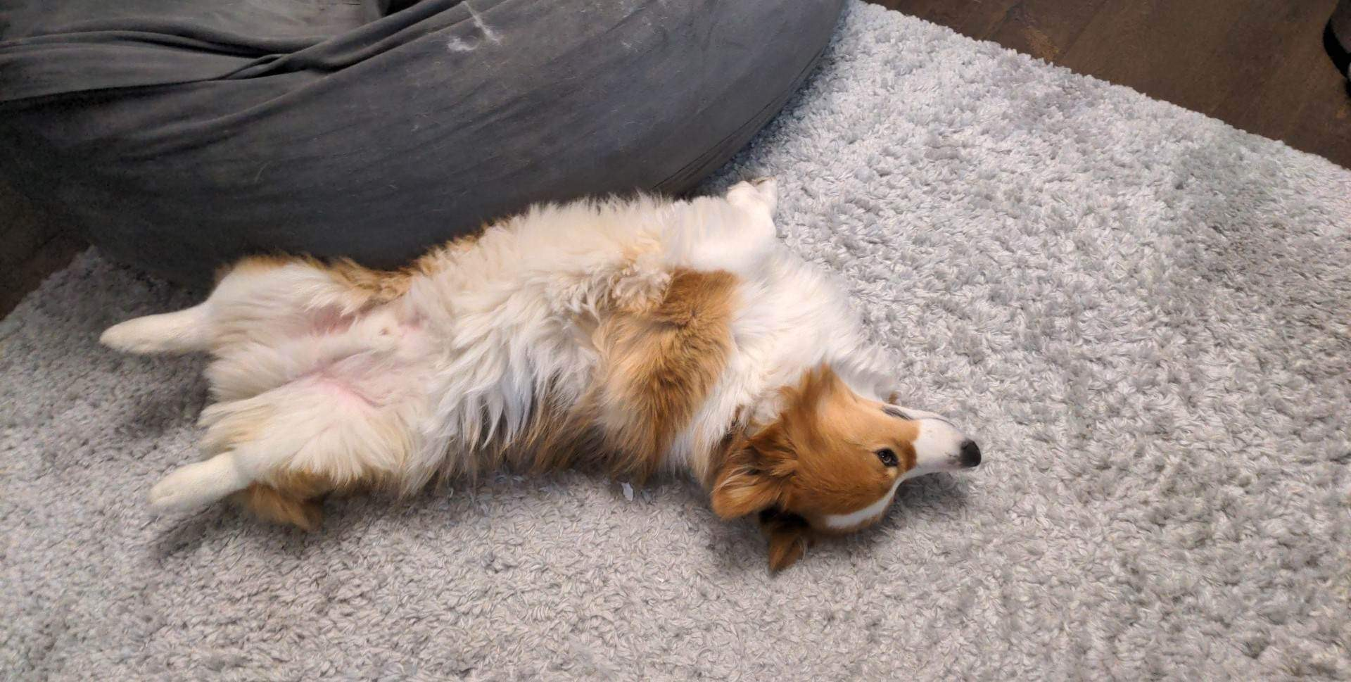
Aside: Gumball

