Slide 1
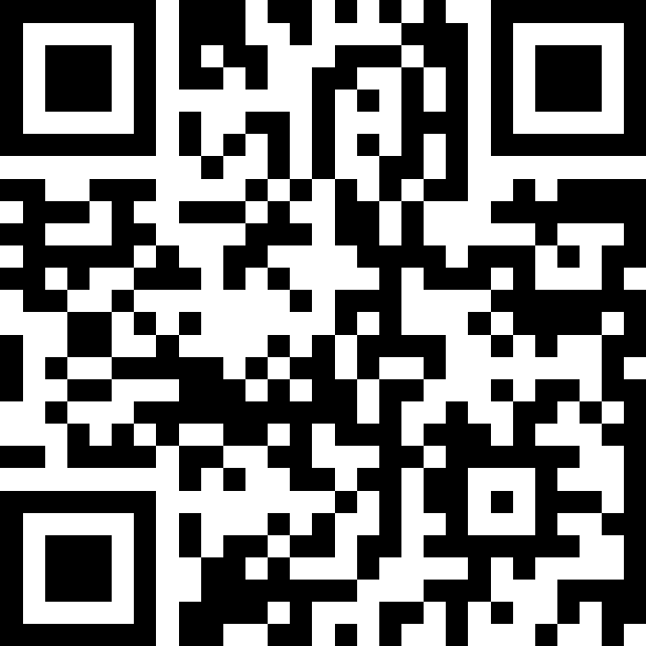
Datatypes and Expressions
BEFORE WE START
LEC 02
Talk to your neighbors:
What’s your favorite song right now?
Respond on sli.do!
Music: 🌻 CSE 121 26sp Lecture Tunes 🌻
Instructor:
Matt Wang
TAs:
Abdul
Dalton
Johnathan
Ruslana
Tamsyn
Amogh
Ethan
Minh
Sam
TJ
Anant
Hayden
Navya
Savannah
Trey
Anum
Jesse
Paul
Spencer
Cayden
Jessica
Reese
Shayna

Slide 2
Agenda (1/5)
Announcements, Reminders
Intro Survey Recap
Datatypes and Expressions Review
Expressions Practice
Combining Variables and Expressions

Slide 3
Announcements, Reminders
Creative Project 0 due tonight by 11:59 PM
Programming Assignment 0 releases later today
  due Tuesday, April 14th at 11:59 PM
  now on regular "cadence" (Wed release, due following Tue)
IPL is open! Schedule & instructions on website.
Section credit and Pre-Section Work details

Slide 4
Agenda (2/5)
Announcements, Reminders
Intro Survey Recap
Datatypes and Expressions Review
Expressions Practice
Combining Variables and Expressions

Slide 5
Intro Survey – things we’re excited for! (1/2)
Learning how to code!
"I am excited to enter the world of computer science and the language of coding"
"Understanding the fundamental thinking behind programing and coding."
"Learn how to code with others"
"I'm just excited to learn what it's all 'about'. Coding seems like wizard language to me currently."

Slide 6
Intro Survey – things we’re excited for! (2/2)
"Understanding how [CS] has an important role in our world!"
"Coming from a humanities background, I’m most excited about expanding my knowledge into the technical field"
"I am very excited about study groups/office hours possibilities. We're all relatively new to programming, so we will most likely also have similar struggles."
"I’m excited to learn the basics of CS because my best friend majors in it at UCLA and I have no idea what he is talking about ever so maybe I can better understand him"

Slide 7
Addressing worries from intro survey (1/3)
Most common: responses like… "Coding I have never touched it.. ever"
You’re in the right place! This class expects zero prior knowledge.
Second most common: difficulty, workload, pace, & falling behind,
e.g. "coding has a reputation for being super difficult"
programming can be difficult (if it was easy: why have a class?)
121 has many support systems (section, IPL, office hours, Ed, etc.)
if you feel like you’re struggling: reach out early!
  especially with pace of quarter system

Slide 8
Addressing worries from intro survey (2/3)
Grades, competitiveness, this class being a “weed-out” class
explicitly not the goal of this class
course designed against this (grade guarantees, resubmissions, etc.)
Quizzes & final exams (especially handwritten ones)
timed assessments can be stressful – but we’ll build you up slowly!
will have many practice resources and opportunities!

Slide 9
Addressing worries from intro survey (3/3)
Memorization & problem-solving
programming isn’t really about memorizing syntax (or specific facts)
  programmers look things up all the time! (but, this takes time…)
  on assessments, we will give you a reference sheet!
(in our opinion) the hard part of programming is problem-solving
  "breaking a big problem into smaller pieces"
  "building a strong mental model of how a system works”
  we will explicitly work on this as a class!

Slide 10
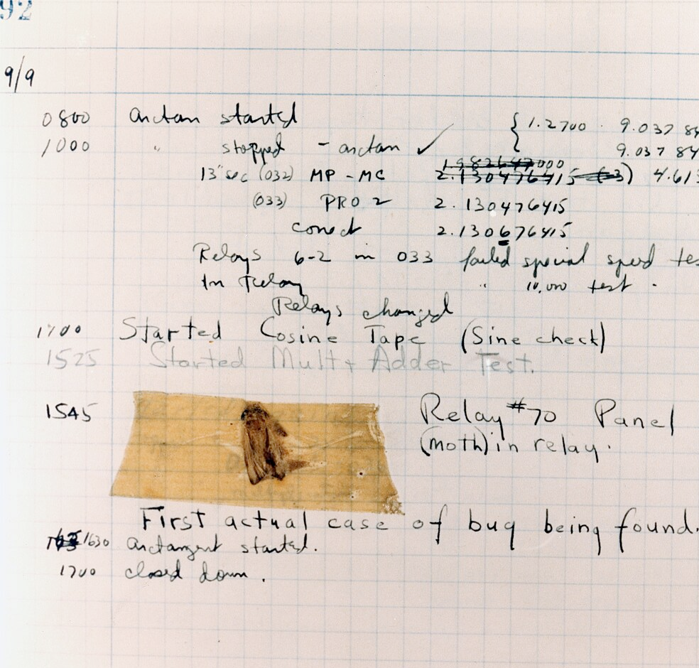
Student Fun Fact: Bugs
"Computer 'bugs' got their name from an actual bug in a computer"
Coined by Grace Hopper – a foundational computer scientist (particularly in "programming languages").
Courtesy of the Naval Surface Warfare Center

Slide 11
Other Fun Facts (from you)
"Hummingbirds are the only birds that can face the front and fly backward."
"Hippos have pink sweat that acts as both UV shielding and moisturizer."
"Sweden has the most islands in the world”
(and more!)

Slide 12
Other Fun Facts (about you)
And … y’all are cool!
"I know how to juggle and can go on for 20+ minutes"
"I am in the drumline here at uw!"
"i dance ballet folklorico"
"I used to remember 75 digits of pi"
"I know 120 digits of pi!"
"I can make a hyperrealistic goat bleat."
Bottom line: meet each other and form a community! (and bleat?)

Slide 13
Agenda (3/5)
Announcements, Reminders
Intro Survey Recap
Datatypes and Expressions Review
Expressions Practice
Combining Variables and Expressions

Slide 14
PCM: Datatypes & Expressions
Programming is about data; we tell Java what type of data we have!
Datatypes (so far): int, double, String, boolean
  note: only String is capitalized!
All values in a (Java) program have a type!
  some are more straightforward, e.g. 42 or "hello world"
    aside: these are called “literals”
  some are more complicated expressions!

Slide 15
PCM: Operators
We learned a ton of operators!
Numerical:
+ Addition
- Subtraction
* Multiplication
/ Division (tricky!)
% Modulo (or “mod”)
<, >, <=, >=, ==, != Relational
Strings:
+ Concatenation (not addition!)
Booleans:
! Logical Not
&& Logical And
|| Logical Or
== and != Relational

Slide 16
PCM: Precedence
Operators have precedence (an order of operations).
In Math:
Parentheses
Exponent
Multiplication
Division
Addition
Subtraction
In Java:
Parentheses
Logical NOT
Multiplication, Modulo, Division
Addition (and concatenation), Subtraction
Relational operators
Equality operators
Logical AND
Logical OR

Slide 17
Expressions in “little steps”
5 + 2 * 4
1 + 2 / 3
6 * 5 % 7
8
0
30
13
1
2

Slide 18
PCM: Conversions
When mixing types in an expression, Java will convert one type to the other and then perform the operation “normally”.
Some conversions are straightforward:
ints can be converted to doubles (add .0)
ints and doubles can be converted to Strings (add "")
So, Java does these for you! (is this good? controversial!)

Slide 19
New: Conversions (Gone Wrong!!)
Other conversions are “lossy”, because you lose data.
e.g. to make 3.14 an int, you’d probably pick either 3 or 4 – but either one loses data
Java won’t do this automatically for you – you need to “ask”.
  called a type cast: you’ll see this in Friday’s PCM + in P0
Some conversions don’t make sense.
how would you convert "Beyoncé" to an int? double?
Java really doesn’t let you do these…

Slide 20
Tracing Expression (Think)
What does this expression evaluate to?
2 + 2 + "hello" + 3 * 5 + 10
"22hello3510"
"22hello1510"
"4hello1510"
"4hello25"
This will cause an error

Slide 21
Tracing Expression (Pair)
What does this expression evaluate to?
2 + 2 + "hello" + 3 * 5 + 10
"22hello3510"
"22hello1510"
"4hello1510"
"4hello25"
This will cause an error

Slide 22
Expression example with mixing types
2 + 2 + "hello" + 3 * 5 + 10
" "
15
4
" "
" "
"4hello"
"4hello15"
"4hello1510"

Slide 23
Agenda (4/5)
Announcements, Reminders
Intro Survey Recap
Datatypes and Expressions Review
Expressions Practice
Combining Variables and Expressions

Slide 24
Work on Expressions and Types Practice (1)
On the Ed lesson for today, and on your handout
Work with folks around you!
TAs & I will walk around and help!
5 * 3 + 1.0
8 / 3 * 2.0
8.0 / 3 * 2
"Hello" + "world"
1 + "2" + 3
1 + 2 + "3"
1 + "2" + (3 + 4)

Slide 25
Part 1 Walkthrough (steps)
"Hello" + "world"
"Helloworld"
5 * 3 + 1.0
8 / 3 * 2.0
8.0 / 3 * 2
.0
.0
2
15
.0
2.666…
.0
16.0
4.0
5.333…
1 + "2" + 3
1 + 2 + "3"
1 + "2" + (3 + 4)
" "
" "
" "
" "
"12"
" "
"12"
7
3
"123"
"33"
"127"

Slide 26
Work on Expressions and Types Practice (2)
On the Ed lesson for today, and on your handout
Work with folks around you!
TAs & I will walk around and help!
5 * 3 < 12
10 % 3 == 10 / 3
5 < 9 || (7 != 7)
!(1 + 2 == 3 && 10 % 4 > 2)

Slide 27
Part 2 Walkthrough (1)
5 * 3 < 12
10 % 3 == 10 / 3
5 < 9 || (7 != 7)
15
1
false
1 == 10 / 3
15 < 12
5 < 9 || false
false
3
1 == 3
true
true || false
false
true

Slide 28
Part 2 Walkthrough (2)
!(1 + 2 == 3 && 10 % 4 > 2)
!(1 + 2 == 3 && 2 > 2)
!( 3 == 3 && 2 > 2)
!( 3 == 3 && false )
!( true && false )
!( false )
true

Slide 29
Agenda (5/5)
Announcements, Reminders
Intro Survey Recap
Datatypes and Expressions Review
Expressions Practice
Combining Variables and Expressions

Slide 30
Ed time :)
Applying what we learned to variables!

Slide 31
P0: Cornbear’s Café
-------------------------
Cornbear's Café
University of Washington
"Seattle"
-------------------------
2 Espresso $8.16
7 Sesame Latte $43.75
4 Seattle Fog $19.48
-------------------------
Subtotal $71.39
-------------------------
Tax $7.38
Service fee $1.21
Cornbear fee $6.39
-------------------------
Total $86.36
-------------------------
thank you <3
1:00 4/8/2026
Programming Assignment 0 (P0)
  Programming Assignments worth 4 ESN grades
  Usually a bit longer than creative projects
In P0, you’ll
  make a receipt generator
  practice variables, data types, & expressions
  learn a bit about rounding
  reflect on the rules of Java and human language
  see your first “specification” (or “spec”) that breaks up a problem into individual pieces

