Slide 1
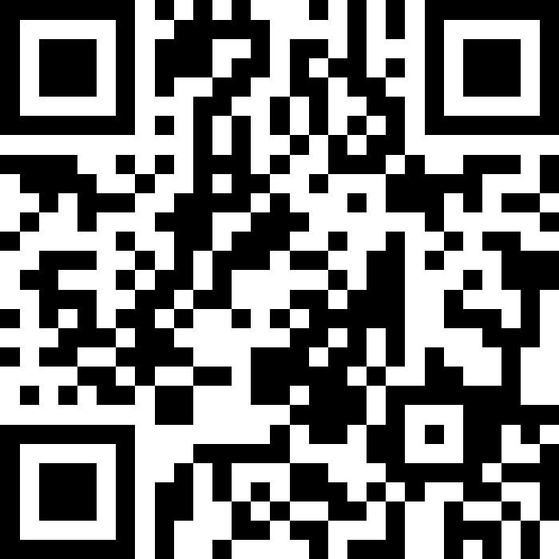
Victory Lap!
BEFORE WE START
LEC 19
Talk to your neighbors:
What is your go-to end-of-finals celebration?
Music: 🌻 CSE 121 26sp Lecture Tunes 🌻
Instructors:
Matt Wang
TAs:
Abdul
Dalton
Johnathan
Ruslana
Tamsyn
Amogh
Ethan
Minh
Sam
TJ
Anant
Hayden
Navya
Savannah
Trey
Anum
Jesse
Paul
Spencer
Cayden
Jessica
Reese
Shayna

Slide 2
Announcements, Reminders
R7 (and R-Extra) due Thursday, June 11th
  all assignments are eligible for resubmission!
  R-Extra email has gone out!
Today is the last day for IPL (instructor office hours already done :/ )
Final Exam: Wednesday, June 10th from 2:30 – 4:20 PM, in GUG 220
  Review the Exam page of website (with policies & resources)
  Cannot make it? Email me ASAP
TA-led review session: Mon, June 8th from 4:30 – 7 PM in BAG 154

Slide 3
Evaluations and Awards
Please give us feedback!
Course Evaluations are due Sunday, June 7th at 11:59 PM
TA Evaluations are also due Sunday, June 7th at 11:59 PM
We read every piece of feedback!
Bob Bandes TA Award nominations open!
  thought your TA was goated? write them a nomination!
  fun fact: some of our faculty won the award when they were TAs!

Slide 4
What is String[] args?
Live demo in class ☺
Note: this is not tested material!

Slide 5
Applications of Computer Science
or “What can I do with what I learned?” – outside of just “write code”:
Help deaf & hard-of-hearing people identify sounds
Develop a programming language that celebrates the world’s languages
Build battery-free robots, put them on insects, then… track murder hornets!?!
Detect and prevent toxicity online & recognize disinformation
Create an interactive atlas of millions of refugee experiences
Fix Olympic badminton & identify cheating in chess
and so much more!

Slide 6
… including our assignments! (1/2)
Computational Biology & Medicine (P2, P3)
  in CSE: Chris Thachuk, Sara Mostafavi, Su-In Lee, Luis Ceze
Computational Art (C0, C1)
  UW CSE has many unique intersections of CS + art!
  “Cultural-Centric Computational Embroidery” (CSE + iSchool)
  “Computational Illusion Knitting”, “How to Knit Objects Weird”
  “WasteBanned: Supporting zero waste fashion design”
Computer Security (C2)
  in CSE: Franzi Roesner, David Kohlbrenner, Nirvan Tyagi

Slide 7
… including our assignments! (2/2)
Games & Graphics (C1, C3)
  at UW: many labs in CSE and iSchool’s GAMER group
  fun fact: Foldit is a crowd-sourced game for protein folding
    David Baker shared last year’s Nobel Prize in Chemistry, in part for this!!
Social Computing (P1)
  at UW: Amy Zhang’s Social Futures Lab + so much of iSchool
and many side quests (in lecture, section, PCM): accessibility
(e.g. UW CREATE), weather, music data, chatbots, and lots of math

Slide 8
Closing the loop on P3 reflections – topics
Y’all listed many other applications of CS too! Some common areas:
civil engineering & architecture
sports
agriculture
environmental science & engineering
archaeology
2D & 3D animation

Slide 9
Libraries & Archives! (1/3)
“Sometimes I enjoy volunteering online by transcribing historical documents which is really important not only for accessibility of information across large distances but also a more viable way of preserving information.
Not only is computer science really important in the actual creation of websites and digital archives to store this information but some of the basic skills can be reminiscent of coding/[pseudocode] like in the videos example of the Old McDonalds song.”

Slide 10
Libraries & Archives! (2/3)
“Also, one of the fields I am interested in post-grad is library science and being a public librarian.
I think when most people think of librarians, they would not think about computer science--but it plays a significant role, because you have to manage databases that track not only what books the library owns, but also whether copies are checked out or on shelves, where on shelves they're located, […]”

Slide 11
Libraries & Archives! (3/3)
“For this I feel like we can talk about libraries! Libraries are what I would consider one of the greatest things the average person ignores [...]
Specifically library digitization and organization have been incorporating computer science to streamline access to knowledge.
For example with the UW library you can check the status of a book and where you can find it thanks to the digitization of what began as a physical information system.”

Slide 12
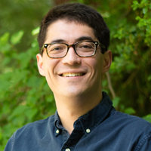
Benjamin Charles Germain Lee
Assistant Professor at UW’s iSchool
previous PhD student in CSE at UW; undergrad in astrophysics & math (not CS!)
very cool work related to libraries & archives
  Newspaper Navigator (Library of Congress)
  Govscape – searching > 10 million US government PDFs!!
  archival work at US Holocaust Memorial Museum (see: “Uncanny Testimony”)

Slide 13
Future Courses
More 12X!
or “What can I do next?”
Course | Overview
CSE 122 | Data structures, object-oriented programming
CSE 123 | More OOP, recursion
Non-majors
Course | Overview
CSE 154 | Intro to web programming (several languages)
CSE 160 | Intro programming, data analysis (Python)
CSE 163 | Intermediate programming, data analysis (Python)
CSE 180 | Introduction to data science (Python)
CSE 373 | Data structures and algorithms (in Java)
CSE 374 | Low-level programming and tools (C/C++)
CSE 412 | Intro to Data Visualization
CSE 416 | Intro. to Machine Learning
CSE 493E | Accessibility
Majors
Course | Overview
CSE 311 | Mathematical foundations
CSE 331 | Software design/implementation
CSE 340 | Interaction programming (apps)
CSE 341 | Programming languages
CSE 351 | Hardware / Software Interface
CSE 480 | Social impacts of computing
Related majors: Informatics, ACMS, HCDE, ECE, …
See: https://www.cs.washington.edu/academics/ugrad/current-students and https://www.cs.washington.edu/academics/ugrad/nonmajor-options/nonmajor-courses

Slide 14
Closing the loop on P3 reflections – journey
We also asked you to reflect on your journey learning CS!
Impossible to adequately summarize them all, but the biggest theme was combating myths about computer science:
what programming & computer science is
what makes computer science hard (it’s not just syntax!!)
what you need to be a “good” programmer (not always math!!)
what programmers & computer scientists look like
that one bad experience means you’ll always be bad at it

Slide 15
Metacognition & Growth Mindset
“Before taking this class, I thought that some people were naturally good at computer science and just "got it." I thought it would be a skillset that it really hard to learn.
Reflecting back now, I still think that it comes much easier to some people and its still hard to learn and understand what to do from a specification but I also think that I've improved my problem solving skills and understand of coding.”

Slide 16
… and some honest (and funny) answers!
“I honestly didn't think I would enjoy it that much. I got sick of the weed-out classes at UW and expected this one to be the same as the rest. I ended up really enjoying coding and I definitely want to look into a career that revolves around it.... hopefully there are some out there.”
“I thought my friends who understood [CS] were people speaking a gibberish language at me that I would never understand. After taking this course half of this is true! I kinda get it now! It is totally still gibberish though lol.”
“Matt was one of the funniest teachers of all time! would love to see him like posts videos or clips of his teaching.”
– trust me, you don’t ;)

Slide 17
Generalizing beyond Computer Science
Some of you said, ”I’m glad I took this class, but no more CS for me”
That’s totally valid!
Some lessons from this class that could apply more broadly:
how to break big problems into smaller subproblems
how to isolate what part of a system is broken
attention to detail
understanding basics of how software works
how to learn (and reflect) effectively

Slide 18
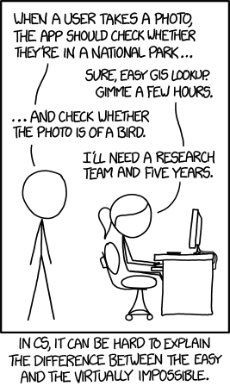
Frequently Asked Questions
How can I get better at programming?
  Practice!
How can I learn to X?
  Classes, books, videos, or self-learn!
  CS (as a field) has lots of free resources :)
What should I do next?
  Anything you’re interested in!
  but: hard to tell what’s easy and what’s hard
Should I learn another language? Which one?
  That depends – what do you want to do?

Slide 19



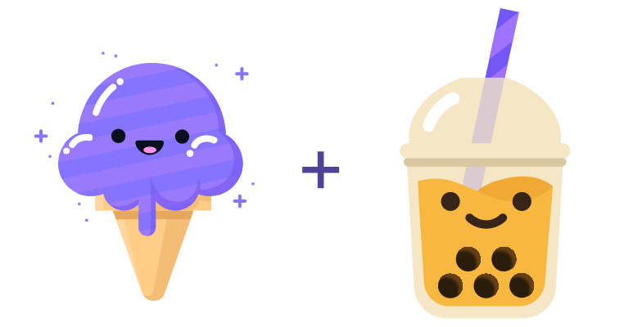

Aside: Cute Programming Language Logos

Slide 20
Summer Break Project: Tic Tac Toe
Build your own Tic Tac Toe game + “AI”!
How would you represent a Tic Tac Toe game in Java?
(hint: arrays will be very, very helpful!)
Write a method that tells you if a Tic Tac Toe game is won.
Write a method that gets input from the user and “makes” a move.
Wrap it all up – into a nice two-player game!

Slide 21
Summer Break Project: Tic Tac Toe++
Make some “AI” that…
just makes a random valid move (you should be able to beat this!)
tries to make a “good” move (~ some if statements)
never loses
  Tic Tac Toe is a “solved game”: a perfect player will never lose.
Or, extend this idea to other grid-based games!
similar-ish: connect four, checkers, battleship
much harder: sudoku, chess, go, othello

Slide 22
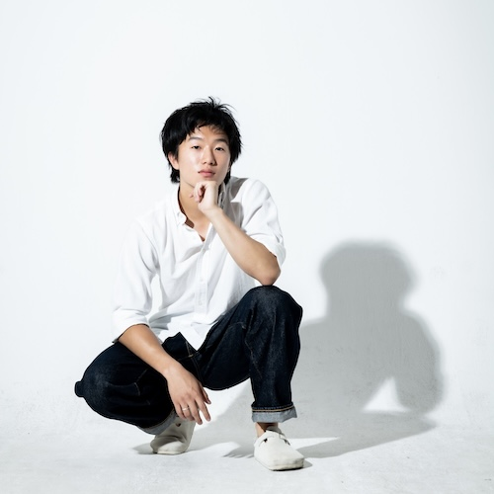
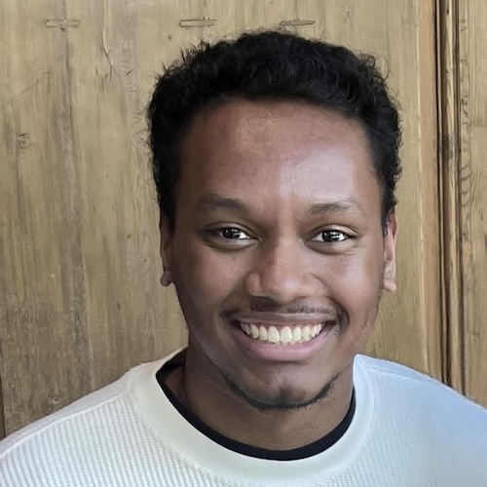
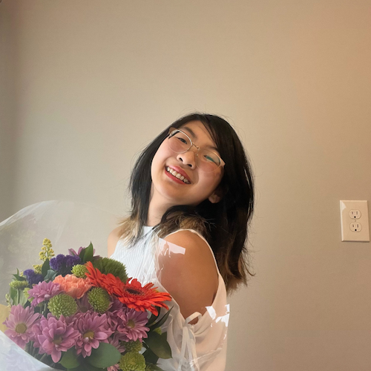
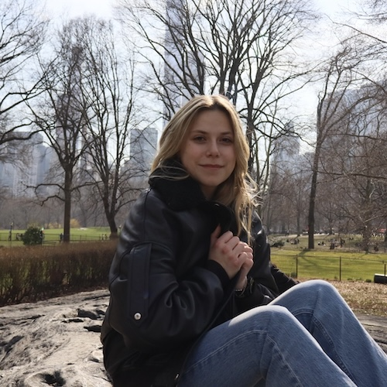
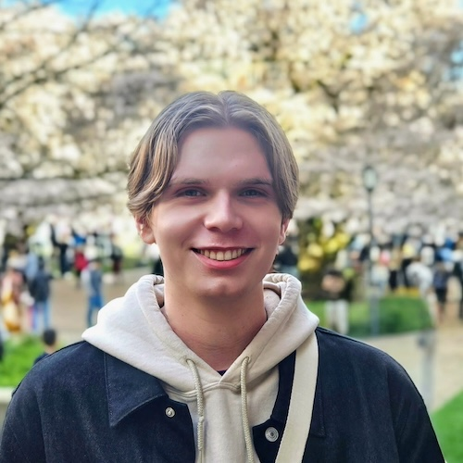
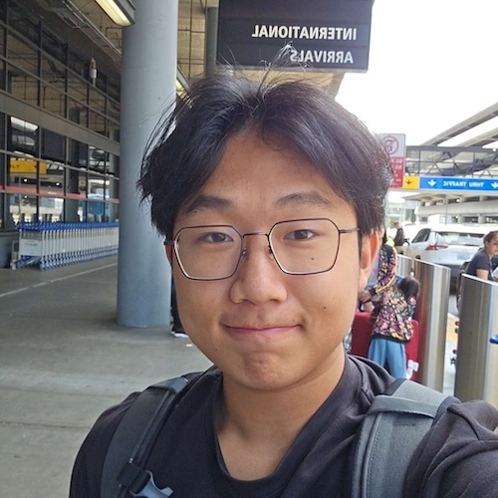
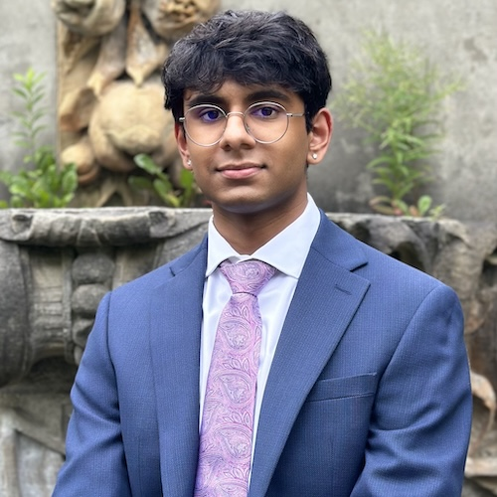
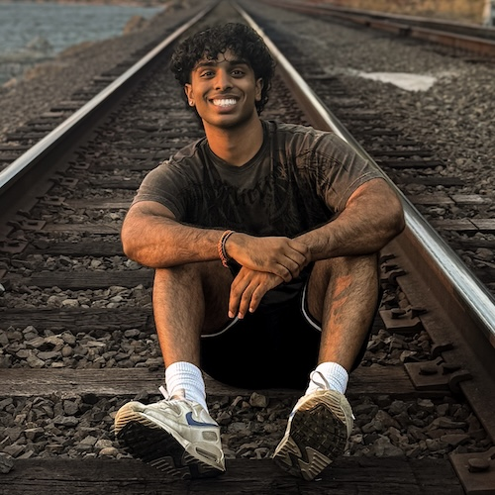
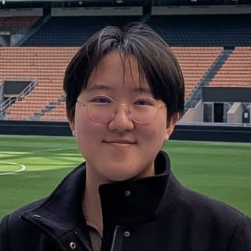
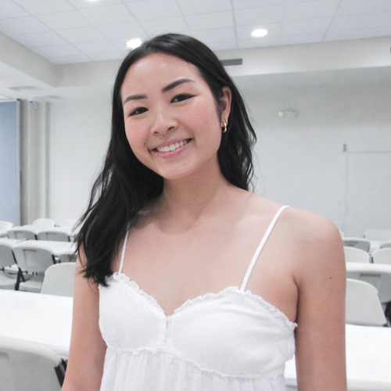
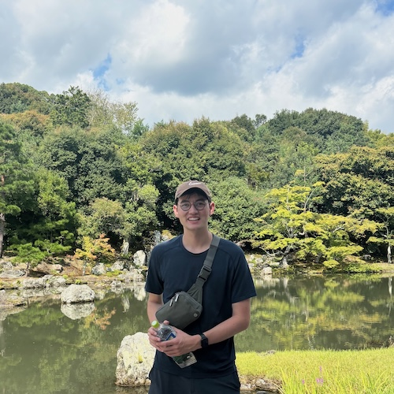
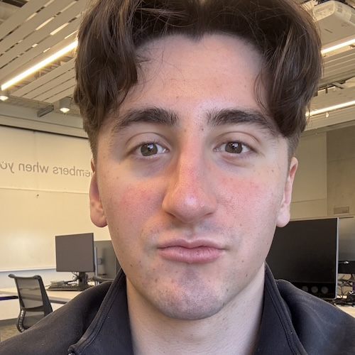
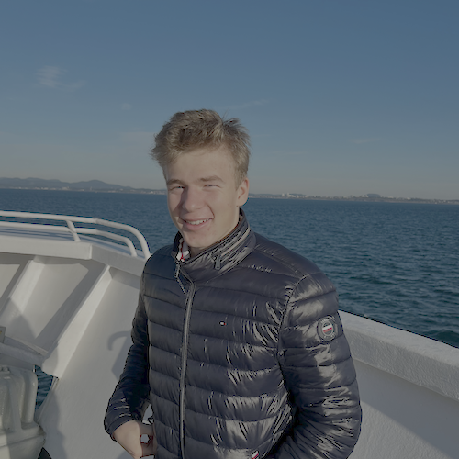

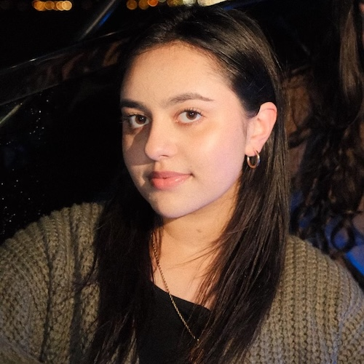
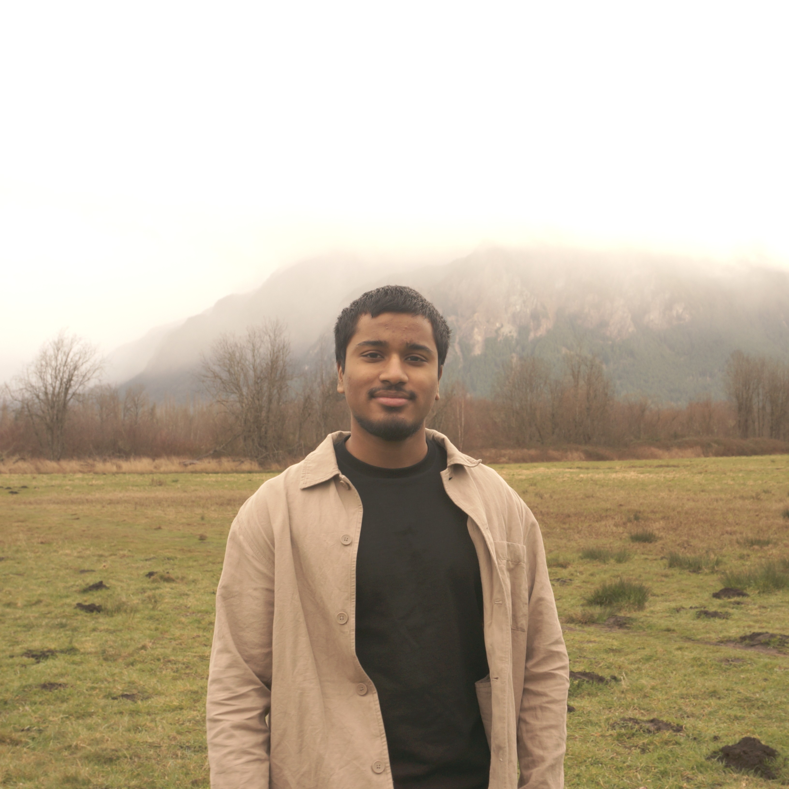
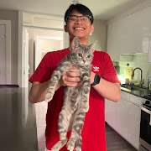
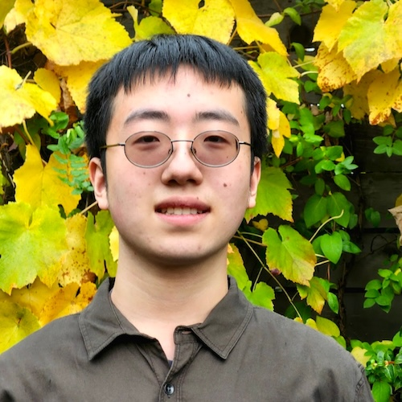
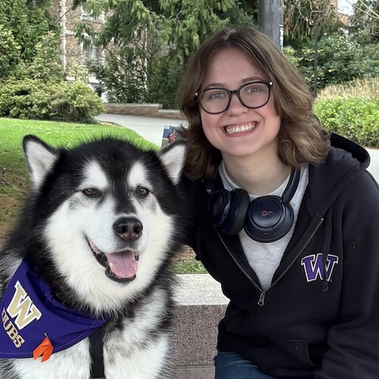
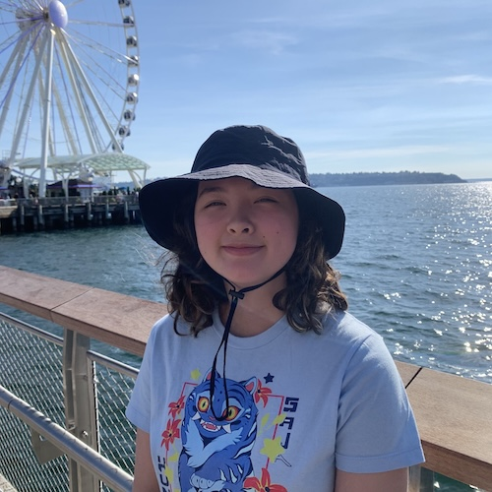
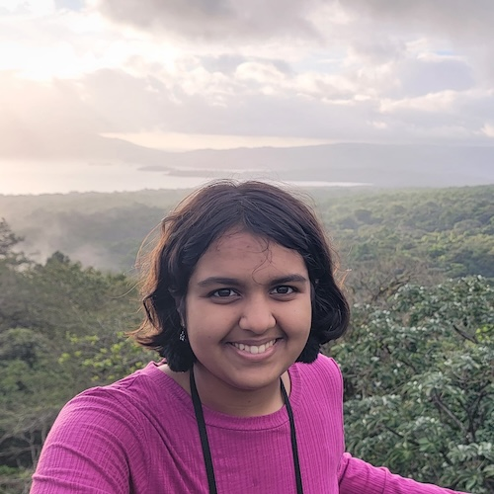

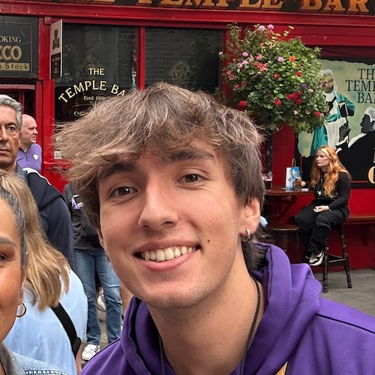
Thank your 23 fabulous TAs!

Slide 23
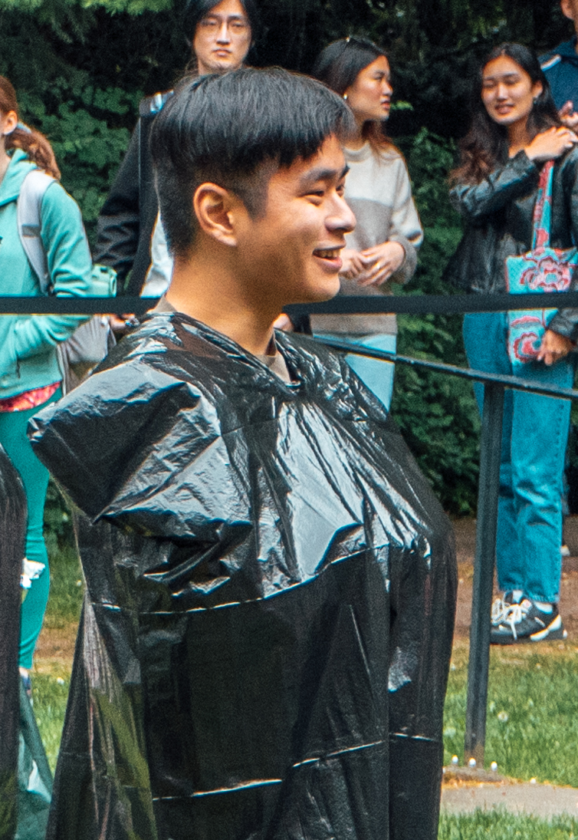
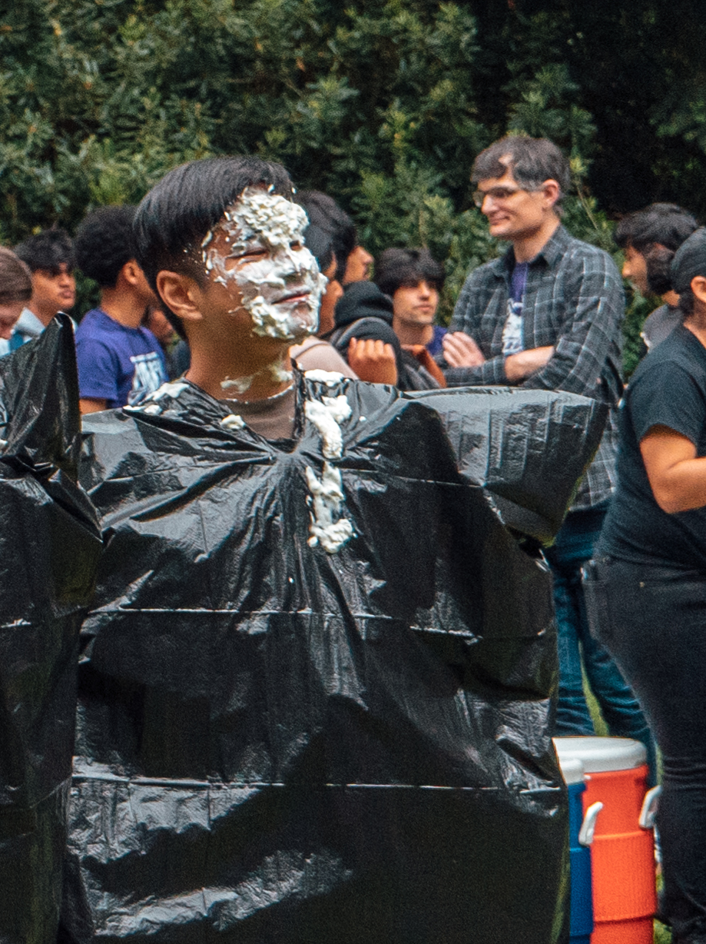
Thank you!
Ask Me (Almost) Anything!
sli.do #cse121

