Slide 1
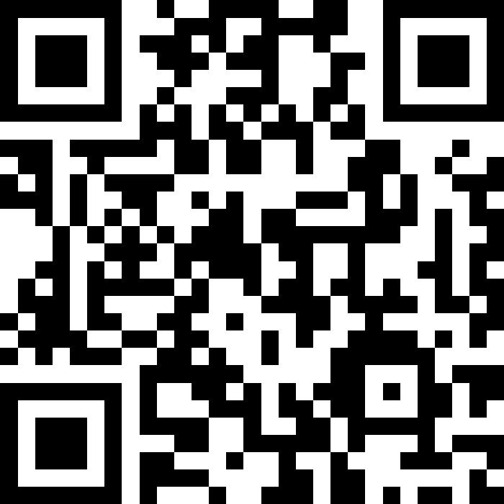
Final Exam Review
BEFORE WE START
LEC 18
Talk to your neighbors:
What will you miss from spring?
What are you excited to leave behind?
Music: 🌻 CSE 121 26sp Lecture Tunes 🌻
Instructors:
Matt Wang (feat. Anum & Savannah!)
TAs:
Abdul
Dalton
Johnathan
Ruslana
Tamsyn
Amogh
Ethan
Minh
Sam
TJ
Anant
Hayden
Navya
Savannah
Trey
Anum
Jesse
Paul
Spencer
Cayden
Jessica
Reese
Shayna

Slide 2
Announcements, Reminders (General)
R6 due Thursday, June 4th
R-Extra releases Friday, June 5th
  Contact your TA if your section credit on Gradescope looks wrong!
  We will email you about R-Extra on Friday (stay tuned!)
R7 and R-Extra close Thursday, June 11th
  All assignments eligible for resubmission for R7 & R-Extra!
IPL closes Friday, June 5th
See End-of-Quarter Announcements
  Fill out course & section evals – we read each one!
  Nominate your 🐐 TAs for the Bob Bandes Award!

Slide 3
Announcements & Reminders (Exam)
Final Exam: Wednesday, June 10th from 2:30 – 4:20 PM, in GUG 220
  Review the Exam page of website (with policies & resources)
  Cannot make it? Email me ASAP
TA-led review session: Mon, June 8th from 4:30 – 7 PM in BAG 154
  Similar to today’s lecture, but with full practice exam
  Plan to record & post recording + practice problems,
  but best experience comes from going in-person!

Slide 4
In-Class Exam Review
Mini-exam overview
  This mini-final does not reflect the difficulty and length of the actual final
  Opportunity to practice exam-style problems on paper
3 problems
  Code Comprehension
  Debugging
  Programming
Task for today:
  Work through each problem (one at a time) independently or with peers
  Afterwards, we’ll walk through our solutions & thought processes
  Problems & key also on Ed (look after class!)

