Slide 1
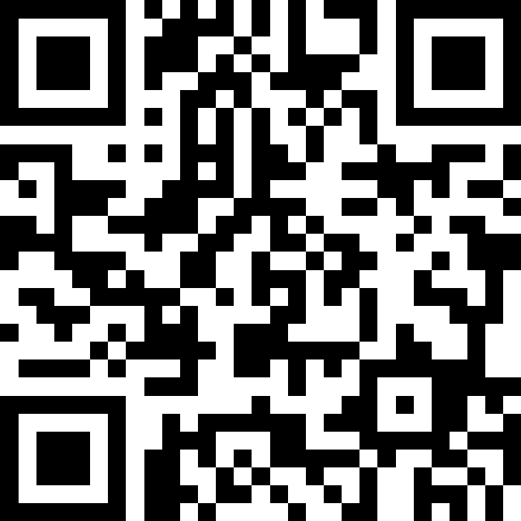
Putting It All Together (Again)!
BEFORE WE START
LEC 17
Talk to your neighbors:
If you could be any marine animal, what would you be? 🐬
Music: 🌻 CSE 121 26sp Lecture Tunes 🌻
Instructors:
Matt Wang
TAs:
Abdul
Dalton
Johnathan
Ruslana
Tamsyn
Amogh
Ethan
Minh
Sam
TJ
Anant
Hayden
Navya
Savannah
Trey
Anum
Jesse
Paul
Spencer
Cayden
Jessica
Reese
Shayna

Slide 2
Announcements, Reminders
P3 due Tuesday, June 2nd
  note: you will get feedback after R7 is due
  (we will grade this differently because of that!)
Resubmissions!
  R6 released, due Thursday, June 4th (eligible: C2, P2, C3)
  R7: All assignments eligible for resubmission!
  R-Extra: Extra resubmission for 11+ sections attended
Final Exam: Wednesday, June 10th from 2:30-4:20 (in GUG 220)
  Fill out the Left-Handed Desk Request form by Tue, June 2nd

Slide 3
The “Core” of the Final Exam
In-person, with assigned seating (more on that next week!)
Same general logistics as quizzes:
  on paper
  we will provide you with one reference sheet, and
  you may bring one double-sided 8.5 x 11-inch page of notes
Will have 6 problems, all similar in style to the quizzes
Focus is on behavior (not code style); minor syntax errors allowed (when unambiguous)
A bit more time per-problem than the quiz!

Slide 4
CSE 121 “Exam Review Systems”
Entire last week is focused on final exam review and prep
  Lecture 18: some strategies & live practice
  Section 17 and 18: even more practice
  Lecture 19: a few last tips, words of encouragement
Optional final exam review session planned for 06/08 – more details soon!
IPL will not be open during finals week, so plan ahead!
Several asynchronous resources, including:
  multiple previous actual finals
  many existing programming problems
  more resources soon (stay tuned for an announcement!)

Slide 5
Some Miscellaneous Exam Thoughts
Be very careful about how you use the previous actual finals
  Great study resource (and matched difficulty), but…
  Hard to “unsee” solutions after looking & too easy to “overfit”
  Use for targeted study, mimic the actual test-taking environment
Make your own cheatsheet, don’t use someone else’s!
  Making the cheatsheet is studying
It is your responsibility to know the policies & procedures
  Let’s take a quick spin of the website page right now :)

Slide 6
Exam Questions?
We will answer some live and put the rest in the class megathread for today!
sli.do #cse121

Slide 7
Scratchwork

Slide 8
(PCM) Array of Counters
0 1 2 2 0 2
public static int[] numCount(Scanner input, int numPrompts) {
int[] counts = ;
for (int i = 0; i < numPrompts; i++) {
int num = input.nextInt();
;
}
return counts;
}

Slide 9
Ed Time :)
(for those looking at just the slides – the rest of this lecture was doing the in-class lesson!)

