Slide 1
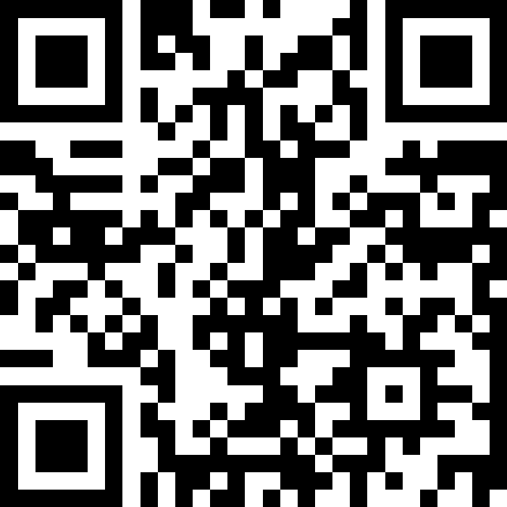
Array Patterns
BEFORE WE START
LEC 16
Talk to your neighbors:
How was your long weekend?
Music: 🌻 CSE 121 26sp Lecture Tunes 🌻
Instructors:
Matt Wang
TAs:
Abdul
Dalton
Johnathan
Ruslana
Tamsyn
Amogh
Ethan
Minh
Sam
TJ
Anant
Hayden
Navya
Savannah
Trey
Anum
Jesse
Paul
Spencer
Cayden
Jessica
Reese
Shayna

Slide 2
Announcements, Reminders
Quiz 2 in section tomorrow (Thursday, May 28th)!
Reference sheet and practice quizzes (+ keys) on Ed
Email Matt before our quiz section if you need to request a makeup
P3 will be released tonight & due Tuesday, June 2nd
R5 due tomorrow (eligible: P1, C2, P2)
P1 cycling out of eligibility after R5
Final Exam on Wednesday, June 10th at 2:30 – 4:20 PM (in this room!)
Left-handed desk request form out now, due Tuesday, June 2nd
More details posted soon, and will be discussed on Friday

Slide 3
Closing the Loop: P2 Reflections (Bias!)
Clear consensus on potential for bias (related to the video!)
“classic” social issues: insurance & zip code (proxies for wealth, socioeconomic status, geography, and race)
domain-specific biases:
not all medical conditions are temperature or pain-based!
systemic underreporting in reported pain levels (particularly across cultures, gender, and chronic illness)
(and many more!)

Slide 4
P2 Reflection Excerpt: Pain Tolerance
“Another Bias that could happen is varying pain tolerances. I have a very high pain tolerance. When my appendix completely ruptured when I was 9 years old, I wasn't in that much pain, while my body was in danger of developing sepsis.”

Slide 5
Closing the Loop: P2 Reflections (Fixes?)
Less clear consensus on how to fix potential bias.
many suggested removing zip code and/or insurance
some instead suggest using zip code to correct for inequity (e.g. prioritizing patients who don’t live close to hospitals)
others noted practical reasons why you might need these
many suggested collecting more data
most common: medical history, other vitals, wait time
but, little agreement on what to add (and how to weight them)!
should we consider factors like disability? gender? race?

Slide 6
Closing the Loop: P2 Reflections (So What?)
Three takeaways:
Technology is not neutral: it is made by people (and their biases)!
Solving these issues is hard! Often no “obviously correct” answer.
First step is to start thinking (reflection!) – but far from the last!
Will you have to make a patient prioritization algorithm in your job?
Honestly, maybe! (hospitals are one of the largest employers: UW Medicine employs 35,000 people)
Will you make ”data-driven” decisions in the future? Absolutely.

Slide 7
P2 Reflection Excerpt: Real-Life P2!
I recently visited a medical center for a routine procedure and the nurse treating me mentioned that they had recently implemented a new scheduling system that schedules and assigns patients to rooms and providers. The nurse had said to me that the system fails to consider human error such as a patient showing up late, or two patients being in one room when they aren't a good fit to be together
…
There are still many flaws that show up in a system that seems so simple, which my nurse mentioned had been throwing everyone off all day.

Slide 8
(PCM) Why Discuss Array Patterns?
Arrays are important! This is our fourth lecture covering arrays
Analogy: tools in toolbox
Helpful for your future in programming

Slide 9
(PCM) Counting Elements that Meet a Condition
"one" | "two" | "three" | "six" | "seven" | "eight" | "ten"
public static int evenLength(String[] list) {
int countEven = 0;
for (int i = 0; i < list.length; i++) {
if ( ) {
countEven++;
}
}
return countEven;
}

Slide 10
(PCM) Modifying Elements of an Array
4 | 8 | 15 | 16 | 23 | 42
public static void clamp(int min, int max, int[] list) {
for (int i = 0; i < list.length; i++) {
if ( > max) {
= max;
} else if ( < min) {
= min;
}
}
}

Slide 11
(PCM) Searching for an Element
"one" | "two" | "three" | "six" | "seven" | "eight" | "ten"
public static int indexOfIgnoreCase(String phrase, String[] list) {
for (int i = 0; i < list.length; i++) {
if ( ) {
return ;
}
}
return ;
}
i
-1

Slide 12
(PCM) Shifting Elements
9.6 | -88.0 | 4.815 | 0.009 | 7.0184 | 42.9
public static void rotateRight(double[] list) {
double lastElement = list[list.length - 1];
for (int i = list.length - 1; i > 0; i--) {
list[i] = list[i - 1];
}
;
}

Slide 13
(PCM) Analyzing Multiple Elements in an Array (isPalindrome)
0 | 1 | 9 | 1 | 0
public static boolean isPalindrome(int[] list) {
for (int i = 0; i < list.length / 2; i++) {
if (list[i] != list[list.length - 1 - i]) {
return ;
}
}
return ;
}

Slide 14
(PCM) Analyzing Multiple Elements in an Array (isMirrored)
4.1 | 5.5 | 4.1
6.0 | -1.1 | 6.0
public static boolean isMirrored(double[][] arr) {
for (int i = 0; i < arr.length; i++) {
int rowLength = ;
for (int j = 0; j < ; j++) {
if (arr[i][j] != arr[i][rowLength - 1 - j]) {
return ;
}
}
}
return ;
}

Slide 15
(PCM) Array of Counters
0 1 2 2 0 2
public static int[] numCount(Scanner input, int numPrompts) {
int[] counts = ;
for (int i = 0; i < numPrompts; i++) {
int num = input.nextInt();
; }
return counts;
}

Slide 16
(PCM) Your Turn!
Review the problems in the Array Patterns PCM
On Slido, vote for any problems you would like to go over together!
If you have time, try some new problems!
[NEW] rotateLeft: Shifting Elements problem
[NEW] isAllPairs: Analyzing Multiple Elements problem
[NEW] transpose: 2D Analyzing Multiple Elements/Shifting Elements problem

Slide 17
(PCM) Questions to Ask Ourselves
“Are we looking at each element in the array, one at a time?”
Loop traversal
“Are we changing elements in the array?”
Update the array at a specific index
“Do we only want to do a task if a certain condition is true?”
Conditional(s)

Slide 18
rotateLeft
0.1 | 0.2 | 0.3 | 0.4 | 0.5

Slide 19
isAllPairs
3 | 3 | 4 | 4 | 5 | 5 | 6 | 6 | 7 | 7
-1 | -1 | 0 | 0 | 4 | 8 | 8 | 9 | 10 | 10

Slide 20
transpose
1 | 2 | 3
4 | 5 | 6
7 | 8 | 9

