Slide 1
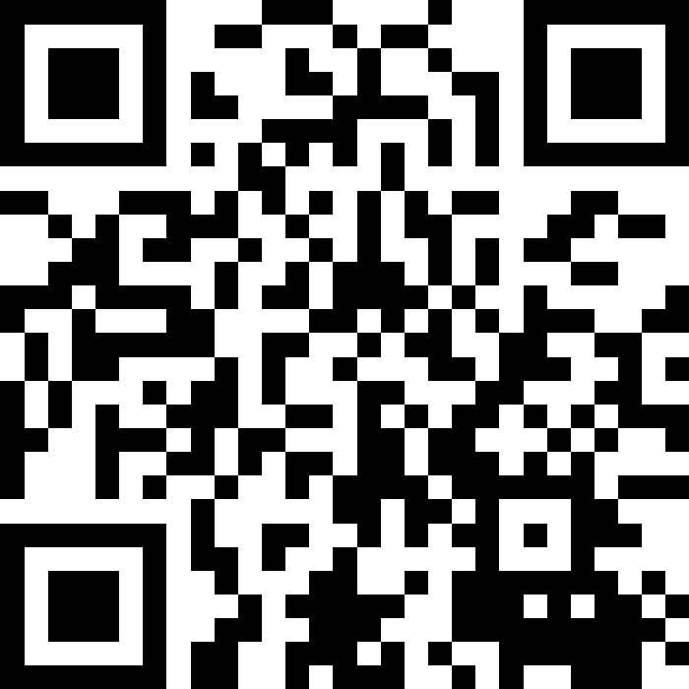
Reference Semantics
BEFORE WE START
LEC 14
Talk to your neighbors:
What’s your favorite sport or competition to watch?
Music: 🌻 CSE 121 26sp Lecture Tunes 🌻
Instructors:
Matt Wang
TAs:
Abdul
Dalton
Johnathan
Ruslana
Tamsyn
Amogh
Ethan
Minh
Sam
TJ
Anant
Hayden
Navya
Savannah
Trey
Anum
Jesse
Paul
Spencer
Cayden
Jessica
Reese
Shayna

Slide 2
Announcements, Reminders
C3 released tonight, due Tuesday, May 26th
R4 due tomorrow (eligible: C1, P1, C2)
  C1 cycling out of eligibility after R4
Quiz 2 on Thursday, May 28th
  Conditionals, while loops, User Input (Scanner), Arrays, Reference Semantics
  can’t make it? email Matt before your quiz!

Slide 3
Think Pair Share: arrayMystery (think)
What would the array arr store at the end of this arrayMystery method if {-20, 20, 26, 32, 50, 3} was passed in?
public static void arrayMystery(int[] arr) {
for (int i = arr.length - 1; i >= 1; i--) {
if (arr[i] > arr[i - 1] + 10) {
arr[i - 1] = arr[i - 1] + 5;
}
}
}
{-20, 20, 26, 32, 50, 3}
{-15, 25, 31, 37, 55, 8}
{-15, 25, 31, 37, 50, 3}
{-15, 20, 26, 37, 50, 3}

Slide 4
Think Pair Share: arrayMystery (Pair)
What would the array arr store at the end of this arrayMystery method if {-20, 20, 26, 32, 50, 3} was passed in?
public static void arrayMystery(int[] arr) {
for (int i = arr.length - 1; i >= 1; i--) {
if (arr[i] > arr[i - 1] + 10) {
arr[i - 1] = arr[i - 1] + 5;
}
}
}
{-20, 20, 26, 32, 50, 3}
{-15, 25, 31, 37, 55, 8}
{-15, 25, 31, 37, 50, 3}
{-15, 20, 26, 37, 50, 3}

Slide 5
Tracing through arrayMystery
i
{-20, 20, 26, 32, 50, 3}
public static void arrayMystery(int[] a) {
for (int i = a.length - 1; i >= 1; i--) {
if (a[i] > a[i - 1] + 10) {
a[i - 1] = a[i - 1] + 5;
}
}
}
a

Slide 6
PCM Review: Value Semantics vs. Reference Semantics
Value Semantics
Applies when working with primitive types
Variables/parameters hold a copy of the actual value
Reference Semantics
Applies when working with objects
Variables/parameters hold a reference to the object
int a = 3;
int[] list1 = {4, 8, 15};
3
4
8
15
int a
int[] list1

Slide 7
PCM Review: Value Semantics (setup)
int a
Applies when working with primitive types
Variables/parameters hold a copy of the actual value
3
int b
int a = 3;
int b = a;
a = 99;

Slide 8
PCM Review: Value Semantics
int a
Applies when working with primitive types
Variables/parameters hold a copy of the actual value
3
99
int b
3
int a = 3;
int b = a;
a = 99;

Slide 9
PCM Review: Reference Semantics (setup)
int[] list1
Applies when working with objects
  Including arrays!
Variables/parameters hold a reference to the object
4
int[] list1 = {4, 8, 15};
int[] list2 = list1;
list1[0] = 99;
int[] list2

Slide 10
PCM Review: Reference Semantics
Applies when working with objects
  Including arrays!
Variables/parameters hold a reference to the object
99
int[] list1
4
8
15
int[] list1 = {4, 8, 15};
int[] list2 = list1;
list1[0] = 99;
int[] list2

Slide 11
Value Semantics & Methods
boolean test = true;
flipValue(test);
public static void flipValue(boolean b) {
b = !b;
}

Slide 12
Reference Semantics & Methods
boolean[] tests = {true, false, false, false};
flipValues(tests);
public static void flipValues(boolean[] b) {
for (int i = 0; i < b.length; i++) {
b[i] = !b[i];
}
}

Slide 13
PCM Review: null
null is the absence of a reference!
sort of the “zero” for references
default value for object types (e.g. Random, Scanner, and String)
A NullPointerException is an error that happens
when you ask null to “do something”, which includes:
calling .toUpperCase() on null? NullPointerException!
calling .nextInt() on null? NullPointerException!
many, many more

Slide 14
PCM Review: avoiding NullPointerException
if (strs[i] != null) {
System.out.println(strs[i].toUpperCase());
} else {
System.out.println("element " + i + " is null.");
}

