Slide 1
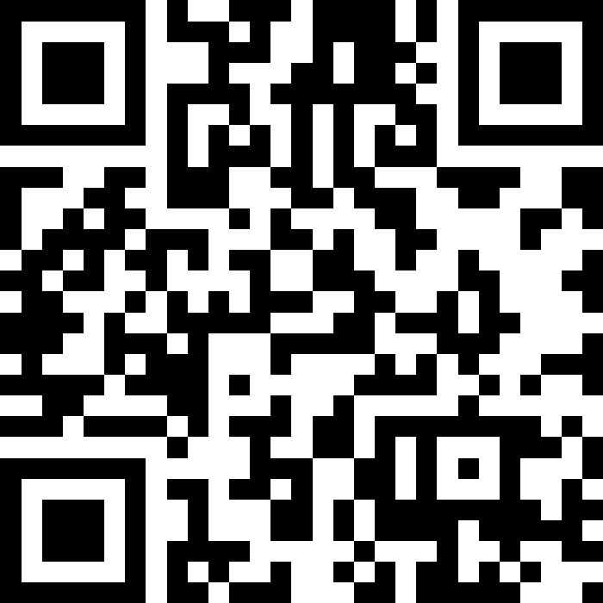
User Input (Scanner)
BEFORE WE START
LEC 11
Talk to your neighbors:
If you had to compete in one Olympic sport, what would it be?
Music: 🌻 CSE 121 26sp Lecture Tunes 🌻
Instructor:
Matt Wang
TAs:
Abdul
Dalton
Johnathan
Ruslana
Tamsyn
Amogh
Ethan
Minh
Sam
TJ
Anant
Hayden
Navya
Savannah
Trey
Anum
Jesse
Paul
Spencer
Cayden
Jessica
Reese
Shayna

Slide 2
Announcements, Reminders
P2 due Tuesday, May 19th
R3 out yesterday and due Thursday, May 14th
P0, C1, P1, C2 eligible
last opportunity to resubmit P0
Quiz 1 is Thursday, May 14th, in your registered quiz section
resources posted on Ed last night!
topics: for loops, nested for loops, Random, Math, methods, parameters, returns, conditionals, while loops
Canvas outage mostly doesn’t affect us – recordings available via Panopto from course website (but let us know if you see issues!)

Slide 3
for loops are while loops?
for (int i = 0; i < bigYikes; i++) {
// ...
}
int i = 0;
while (i < bigYikes) {
// ...
i++;
}

Slide 4
for loops are while loops! (almost*)
for (int i = 0; i < bigYikes; i++) {
// ...
}
int i = 0;
while (i < bigYikes) {
// ...
i++;
}
*as a technical note, these aren’t exactly the same – there are some minor technical details that are different, most notably the scope of i is different in the two loops

Slide 5
for loops vs. while loops ⚔️
For loops and while loops are quite similar! This is the first (but certainly not the last) time where you need to decide which to use!
There’s not always a “correct” answer, but some advice:
is the condition definite or indefinite
Describing the problem!
“I will do __ X times” or “for each __ I will __” – sounds like for!
“I will do __ until” or “while __ is true, I will” – sounds like while!
it’s okay to change your mind after you try one approach!

Slide 6
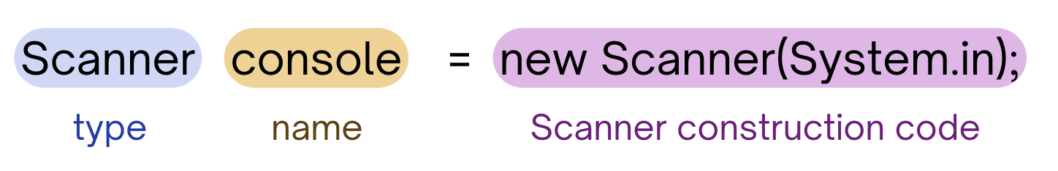
PCM Review: Scanner
An object that we can use to read in input
In the java.util “package”!
Methods | Description
nextInt() | Reads the next token from the user as an int and returns it.
nextDouble() | Reads the next token from the user as a double and returns it.
next() | Reads the next token from the user as a String and returns it.
nextLine() | Reads an entire line from the user as a String and returns it.

Slide 7
PCM Review: Tokens
A unit of user input, as read by the Scanner
Tokens are separated by whitespace (spaces, tabs, new lines)
23 John Smith
42.0 "Hello world" $2.50 " 19

Slide 8
PCM Review: InputMismatchException
Exceptions are errors that occur while a program is running that stops the program from running.
There are different types of exceptions that can occur, and the name of the exception can help you understand what caused the error!
An InputMismatchException occurs when the Scanner tries to read input in as a specific type, but the input cannot be interpreted as that type.
(e.g., trying to read in "hello" as an int)

Slide 9
Think Pair Share: Cornbear (Think)
When calling the following method, which of these user inputs would not cause an error? (choose multiple)
public static void cornbear() {
Scanner console = new Scanner(System.in);
int amt = console.nextInt();
String firstName = console.next();
String secondName = console.next();
double price = console.nextDouble();
}
6 Gumball’s Treats $12.48
3 Sesame Latte 16.47
2 The Hunger Games 21.98
4 Gumballs 900.24
2 Grammy Awards 90095

Slide 10
Think Pair Share: Cornbear (Pair)
When calling the following method, which of these user inputs would not cause an error? (choose multiple)
public static void cornbear() {
Scanner console = new Scanner(System.in);
int amt = console.nextInt();
String firstName = console.next();
String secondName = console.next();
double price = console.nextDouble();
}
6 Gumball’s Treats $12.48
3 Sesame Latte 16.47
2 The Hunger Games 21.98
4 Gumballs 900.24
2 Grammy Awards 90095

Slide 11
Reminder: Fencepost Pattern
Some task where one piece is repeated n times, and another piece is repeated n-1 times and they alternate
h-u-s-k-i-e-s

Slide 12
Fencepost Pattern … for User Input?
Some task where one piece is repeated n times, and another piece is repeated n-1 times and they alternate
Roll?
You rolled:
Roll?
You rolled:
Roll?
...

