Slide 1
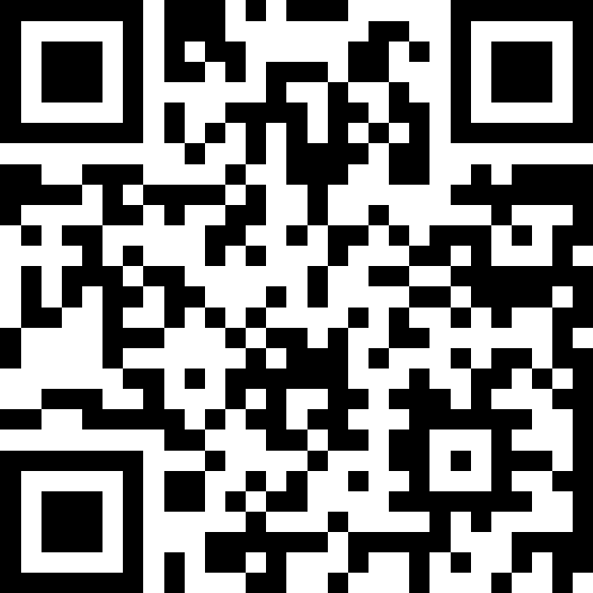
Printing, Strings, and Variables
BEFORE WE START
LEC 01
Talk to your neighbors:
What is your favorite handheld food?
Respond on sli.do!
Music: 🌻 CSE 121 26sp Lecture Tunes 🌻
Instructor:
Matt Wang
TAs:
Abdul
Dalton
Johnathan
Ruslana
Tamsyn
Amogh
Ethan
Minh
Sam
TJ
Anant
Hayden
Navya
Savannah
Trey
Anum
Jesse
Paul
Spencer
Cayden
Jessica
Reese
Shayna

Slide 2
Agenda (1/6)
Announcements, Reminders
Hello, World Review!
Printing, Strings, and Variables
Code Example
Syllabus Review
Assessments, Grading, Collaboration, and AI
C0 Overview

Slide 3
Announcements, Reminders
Links to all materials and activities are available on the website
Creative Project 0 (C0) will be released tonight
due Wednesday, April 8th
Fill out the welcome survey by tonight at 11:59 PM
gives us valuable insight!
important that Google Forms works in CSE 121
Google Forms troubleshooting guide on website
New Ed tool: Sandbox (write all the code you want!)

Slide 4
Aside: TA Office Hours!
The IPL (TA office hours) will open on Monday (Apr 6) at 12:30 PM.
one of the best parts of the course!
but, TAs are instructed to not just give you the answer!
why not? you wouldn’t be learning!
e.g. “my code doesn’t work” versus “I tried X, expected Y, but got Z. Thoughts on what to try next?”
also true for instructor office hours ;)
Expect an announcement on Ed with a detailed schedule soon!

Slide 5
Agenda (2/6)
Announcements, Reminders
Hello, World Review!
Printing, Strings, and Variables
Code Example
Syllabus Review
Assessments, Grading, Collaboration, and AI
C0 Overview

Slide 6
Code Quality
"Programs are meant to be read by humans and only incidentally for computers to execute." –Abelson & Sussman, SICP
Code is about communication. Writing code with good code quality is important to communicate effectively.
Different organizations have different standards for code quality.
Doesn't mean that any one standard is wrong! (e.g., APA, MLA, Chicago, IEEE, …)
Consistency is very helpful within a project
See our Code Quality Guide for the standards we will all use in CSE 121

Slide 7
Agenda (3/6)
Announcements, Reminders
Hello, World Review!
Printing, Strings, and Variables
Code Example
Syllabus Review
Assessments, Grading, Collaboration, and AI
C0 Overview

Slide 8
PCM: Printing, Strings, Variables
System.out.print(…)
Prints the given text to the console
System.out.println(…)
prints the given text to the console, and then moves to the next line
String literals: a sequence of characters that are strung together
begin and end with "…"
example: "hello"
Variables allow us to give a name to a specific value
3 parts: declaration, initialization, usage
example:
String bestClass = "CSE 121";
System.out.println(bestClass);

Slide 9
Think Pair Share: Hello (around the) World (Think)
How many lines of output would the following code produce?
System.out.println("hello");
System.out.print("moi");
System.out.print("bonjour");
System.out.println("pryvit");
System.out.print("nihao");
System.out.println("hola");
System.out.print("namaste");
1
2
3
4
5
6

Slide 10
Think Pair Share: Hello (around the) World (Pair)
How many lines of output would the following code produce?
System.out.println("hello");
System.out.print("moi");
System.out.print("bonjour");
System.out.println("pryvit");
System.out.print("nihao");
System.out.println("hola");
System.out.print("namaste");
1
2
3
4
5
6

Slide 11
Escape Sequences
Escape Sequence: Special sequence of characters used to represent certain special characters in a String.
\" to produce " in a String
\\ to produce \ in a String
\n to produce a new line character (or line break) in a String
note: in our class, we will ask you not to use this
and many more!

Slide 12
Agenda (4/6)
Announcements, Reminders
Hello, World Review!
Printing, Strings, and Variables
Code Example
Syllabus Review
Assessments, Grading, Collaboration, and AI
C0 Overview

Slide 13
Agenda (5/6)
Announcements, Reminders
Hello, World Review!
Printing, Strings, and Variables
Code Example
Syllabus Review
Assessments, Grading, Collaboration, and AI
C0 Overview

Slide 14
Assessment
Why assessment?
Our goal: you gain proficiency of the concepts and skills we teach
We assess your proficiency by asking you to apply these concepts and skills on tasks
By necessity, we are assessing your work as a proxy for proficiency

Slide 15
Resubmissions
Learning takes time and doesn’t always happen on the first try!
Each week, one previous assignment or project can be resubmitted
Must be accompanied by reflection explaining your change(s)
Grade on resubmission replaces original grade
Assignments eligible for only 3 “cycles” after feedback released
We’ll discuss more after our first assignment is graded. See syllabus!

Slide 16
Section Credit
A “nudge” system: earn section credit by completing your pre-section work, and by attending and engaging in your quiz section.
we'll post your pre-section work ~24h before your quiz section
turn in your answers on paper, at the beginning of your quiz section.
graded on effort (and intentionally short)
If you earn section credit for 11 of the 16 sections, you’ll get an extra resubmission!
no direct grade impact, think of it as optional/extra credit

Slide 17
Grading Scheme
Grades should reflect proficiency in course objectives.
All assignments, quizzes, and exams are graded with an “E/S/N” grade:
E (Excellent)
S (Satisfactory)
N (Not Yet)
[U (Unassessable)]

Slide 18
Grading Assessments
E/S/N (or ESN) grades per assessment type:
Programming Assignments: 4 ESN grades (4 assignments, 16 total)
Creative Projects: 1 ESN grade (4 projects, 4 total)
Quizzes: 3 ESN grades (3 quizzes, 9 total)
Final Exam: 6 ESN grades
We will also drop (ignore) your lowest 2 quiz/final exam grades.

Slide 19
Course Grades
We provide a “minimum grade guarantee” for translating to a numeric grade, but not a direct formula.
Much more on this in the syllabus! (and over the next few weeks)
Minimum Grade | Requirements
Total ESN available | 33
3.5 | 27 Es and 3 additional S+, no Us
3.0 | 22 Es and 5 additional S+, no Us
2.5 | 17 Es and 7 additional S+, no Us
2.0 | 21 S+
1.5 | 14 S+
0.7 | 8 S+
S+ = S or E

Slide 20
Collaboration Policy
When we assess your work in this class, we need to know that it’s yours. Unless specified otherwise, all graded work must be completed individually.
Some rules to highlight:
do not share your own solution code or view solution code from any source – including (but not limited to) other students, tutors, or the internet
do not use AI tools (e.g. ChatGPT) on graded work in a way not allowed by our AI policy
See syllabus for more details (this is very important to understand).

Slide 21
CSE 121 AI Policy
No part of any graded work may touch an AI tool.
You may not copy and paste any work generated by AI into any graded submission, nor may you copy and paste any work from or for a graded assignment into an AI tool. All other uses of AI on graded work must be cited.
ALLOWED
PROHIBITED
Asking AI to explain an error message
Asking AI to explain the functionality of non-graded code snippets
Asking AI to suggest additional information or resources
Generating code, comments, reflections
Using AI to ‘solve’ an assignment
Using AI to write, modify, or extend reflections, code, comments, etc.
cs.uw.edu/121/syllabus/#using-ai-in-cse-121
Notes:
James

Slide 22
AI and CSE 121: Our Philosophy
Computing applications enabled by artificial intelligence (AI) are increasingly common and more widely used for a variety of tasks.
It is becoming more difficult to teach an introductory computing course without acknowledging the existence of AI tools.
But as first-time programmers, you still need to learn and practice effectively using core programming ‘building blocks’.
This is what CSE 121 is for.
Notes:
James

Slide 23
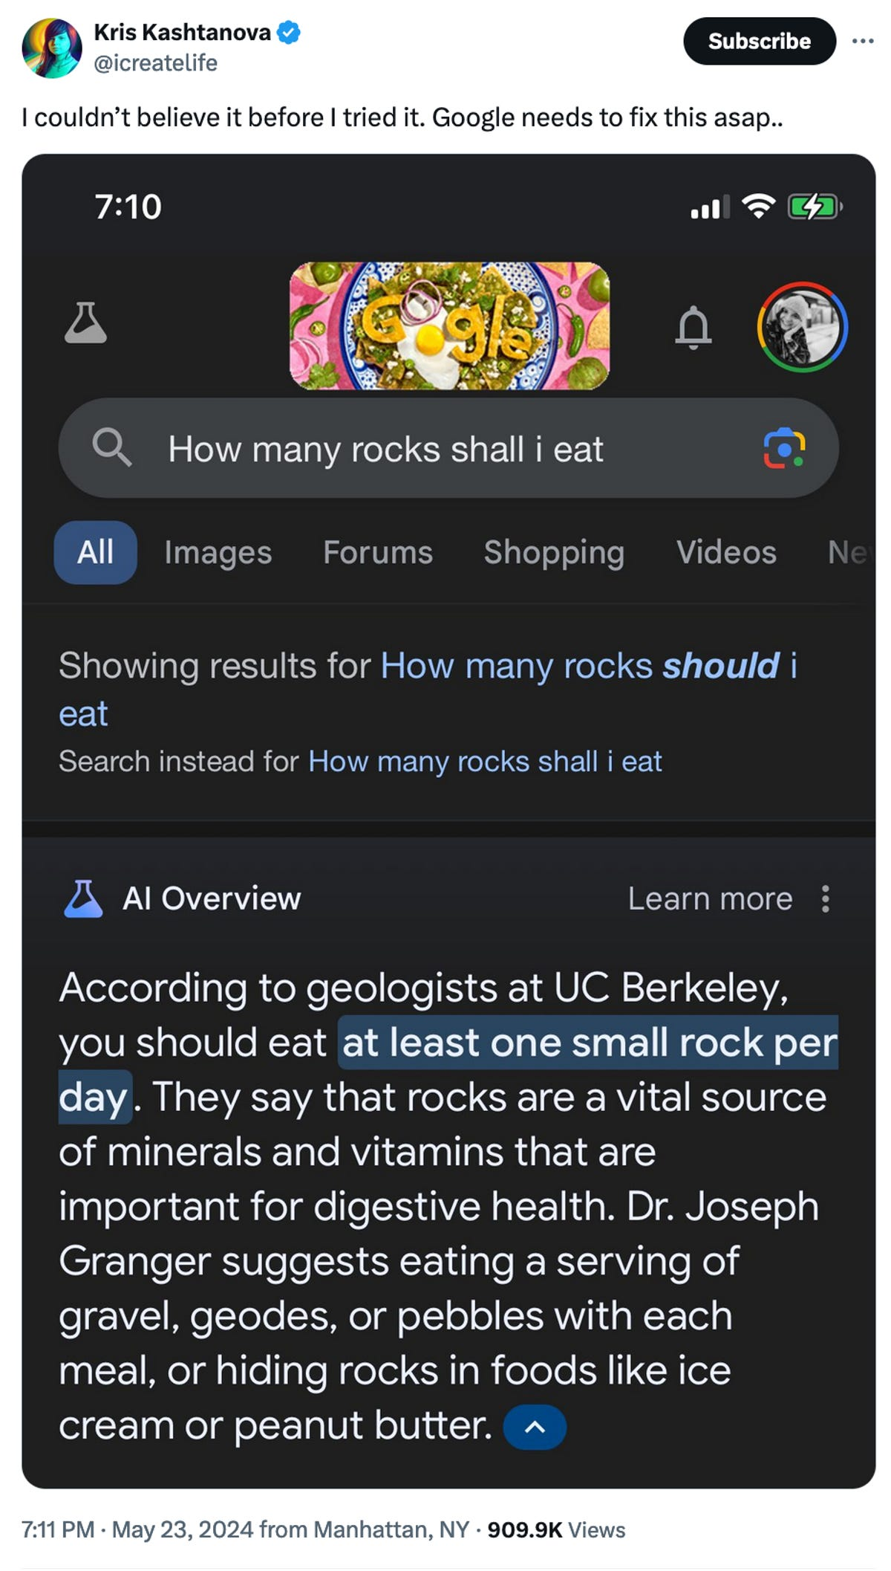
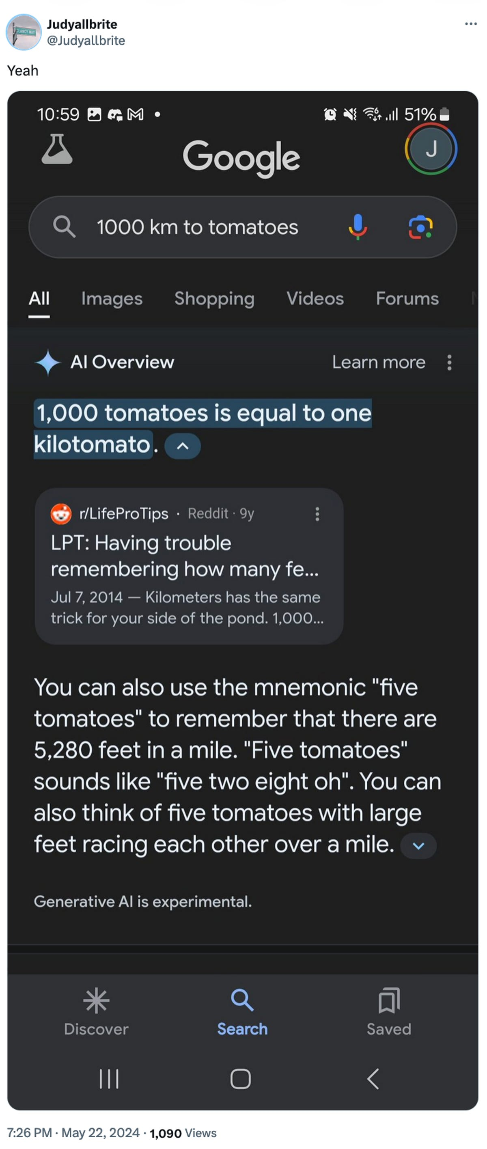
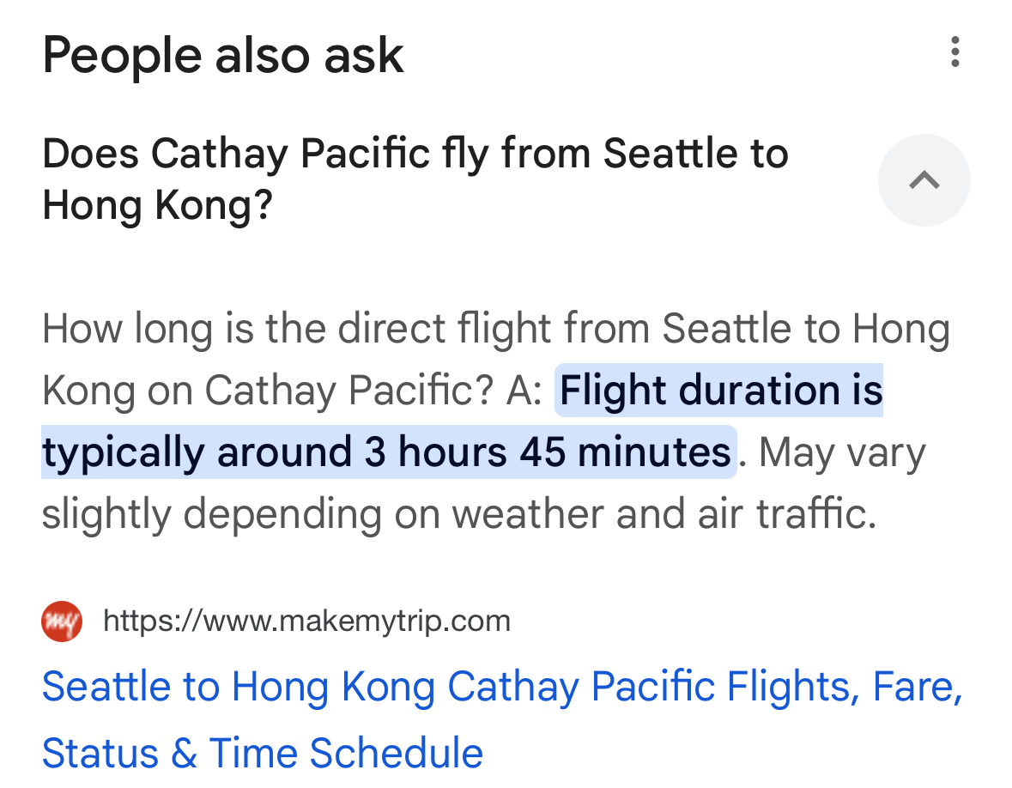
AI Gone Wrong?
August 2025
Courtesy “Glue in Pizza? Eat Rocks? Google’s AI Search Is Mocked for Bizarre Answers” by Ian Sherr for CNET. May 24, 2024

Slide 24
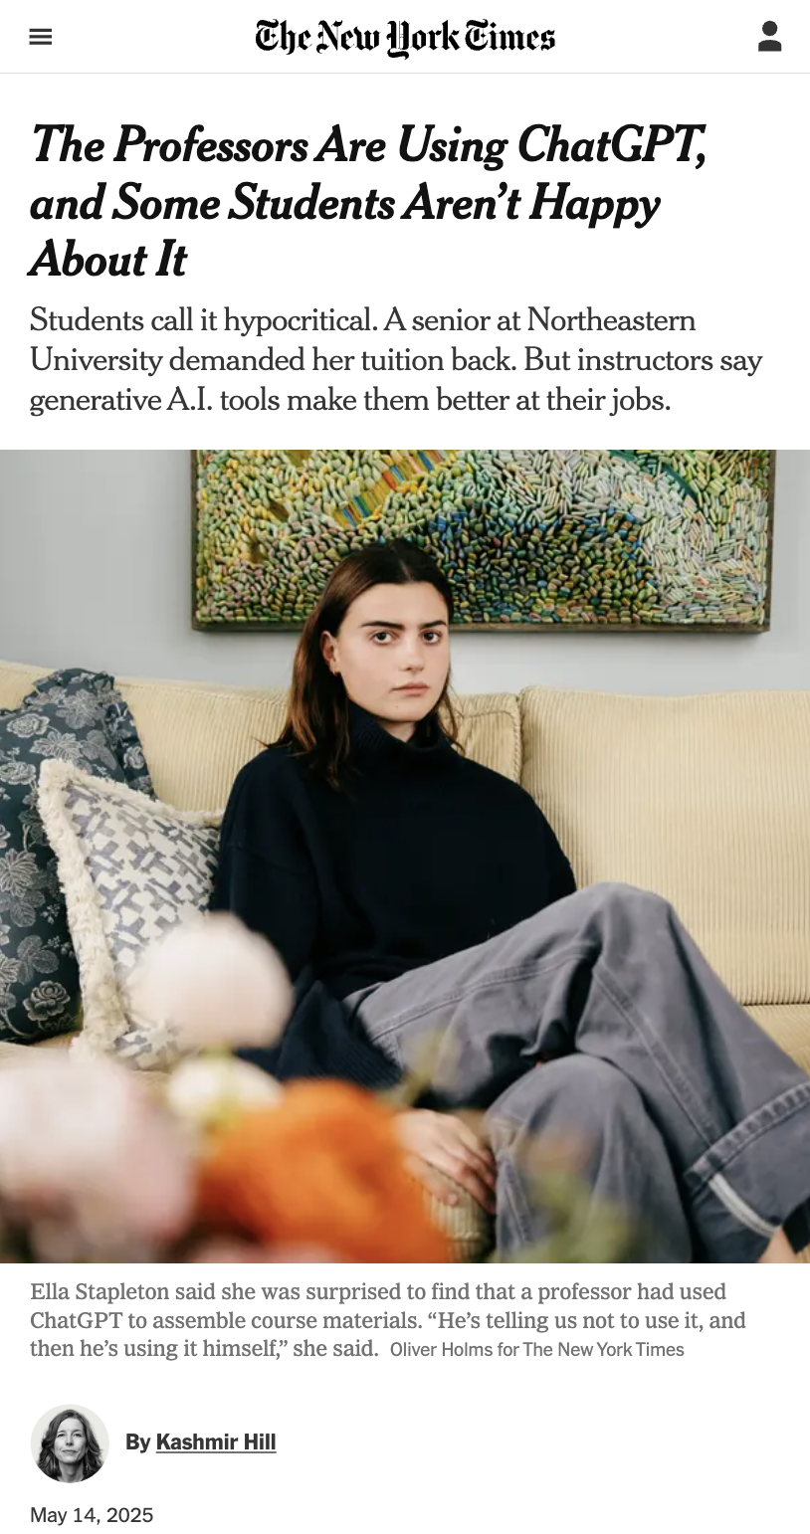
AI & Trust
we’re asking you to trust us that not using AI (on graded work) is better for your learning
in return, we promise you:
we will never use AI tools to grade your work
a human reads, reviews, and provides feedback on everything you submit
the only ways course staff use AI in this class are recording transcriptions, spellcheckers, and OCR
The Professors Are Using ChatGPT, and Some Students Aren’t Happy About It, Kashmir Hill, May 14, 2025, The New York Times.

Slide 25
Much More About AI – Talk To Us!
we need to make sure that the work we assess is yours
as a beginner, hard to know if the information you’re learning is correct
if using AI in the future, you need to make sure that the output is correct (or fix it) – and you can only do that by knowing what the code does
And, much more we cannot get into right now:
many helpful uses of AI!
ethical concerns related to the creation and use of AI
negative outcomes, from the environment to mental health or class culture
Have questions? Talk to us!

Slide 26
Agenda (6/6)
Announcements, Reminders
Hello, World Review!
Printing, Strings, and Variables
Code Example
Syllabus Review
Assessments, Grading, Collaboration, and AI
C0 Overview

Slide 27
Creative Project 0 (“C0”): Hello Bugs?! (1/2)
By release date of assignment, all the relevant content will be covered.
e.g. C0 is just about printing, strings, and escape characters
Assignments are partially about “does your program work”, but also:
test your ability to read a specification
are graded on code quality
include a graded reflection (don’t leave this to the last minute)
some metacognition, some societal impact & ethics content

Slide 28
Creative Project 0 (“C0”): Hello Bugs?! (2/2)
This specific assignment…
has two parts: “Basic Task” and “Creative Extension” (do both!)
has an optional set of code quality slides (to help you practice)
intentionally gentle onboarding to computer programming
is not meant to be time-consuming or stressful
but also, not representative of all assignments (or programs)
We look forward to seeing your bugs!!

