Slide 1
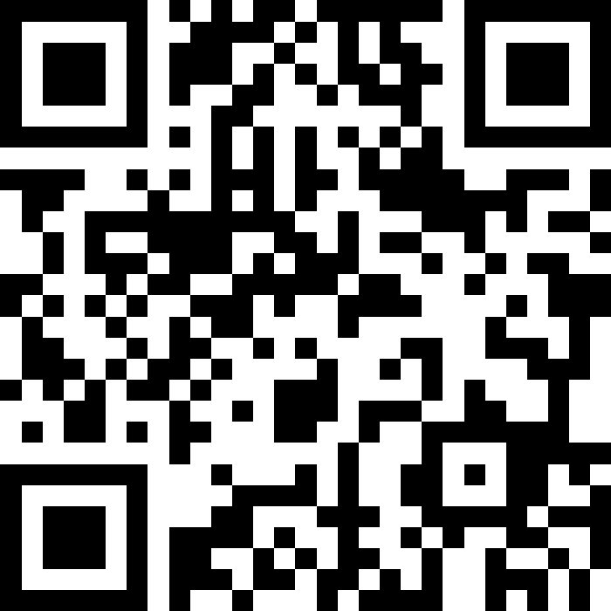
While Loops
BEFORE WE START
LEC 10
Talk to your neighbors:
What’s your favorite spot
on the Ave?
Music: 🍂 CSE 121 26au Lecture Tunes 🍂
Instructor:
Miya Natsuhara and Anjali Pal
TAs:
Samrutha
William
Samvedha
Syreeta
Ryan
Anant
Henry
Reese
Savannah
Tamsyn
Cedric
Anum
Navya
Gene
Margot
Sarah K
Ethan
Evelyn
Owen
Jameson
Paul
Gurbax
Tony
Lucas
Alex
Jesse
Matthew
Jennie
Anisha
TJ
Ivory
Sarah W
Avery

Slide 2
Agenda (1/3)
Announcements, Reminders
while loop review
Rolling more dice!

Slide 3
Announcements, Reminders
Computer Quiz 1 ongoing! Window ends Wednesday, Nov 4
  Make sure to reserve your spot early!
  Remember – the last opportunity to schedule or reschedule a CQ1 timeslot is 11:59pm the night before the timeslot in question
Paper Quiz 1 on Tuesday, Nov 3 in your registered quiz section

Slide 4
Agenda (2/3)
Announcements, Reminders
while loop review
Rolling more dice!

Slide 5
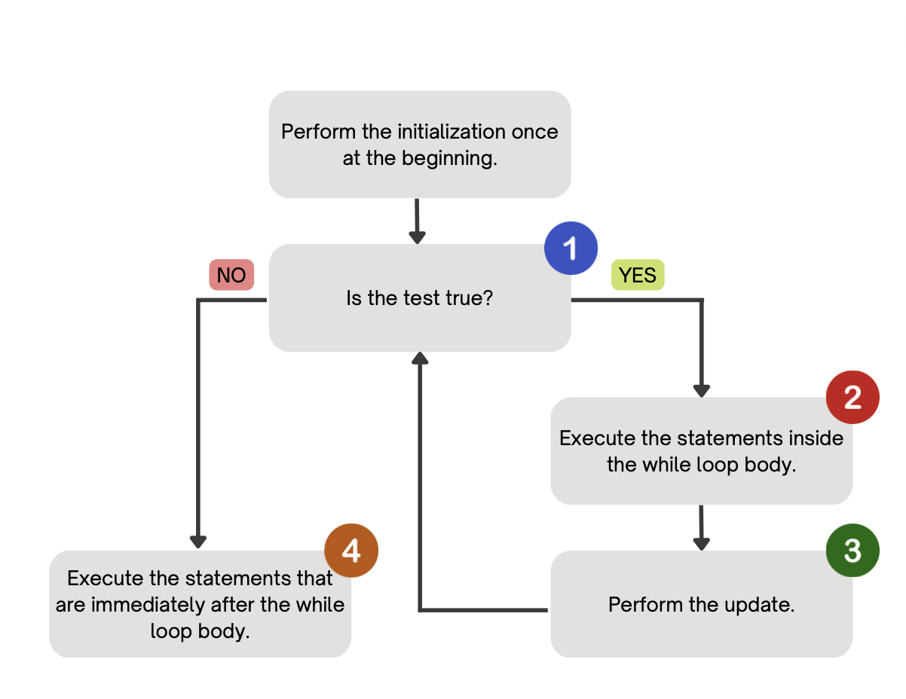
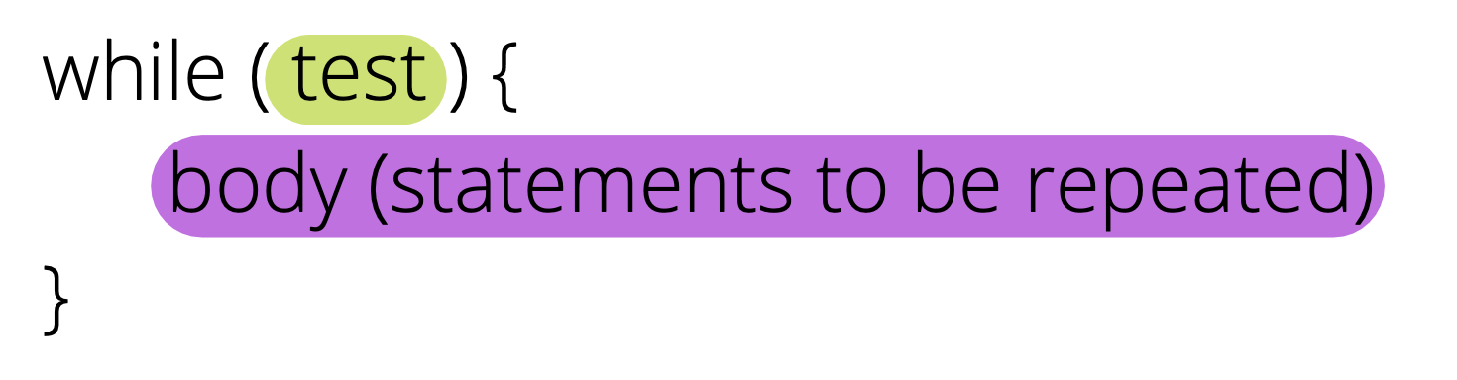
PCM Review: while loops
Repeatedly executes its body as long as the logical test is true.

Slide 6
Think Pair Share: mystery (think)
public static void mystery(Random randy,
int lucky) {
int roll = -1; // "priming" the loop
int x = -1;
while (roll != lucky) {
roll = randy.nextInt(20) + 1;
if (x < roll) {
x = roll;
}
}
System.out.println("Lucky number " + x);
}
How would you describe what the variable x calculates?
The largest value rolled
The smallest value rolled
The first value rolled
The last value rolled
The sum of all values rolled

Slide 7
Think Pair Share: mystery (pair)
public static void mystery(Random randy,
int lucky) {
int roll = -1; // "priming" the loop
int x = -1;
while (roll != lucky) {
roll = randy.nextInt(20) + 1;
if (x < roll) {
x = roll;
}
}
System.out.println("Lucky number " + x);
}
How would you describe what the variable x calculates?
The largest value rolled
The smallest value rolled
The first value rolled
The last value rolled
The sum of all values rolled

Slide 8
for loops are while loops?
for (int i = 0; i < bigYikes; i++) {
// ...
}
int i = 0;
while (i < bigYikes) {
// ...
i++;
}

Slide 9
for loops are while loops! (almost*)
for (int i = 0; i < bigYikes; i++) {
// ...
}
int i = 0;
while (i < bigYikes) {
// ...
i++;
}
*as a technical note, these aren’t exactly the same – there are some minor technical details that are different, most notably the scope of i is different in the two loops

Slide 10
for loops vs. while loops ⚔️
For loops and while loops are quite similar! This is the first (but certainly not the last) time where you need to decide which to use!
There’s not always a “correct” answer, but some advice:
is the condition definite or indefinite
Describing the problem!
  “I will do __ X times” or “for each __ I will __” – sounds like for!
  “I will do __ until” or “while __ is true, I will” – sounds like while!
it’s okay to change your mind after you try one approach!

Slide 11
Agenda (3/3)
Announcements, Reminders
while loop review
Rolling more dice!

