Slide 1
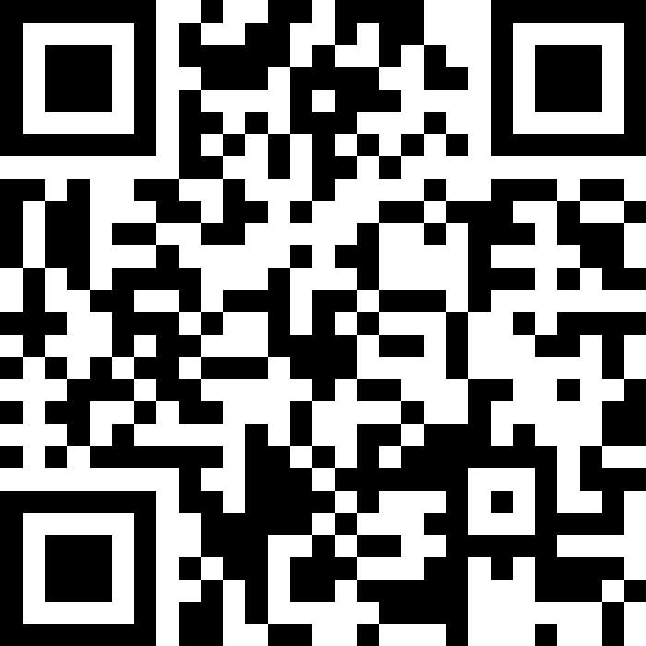
More Methods, Parameters, and Returns
BEFORE WE START
LEC 08
Talk to your neighbors:
What’s your favorite book?
Respond on sli.do!
Music: 🍂 CSE 121 26au Lecture Tunes 🍂
Instructor:
Miya Natsuhara and Anjali Pal
TAs:
Samrutha
William
Samvedha
Syreeta
Ryan
Anant
Henry
Reese
Savannah
Tamsyn
Cedric
Anum
Navya
Gene
Margot
Sarah K
Ethan
Evelyn
Owen
Jameson
Paul
Gurbax
Tony
Lucas
Alex
Jesse
Matthew
Jennie
Anisha
TJ
Ivory
Sarah W
Avery

Slide 2
Agenda (1/4)
Announcements, Reminders
Methods, Parameters Warmup
Returns Review
Finding Primes Example

Slide 3
Announcements, Reminders
P0 and CQ0 Grades now visible on Ed + Gradebook
  See Ed Announcement
CQ 1 Today through next Wednesday
  Sign up for a slot by 11:59pm the night before
  There are more than enough slots for everyone, but there won’t be if everyone tries to wait until the last day to sign up
PQ 1 Tuesday, November 3rd
cse121-instructors@cs.washington.edu if you need to reach Miya and me

Slide 4
Agenda (2/4)
Announcements, Reminders
Methods, Parameters Warmup
Returns Review
Finding Primes Example

Slide 5
Think Pair Share: mystery example (think)
What is the output of this program?
A. 7 and -4
7 and -2
B. 6 and 1
7 and 1
C. 5 and -4
9 and -2
D. 7 and -4
9 and -2
public static void main(String[] args) {
int x = 1;
int y = 2;
int z = 5;
mystery(z, y, x);
mystery(z + x, y + x, y * 2);
}
public static void mystery(int x, int z, int y) {
z += x;
System.out.println(z + " and " + (y - x));
}

Slide 6
Think Pair Share: mystery example (pair)
What is the output of this program?
A. 7 and -4
7 and -2
B. 6 and 1
7 and 1
C. 5 and -4
9 and -2
D. 7 and -4
9 and -2
public static void main(String[] args) {
int x = 1;
int y = 2;
int z = 5;
mystery(z, y, x);
mystery(z + x, y + x, y * 2);
}
public static void mystery(int x, int z, int y) {
z += x;
System.out.println(z + " and " + (y - x));
}

Slide 7
Agenda (3/4)
Announcements, Reminders
Methods, Parameters, Warmup
Returns Review
Finding Primes Example

Slide 8
PCM: Returns
Returns allow us to send values out of a method
  public static <type> myMethod(int num) {
  System.out.print(num + " is the best!");
  ...
  return <value of correct type>
  }
Calling a method that returns a value…
  <type> result = myMethod(42);
return does 3 things:
Evaluate the expression
Return this value to where the method was called
Exit the method

Slide 9
Recall: Math
Method | Description
Math.abs(value) | Returns the absolute value of value
Math.ceil(value) | Returns value rounded up
Math.floor(value) | Returns value rounded down
Math.max(value1, value2) | Returns the larger of the two values
Math.min(value1, value2) | Returns the smaller of the two values
Math.round(value) | Returns value rounded to the nearest whole number* note: need to cast result to int (it’s complicated!)
Math.sqrt(value) | Returns the square root of value
Math.pow(base, exp) | Returns base raised to the exp power

Slide 10
Recall: String Methods
Method | Description
length() | Returns the length of the string.
charAt(i) | Returns the character at index i of the string
indexOf(s) | Returns the index of the first occurrence of s in the string; returns -1 if s doesn't appear in the string
substring(i, j) or substring(i) | Returns the characters in this string from i (inclusive) to j (exclusive); if j is omitted, goes until the end of the string
contains(s) | Returns whether or not the string contains s
equals(s) | Returns whether or not the string is equal to s (case-sensitive)
equalsIgnoreCase(s) | Returns whether or not the string is equal to s ignoring case
toUpperCase() | Returns an uppercase version of the string
toLowerCase() | Returns a lowercase version of the string

Slide 11
Recall: chaining methods in expressions
b | u | b | b | l | e |  | g | u | m
0 | 1 | 2 | 3 | 4 | 5 | 6 | 7 | 8 | 9
s.substring(7, 8).toUpperCase() + s.substring(8) + "ball"
"g".toUpperCase() + s.substring(8) + "ball"
"G" + s.substring(8) + "ball"
"G" + "um" + "ball"

Slide 12
Remember: Method Comments
Each method you write (except main) should have a short comment!
// Behavior:
// - Calculates net profit using monthly income and daily spending.
// Parameters:
// - income: user's income this month (non-negative)
// - spending: amount spent each day this month (non-negative)
// Returns:
// - int: the net profit or loss. Positive if profit, negative if loss.
public static int calculateNetExpenses(int income, int spending) {
return income - (spending * DAYS_IN_MONTH);
}

Slide 13
Think Pair Share: return example (think)
A. -1
B. 0
C. 4
D. 5
What value is returned from this method?
public static int returnExample() {
for (int i = 0; i < 5; i++) {
return i;
}
return -1;
}

Slide 14
Think Pair Share: return example (pair)
A. -1
B. 0
C. 4
D. 5
What value is returned from this method?
public static int returnExample() {
for (int i = 0; i < 5; i++) {
return i;
}
return -1;
}

Slide 15
Agenda (4/4)
Announcements, Reminders
Methods, Parameters Warmup
Returns Review
Finding Primes Example

Slide 16
Common Problem-Solving Strategies
Analogy – Is this similar to another problem you've seen?
Brainstorming – Consider steps to solve problem before jumping into code
  Try to do an example "by hand" → outline steps
Solve sub-problems – Is there a smaller part of the problem to solve?
Debugging – Does your solution behave correctly?
  What is it doing?
  What do you expect it to do?
  What area of your code controls that part of the output?
Iterative Development – Can we start by solving a different problem that is easier?

