Slide 1

Nested Loops, Cumulative Sum, Scope, Class Constants
BEFORE WE START
LEC 05
Talk to your neighbors:
What’s your favorite dessert?
Music: 🍂 CSE 121 26au Lecture Tunes 🍂
Instructor:
Miya Natsuhara and Anjali Pal
TAs:
Samrutha
William
Samvedha
Syreeta
Ryan
Anant
Henry
Reese
Savannah
Tamsyn
Cedric
Anum
Navya
Gene
Margot
Sarah K
Ethan
Evelyn
Owen
Jameson
Paul
Gurbax
Tony
Lucas
Alex
Jesse
Matthew
Jennie
Anisha
TJ
Ivory
Sarah W
Avery

Slide 2
Agenda (1/4)
Announcements, Reminders
Fencepost Review
Nested for Loop Practice
Addition Problem

Slide 3
Announcements, Reminders
P1 will be released later today, due Tues, Oct 27
Computer Quiz 1 (related to P1) will be running Wed, Oct 28 – Wed, Nov 4

Slide 4
Agenda (2/4)
Announcements, Reminders
Fencepost Review
Nested for Loops
Addition Problem

Slide 5
Wed PCM: String Traversals
// For some String s
for (int i = 0; i < s.length(); i++) {
// do something with s.charAt(i)
}

Slide 6
Go Huskies?
h-u-s-k-i-e-s

Slide 7
The Fencepost Pattern
Some task where one piece is repeated n times, and another piece is repeated n-1 times and they alternate
h-u-s-k-i-e-s

Slide 8
Agenda (3/4)
Announcements, Reminders
Fencepost Review
Nested for Loops
Addition Problem

Slide 9
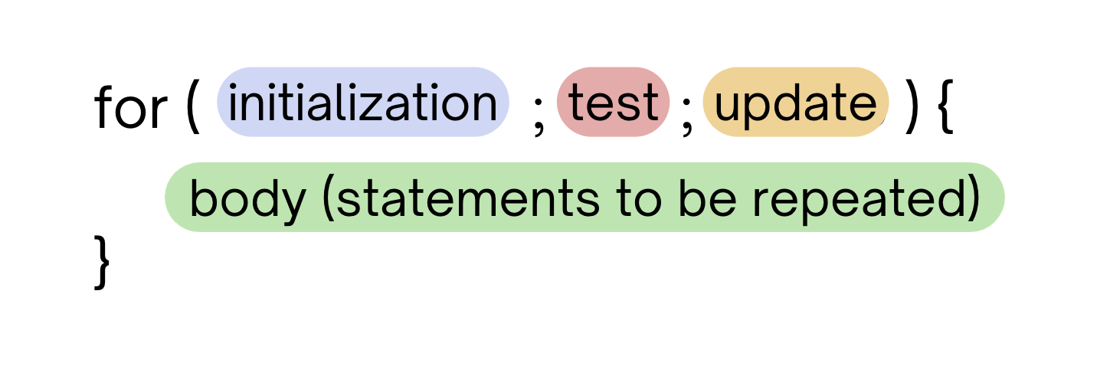
Fri PCM: for Loops!
For loops are our first control structure: a syntax structure that controls the execution of other statements.

Slide 10
PCM: Nested for Loops
for (int outerLoop = 1; outerLoop <= 5; outerLoop++) {
System.out.println("outer loop iteration #" + outerLoop);
for (int innerLoop = 1; innerLoop <= 3; innerLoop++) {
System.out.println(" inner loop iteration #" + innerLoop);
}
System.out.println(outerLoop);
}

Slide 11
PCM: Nested for Loops, “Inner Loop”
for (int outerLoop = 1; outerLoop <= 5; outerLoop++) {
System.out.println("outer loop iteration #" + outerLoop);
for (int innerLoop = 1; innerLoop <= 3; innerLoop++) {
System.out.println(" inner loop iteration #" + innerLoop);
}
System.out.println(outerLoop);
}
inner
loop
outer
loop

Slide 12
Think Pair Share: Nested Triangle (Think)
What output is produced by the following code?
for (int i = 1; i <= 5; i++) {
for (int j = 1; j <= i; j++) {
System.out.print(i);
}
System.out.println();
}
1
12
123
1234
12345
i
ii
iii
iiii
iiiii
1
22
333
4444
55555
1
11
111
1111
11111
A. B. C. D.

Slide 13
Think Pair Share: Nested Triangle (Pair)
What output is produced by the following code?
for (int i = 1; i <= 5; i++) {
for (int j = 1; j <= i; j++) {
System.out.print(i);
}
System.out.println();
}
1
12
123
1234
12345
i
ii
iii
iiii
iiiii
1
22
333
4444
55555
1
11
111
1111
11111
A. B. C. D.

Slide 14
Think Pair Share: Nested Triangle 2 (Think)
What code produces the following output?
A.
B.
C.
D.
for (int i = 1; i <= 5; i++) {
for (int j = 1; j <= i; j++) {
System.out.print(i);
}
System.out.println();
}
for (int i = 1; i <= 5; i++) {
for (int j = 1; i <= j; j++) {
System.out.print(j);
}
System.out.println();
}
1
12
123
1234
12345
for (int i = 1; i <= 5; i++) {
for (int j = 1; j <= i; j++) {
System.out.print(j);
}
System.out.println();
}
for (int i = 1; i <= 5; i++) {
for (int j = 1; j <= i; i++) {
System.out.print(j);
}
System.out.println();
}

Slide 15
Think Pair Share: Nested Triangle 2 (Pair)
What code produces the following output?
A.
B.
C.
D.
for (int i = 1; i <= 5; i++) {
for (int j = 1; j <= i; j++) {
System.out.print(i);
}
System.out.println();
}
for (int i = 1; i <= 5; i++) {
for (int j = 1; i <= j; j++) {
System.out.print(j);
}
System.out.println();
}
1
12
123
1234
12345
for (int i = 1; i <= 5; i++) {
for (int j = 1; j <= i; j++) {
System.out.print(j);
}
System.out.println();
}
for (int i = 1; i <= 5; i++) {
for (int j = 1; j <= i; i++) {
System.out.print(j);
}
System.out.println();
}

Slide 16
PCM: Scope
Scope: the part of a program where a variable exists
(and can thus be referenced, modified, or used).
General Rule: a variable ‘exists’ from its declaration to the closing brace of that indentation level }
Exception applies to for loops (header is “part” of the body)
for (int outerLoop = 1; outerLoop <= 5; outerLoop++) {
System.out.println("outer loop iteration #" + outerLoop);
for (int innerLoop = 1; innerLoop <= 3; innerLoop++) {
System.out.println(" inner loop iteration #" + innerLoop);
}
System.out.println(outerLoop);
}
innerloop’s scope
outerloop’s scope

Slide 17
Agenda (4/4)
Announcements, Reminders
Fencepost Review
Nested for Loops
Addition Problem

Slide 18
Pseudocode
Quite literally: “fake” code
Goal: writing that is
  for humans
  structured like code
  “easy” to convert to code
  not beholden to the same
  preciseness as code
// Example for "name" demo
// find the space in the name
// use substring to get first, last name
// get first char of first name w/ charAt
// concatenate all to get name

Slide 19
PCM: Class Constants
A fixed value visible (in-scope) to the whole program (the entire class).
Value is set at declaration, cannot be reassigned – value is constant.
public static final type NAME_OF_CONSTANT = expression;

