Slide 1

for Loops
BEFORE WE START
LEC 05
Talk to your neighbors:
What’s your favorite TV show right now?
Respond on sli.do!
Music: 🍂 CSE 121 26au Lecture Tunes 🍂
Instructor:
Miya Natsuhara and Anjali Pal
TAs:
Samrutha
William
Samvedha
Syreeta
Ryan
Anant
Henry
Reese
Savannah
Tamsyn
Cedric
Anum
Navya
Gene
Margot
Sarah K
Ethan
Evelyn
Owen
Jameson
Paul
Gurbax
Tony
Lucas
Alex
Jesse
Matthew
Jennie
Anisha
TJ
Ivory
Sarah W
Avery

Slide 2
Announcements, Reminders
Computer Quiz 0 window currently ongoing!
  Make sure to sign up for a timeslot if you have not already!
  Window ends on Wed 10/21 – if you wait until the last minute, there may not be any timeslots left
Paper Quiz 0 is next Tuesday, October 20 (in your registered quiz section)
  Can’t make it? Email ASAP (cse121-instructors@cs.washington.edu)
  Paper Quiz Logistics announcement
Section Participation grades for Section 0, 1, 2 posted on Canvas!
  Reach out to your quiz section TA if something looks off

Slide 3
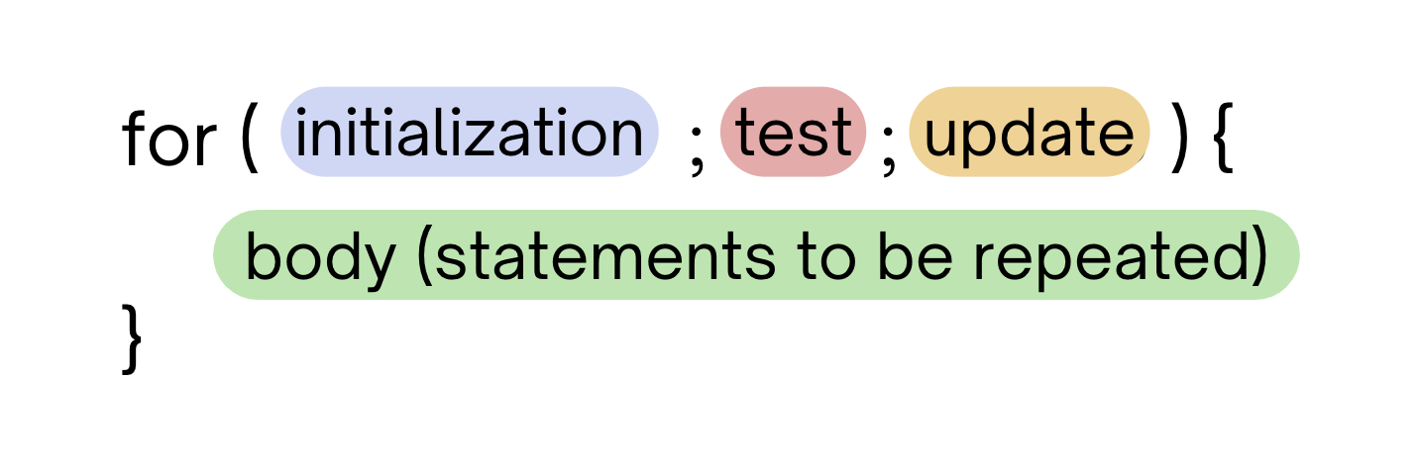
PCM Review: for loops!
For loops are our first control structure: a syntax structure that controls the execution of other statements.

Slide 4
PCM Review: for loops (example)
for (int counter = 1; counter <= 5; counter++) {
System.out.println("I love CSE 121!");
}

Slide 5
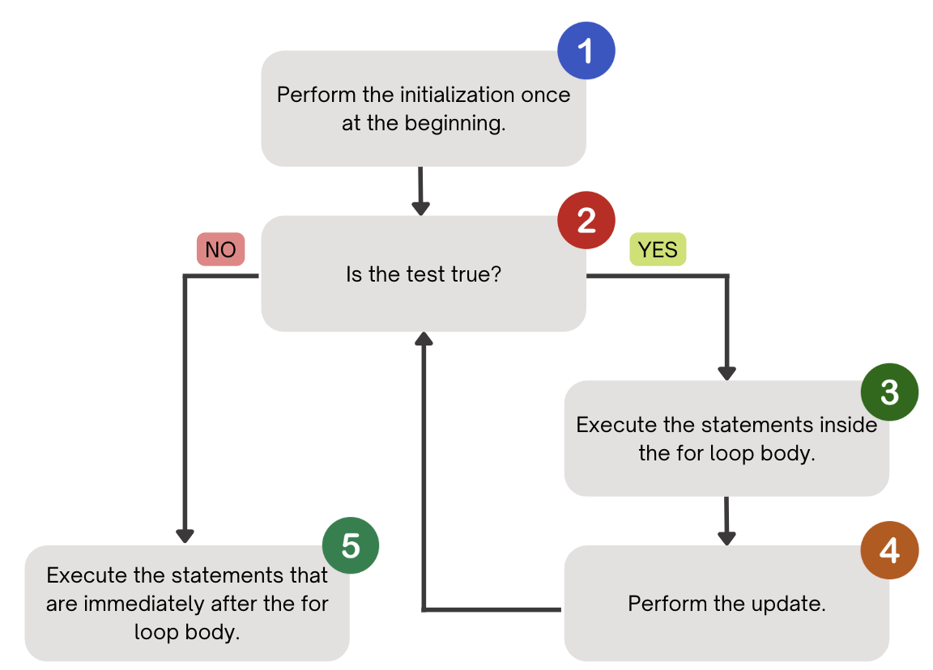
PCM Review: for loops (a helpful flowchart)

Slide 6
Tracing through a for loop
counter
1
2
4
1
2
3
4
5
6
for (int counter = 1; counter <= 5; counter++) {
System.out.println("I love CSE 121!");
}
3
5
I love CSE 121!
I love CSE 121!
I love CSE 121!
I love CSE 121!
I love CSE 121!

Slide 7
Think Pair Share: squared loops (Think)
What output does the following code produce?
for (int i = 1; i <= 7; i++) {
System.out.println(i + " squared = " + i * i);
}
A.
i squared = i * i
i squared = i * i
i squared = i * i
i squared = i * i
i squared = i * i
i squared = i * i
B.
i squared = i * i
i squared = i * i
i squared = i * i
i squared = i * i
i squared = i * i
i squared = i * i
i squared = i * i
C.
1 squared = 1
2 squared = 4
3 squared = 9
4 squared = 16
5 squared = 25
6 squared = 36
D.
1 squared = 1
2 squared = 4
3 squared = 9
4 squared = 16
5 squared = 25
6 squared = 36
7 squared = 49

Slide 8
Think Pair Share: squared loops (Pair)
What output does the following code produce?
for (int i = 1; i <= 7; i++) {
System.out.println(i + " squared = " + i * i);
}
A.
i squared = i * i
i squared = i * i
i squared = i * i
i squared = i * i
i squared = i * i
i squared = i * i
B.
i squared = i * i
i squared = i * i
i squared = i * i
i squared = i * i
i squared = i * i
i squared = i * i
i squared = i * i
C.
1 squared = 1
2 squared = 4
3 squared = 9
4 squared = 16
5 squared = 25
6 squared = 36
D.
1 squared = 1
2 squared = 4
3 squared = 9
4 squared = 16
5 squared = 25
6 squared = 36
7 squared = 49

Slide 9
PCM: Math
Math.<method>(…)
Method | Description
Math.abs(value) | Returns the absolute value of value
Math.ceil(value) | Returns value rounded up
Math.floor(value) | Returns value rounded down
Math.max(value1, value2) | Returns the larger of the two values
Math.min(value1, value2) | Returns the smaller of the two values
Math.round(value) | Returns value rounded to the nearest whole number* note: need to cast result to int (it’s complicated!)
Math.sqrt(value) | Returns the square root of value
Math.pow(base, exp) | Returns base raised to the exp power

Slide 10
PCM Review: String Traversals
// For some String s
for (int i = 0; i < s.length(); i++) {
// do something with s.charAt(i)
}
b | u | b | b | l | e |  | g | u | m
0 | 1 | 2 | 3 | 4 | 5 | 6 | 7 | 8 | 9

Slide 11
Go Huskies?
h-u-s-k-i-e-s

Slide 12
The Fencepost Pattern
Some task where one piece is repeated n times, and another piece is repeated n-1 times and they alternate
h-u-s-k-i-e-s

