Slide 1

Random, Conditionals
BEFORE WE START
LEC 09
Talk to your neighbors:
How are you doing? (like, actually)
Music: 🍂 CSE 121 26au Lecture Tunes 🍂
Instructor:
Miya Natsuhara and Anjali Pal
TAs:
Samrutha
William
Samvedha
Syreeta
Ryan
Anant
Henry
Reese
Savannah
Tamsyn
Cedric
Anum
Navya
Gene
Margot
Sarah K
Ethan
Evelyn
Owen
Jameson
Paul
Gurbax
Tony
Lucas
Alex
Jesse
Matthew
Jennie
Anisha
TJ
Ivory
Sarah W
Avery

Slide 2
Announcements, Reminders
CQ0 : Today through next Wednesday
  Schedule through Canvas
    You must sign up for a timeslot by 11:59pm the night before
PQ0 : Tuesday, October 20th

Slide 3
Randomness
Having a computer generate truly random numbers is hard!

Slide 4

Pseudo-Randomness
LavaRand: CloudFlare’s
Wall of Lava Lamps
Having a computer generate truly random numbers is hard!
Instead, computers generate numbers that “look random” in a predictable way, using mathematical formulas
can use “external” variables like time, mouse position, etc.
if we “fix” these variables, we can reproduce the same behavior
  very important for testing!
Randomness is very important: applications in cryptography, security, machine learning, and more!

Slide 5
PCM: Random
The Random class helps us generate pseudo-random numbers.
We create a new Random number generator by calling new Random()
First, we need to import the Random class with import java.util.*;
We can “seed” the generator to make it behave deterministically
Method | Description
nextInt() nextInt(max) nextInt(min, max) | Returns a random integer Returns a random integer in the range [0, max) Returns a random integer in the range [min, max)
nextDouble() nextDouble(max) nextDouble(min, max) | Returns a random double in the range [0.0, 1.0) Returns a random double in the range [0.0, max) Returns a random double in the range [min, max)

Slide 6
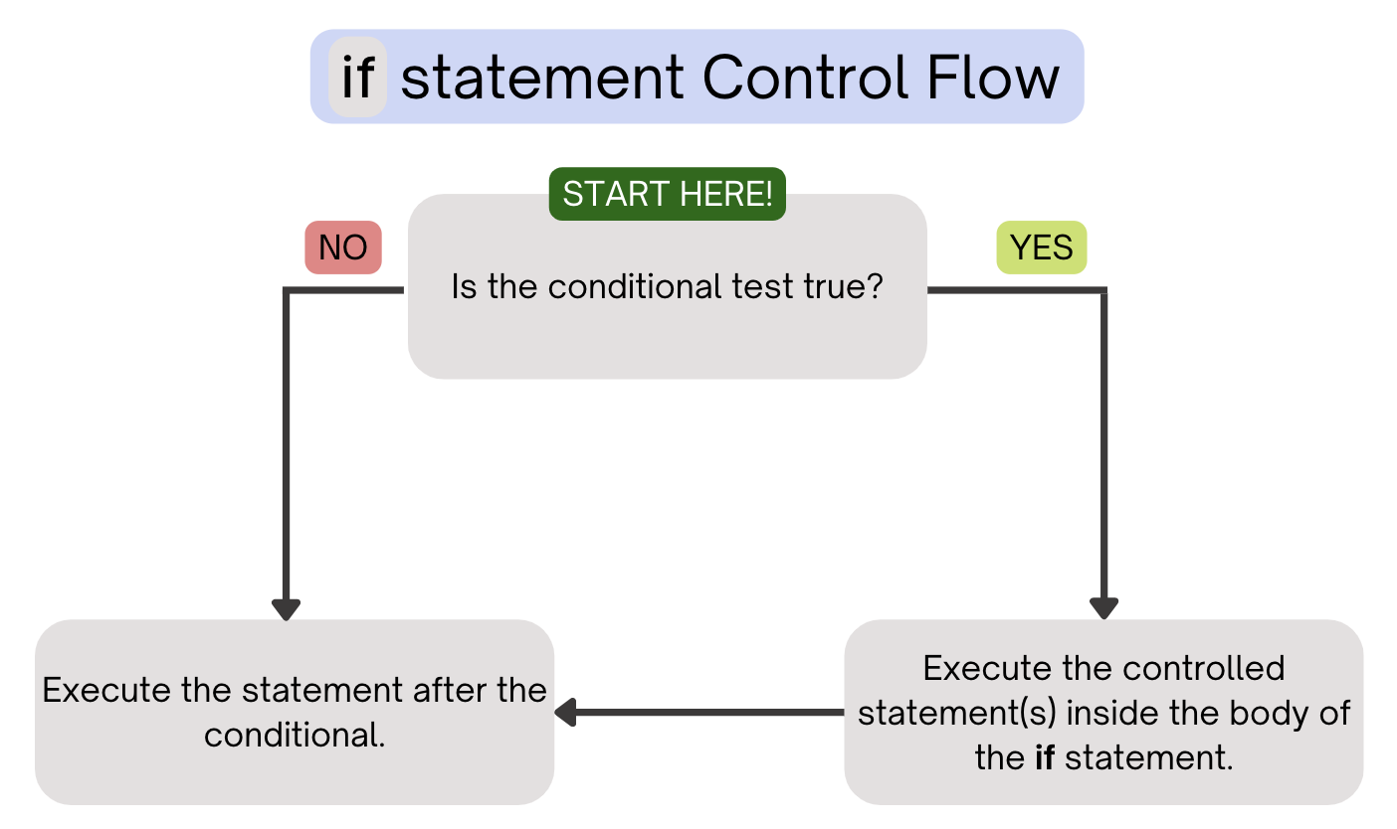
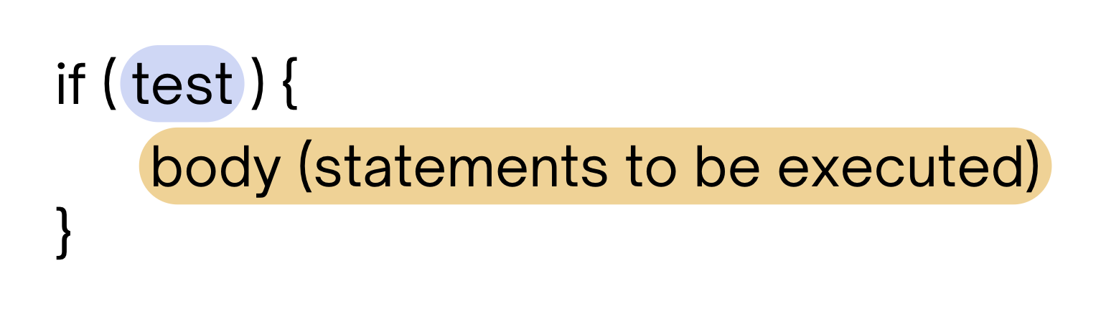
PCM Review: if Statements
Executes a block of statements if and only if the test is true

Slide 7
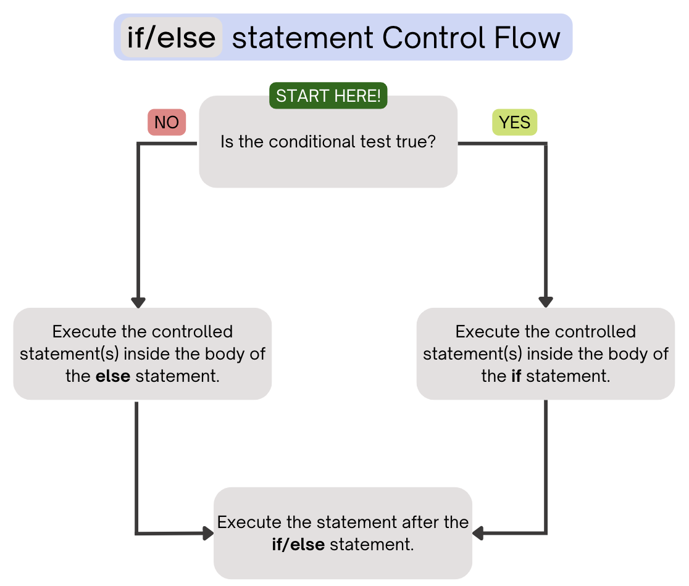
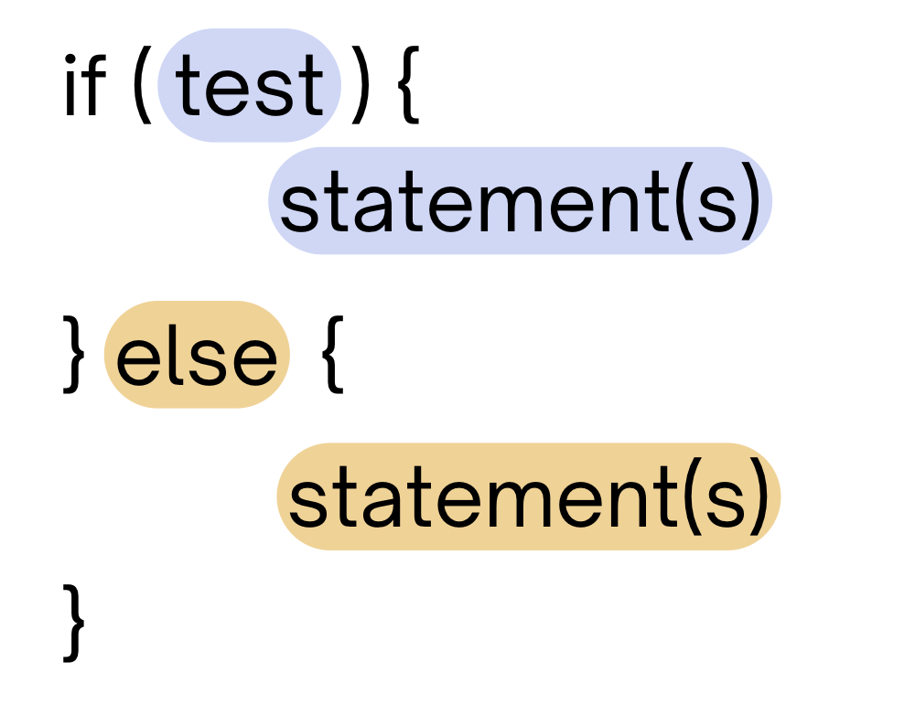
PCM Review: if-else
If the test is true: execute block of statements
If false, execute other block of statements

Slide 8
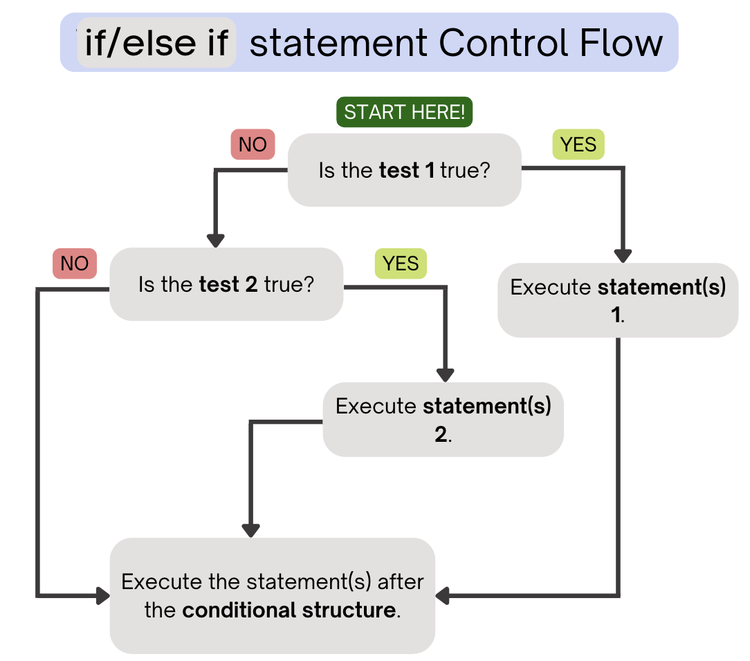
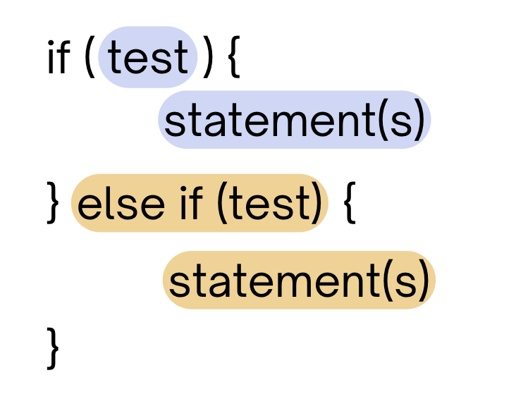
PCM Review: if-else if
If the first test is true, execute that block
If not, proceed to the next test, and repeat
If none were true, don’t execute any blocks
Note After entering an if /else if
block, skip all remaining blocks.

Slide 9
Reminder: Boolean Operators!
! (NOT)
&& (AND)
|| (OR)
relational: <, >, <=, >=, ==, !=
Very common with conditionals
if (day.equals("Wed") || day.equals("Fri")) {
System.out.println("121 lecture!");
} else if (day.equals("Tue") || day.equals("Thu")) {
System.out.println("121 quiz section!");
} else {
System.out.println("no 121!");
}

Slide 10
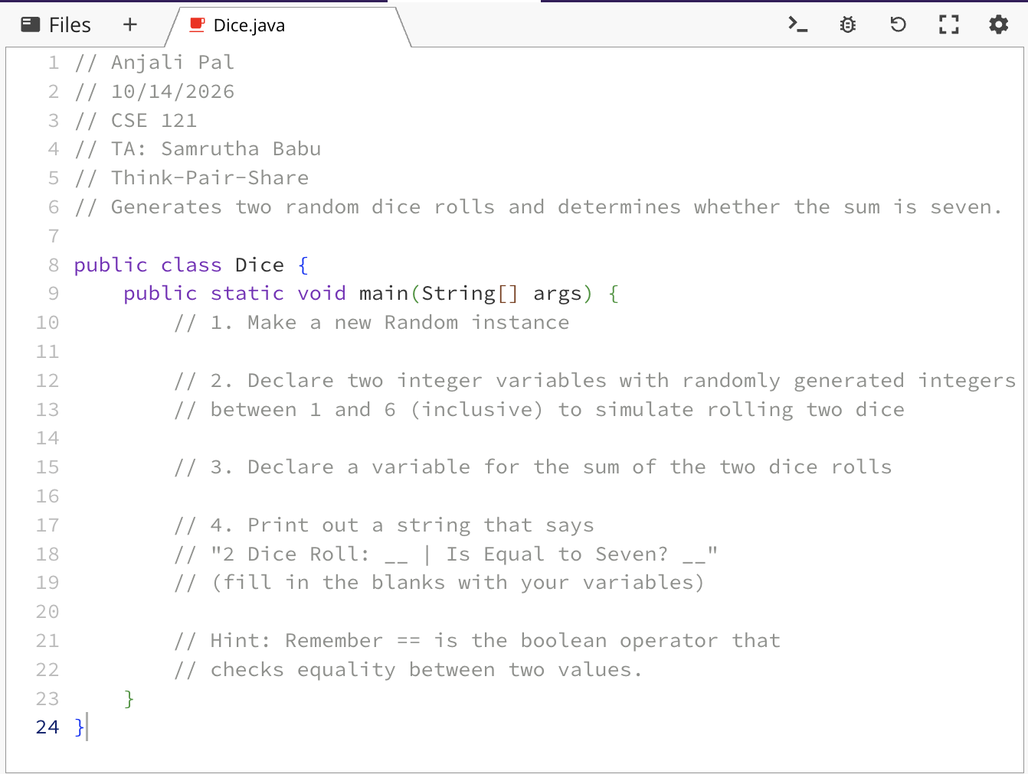
Think Pair Share: Odds and Evens (Pair)
1. Work with a neighbor to fill in the program.
2. Keep clicking Run until the program prints true.
3. On slido: how many times does it take?

Slide 11
Think Pair Share: Odds and Evens (Think)
Random rand = new Random();
int a = 2;
int b = rand.nextInt(10);
if (a % 2 == 0) {
System.out.print("even ");
} else if (a == 2) {
System.out.print ("2 ");
} else if (b == 10) {
System.out.print("10 ");
}
System.out.print(a + " ");
if (a * b % 2 == 1) {
System.out.print("odd");
}
What does this program output?
A. even 2
B. even 2 2
C. even 2 10 2 odd
D. even 2 odd
E. The output depends on what random integer b is.
F. None of the above

Slide 12
Think Pair Share: Odds and Evens (Pair)
Random rand = new Random();
int a = 2;
int b = rand.nextInt(10);
if (a % 2 == 0) {
System.out.print("even ");
} else if (a == 2) {
System.out.print ("2 ");
} else if (b == 10) {
System.out.print("10 ");
}
System.out.print(a + " ");
if (a * b % 2 == 1) {
System.out.print("odd");
}
What does this program output?
A. even 2
B. even 2 2
C. even 2 10 2 odd
D. even 2 odd
E. The output depends on what random integer b is.
F. None of the above

Slide 13
“Useless” Conditionals
public static void main(String[] args) {
int n = 1;
String response = "even";
if (n % 2 == 1) {
response = "odd ";
} else if (n == 1) {
response = "one ";
}
System.out.println(response);
}
This else if statement never runs!

