Slide 1
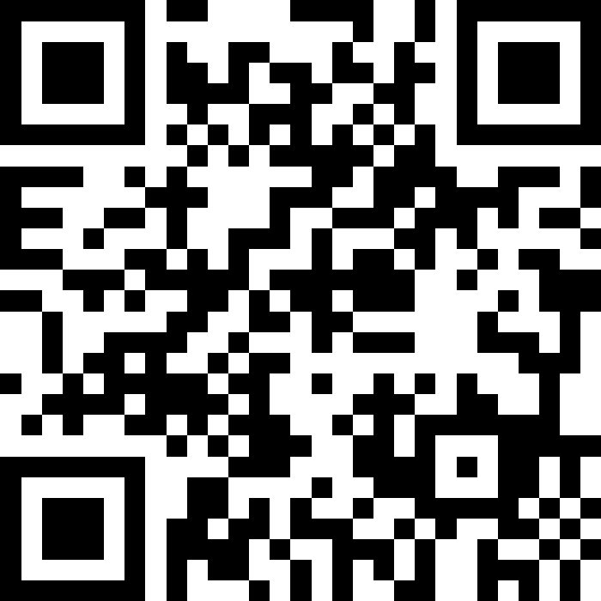
Strings, char, and Variables
BEFORE WE START
LEC 03
Talk to your neighbors:
What is your favorite emoji? 😀
Respond on sli.do!
Music: 🍂 CSE 121 26au Lecture Tunes 🍂
Instructor:
Miya Natsuhara and Anjali Pal
TAs:
Samrutha
William
Samvedha
Syreeta
Ryan
Anant
Henry
Reese
Savannah
Tamsyn
Cedric
Anum
Navya
Gene
Margot
Sarah K
Ethan
Evelyn
Owen
Jameson
Paul
Gurbax
Tony
Lucas
Alex
Jesse
Matthew
Jennie
Anisha
TJ
Ivory
Sarah W
Avery

Slide 2
Agenda (1/3)
Announcements, Reminders (now)
Casting, More Variables and Operators!
Strings and Characters Review
  code example!

Slide 3
Announcements, Reminders
Programming Project 0 is out, due Tuesday 10/13
Computer Quiz 0 will take place from Wednesday 10/14 - Wednesday 10/21
  Sign up for a computer quiz time slot through Canvas!
    Wide variety of time slots – let us know if you none of them work for your schedule!
  Quizzes will generally be taken on your own devices – if you don't have a laptop/surface, please let us know so we can make sure to provide a computer for you to use!
  Ed posts: Computer Quiz Scheduling, Computer Quiz Logistics

Slide 4
Agenda (2/3)
Announcements, Reminders
C0 Reflection Recap
Casting, More Variables and Operators! (now)
Strings and Characters Review
  code example!

Slide 5
PCM: Variables
Recall: Variables allow us to give a name to a specific value
  3 parts: declaration, initialization, usage
  Example:
Declaration: int num;
Initialization: num = 30;
Or all in one line: int num = 30;
String bestBoy = "gumball";
System.out.println(bestBoy);

Slide 6
PCM: Casting
Java will do some type conversions for us
  E.g., int to double, double to String, int to String
BUT some conversions Java won't do for us…
  Nonsensical conversions (e.g., "Gumball" to int)
  Conversions that are "lossy" (e.g., double to int)
    We can ask Java to typecast for us
double num = 8.83;
int numInt = (int) num;

Slide 7
New: Manipulating Variables
They’re made to be manipulated, modified, and re-used!
  int myFavoriteNumber = 7;
  int tripleFavNum = myFavoriteNumber * 3;
  myFavoriteNumber = myFavoriteNumber + 3;
Note! This doesn’t really make any mathematical sense. That’s because in Java, = is assignment, not equality!

Slide 8
New Operator: +=
myFavoriteNumber = myFavoriteNumber + 3;
This pattern is so common, we have a shorthand for it!
myFavoriteNumber += 3;
This works for both numeric addition and string concatenation!

Slide 9
More Shorthand Operators
The shorthands -=, *=, /=, and %= exist too!
myFavoriteNumber /= 3;
Should this work for integers? Doubles? Strings?

Slide 10
Even Shorter Shorthands
There are even shorter operators for “incrementing” and “decrementing”!
myFavoriteNumber++; // myFavoriteNumber += 1;
myFavoriteNumber--; // myFavoriteNumber -= 1;
Should this work for integers? Doubles? Strings?

Slide 11
Think Pair Share: A, B, C Variables (Think)
What values do a, b, and c hold after this code is executed?
int a = 10;
int b = 30;
int c = a + b;
c -= 10;
a = b + 5;
b /= 2;
10, 30, 40
35, 15, 30
35, 15.5, 30
20, 15, 30

Slide 12
Think Pair Share: A, B, C Variables (Pair)
What values do a, b, and c hold after this code is executed?
int a = 10;
int b = 30;
int c = a + b;
c -= 10;
a = b + 5;
b /= 2;
10, 30, 40
35, 15, 30
35, 15.5, 30
20, 15, 30

Slide 13
Agenda (3/3)
Announcements, Reminders
Typecasting
Casting, More Variables and Operators!
Strings and Characters Review (now)
  code example!

Slide 14
PCM: Strings & chars
Recall: String literals are a sequence of characters that are strung together, begin and end with ""
  Use zero-based indexing
A char represents a single character
  Begin and end with single quotes ( ' )
  Strings are made up of chars!
g | u | m | b | a | l | l
0 | 1 | 2 | 3 | 4 | 5 | 6
char letter = 'g';
char anotherLetter = 'b';

Slide 15
PCM: String Methods
Usage: <string_variable>.<method>(…)
Method | Description
length() | Returns the length of the string.
charAt(i) | Returns the character at index i of the string
indexOf(s) | Returns the index of the first occurrence of s in the string; returns -1 if s doesn't appear in the string
substring(i, j) or substring(i) | Returns the characters in this string from i (inclusive) to j (exclusive); if j is omitted, goes until the end of the string
contains(s) | Returns whether or not the string contains s
equals(s) | Returns whether or not the string is equal to s (case-sensitive)
equalsIgnoreCase(s) | Returns whether or not the string is equal to s ignoring case
toUpperCase() | Returns an uppercase version of the string
toLowerCase() | Returns a lowercase version of the string

Slide 16
Think Pair Share: Gumball (Think)
Suppose s contains the String "bubble gum".
Which statement would result in s containing "Gumball" instead?
s.substring(7) + "ball";
s = s.substring(7, 9) + "ball";
s = s.charAt(7).toUpperCase() + "ball";
s = s.substring(7, 8).toUpperCase()
+ s.substring(8) + "ball";
b | u | b | b | l | e |  | g | u | m
0 | 1 | 2 | 3 | 4 | 5 | 6 | 7 | 8 | 9

Slide 17
Think Pair Share: Gumball (Pair)
Suppose s contains the String "bubble gum".
Which statement would result in s containing "Gumball" instead?
s.substring(7) + "ball";
s = s.substring(7, 9) + "ball";
s = s.charAt(7).toUpperCase() + "ball";
s = s.substring(7, 8).toUpperCase()
+ s.substring(8) + "ball";
b | u | b | b | l | e |  | g | u | m
0 | 1 | 2 | 3 | 4 | 5 | 6 | 7 | 8 | 9

Slide 18
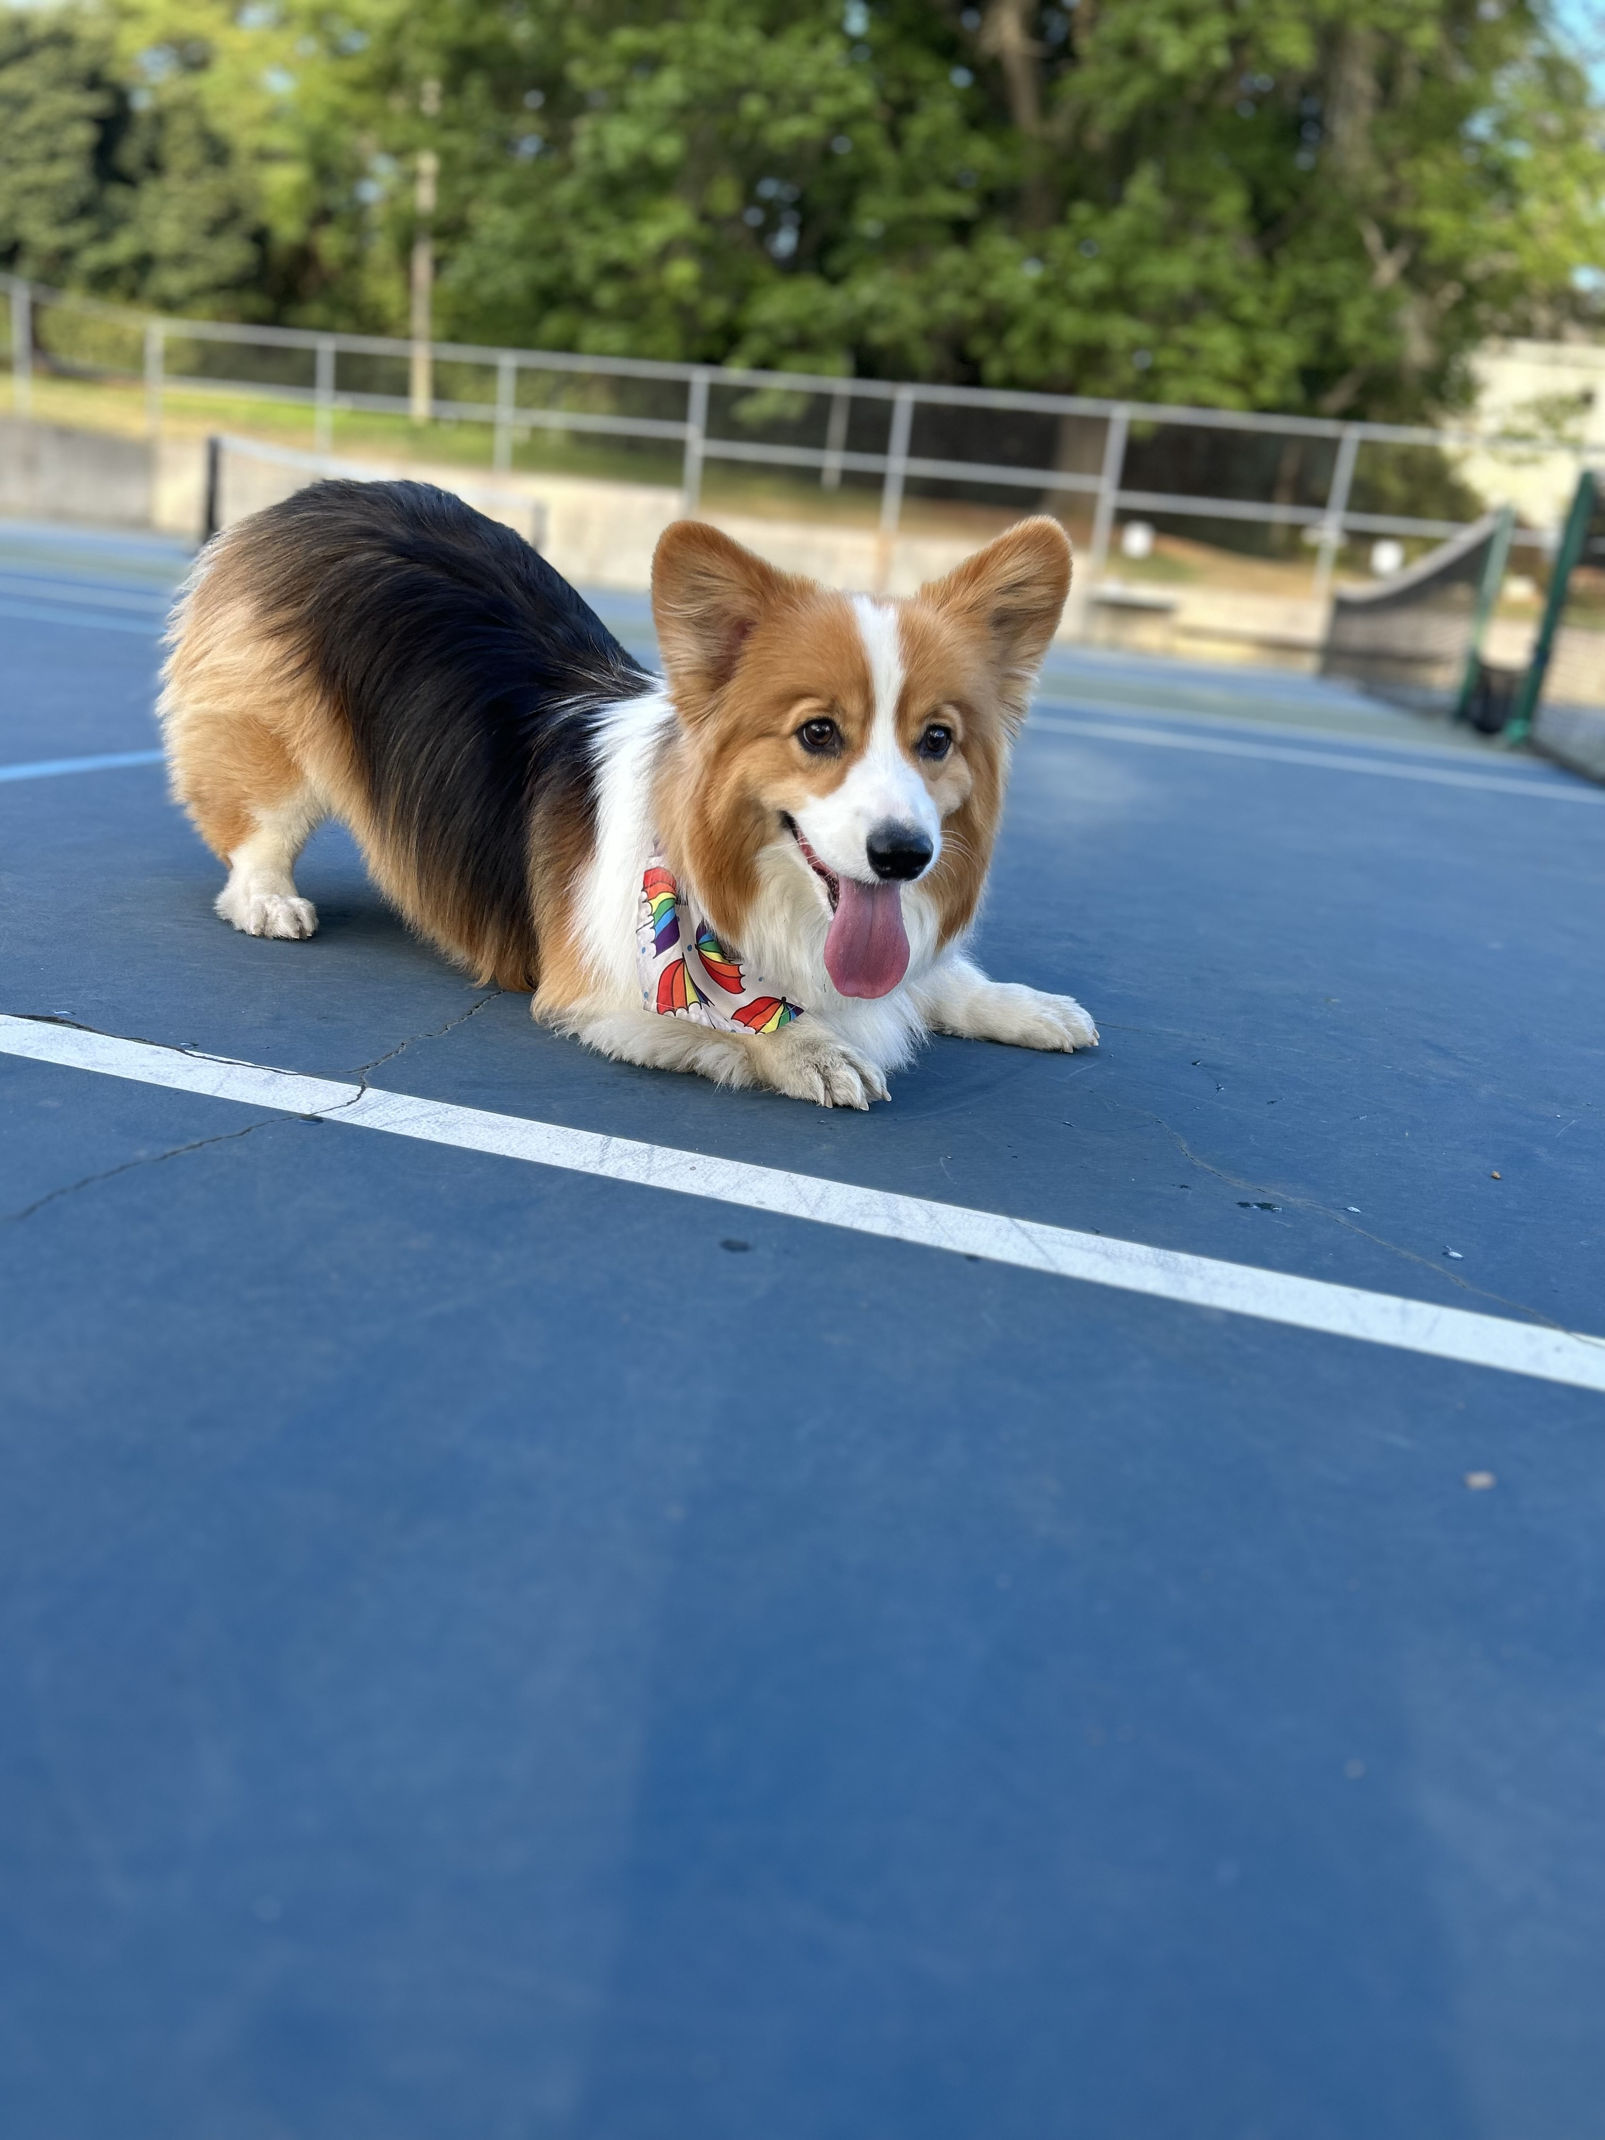
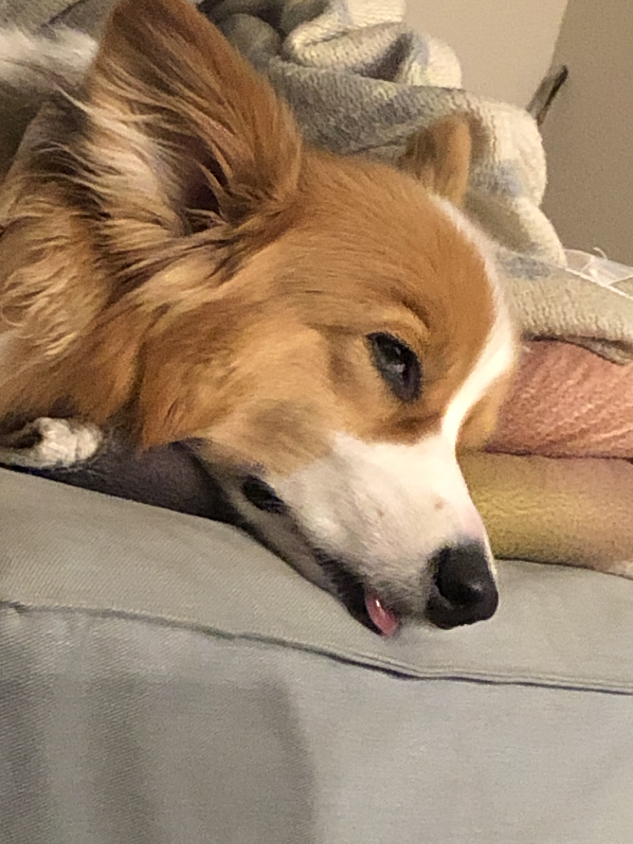


Aside: Gumball

