Slide 1
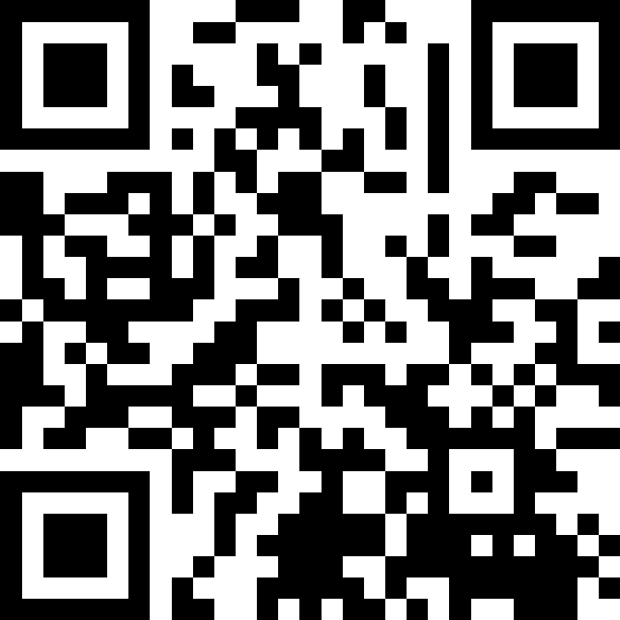
Datatypes and Expressions
BEFORE WE START
LEC 02
Talk to your neighbors:
What’s your favorite song right now?
Respond on sli.do!
Music: 🍂 CSE 121 26au Lecture Tunes 🍂
Instructor:
Miya Natsuhara and Anjali Pal
TAs:
Samrutha
William
Samvedha
Syreeta
Ryan
Anant
Henry
Reese
Savannah
Tamsyn
Cedric
Anum
Navya
Gene
Margot
Sarah K
Ethan
Evelyn
Owen
Jameson
Paul
Gurbax
Tony
Lucas
Alex
Jesse
Matthew
Jennie
Anisha
TJ
Ivory
Sarah W
Avery

Slide 2
Agenda (1/5)
Announcements, Reminders
Intro Survey Recap
Datatypes and Expressions Review
Expressions Practice
Combining Variables and Expressions

Slide 3
Announcements, Reminders
Programming Project 0 releases later today
  due Tuesday, October 13th at 11:59 PM
IPL is open! Schedule & instructions on website.
Make sure to read the syllabus if you haven't already!
  Added more information about participation grade
  Complete participation tasks by attempting PCM for a day of lecture (even if not all correct), or by attending and engaging in quiz section
  Must complete 26/32 participation tasks for an E; 22/32 participation tasks for an S

Slide 4
Agenda (2/5)
Announcements, Reminders
Intro Survey Recap
Datatypes and Expressions Review
Expressions Practice
Combining Variables and Expressions

Slide 5
Intro Survey – things we’re excited for! (1/2)
Learning how to code!
"Learning the fundamentals of code"
"Learning too Code and hopefully learned how to mod Minecraft"
"understanding the fundamentals of code and being able to build things from scratch. If I use AI, I want to be able to understand, review, and cross reference. I'll be able to say 'I can code!' and hold conversations about it"
"Just to be able to understand basic code, and understand why certain things (like websites and stuff) are the way they are and how I can change them"

Slide 6
Intro Survey – things we’re excited for! (2/2)
"I'm excited to get exposure to CSE and see if it interests me."
"Getting started to learn coding and also working with others to build connections."
"I'm excited to learn Java, get more familiar with coding in a college setting, and hopefully meet a lot of new people in the class."
"I want to learn how to create programs for my engineering projects."
"learning something new outside of any other course of area I've learned before"

Slide 7
Addressing worries from intro survey (1/3)
A common response: things like "Not having any past computer science experience"
You’re in the right place! This class expects zero prior knowledge.
Another common response: difficulty, workload, pace, & falling behind,
e.g. "Struggling and finding the course too rigorous for me"
programming can be difficult (if it was easy: why have a class?)
121 has many support systems (section, IPL, office hours, Ed, etc.)
if you feel like you’re struggling: reach out early!
  especially with pace of quarter system

Slide 8
Addressing worries from intro survey (2/3)
Grades, competitiveness, this class being a “weed-out” class
explicitly not the goal of this class
course designed against this (grade guarantees, retake/override policy, etc.)
Quizzes & final exams
timed assessments can be stressful – but we’ll build you up slowly!
will have many practice resources and opportunities!

Slide 9
Addressing worries from intro survey (3/3)
Memorization & problem-solving
programming isn’t really about memorizing syntax (or specific facts)
  programmers look things up all the time! (but, this takes time…)
  on assessments, we will give you a reference sheet!
(in our opinion) the hard part of programming is problem-solving
  "breaking a big problem into smaller pieces"
  "building a strong mental model of how a system works”
  we will explicitly work on this as a class!

Slide 10
Agenda (3/5)
Announcements, Reminders
Intro Survey Recap
Datatypes and Expressions Review
Expressions Practice
Combining Variables and Expressions

Slide 11
PCM: Datatypes & Expressions
Programming is about data; we tell Java what type of data we have!
Datatypes (so far): int, double, String, boolean
  note: only String is capitalized!
All values in a (Java) program have a type!
  some are more straightforward, e.g. 42 or "hello world"
    aside: these are called “literals”
  some are more complicated expressions!

Slide 12
PCM: Operators
We learned a ton of operators!
Numerical:
+ Addition
- Subtraction
* Multiplication
/ Division (tricky!)
% Modulo (or “mod”)
<, >, <=, >=, ==, != Relational
Strings:
+ Concatenation (not addition!)
Booleans:
! Logical Not
&& Logical And
|| Logical Or
== and != Relational

Slide 13
PCM: Precedence
Operators have precedence (an order of operations).
In Math:
Parentheses
Exponent
Multiplication
Division
Addition
Subtraction
In Java:
Parentheses
Logical NOT
Multiplication, Modulo, Division
Addition (and concatenation), Subtraction
Relational operators
Equality operators
Logical AND
Logical OR

Slide 14
Expressions in “little steps”
5 + 2 * 4
1 + 2 / 3
6 * 5 % 7
8
0
30
13
1
2

Slide 15
PCM: Conversions
When mixing types in an expression, Java will convert one type to the other and then perform the operation “normally”.
Some conversions are straightforward:
ints can be converted to doubles (add .0)
ints and doubles can be converted to Strings (add "")
So, Java does these for you! (is this good? controversial!)

Slide 16
New: Conversions (Gone Wrong!!)
Other conversions are “lossy”, because you lose data.
e.g. to make 3.14 an int, you’d probably pick either 3 or 4 – but either one loses data
Java won’t do this automatically for you – you need to “ask”.
  called a type cast: you’ll see this in Friday’s PCM + in P0
Some conversions don’t make sense.
how would you convert "Beyoncé" to an int? double?
Java really doesn’t let you do these…

Slide 17
Tracing Expression (Think)
What does this expression evaluate to?
2 + 2 + "hello" + 3 * 5 + 10
"22hello3510"
"22hello1510"
"4hello1510"
"4hello25"
This will cause an error

Slide 18
Tracing Expression (Pair)
What does this expression evaluate to?
2 + 2 + "hello" + 3 * 5 + 10
"22hello3510"
"22hello1510"
"4hello1510"
"4hello25"
This will cause an error

Slide 19
Expression example with mixing types
2 + 2 + "hello" + 3 * 5 + 10
" "
15
4
" "
" "
"4hello"
"4hello15"
"4hello1510"

Slide 20
Agenda (4/5)
Announcements, Reminders
Intro Survey Recap
Datatypes and Expressions Review
Expressions Practice
Combining Variables and Expressions

Slide 21
Work on Expressions and Types Practice (1)
On the Ed lesson for today, and on your handout
Work with folks around you!
TAs & I will walk around and help!
5 * 3 + 1.0
8 / 3 * 2.0
8.0 / 3 * 2
"Hello" + "world"
1 + "2" + 3
1 + 2 + "3"
1 + "2" + (3 + 4)

Slide 22
Part 1 Walkthrough (blank)

Slide 23
Part 1 Walkthrough (steps)
"Hello" + "world"
"Helloworld"
5 * 3 + 1.0
8 / 3 * 2.0
8.0 / 3 * 2
.0
.0
2
15
.0
2.666…
.0
16.0
4.0
5.333…
1 + "2" + 3
1 + 2 + "3"
1 + "2" + (3 + 4)
" "
" "
" "
" "
"12"
" "
"12"
7
3
"123"
"33"
"127"

Slide 24
Work on Expressions and Types Practice (2)
On the Ed lesson for today, and on your handout
Work with folks around you!
TAs & I will walk around and help!
5 * 3 < 12
10 % 3 == 10 / 3
5 < 9 || (7 != 7)
!(1 + 2 == 3 && 10 % 4 > 2)

Slide 25
Part 2 Walkthrough (blank)

Slide 26
Part 2 Walkthrough (steps 1)
5 * 3 < 12
10 % 3 == 10 / 3
5 < 9 || (7 != 7)
15
1
false
1 == 10 / 3
15 < 12
5 < 9 || false
false
3
1 == 3
true
true || false
false
true

Slide 27
Part 2 Walkthrough (steps 2)
!(1 + 2 == 3 && 10 % 4 > 2)
!(1 + 2 == 3 && 2 > 2)
!( 3 == 3 && 2 > 2)
!( 3 == 3 && false )
!( true && false )
!( false )
true

Slide 28
Agenda (5/5)
Announcements, Reminders
Intro Survey Recap
Datatypes and Expressions Review
Expressions Practice
Combining Variables and Expressions

Slide 29
Ed time :)
Applying what we learned to variables!

