Slide 1

Printing, Strings, and Variables
BEFORE WE START
LEC 01
Talk to your neighbors:
What is your favorite handheld food?
Respond on sli.do!
Music: 🍂 CSE 121 26au Lecture Tunes 🍂
Instructor:
Miya Natsuhara and Anjali Pal
TAs:
Samrutha
William
Samvedha
Syreeta
Ryan
Anant
Henry
Reese
Savannah
Tamsyn
Cedric
Anum
Navya
Gene
Margot
Sarah K
Ethan
Evelyn
Owen
Jameson
Paul
Gurbax
Tony
Lucas
Alex
Jesse
Matthew
Jennie
Anisha
TJ
Ivory
Sarah W
Avery

Slide 2
Agenda
Announcements, Reminders
Syllabus Review
  Assessments, Grading, Collaboration, and AI
Hello, World Review!
Printing, Strings, and Variables
Code Example

Slide 3
Announcements, Reminders
Links to all materials and activities are available on the website
Fill out the welcome survey by tonight at 11:59 PM
  gives us valuable insight!
  important that Google Forms works in CSE 121
  Google Forms troubleshooting guide on website
New Ed tool: Sandbox (write all the code you want!)

Slide 4
Aside: TA Office Hours!
The IPL (TA office hours) will open on Monday (Apr 6) at 12:30 PM.
one of the best parts of the course!
but, TAs are instructed to not just give you the answer!
  why not? you wouldn’t be learning!
  e.g. “my code doesn’t work” versus
  “I tried X, expected Y, but got Z. Thoughts on what to try next?”
  also true for instructor office hours ;)
Expect an announcement on Ed with a detailed schedule soon!

Slide 5
Agenda
Announcements, Reminders
Syllabus Review
  Assessments, Grading, Collaboration, and AI
Hello, World Review!
Printing, Strings, and Variables
Code Example

Slide 6
Assessment
Why assessment?
Our goal: you gain proficiency of the concepts and skills we teach
We assess your proficiency by asking you to apply these concepts and skills on tasks
By necessity, we are assessing your work as a proxy for proficiency

Slide 7
Grading
All assignments will be graded E (Excellent), S (Satisfactory), or N (Not yet)
  Under certain circumstances, U (Unassessable) may be assigned.
Final grades will be assigned based on the number of grades at each level
See the syllabus for more details

Slide 8
Graded Work
Programming Assignments: 1 ESN grade (4 assignments, 4 total)
  Structured programming assignments to gain practice using the programming constructs introduced in class
Computer Quizzes: 4 ESN grades (4 computer quizzes, 16 total)
  Derived from the corresponding programming assignment
  Modify, improve, augment, and explain project code
  Proctored, no AI or external resources allowed
Paper Quizzes: 4 ESN grades (4 paper quizzes, 16 total)
  Questions about the core conceptual material
  Proctored, no electronics usage allowed
Code Quality: 3 ESN grades
  Cumulative across computer quizzes
Participation: 1 ESN grade
  PCMs + engagement during Section
Total: 40 ESN grades

Slide 9
Course Grades
We provide a “minimum grade guarantee” for translating to a numeric grade, but not a direct formula.
Much more on this in the syllabus! (and over the next few weeks)
Minimum Grade | Requirements
Total ESN available | 40
3.5 | 32 Es and 3 additional S+
3.0 | 24 Es and 8 additional S+
2.5 | 16 Es and 13 additional S+
2.0 | 8 Es and 18 additional S+
1.5 | 18 S+
0.7 | 10 S+
S+ = S or E

Slide 10
Computer Quiz Retake and Paper Quiz Overriding Policy
Learning takes time and doesn’t always happen on the first try!
One Programming Project + Computer Quiz pair can be resubmitted and retaken
  If you resubmit code, you must retake the quiz. You may retake the quiz with the same code you submitted previously.
  Grade on resubmission/retake will replace the original grade.
  Retakes happen in the last week of classes through final exams.
Paper Quiz 4 will be administered during the Final Exam period, and will additionally include an opportunity to replace one problem grade from each previous paper quiz

Slide 11
Collaboration and AI
We encourage you to collaborate (with each other and/or AI tools) on programming projects
You may not collaborate (with classmates or AI) on Quizzes
Computer quizzes closely correspond to programming assignments, so understanding your project code is key to success on the quiz
You must cite your collaborators (classmates or AI)
Do not discuss quizzes until after grades are released
See the syllabus for more details. Violations of these policies will be reported to the Office of Community Standards & Student Conduct.

Slide 12
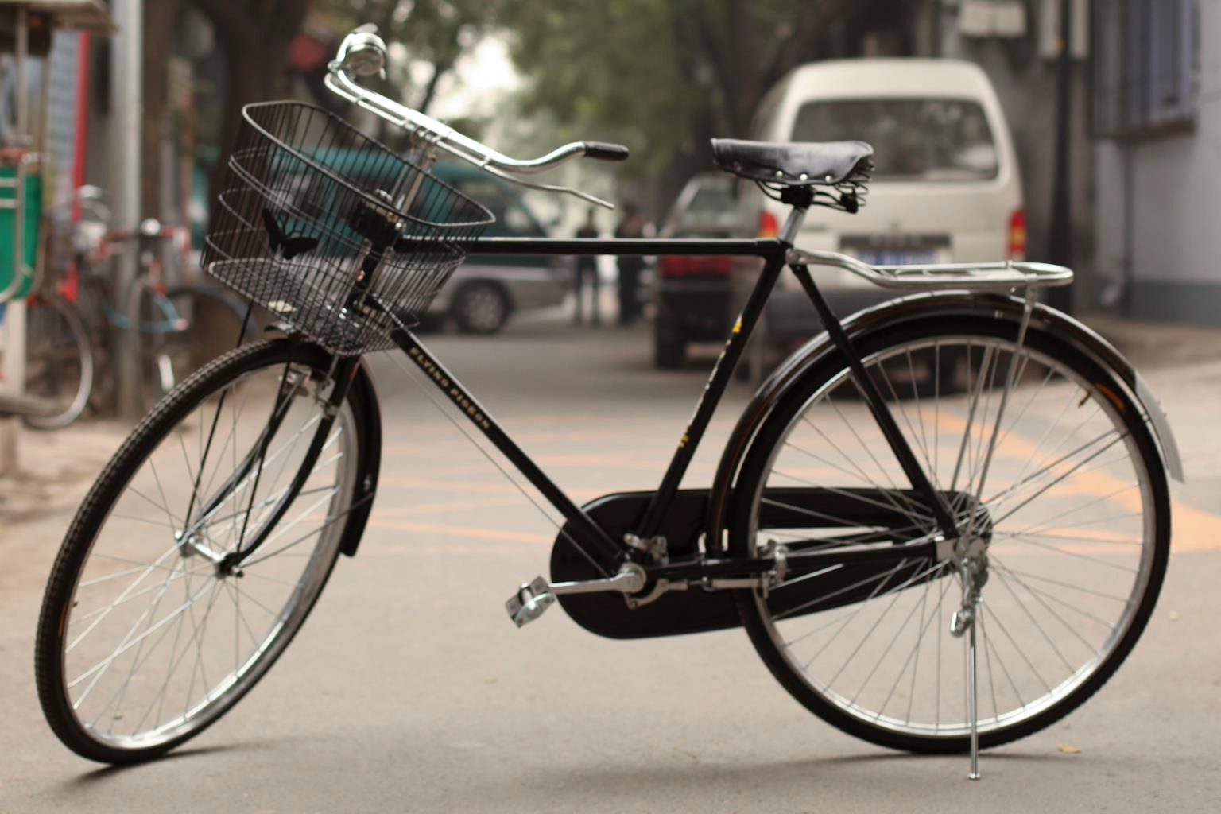
Much More About AI – Talk To Us!
AI can be used to generate useful code in lots of settings!
  Currently, mostly AI + expert programmers. There is limited data about software created by AI + non-expert programmers
AI can provide a tempting way to avoid productive struggle
ethical concerns related to the creation and use of AI
negative outcomes, from the environment to mental health or class culture
Have questions? Talk to us!

Slide 13
Agenda
Announcements, Reminders
Syllabus Review
  Assessments, Grading, Collaboration, and AI
Hello, World Review!
Printing, Strings, and Variables
Code Example

Slide 14
Code Quality
"Programs are meant to be read by humans and only incidentally for computers to execute." –Abelson & Sussman, SICP
Code is about communication. Writing code with good code quality is important to communicate effectively.
Different organizations have different standards for code quality.
Doesn't mean that any one standard is wrong! (e.g., APA, MLA, Chicago, IEEE, …)
Consistency is very helpful within a project
See our Code Quality Guide for the standards we will all use in CSE 121

Slide 15
Agenda
Announcements, Reminders
Syllabus Review
  Assessments, Grading, Collaboration, and AI
Hello, World Review!
Printing, Strings, and Variables
Code Example

Slide 16
PCM: Printing, Strings, Variables
System.out.print(…)
  Prints the given text to the console
System.out.println(…)
  prints the given text to the console, and then moves to the next line
String literals: a sequence of characters that are strung together
  begin and end with "…"
  example: "hello"
Variables allow us to give a name to a specific value
  3 parts: declaration, initialization, usage
  example:
String bestClass = "CSE 121";
System.out.println(bestClass);

Slide 17
Think Pair Share: Hello (around the) World (Think)
How many lines of output would the following code produce?
System.out.println("hello");
System.out.print("moi");
System.out.print("bonjour");
System.out.println("pryvit");
System.out.print("nihao");
System.out.println("hola");
System.out.print("namaste");
1
2
3
4
5
6

Slide 18
Think Pair Share: Hello (around the) World (Pair)
How many lines of output would the following code produce?
System.out.println("hello");
System.out.print("moi");
System.out.print("bonjour");
System.out.println("pryvit");
System.out.print("nihao");
System.out.println("hola");
System.out.print("namaste");
1
2
3
4
5
6

Slide 19
Escape Sequences
Escape Sequence: Special sequence of characters used to represent certain special characters in a String.
\" to produce " in a String
\\ to produce \ in a String
\n to produce a new line character (or line break) in a String
  note: in our class, we will ask you not to use this
and many more!

Slide 20
Agenda
Announcements, Reminders
Syllabus Review
  Assessments, Grading, Collaboration, and AI
Hello, World Review!
Printing, Strings, and Variables
Code Example

