Slide 1

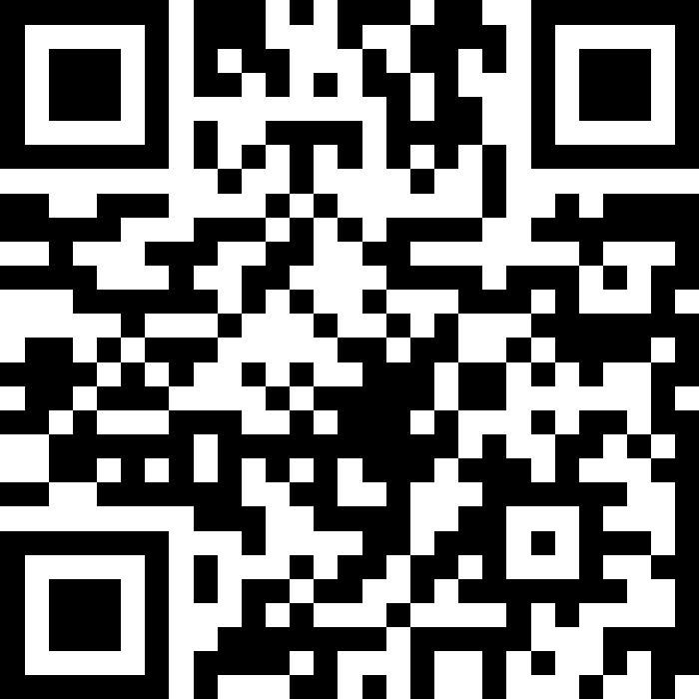
Welcome!
BEFORE WE START
LEC 00
Talk to your neighbors:
Introduce yourself!
What is your name? Major?
What would you be doing if you didn’t have class right now?
Instructor:
Miya Natsuhara and Anjali Pal
TAs:
Samrutha
William
Samvedha
Syreeta
Ryan
Anant
Henry
Reese
Savannah
Tamsyn
Cedric
Anum
Navya
Gene
Margot
Sarah K
Ethan
Evelyn
Owen
Jameson
Paul
Gurbax
Tony
Lucas
Alex
Jesse
Matthew
Jennie
Anisha
TJ
Ivory
Sarah W
Avery
Notes:
Slido event: https://app.sli.do/event/fbMDCbKDdWtoDpyJGDj8Ht
Or slido.com and event code #cse121

Slide 2
Lecture Outline
Today:
Introductions :)
About this course
Our learning model
Culture and community
Tools
Our first program!
On Friday:
Assessment and grading
Collaboration
More programming!

Slide 3
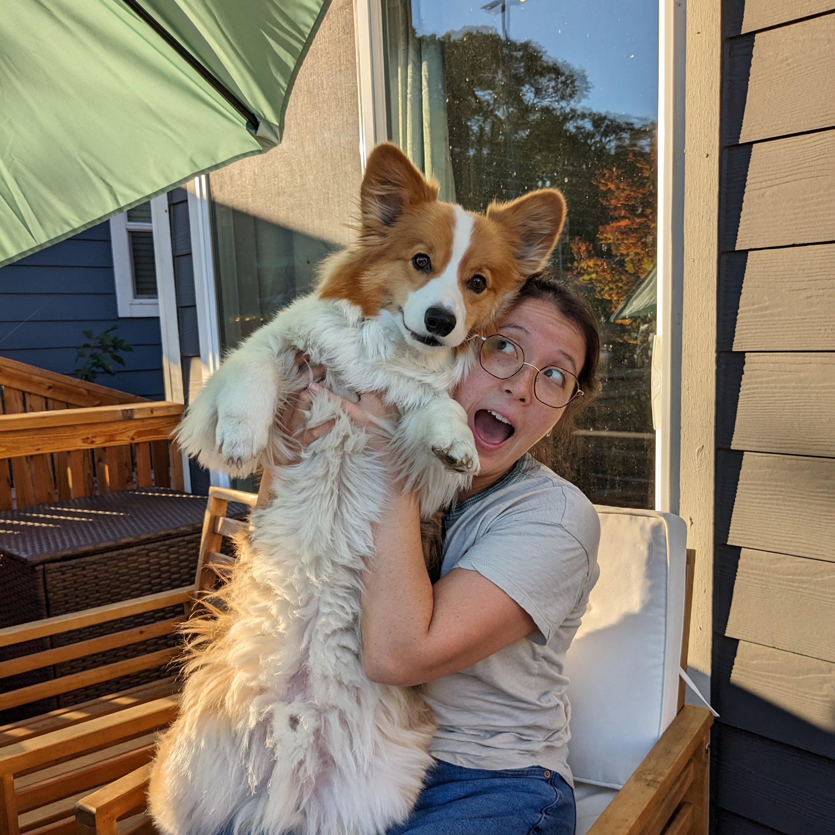
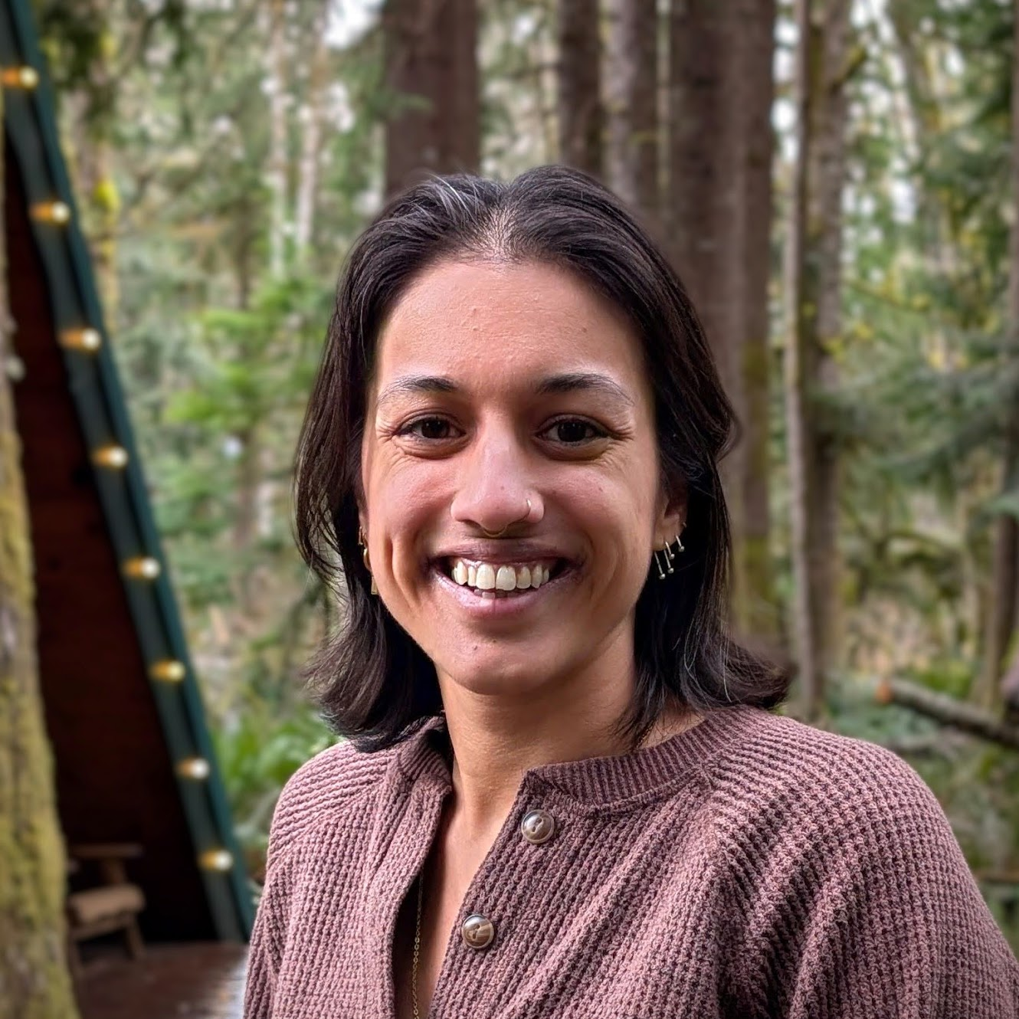
Hi, we’re Miya (she/her) and Anjali (she/her)!
Assistant Teaching Professor
Frequent intro CS instructor
Works in areas of CS Education, Accessibility
Non-CS hobbies: knitting, baking, playing with my corgi
5th year Ph. D. student
First time teaching intro!
Works in Programming Languages, Verification
Non-CS hobbies: hiking, frisbee, pottery

Slide 4




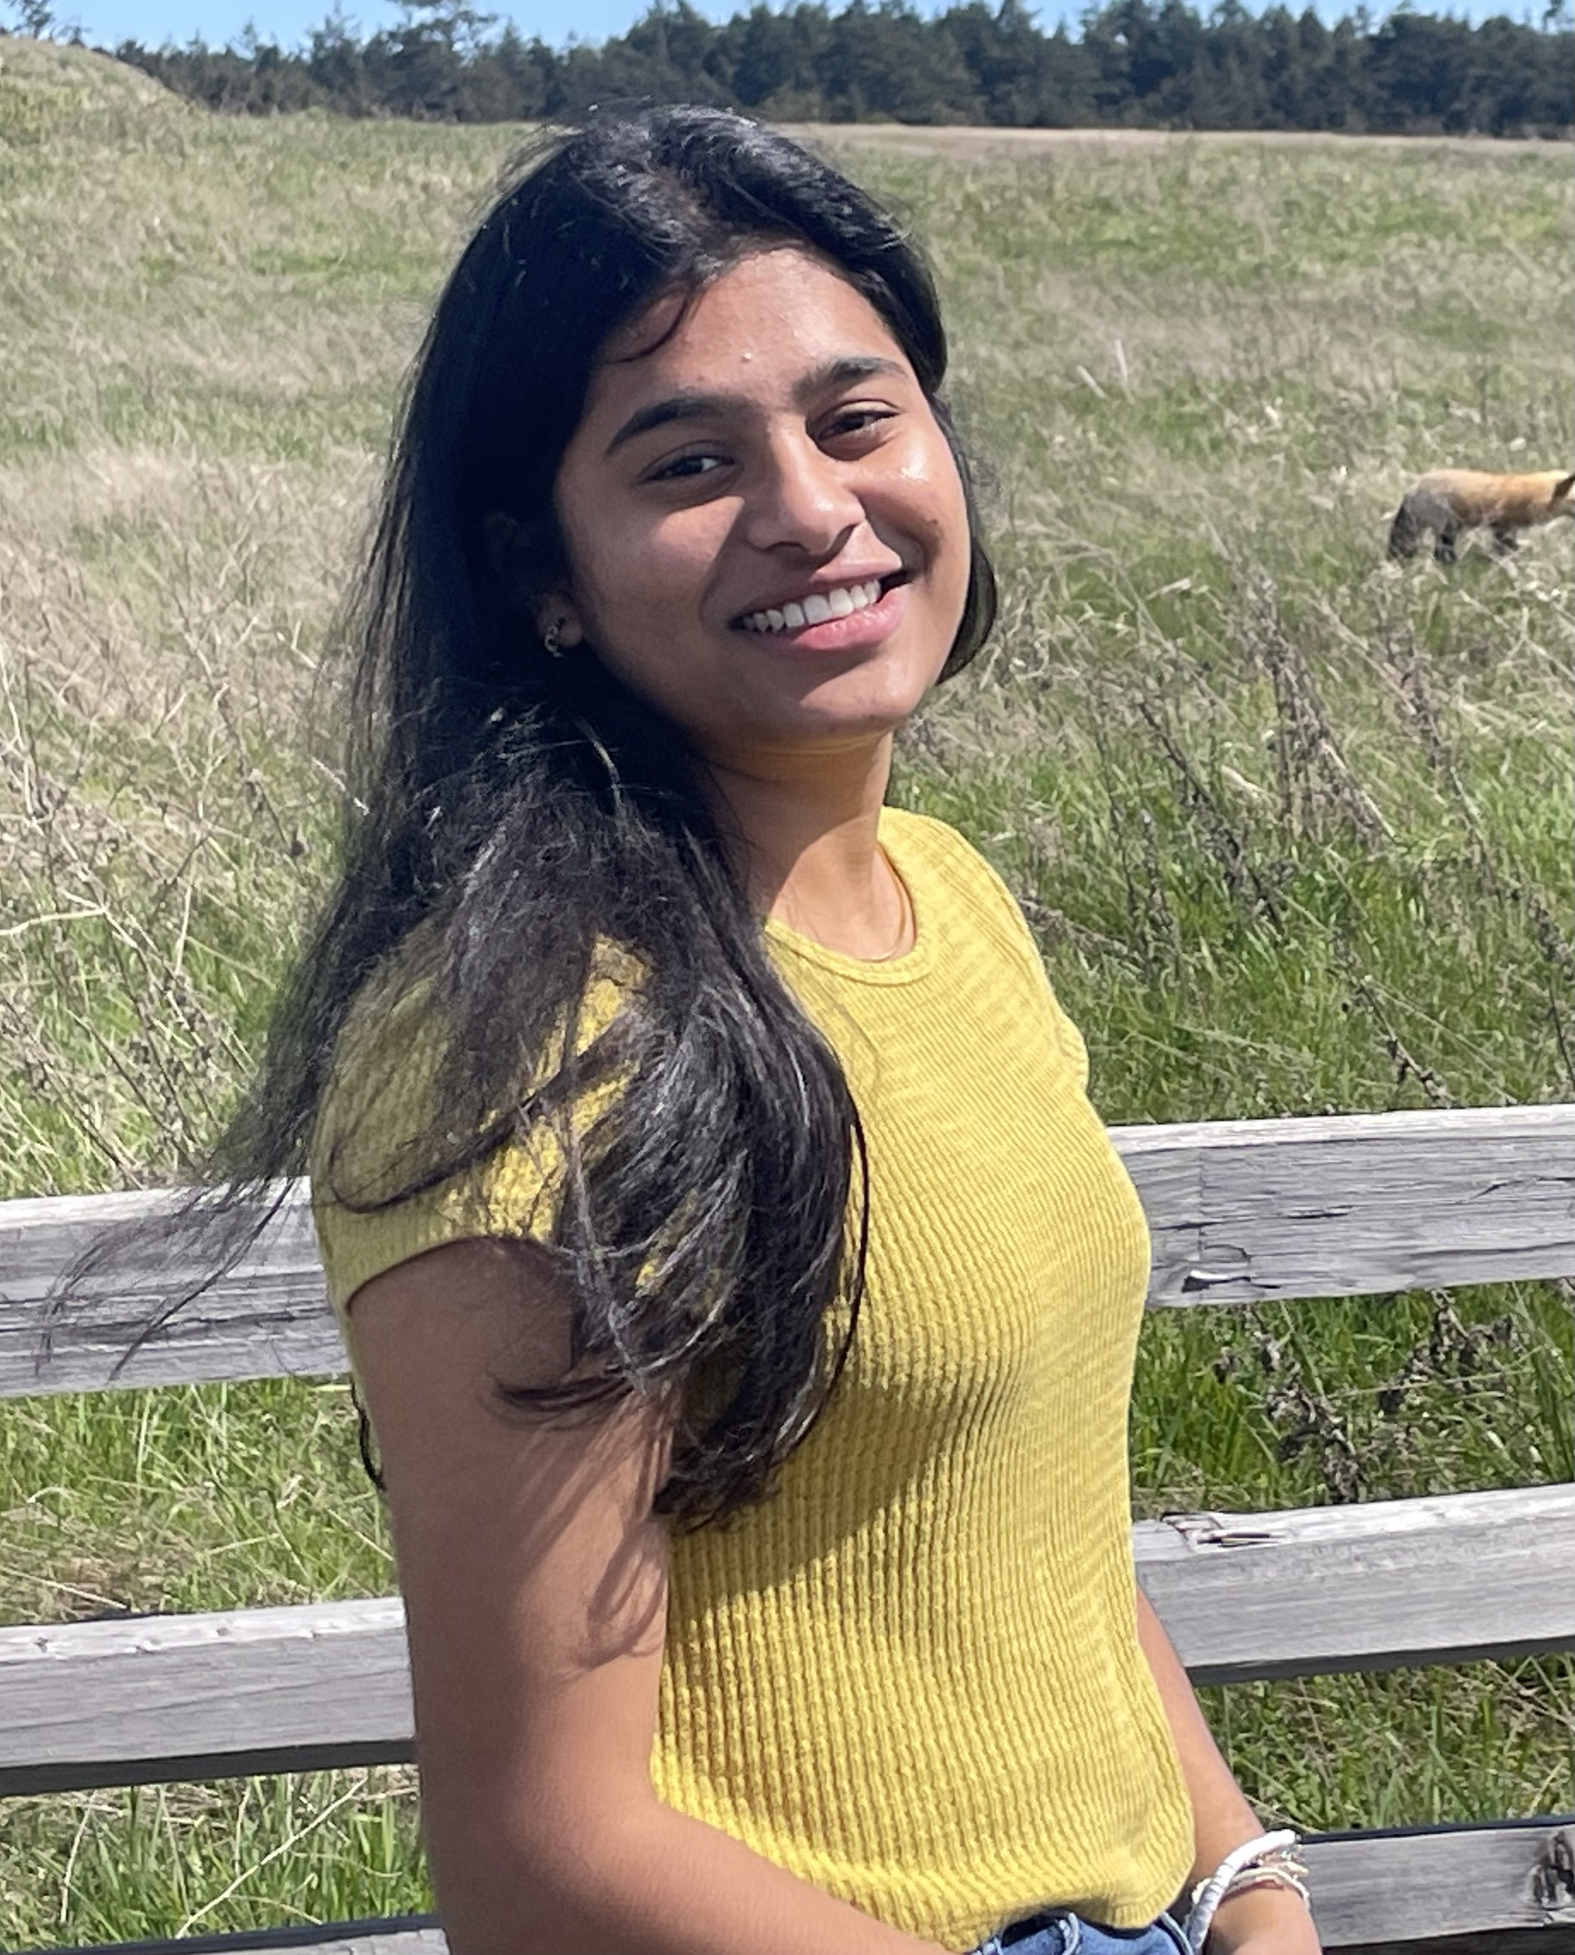

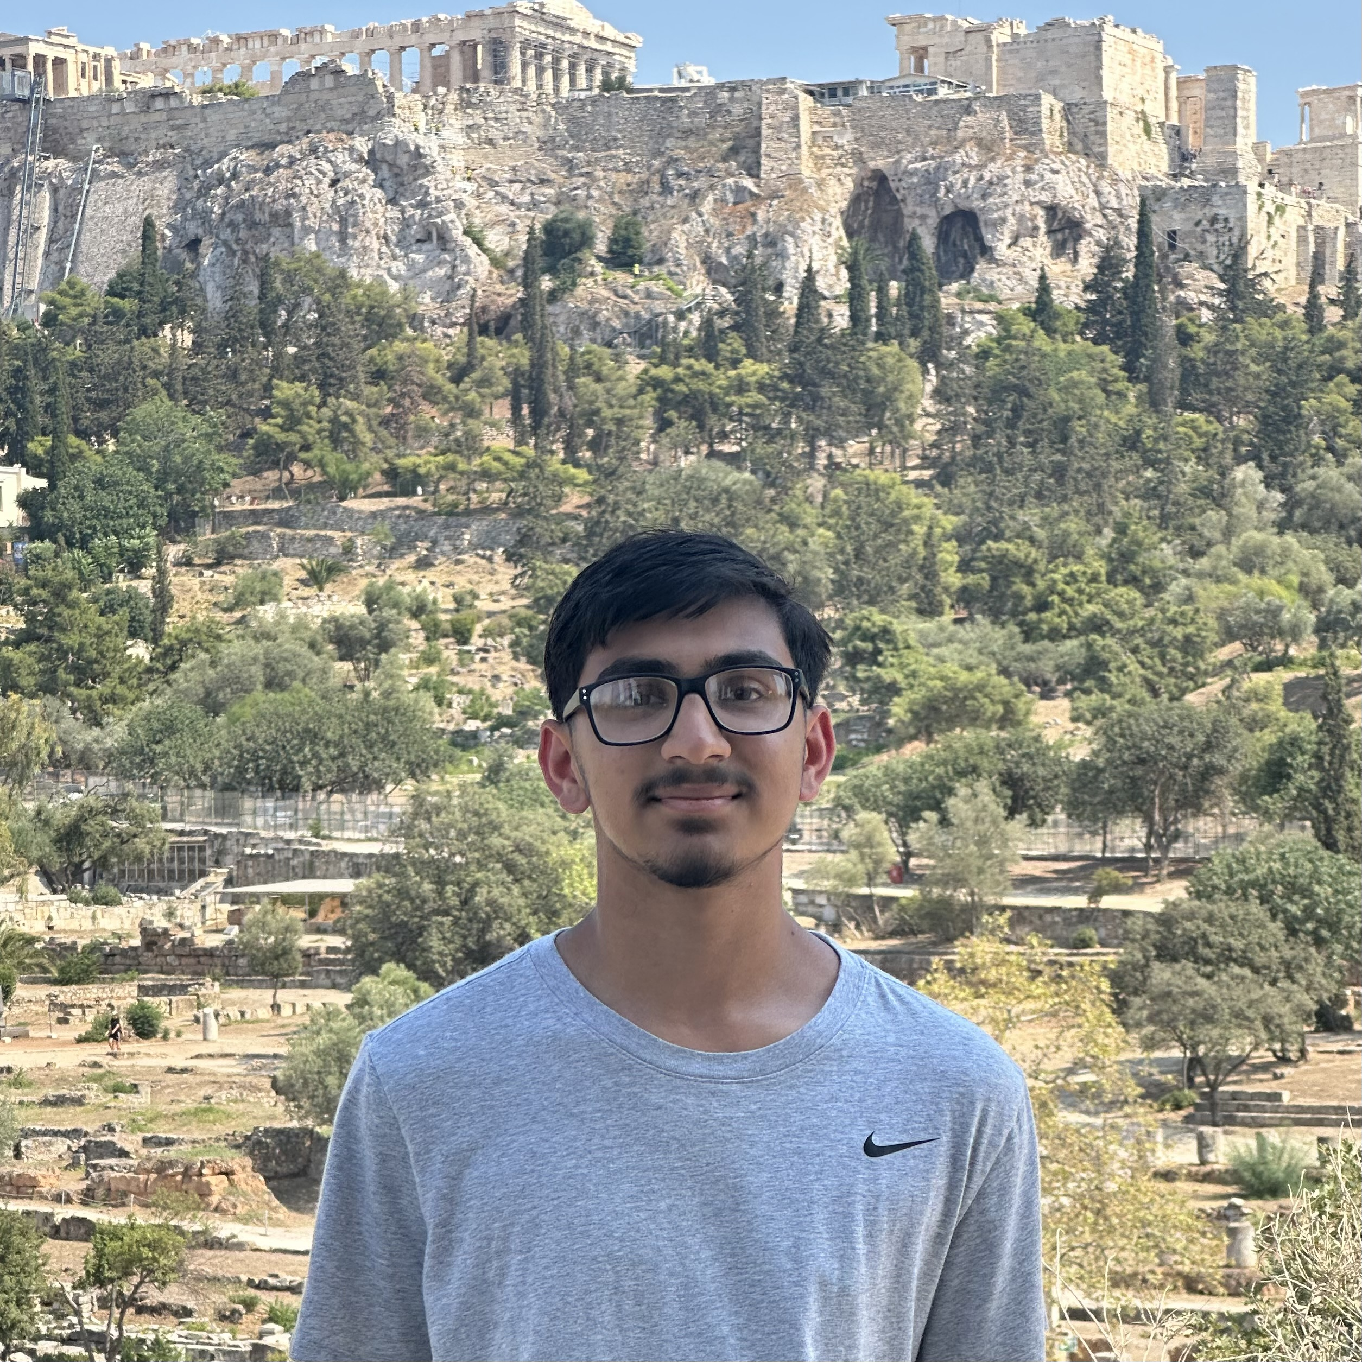
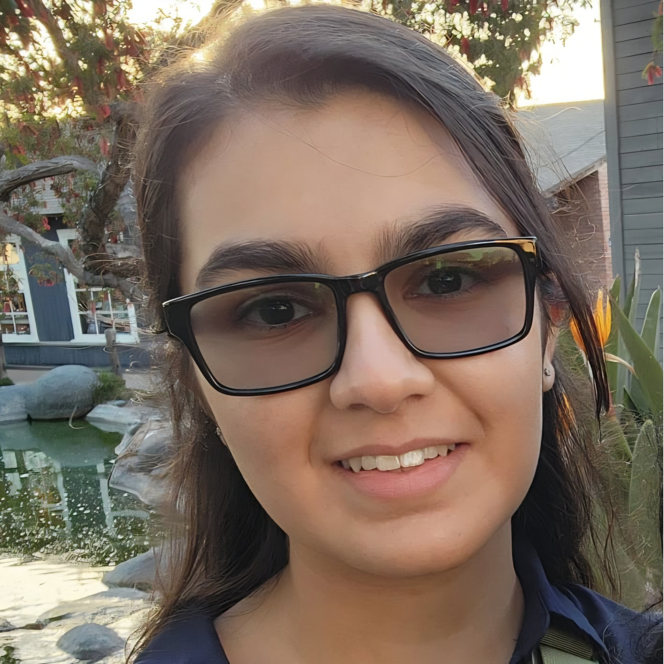
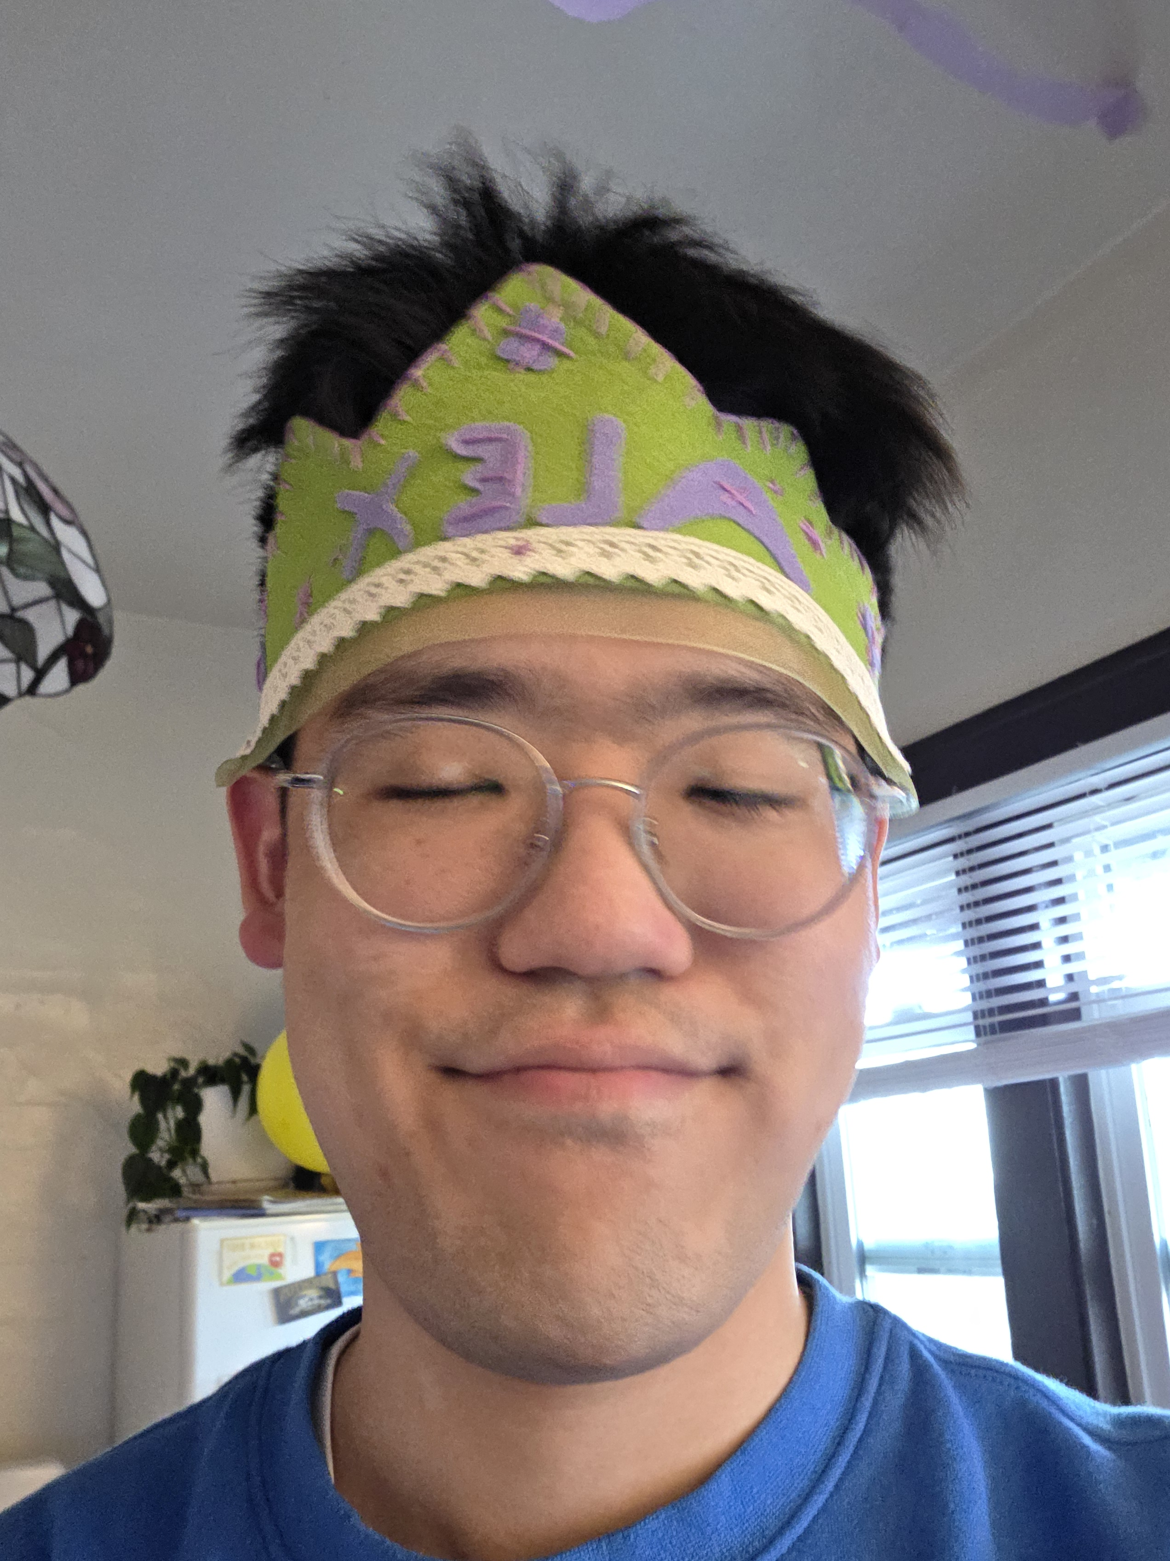
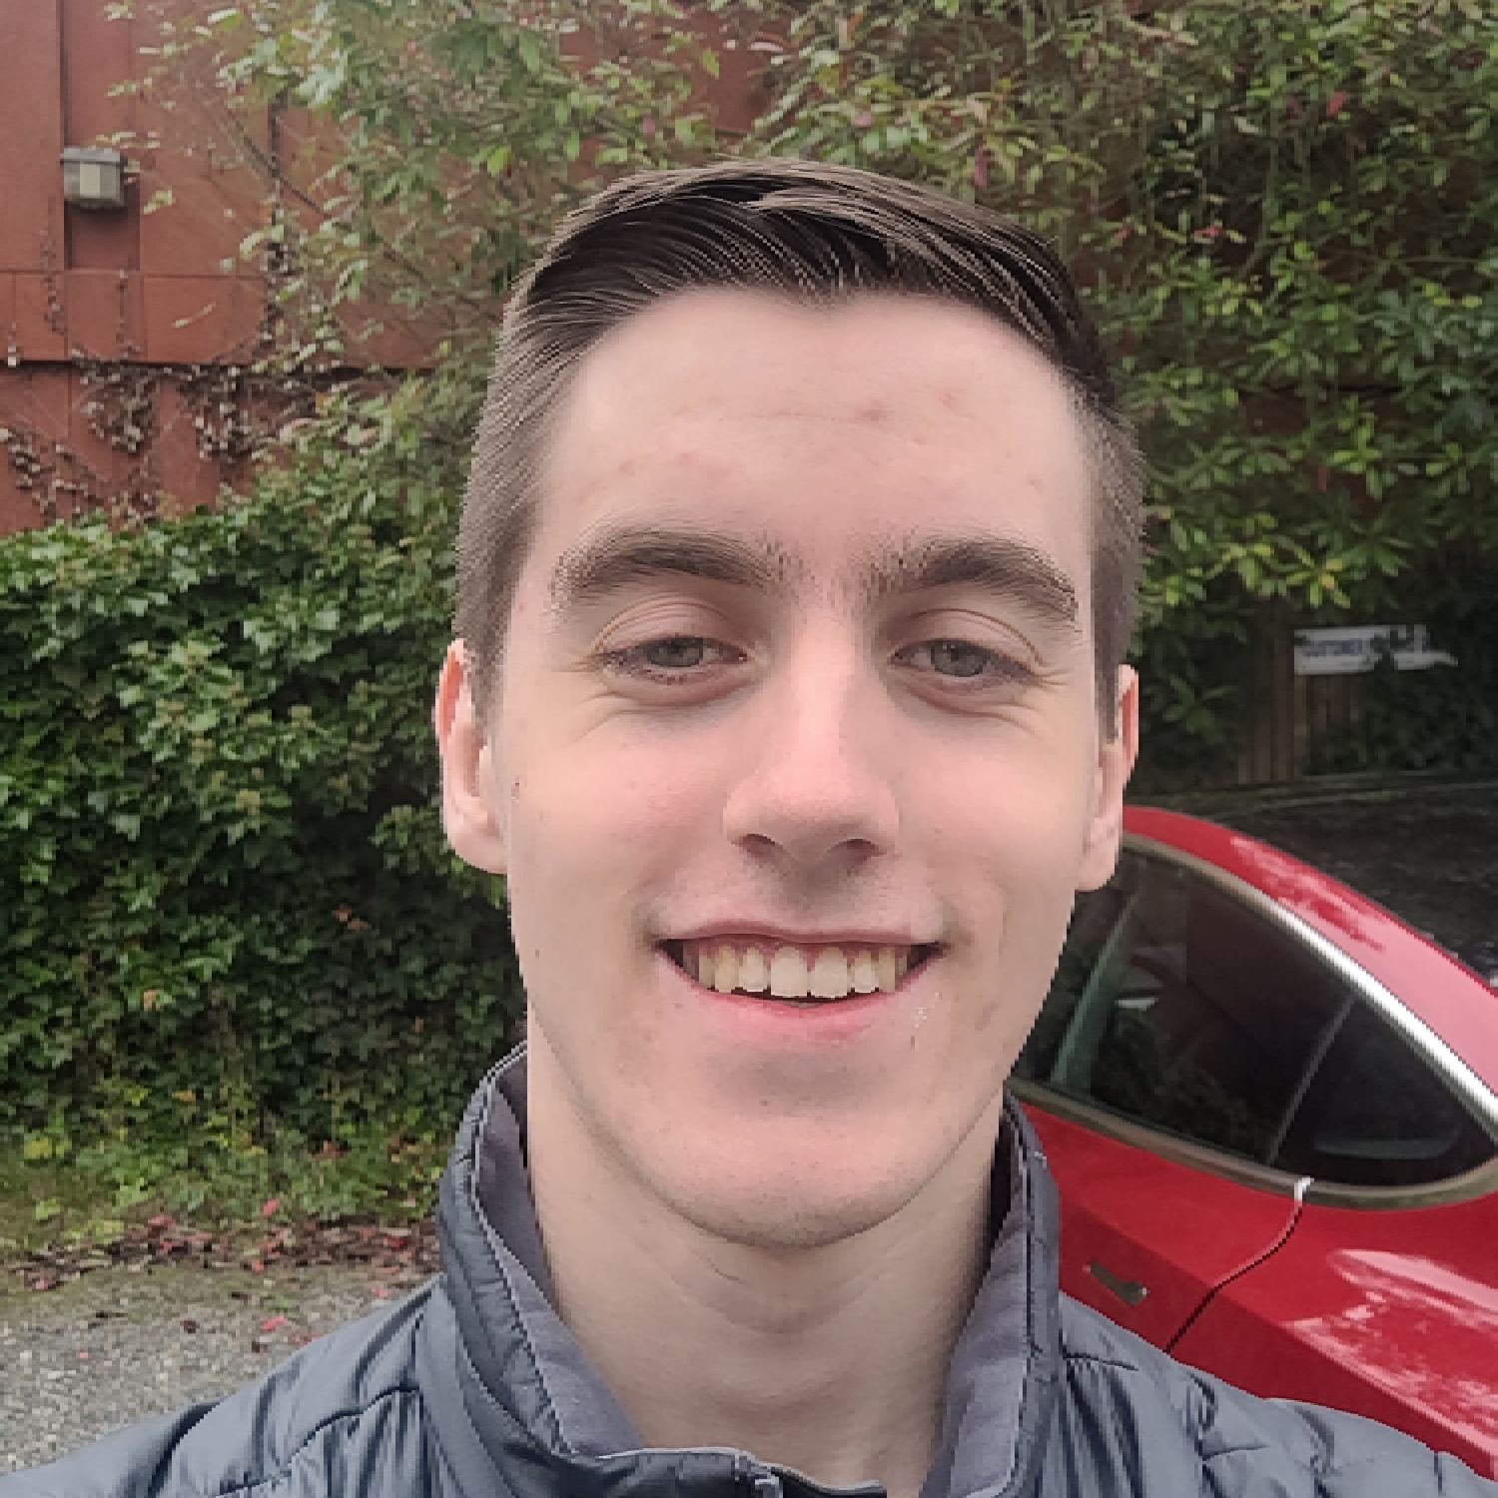
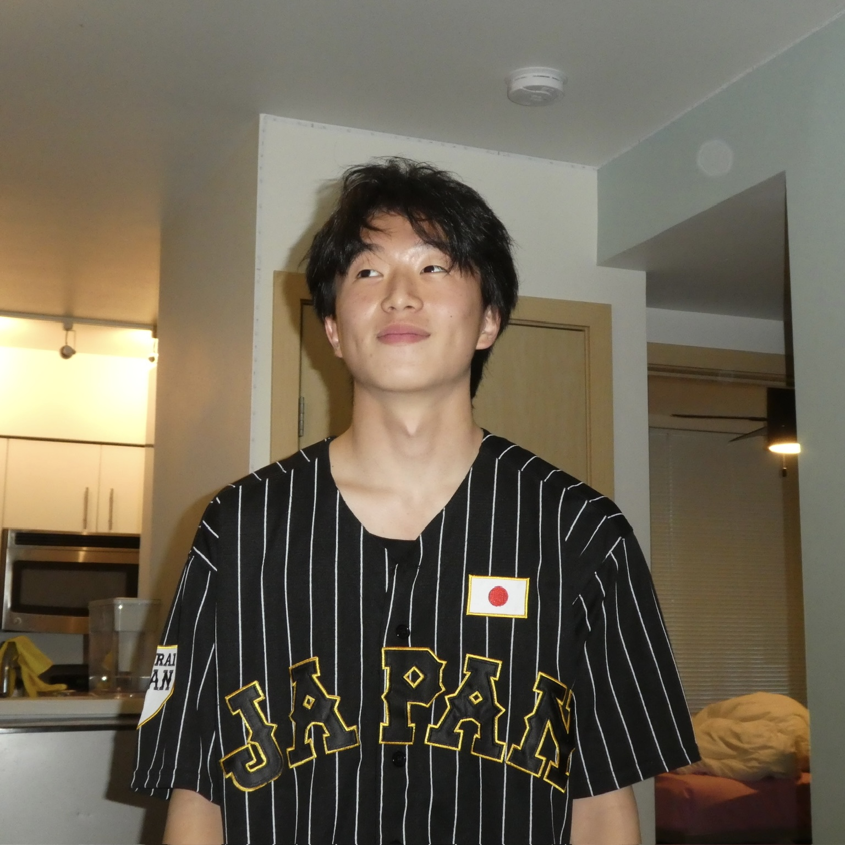
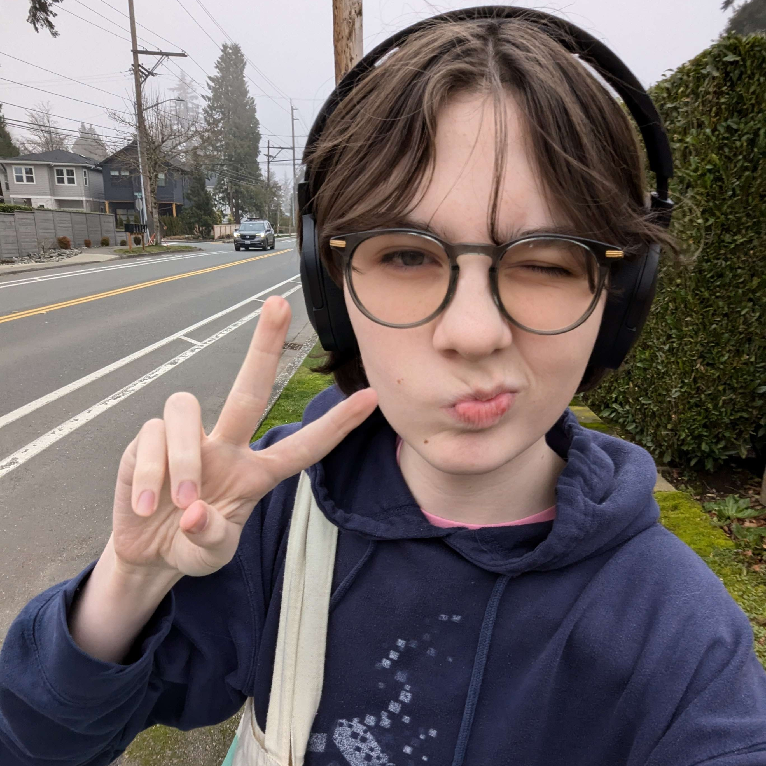


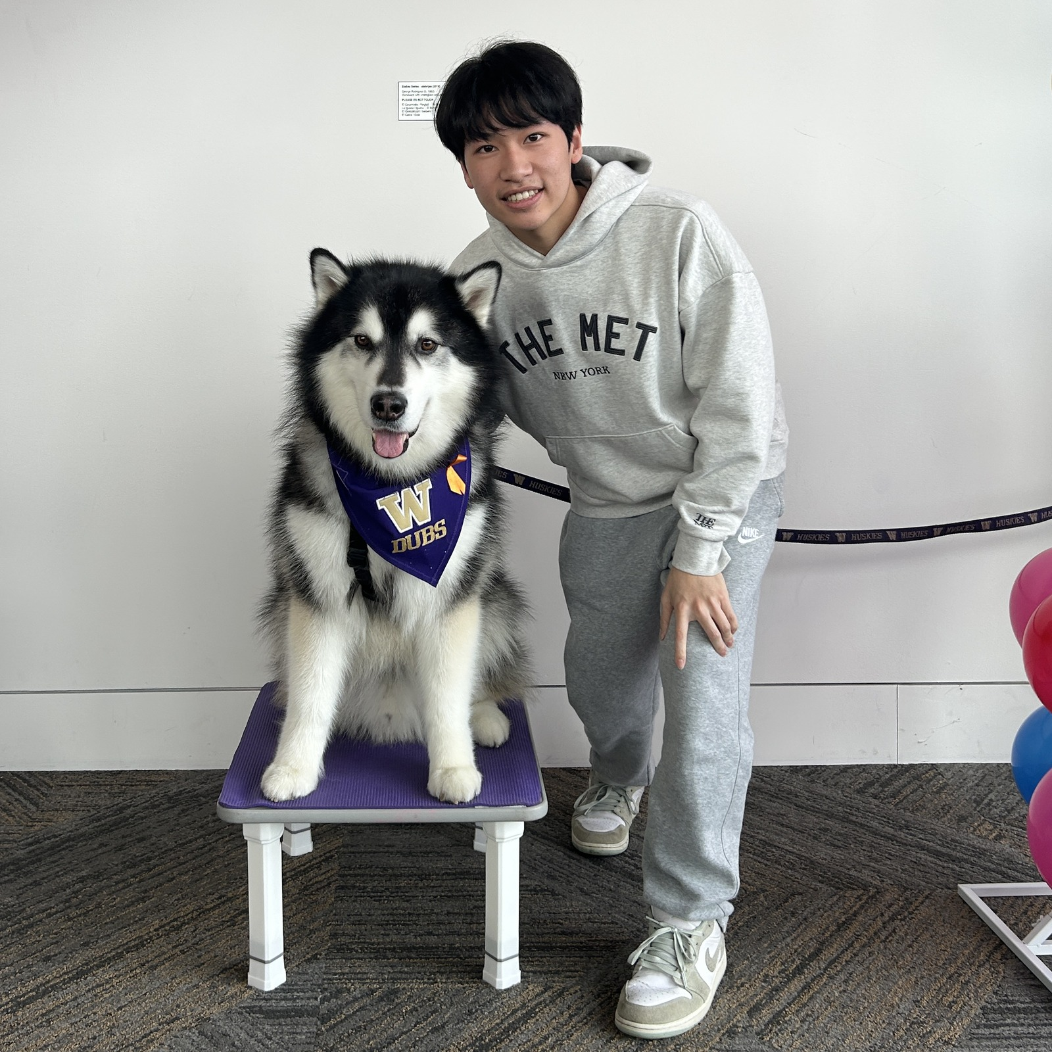
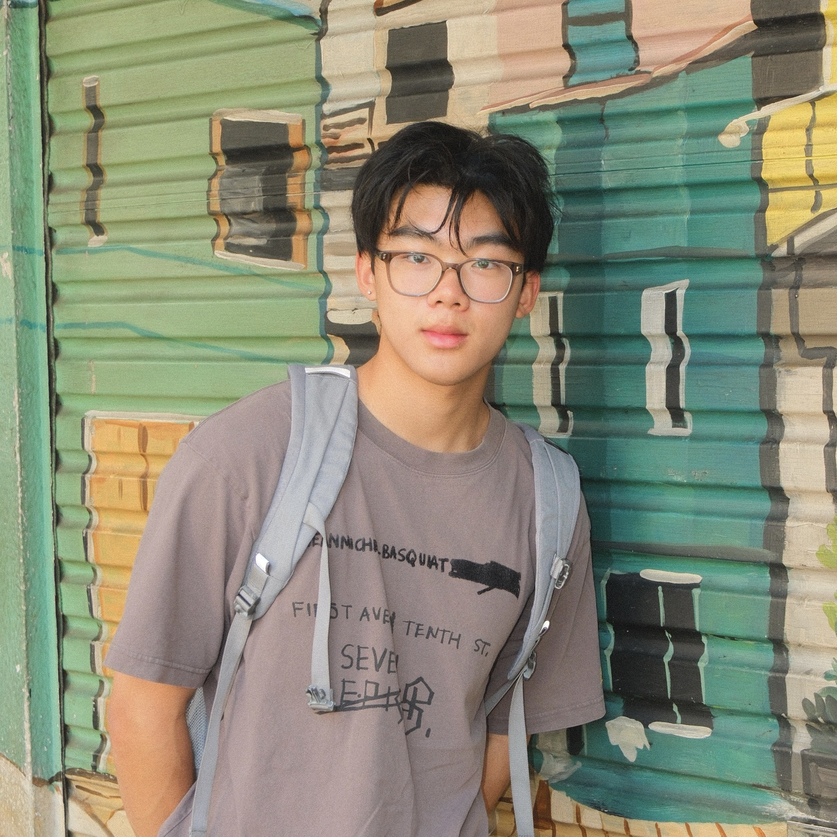
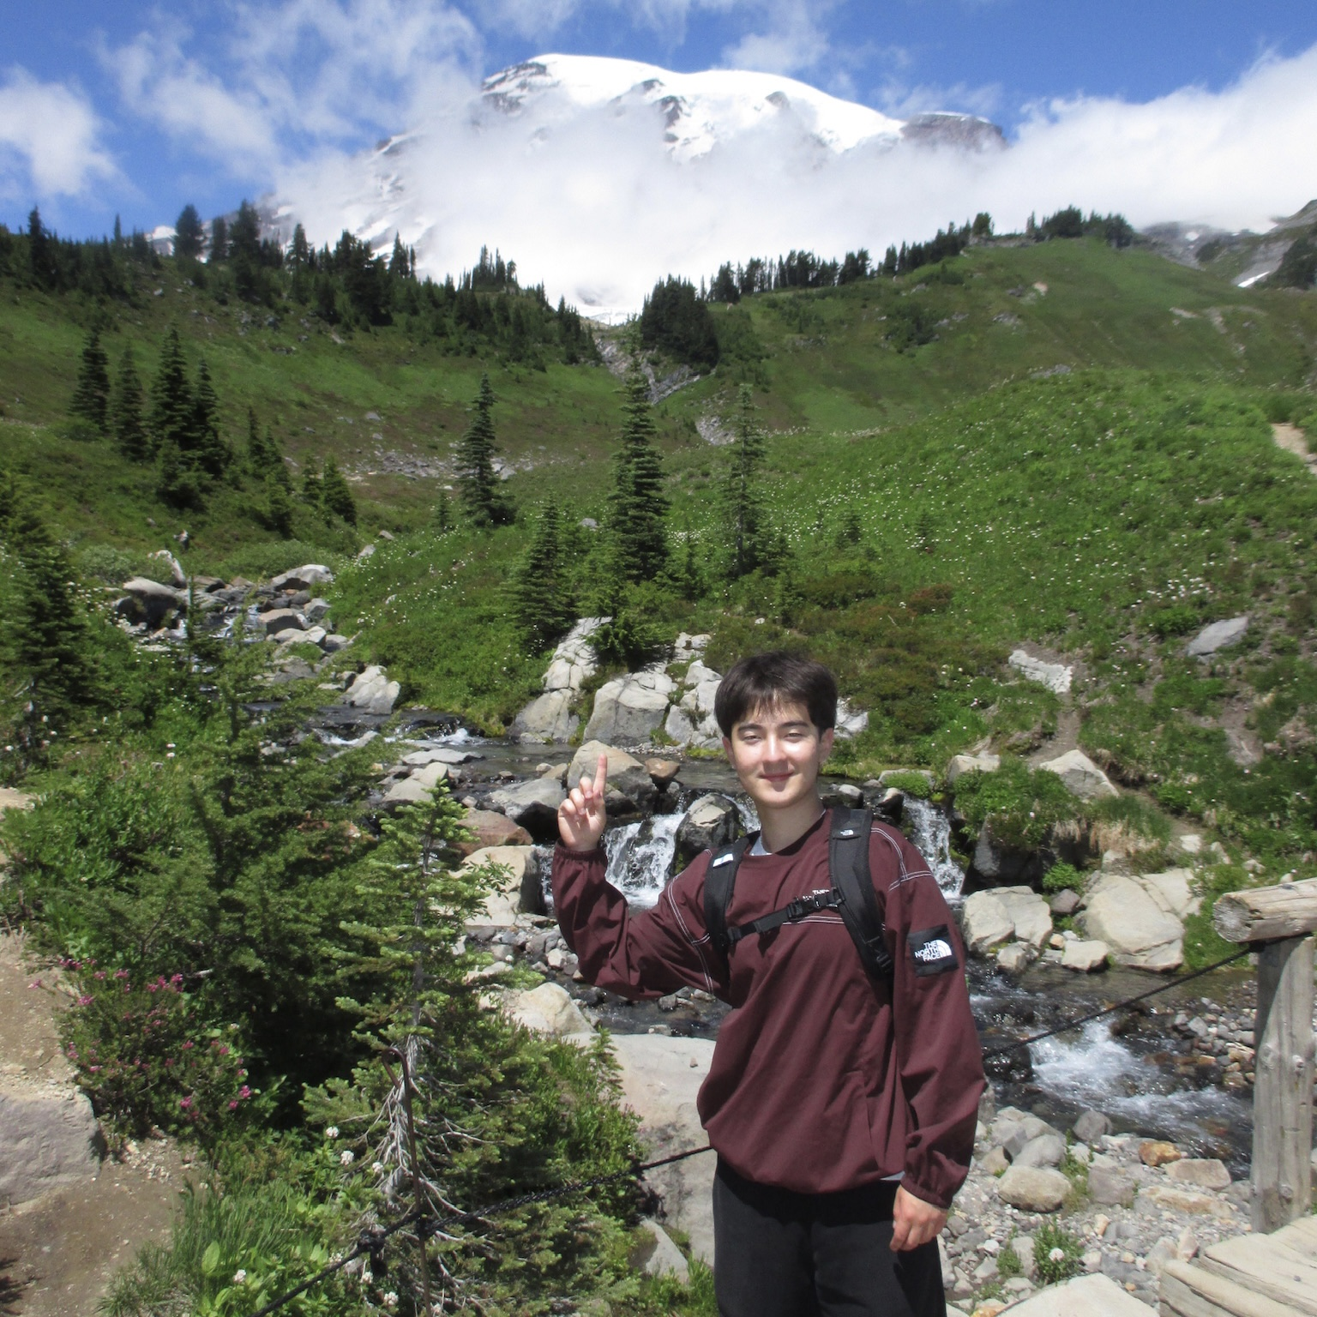
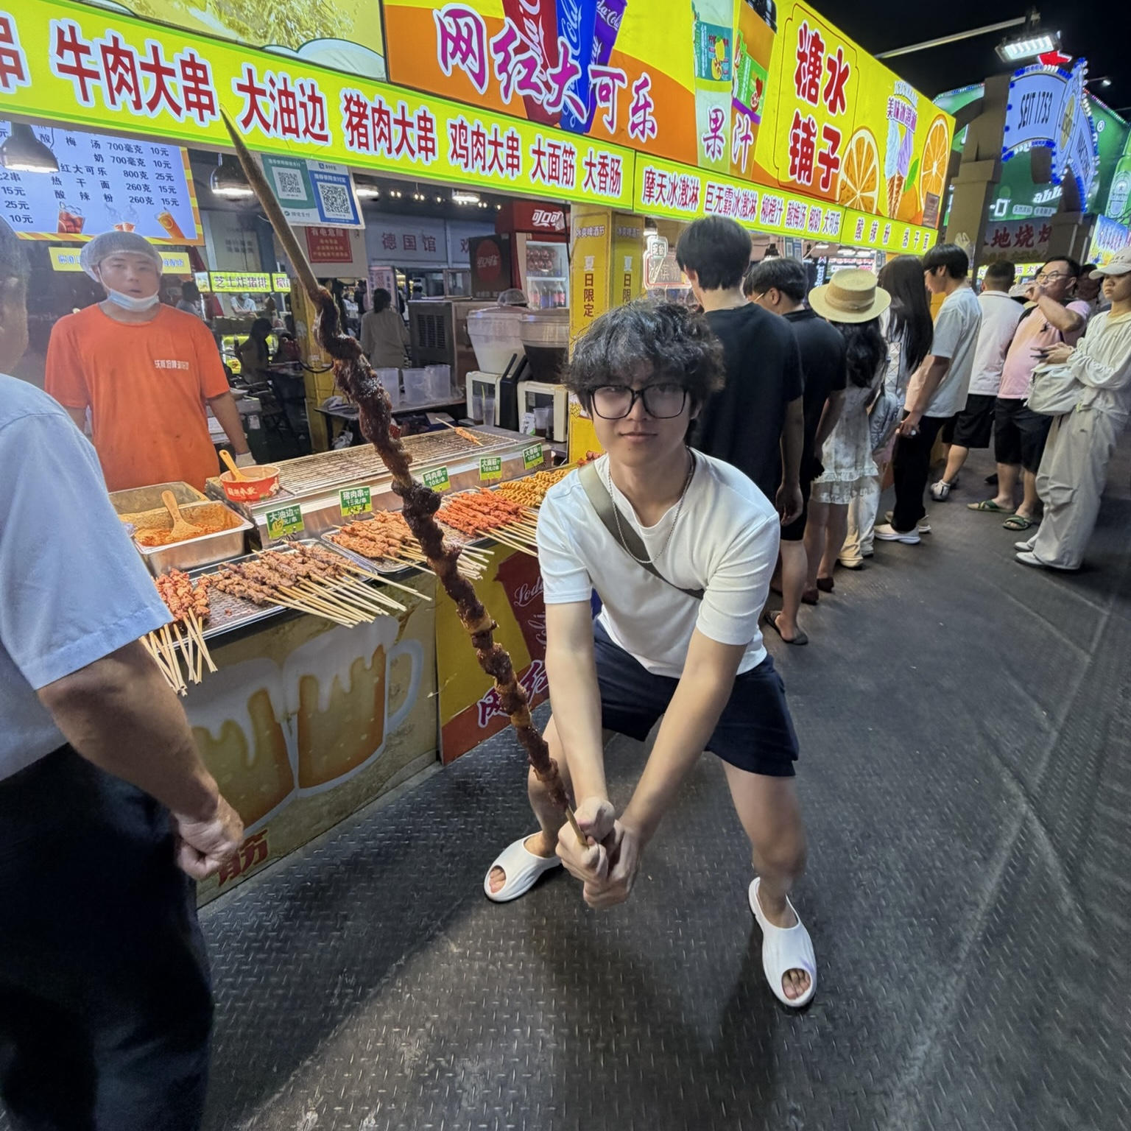


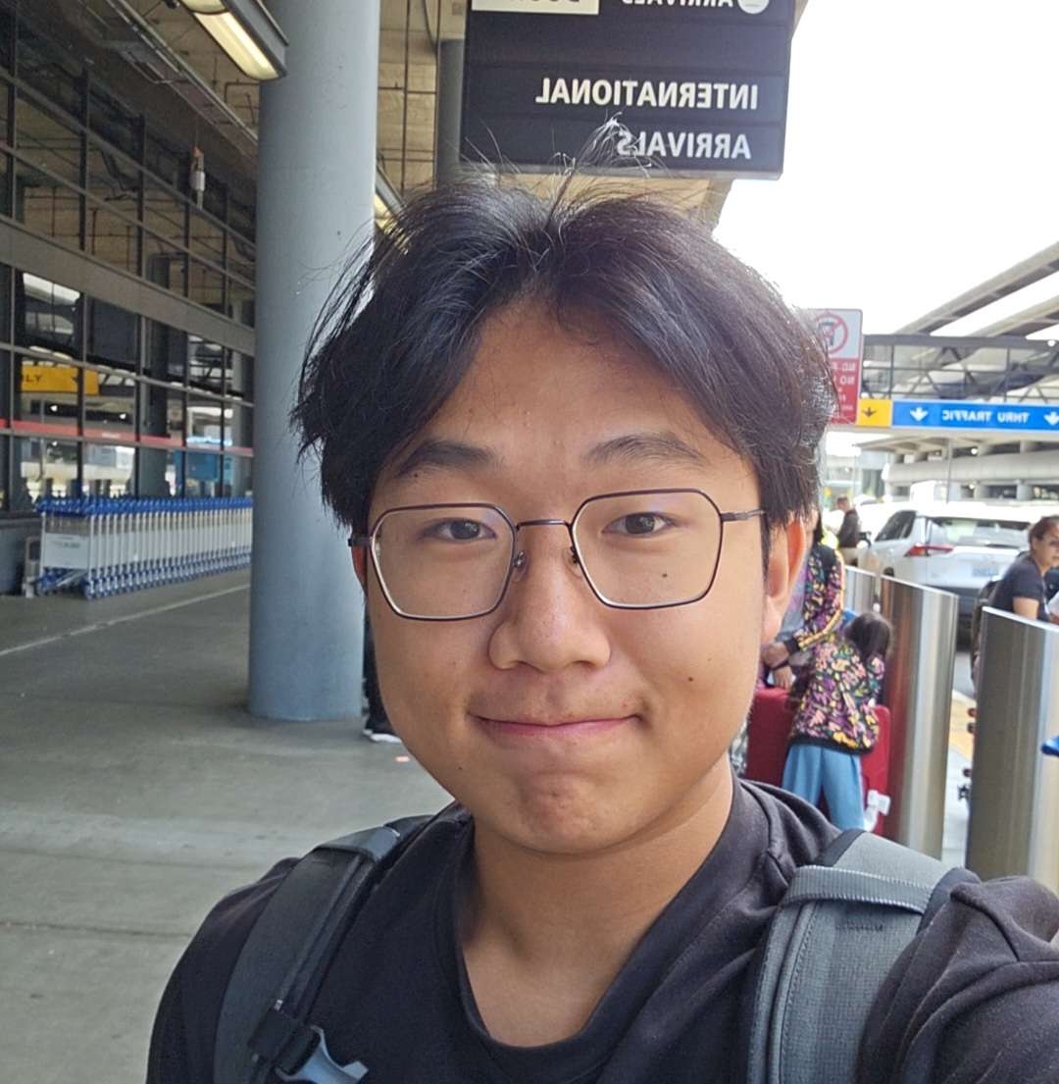

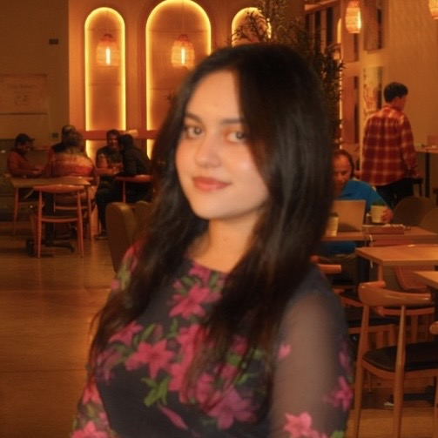
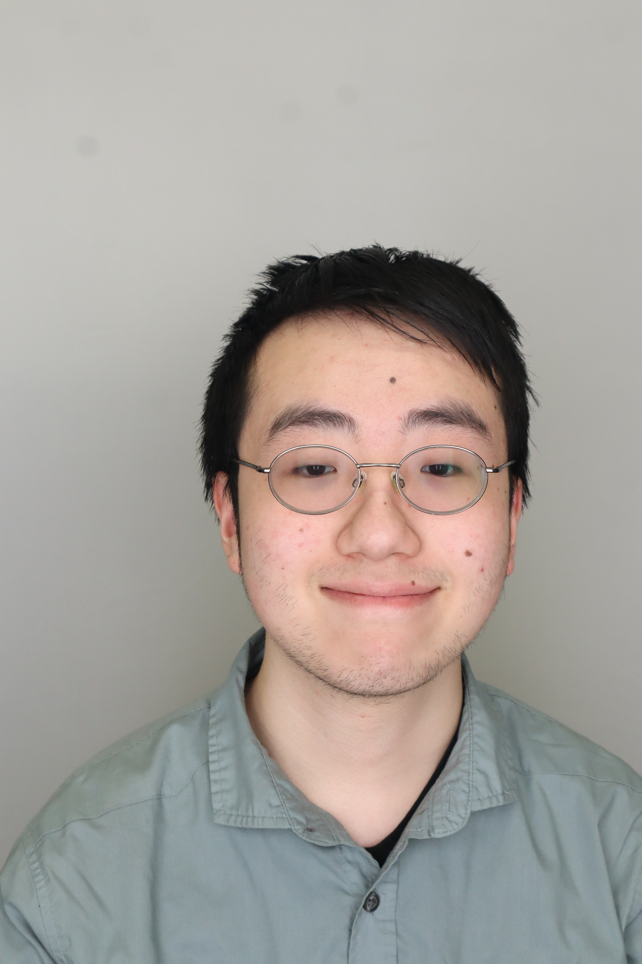


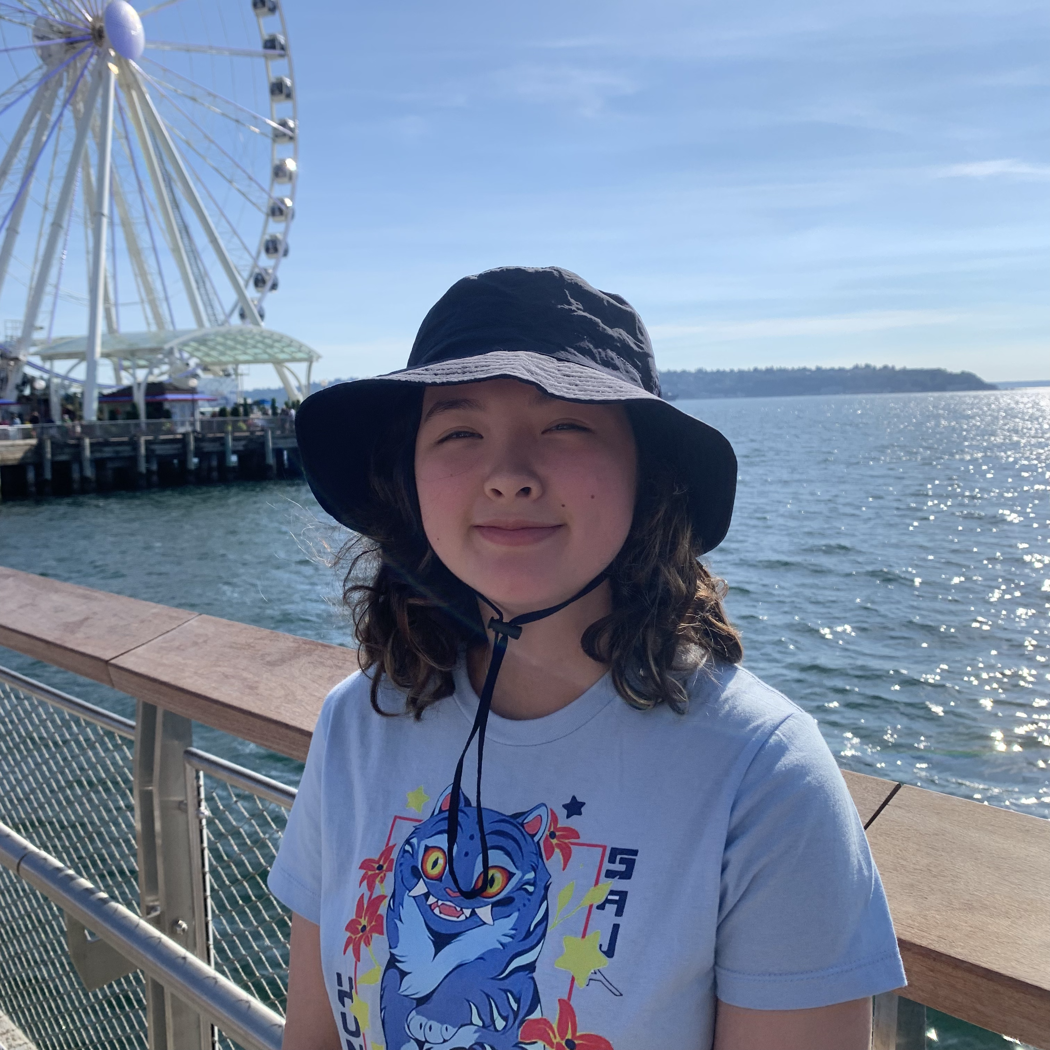
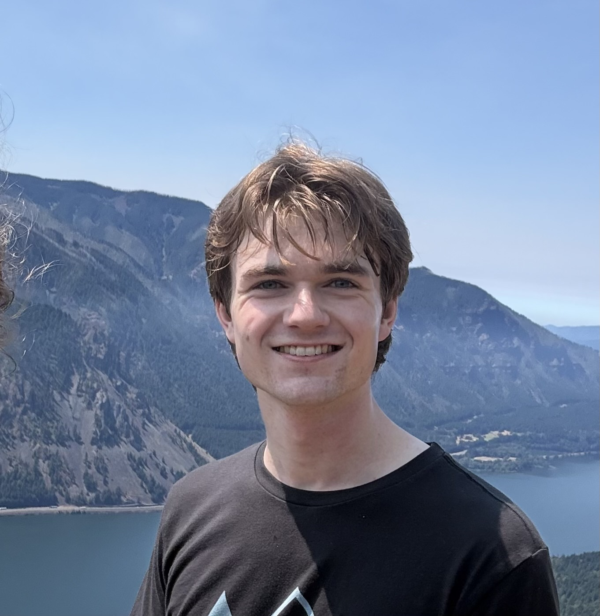
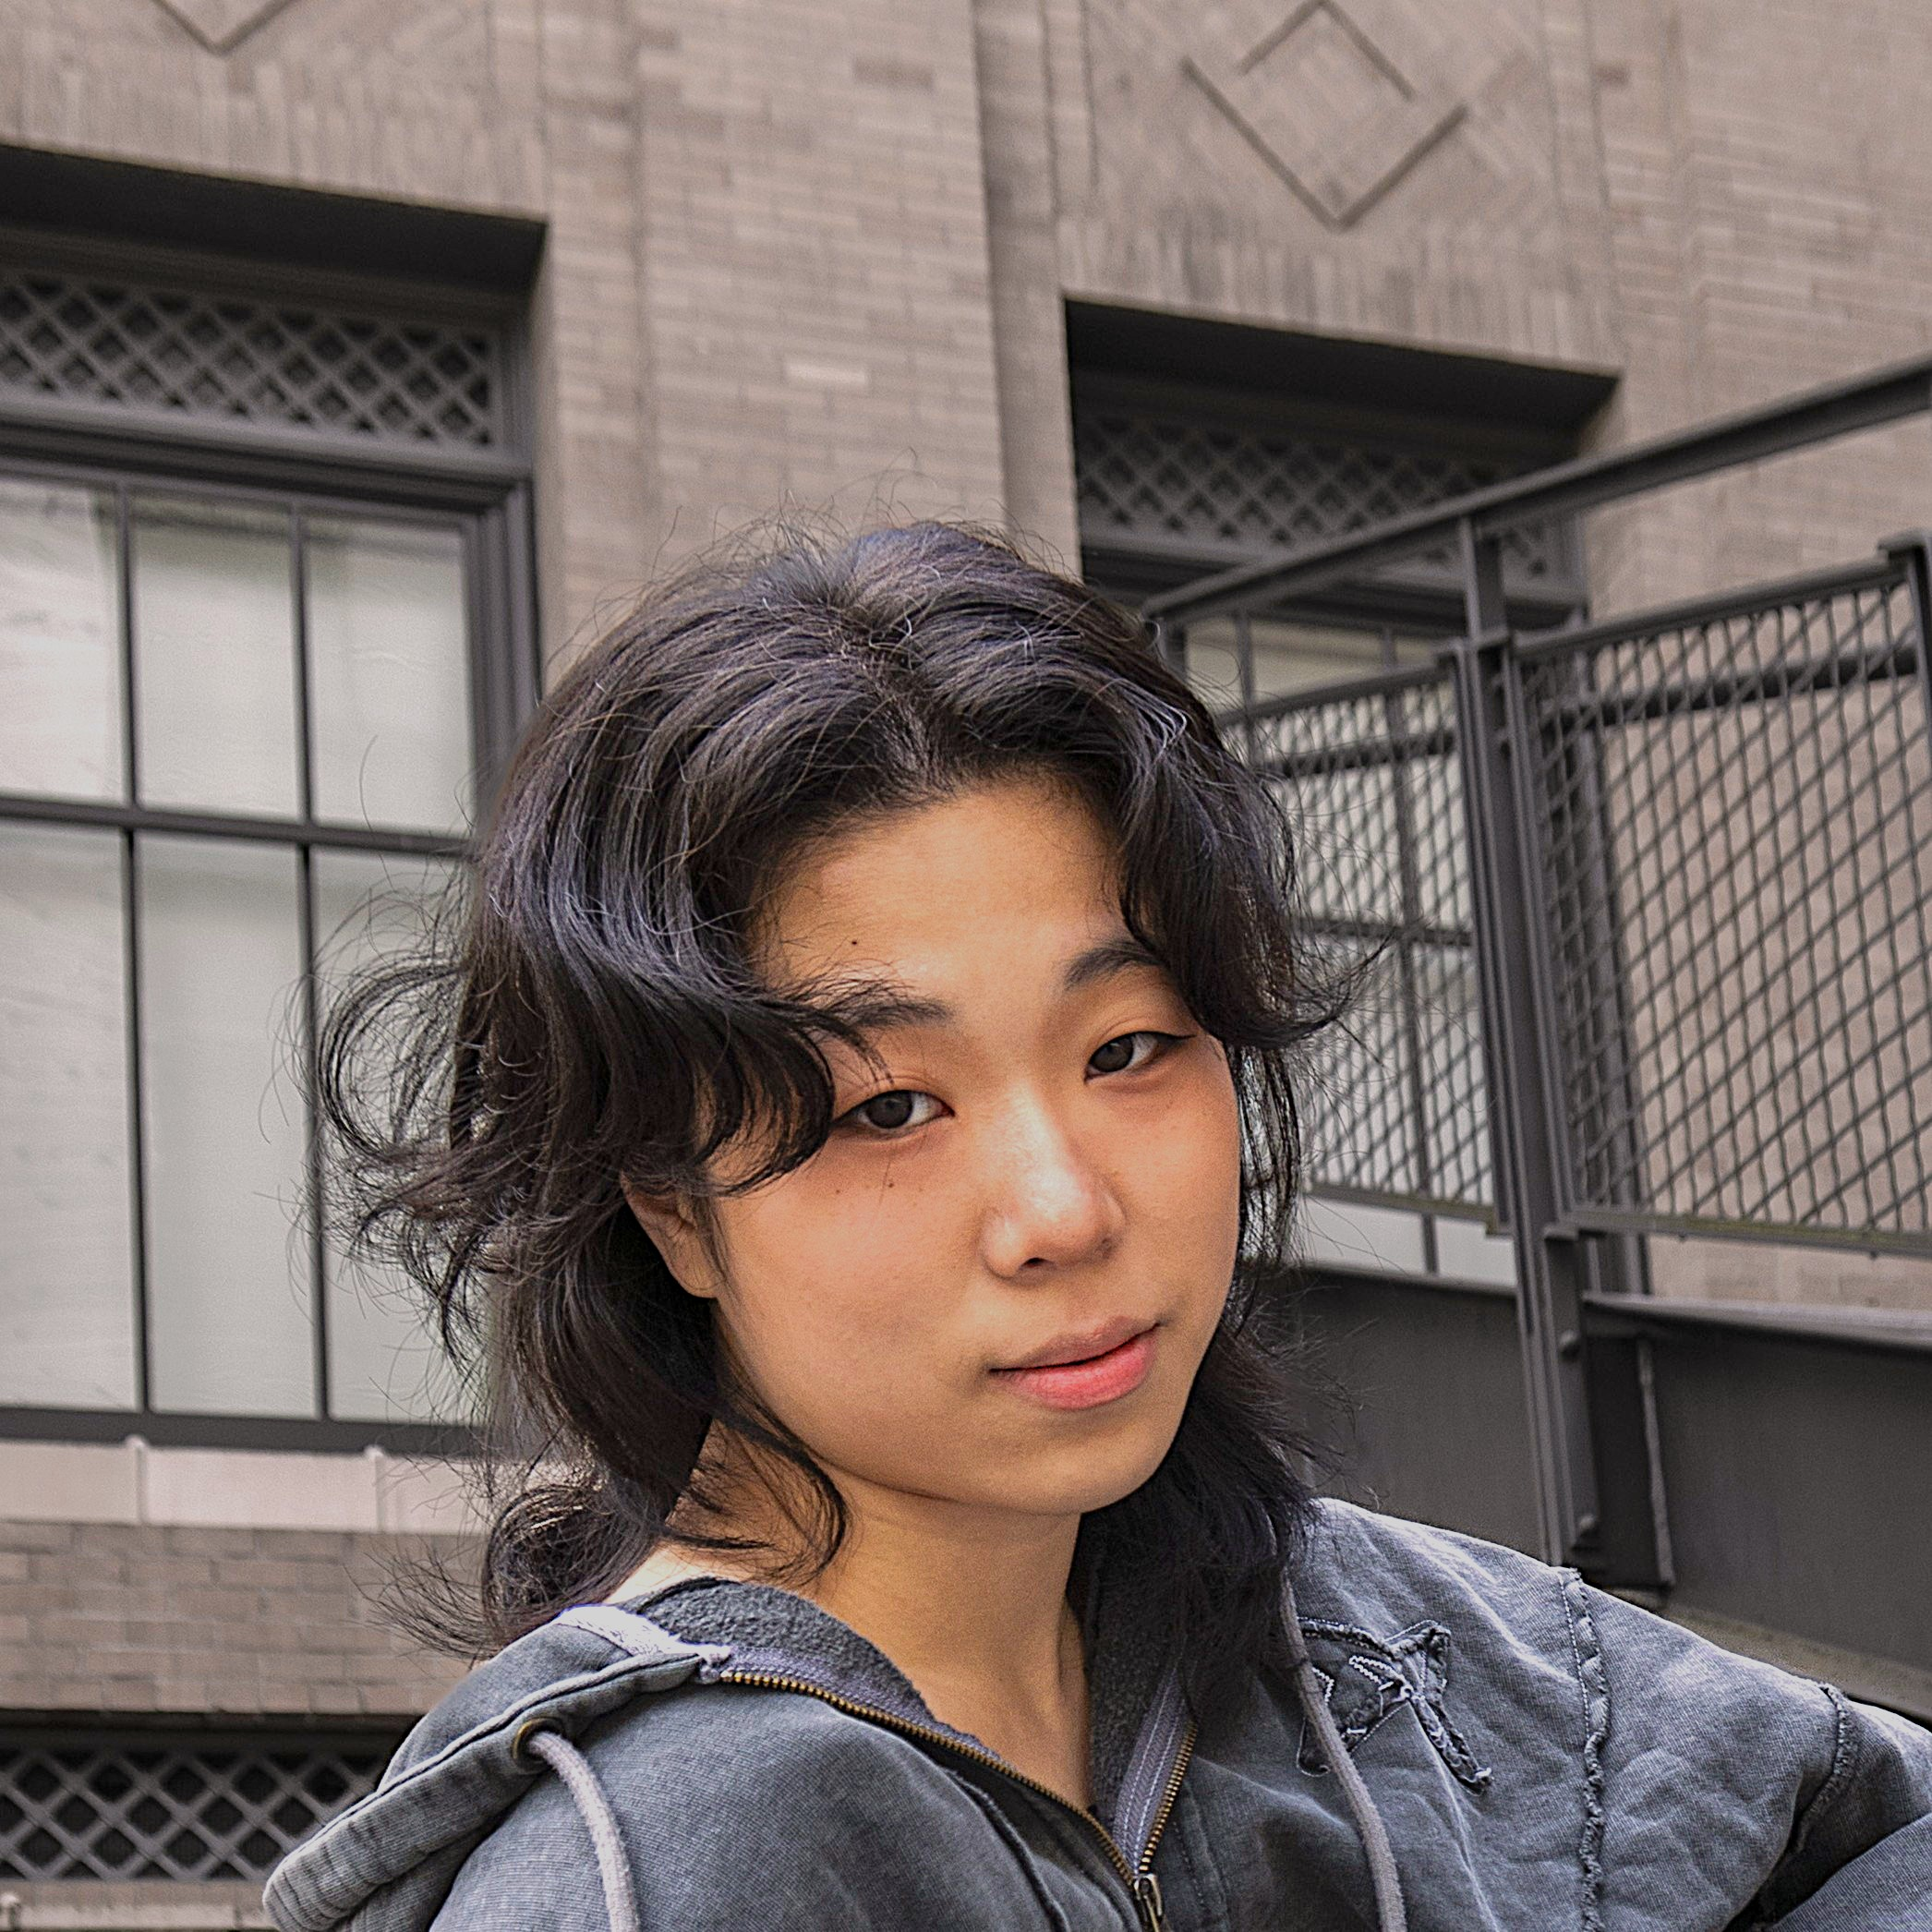
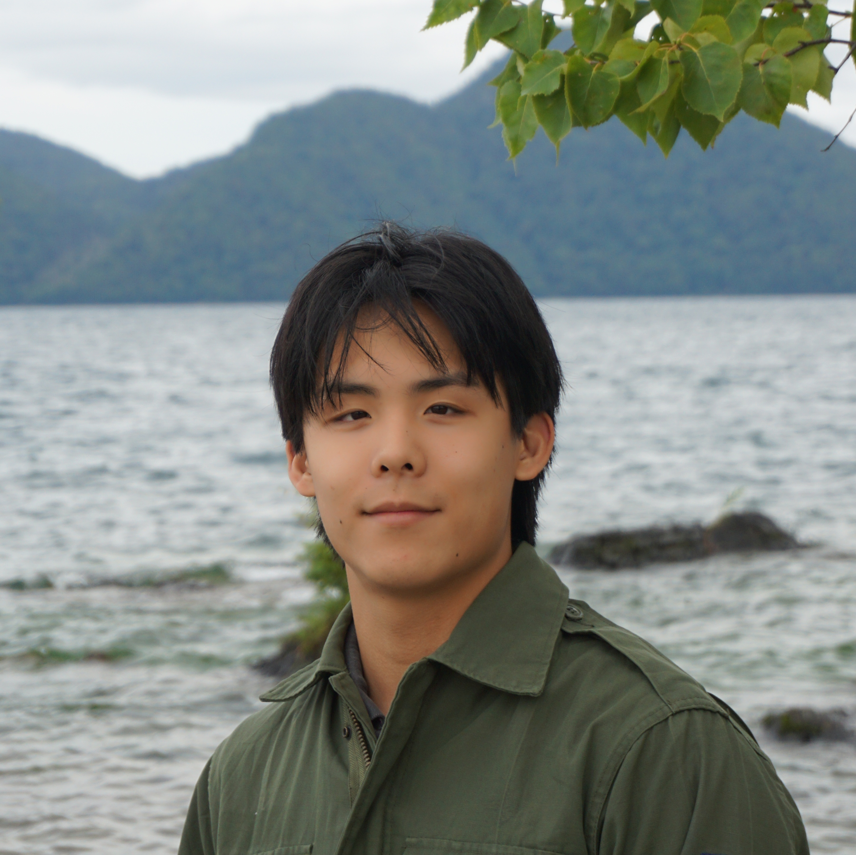


Meet your TAs!

Slide 5
Agenda: About This Course
Today:
Introductions :)
About this course
  Learning objectives
  Similar courses
  Course components
Our learning model
Culture and community
Tools
Our first program!
On Friday:
Assessment and grading
Collaboration
More programming!

Slide 6
Learning Objectives
or, “What will I learn in this class?”
Bottom line:
Intro to Programming, part 1
Not quite:
“How do computers work?”
“Intro to the Java language”
“All you need to program”
Math!
Learning Objectives:
Computational Thinking
Code Comprehension
Code Writing
Communication
Testing
Debugging
Ethics & Societal Impact

Slide 7
Other Similar Courses
Course | Good choice if…
CSE 121 (this is us!) | You’ve never programmed before AND You are, or want to be in a major such as CS, CE, ECE, Info, etc. that requires Java programming
CSE 122 | You’ve done some programming (roughly one course worth) in any programming language AND You are, or want to be in a major such as CS, CE, ECE, Info, etc. that requires Java programming
CSE 123 | You’ve taken CSE 122 (or equivalent) AND You are, or want to be in a major such as CS, CE, ECE, Info, etc. that requires Java programming
CSE 143 | You took CSE 142 (at UW, through UWHS, or at community college) OR You took AP CS A (or similar) and feel confident in all the material
CSE 143X | You have programmed quite a bit before, but not in Java OR You have lots of extra time to put into learning and tend to pick things up quickly
CSE 160 | You’ve never programmed before AND You’re interested in data science and analysis OR You’d rather learn Python than Java* OR You are, or want to be in a major such as Physics, Bio, Stat, etc. where your primary goal is analyzing data through programming (rather than building software)
Also see: guided self-placement and CSE page on introductory courses for more info.

Slide 8
Course Components
LECTURES
x16
PRE-CLASS MATERIALS
x~15
PROGRAMMING PROJECTS
x4
We’re here!
Introduce concepts, practice
ideas, discuss applications.
Pre-class materials to prepare for
class each day. Due before class.
Short lessons introducing concepts to be discussed in lecture that day
Due before each lecture
Structured assignments
Programming in Java
Applying & implementing course concepts
COMPUTER QUIZZES
x4
PAPER QUIZZES
x4
SECTIONS
x14
45 minutes, scheduled individually
Builds on the programming projects
Taken in quiz section/final exam period
45 minutes on paper
Held in person
More practice, reviews, applications
TA advice, how to be an effective student
Preparation for quizzes
Graded Assignments
Meetings

Slide 9
Agenda: Our Learning Model
Today:
Introductions :)
About this course
Our learning model
  Learning objectives
  Similar courses
  Course components
Culture and community
Tools
Our first program!
On Friday:
Assessment and grading
Collaboration
More programming!

Slide 10

How did you learn how to ride a bike?

Slide 11

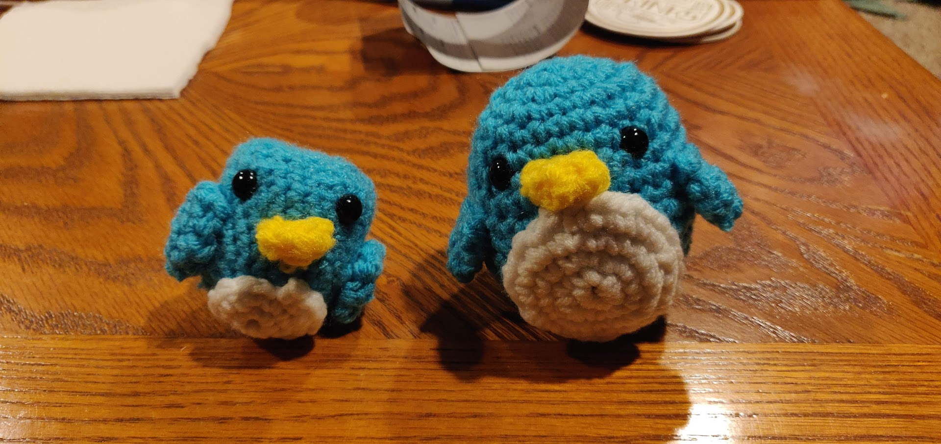
Digression: A Pandemic Hobby (1)
Amigurumi: Japanese art of creating crocheted or knitted stuffed toys

Slide 12
Digression: A Pandemic Hobby (2)
Amigurumi: Japanese art of creating crocheted or knitted stuffed toys

Slide 13

How Learning Works (Amigurumi)
Learning requires active participation in the process.
It’s not as simple as sitting and listening to someone talk at you!
Requires deliberate practice in learning by doing
Involves productive struggle
Benefits from collaborative learning
Does not work well if you cram everything!

Slide 14
How Learning Works
Learning requires active participation in the process.
It’s not as simple as sitting and listening to someone talk at you!
Requires deliberate practice in learning by doing
Involves productive struggle
Benefits from collaborative learning
Does not work well if you cram everything!

Slide 15
Learning and AI: Our Philosophy
AI amplifies the skills of the AI user
We cannot teach an introductory programming course without acknowledging the existence of AI tools.
We strongly believe in the value of learning the fundamentals of programming.
The ability to understand and modify code is more important than ever.
AI use is permitted on some assignments. AI use is not required.

Slide 16
Pre-Class Materials
PRE-CLASS MATERIALS
PCMs are a core element of the course
Prepare for each lecture with readings & practice problems
  Should take ~30 minutes per lecture (why we don’t have Monday lectures!)
Class will start with a brief recap, then pick off where we left off
This means…
      It’s okay if you find them challenging – that means you’re learning!
We can spend lecture diving deeper, answering questions, and think-pair-share
You can ask about pre-lecture material in class or section!

Slide 17
Consistent and Active Participation
ATTENDANCE
Lectures and sections are not going to be just us talking at you!
Instead: live in-class coding, debugging, think-pair-share, and problem—solving
Spending ~1-2 hours each day over Tuesday - Friday is much more effective than cramming right before a quiz!
Catching up:
All lectures are recorded on Panopto; slides are on our website.
Section materials are on Ed, but section will not be recorded

Slide 18
Metacognition
Metacognition: asking questions about your solution process.
Examples:
  While debugging (~troubleshooting): reflect on why you’re trying this change.
  Before running your program: make an explicit prediction of what you expect.
  When working: be aware when you’re not making progress, so you can take a
  break or try a different strategy.
  When designing:
    What are the hard parts of the problem going to be?
    If one or more requirements change, how would the solution change as a result?
    Reflect on how you ruled out alternative ideas along the way to a solution.
  When studying: what is the relationship of this topic to other ideas in the course?
We'll ask you to practice metacognition regularly throughout the course

Slide 19
Learning in CSE 121: Live Support Systems
Programming is hard! We want to give you collaborative support!
Introductory Programming Lab (TA Office Hours) – starting Week 2
many hours/week (and highly rated in the class!)
Face-to-face help from TAs on any course questions
Instructor Office Hours – starting this week!
Great for things from lecture, personal questions, or just saying hi

Slide 20
Learning in CSE 121: Async Support Systems
Ed Board
Best for content and logistics questions – 500+ of you!!
Encourage public posts, except for things about your graded work
Answer other students’ questions – great way to learn!
Email
Best for personal circumstances and/or private questions
Unsure? Feel free to email Miya and Anjali (both of us please!)
  cse121-instructors@cs.washington.edu
May politely ask you to post on Ed instead!
For emails, please use your UW email (protecting student privacy!)

Slide 21
Agenda: Culture and Community
Today:
Introductions :)
About this course
Our learning model
Culture and community
Tools
Our first program!
On Friday:
Assessment and grading
Collaboration
More programming!

Slide 22
Think-Pair-Share: Inclusive Environments
CSE 121 will have many think-pair-share activities. Let’s practice! Today’s think:
What was an experience you had that made you feel welcome or included in a learning environment?
Think on your own, in silence for about ~ 30 seconds
Pair with your neighbor about it (and introduce yourself!!)
Share in sli.do & in class (I’ll take a few volunteers from both)

Slide 23
Think-Pair-Share: Exclusive Environments
CSE 121 will have many think-pair-share activities. Let’s practice! Today’s think:
What was an experience you had that made you feel unwelcome or excluded in a learning environment?
Think on your own, in silence for about ~ 30 seconds
Pair with your neighbor about it (and introduce yourself!!)
Share in sli.do & in class (I’ll take a few volunteers from both)

Slide 24
The CSE 121 Community
ABOUT US
OUR GOALS
Currently ~580 students enrolled!
  Very few are CSE majors
  Wide range of backgrounds, interests, and goals
  Everyone is new to programming
Foster an inclusive and supportive environment for all students to thrive by:
  being respectful
  being kind and understanding
  being honest
  being ourselves

Slide 25
The World Around Us
College is challenging and CSE 121 isn’t your only class.
Life is unpredictable and things happen.
We can’t leave the impacts of the world around us at the classroom door.
OUR POLICIES
SUPPORT
Our course policies are designed for flexibility:
  Asynchronous help
  Lecture recordings
We’re here to support you as a student and as a person.
Please reach out if you’re struggling or have circumstances that require extra support.

Slide 26
Help Us Improve!
This is still a relatively new course! We’re always looking for feedback on how to improve the class for you and for future students.
We really value your feedback!
Let us know what’s working and what isn’t working for you!
Several feedback mechanisms:
Built into the class (e.g. reflections, mid-quarter feedback sessions)
Post on discussion board (can be public/private)
  Note: anonymous is anonymous to other students, not to staff
Use CSE’s Anonymous Feedback Tool (also on website)

Slide 27
Agenda: Tools
Today:
Introductions :)
About this course
Our learning model
Culture and community
Tools
  Course website
  Ed
  Other Key Course Tools
Our first program!
On Friday:
Assessment and grading
Collaboration
More programming!

Slide 28
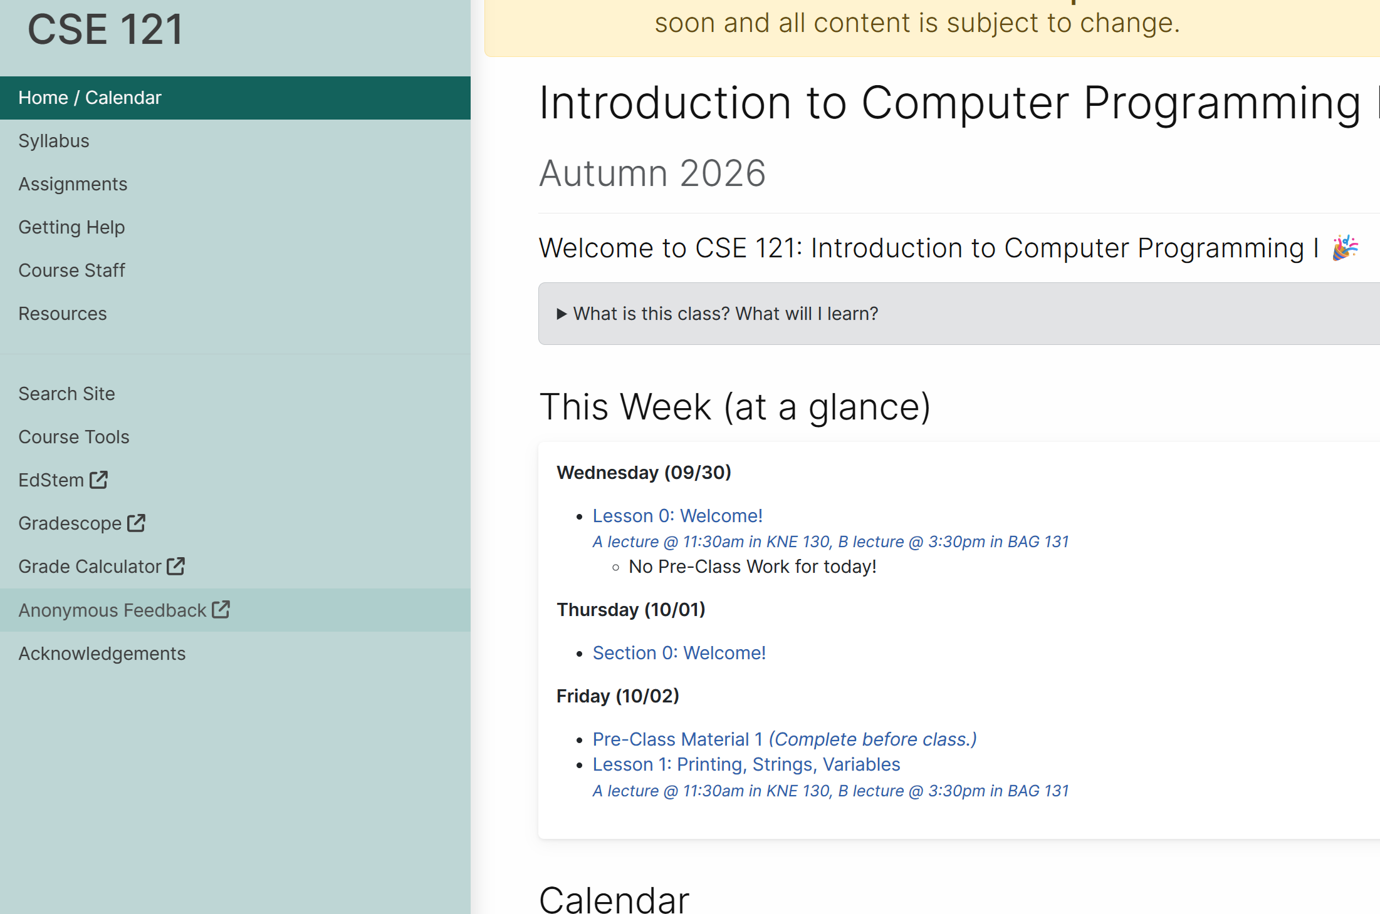
Course Website
cs.uw.edu/121
Primary source of course information (not Canvas)
Calendar will contain links to (almost) all resources
Please review syllabus ASAP
Let’s go on a website tour :)

Slide 29
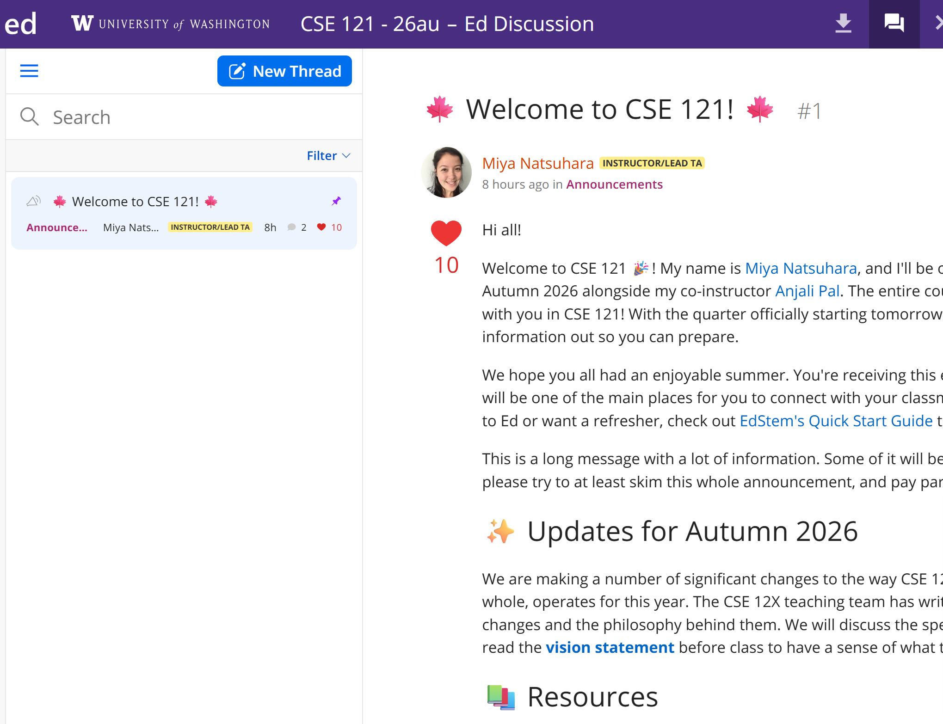
Ed
Our online learning platform
Lessons, sections, announcements
Place to ask questions
Also, where we’ll code!
Intro and walkthrough in Section 0

Slide 30



Other Key Course Tools
sli.do
Ask questions in class
Live activities (ungraded)
No account needed
Canvas
Panopto lecture recordings
(also linked from website)
Gradescope
Quiz and final exam grading
Pre-section work
more course tools introduced soon™️

Slide 31
Switching to Ed: Our First Program!*
*note: in almost all cases, slides are not comprehensive. reviewing the slides will not cover all the content in lecture!

Slide 32
“Homework” for Next Time
First assignment will be released next week, but there are some things to do in the meantime.
TODOs this week:
Fill out the introductory survey (this is part of your pre-section work for tomorrow's section)
Go meet your TA and classmates in Thursday’s quiz section
Complete the pre-class material for Friday (see website/calendar)
Check over syllabus details on website

