Slide 1
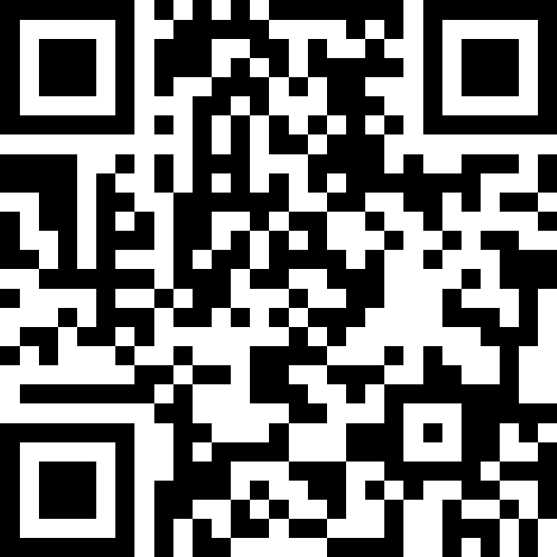
Conditionals
BEFORE WE START
Talk to your neighbours:
What’s your favourite book?
LEC 09
Music: 121 25wi lecture playlist ❄️
Instructor:
Matt Wang
TAs:
Ailsa Alice Chloë Christopher
Ethan Hanna Hannah Hibbah
Janvi Judy Julia Kelsey
Lucas Luke Maitreyi Merav
Ruslana Samrutha Sam Shayna
Sushma Vivian

Slide 2
Announcements, Reminders
C2 released, due Thursday, Feb 13th
R2 out yesterday, due Thursday, Feb 13th
note: this is the last time C0 is eligible for resubmission!
Almost half-way through – feedback wanted!
next Wed, Feb 12th – mid-quarter feedback, during lecture
next Tue, Feb 11th – quiz section feedback, during section
Quiz reminders:
Quiz 0: next Thursday, Feb 13th
Quiz 1: the following Thursday, Feb 20th

Slide 3
Oh, and a quick note on class comments
tl;dr: Matt points out that we’ve adjusted our class comment guidance in the commenting guide.
We’ll retroactively apply this from P1 onwards.
(it’s generally in your favour!)

Slide 4
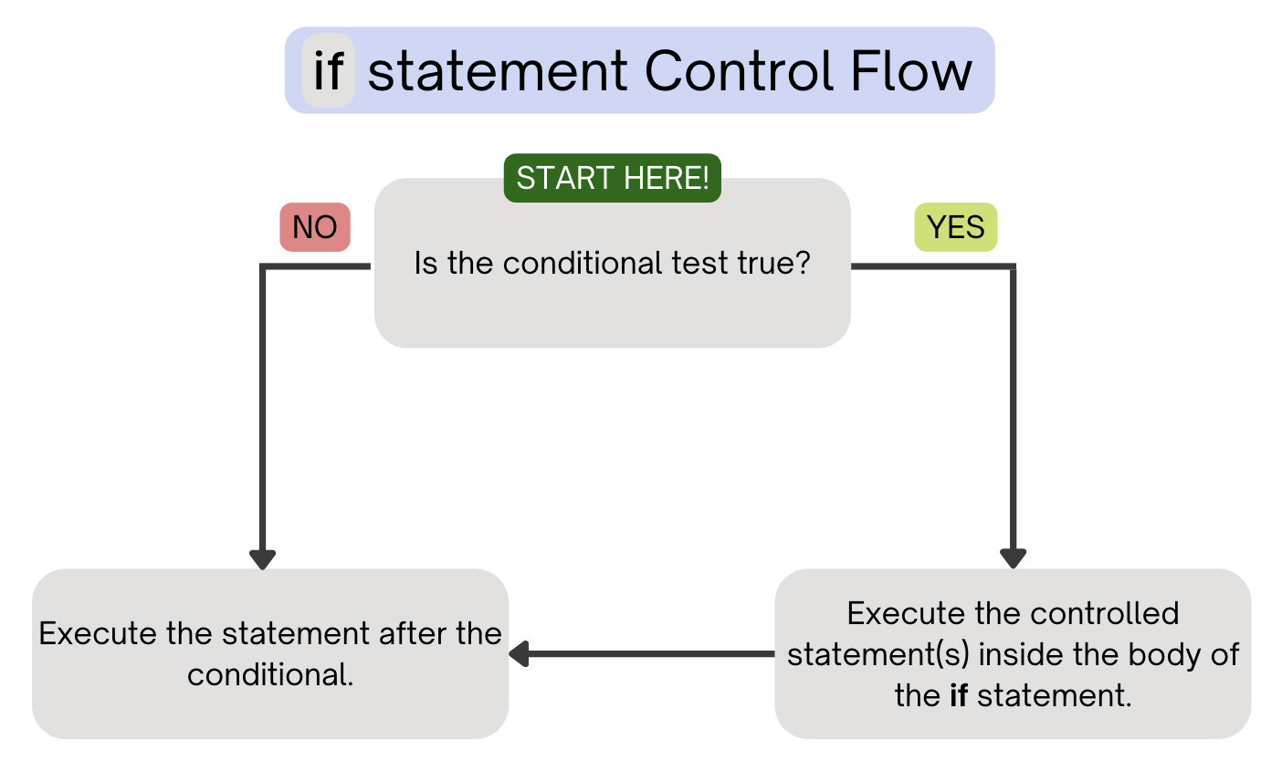
PCM Review: if statements
Executes a block of statements if and only if the test is true

Slide 5
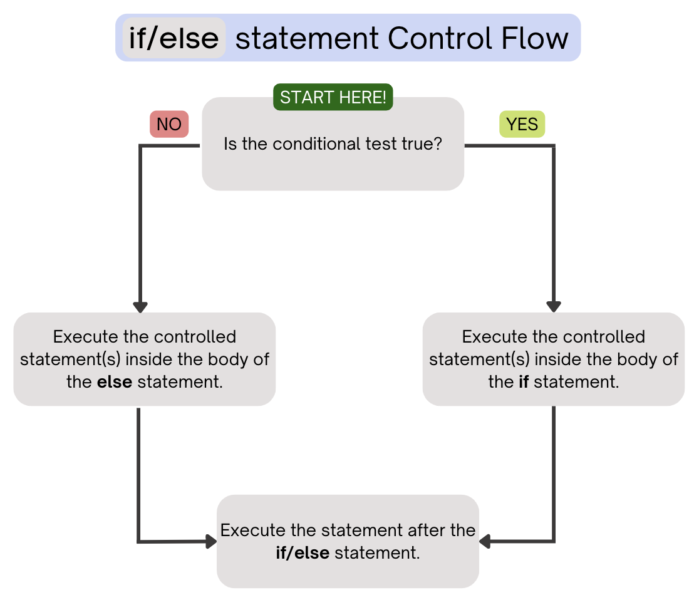
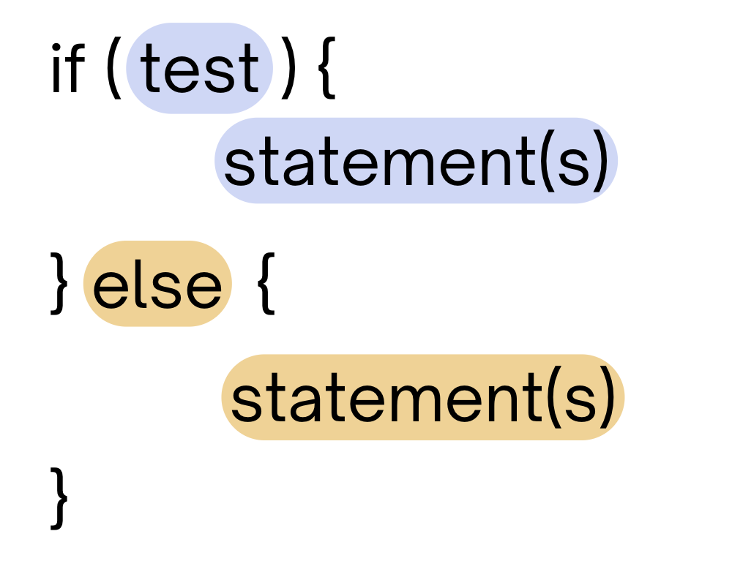
PCM Review: if-else
If the test is true: execute block of statements
If not, execute other block of statements

Slide 6
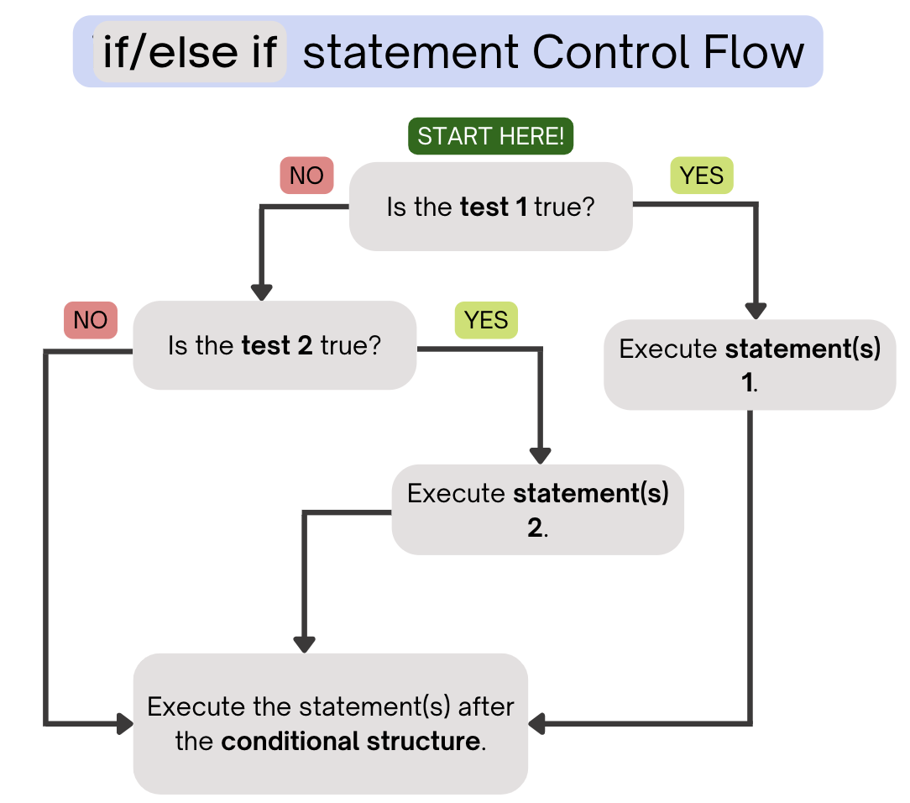
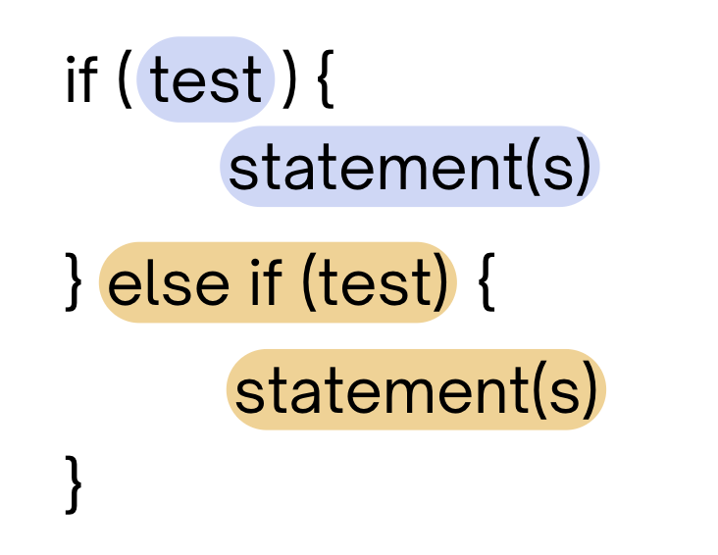
PCM Review: if-else-if
If the first test is true, execute that block
If not, proceed to the next test, and repeat
If none were true, don’t execute any blocks

Slide 7
Think Pair Share: odds and evens (think)
public static void main(String[] args) {
for (int i = 1; i <= 3; i++) {
System.out.print(mystery(i));
}
}
public static String mystery(int n) {
String response = "even ";
if (n % 2 == 1) {
response = "odd ";
} else if (n == 1) {
response = "one ";
}
return response;
}
What does this program output?
A. odd even odd
B. one even odd
C. one even even
D. even even even

Slide 8
Think Pair Share: odds and evens (pair)
public static void main(String[] args) {
for (int i = 1; i <= 3; i++) {
System.out.print(mystery(i));
}
}
public static String mystery(int n) {
String response = "even ";
if (n % 2 == 1) {
response = "odd ";
} else if (n == 1) {
response = "one ";
}
return response;
}
What does this program output?
A. odd even odd
B. one even odd
C. one even even
D. even even even

Slide 9
“Useless” Conditionals (and “Boolean Zen”)
public static void main(String[] args) {
for (int i = 1; i <= 3; i++) {
System.out.print(mystery(i));
}
}
public static String mystery(int n) {
String response = "even ";
if (n % 2 == 1) {
response = "odd ";
} else if (n == 1) {
response = "one ";
}
return response;
}
This else if statement never runs!

Slide 10
Common Problem-Solving Strategies (1/2)
Analogy – Is this similar to another problem you've seen?
Brainstorming – Consider steps to solve problem before jumping into code
Try to do an example "by hand" → outline steps
Solve sub-problems – Is there a smaller part of the problem to solve?
Debugging – Does your solution behave correctly?
What is it doing?
What do you expect it to do?
What area of your code controls that part of the output?
Iterative Development – Can we start by solving a different problem that is easier?

Slide 11
Common Problem-Solving Strategies (2/2)
Analogy – Is this similar to another problem you've seen?
Brainstorming – Consider steps to solve problem before jumping into code
Try to do an example "by hand" → outline steps
Solve sub-problems – Is there a smaller part of the problem to solve?
Debugging – Does your solution behave correctly?
What is it doing?
What do you expect it to do?
What area of your code controls that part of the output?
Iterative Development – Can we start by solving a different problem that is easier?

Slide 12
Announcements, Reminders (again)
C2 released, due Thursday, Feb 13th
R2 out yesterday, due Thursday, Feb 13th
note: this is the last time C0 is eligible for resubmission!
Almost half-way through – feedback wanted!
next Wed, Feb 12th – mid-quarter feedback, during lecture
next Tue, Feb 11th – quiz section feedback, during section
Quiz reminders:
Quiz 0: next Thursday, Feb 13th
Quiz 1: the following Thursday, Feb 20th

