Slide 1
for Loops
BEFORE WE START
Talk to your neighbors:
What did you do for the long weekend?
LEC 04
Music: 121 25wi lecture playlist ❄️
Instructor:
Matt Wang
TAs:
Ailsa Alice Chloë Christopher
Ethan Hanna Hannah Hibbah
Janvi Judy Julia Kelsey
Lucas Luke Maitreyi Merav
Ruslana Samrutha Sam Shayna
Sushma Vivian

Slide 2
Announcements, Reminders
Feedback for C0 released yesterday!
please view your feedback – crucial part of learning process
for regrades (not resubs), please make a private Ed post
C1 releasing later today, due Tuesday, Jan 28th
first assignment with an “unsolved” problem!
Resubmission Cycle 0 (R0) opening tomorrow, due Thursday Jan 30th
Quiz 0 is on Thursday, February 6th (in your registered quiz section)
can’t make it? email Matt ASAP

Slide 3
Reminder: Resubmissions (or “resubs”)
Each week, you may resubmit one Programming Assignment or Creative Project with no penalty. The grade of your resubmission will completely replace your previous grade.
This is a huge opportunity: you get to resubmit your work after we grade it and give you feedback! Please take advantage of this :)
(if you miss an assignment and/or only finish it late – use a resub!)

Slide 4
Resub Logistics
Some logistics:
there are 8 total resub cycles this quarter (and 8 assignments … hm)
assignments eligible to resubmit for 3 cycles after feedback is out
To resubmit:
make and submit your changes
set the submission you want graded as “Final”
submit a Google Form, with a reflection, to confirm your resub
you must submit the form before the deadline for resub to count

Slide 5
NOTE FOR THOSE AT HOME (A START)
This is one of the rare times where the slides will differ for A and B section, since I made an error in the A lecture that I resolved for the B lecture.
The following slides are only for those in A section.
(the slides marked “note for those at home” mark the start and end of the A & B lecture slides)

Slide 6
Correcting a mistake…
Last lecture, I did an example out of order – sorry!
Things that I meant to explain:
.toUpperCase()
single versus double-argument substring
IndexOutOfBoundsException
inclusive versus exclusive bounds
I will do that right now, but if you were confused on Friday, that’s ok!

Slide 7
NOTE FOR THOSE AT HOME (B START)
This is one of the rare times where the slides will differ for A and B section, since I made an error in the A lecture that I resolved for the B lecture.
The following slides are only for those in B section.
(the slides marked “note for those at home” mark the start and end of the A & B lecture slides)

Slide 8
Think Pair Share: gumball Variables (Think)
Suppose s contains the String "bubble gum". Which statement would result in s containing "Gumball" instead?
s.substring(7) + "ball";
s = s.substring(7, 9) + "ball";
s = s.charAt(7).toUpperCase() + "ball";
s = s.substring(7, 8).toUpperCase() + s.substring(8) + "ball";
b | u | b | b | l | e |  | g | u | m
0 | 1 | 2 | 3 | 4 | 5 | 6 | 7 | 8 | 9

Slide 9
Think Pair Share: gumball Variables (Pair)
Suppose s contains the String "bubble gum". Which statement would result in s containing "Gumball" instead?
s.substring(7) + "ball";
s = s.substring(7, 9) + "ball";
s = s.charAt(7).toUpperCase() + "ball";
s = s.substring(7, 8).toUpperCase() + s.substring(8) + "ball";
b | u | b | b | l | e |  | g | u | m
0 | 1 | 2 | 3 | 4 | 5 | 6 | 7 | 8 | 9

Slide 10
NOTE FOR THOSE AT HOME (A & B END)
This is one of the rare times where the slides will differ for A and B section, since I made an error in the A lecture that I resolved for the B lecture.
After this slide, we’re back to regularly scheduled programming (i.e. the same slides for both).
(the slides marked “note for those at home” mark the start and end of the A & B lecture slides)

Slide 11
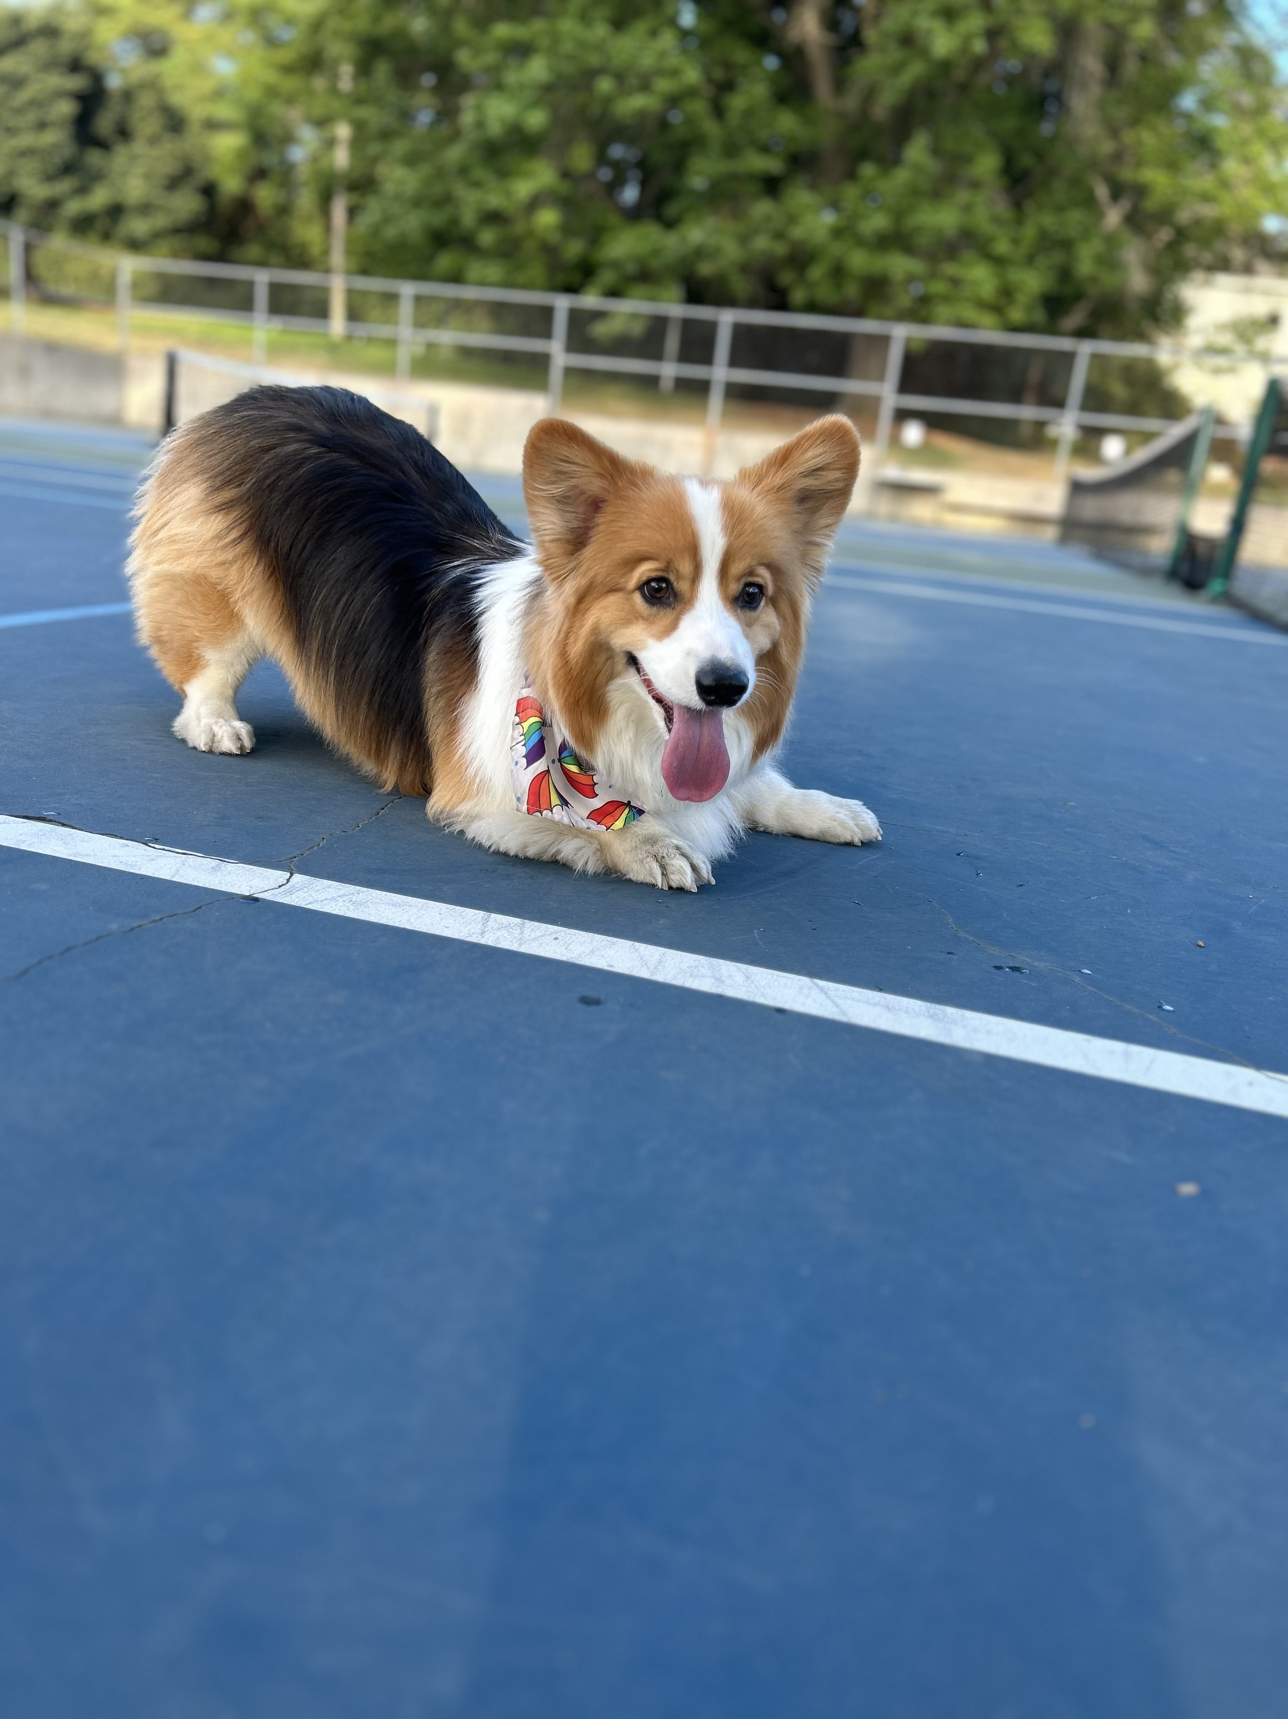
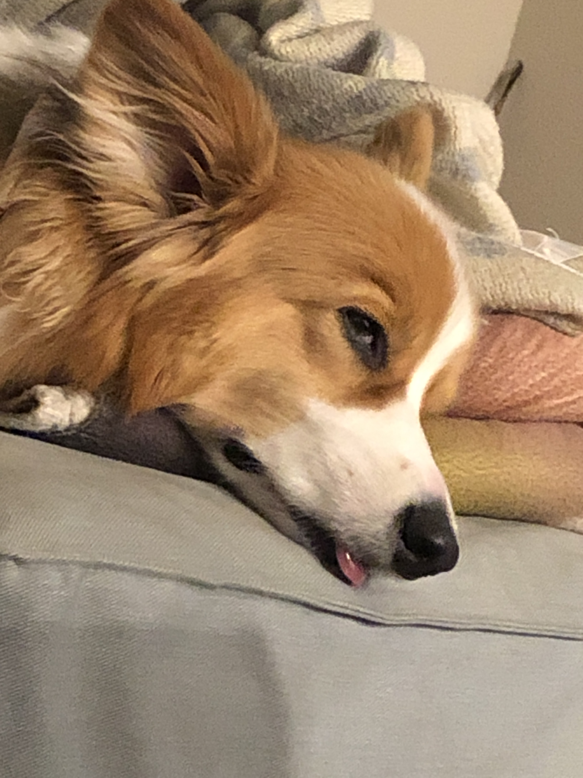
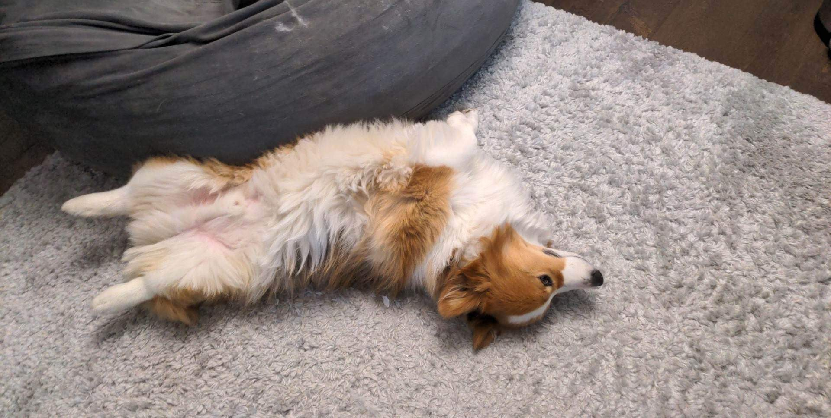
Aside: Gumball

Slide 12
Chaining methods in expressions
b | u | b | b | l | e |  | g | u | m
0 | 1 | 2 | 3 | 4 | 5 | 6 | 7 | 8 | 9
s.substring(7, 8).toUpperCase() + s.substring(8) + "ball"
"g".toUpperCase() + s.substring(8) + "ball"
"G" + s.substring(8) + "ball"
"G" + "um" + "ball"

Slide 13
PCM Review: for loops!
For loops are our first control structure: a syntax structure that controls the execution of other statements.

Slide 14
PCM Review: for loops (a simple example)
for (int counter = 1; counter <= 5; counter++) {
System.out.println("I love CSE 121!");
}

Slide 15
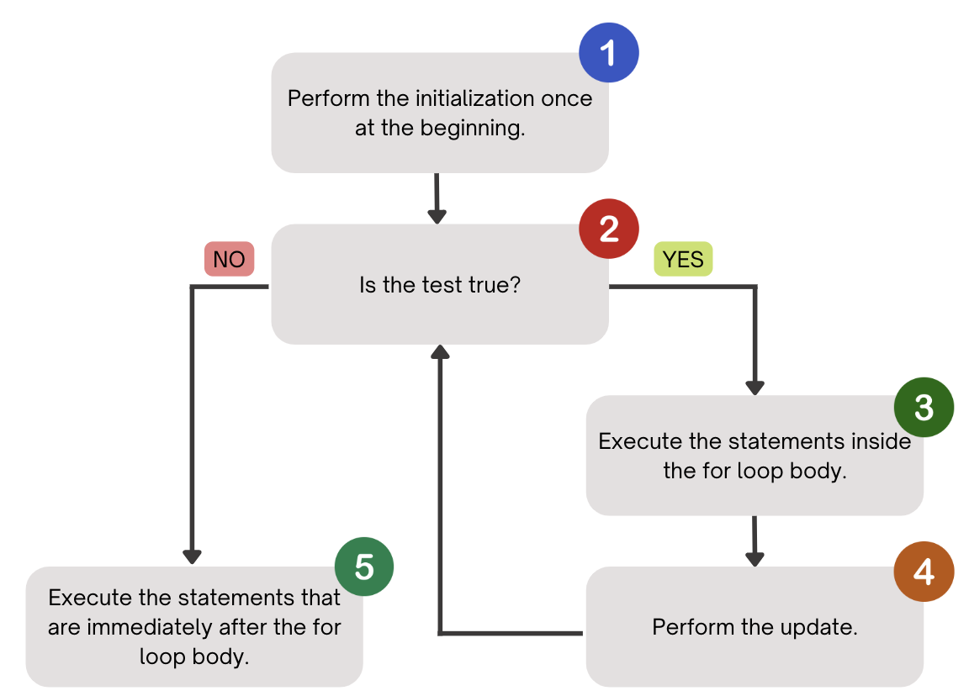
PCM Review: for loops (a helpful flowchart)

Slide 16
Thinking about for loops
counter
1
2
4
1
2
3
4
5
6
for (int counter = 1; counter <= 5; counter++) {
System.out.println("I love CSE 121!");
}
3
5
I love CSE 121!
I love CSE 121!
I love CSE 121!
I love CSE 121!
I love CSE 121!

Slide 17
Think Pair Share: squared loops (Think)
What output does the following code produce?
for (int i = 1; i <= 7; i++) {
System.out.println(i + " squared = " + i * i);
}
A.
i squared = i * i
i squared = i * i
i squared = i * i
i squared = i * i
i squared = i * i
i squared = i * i
B.
i squared = i * i
i squared = i * i
i squared = i * i
i squared = i * i
i squared = i * i
i squared = i * i
i squared = i * i
C.
1 squared = 1
2 squared = 4
3 squared = 9
4 squared = 16
5 squared = 25
6 squared = 36
D.
1 squared = 1
2 squared = 4
3 squared = 9
4 squared = 16
5 squared = 25
6 squared = 36
7 squared = 49

Slide 18
Think Pair Share: squared loops (Pair)
What output does the following code produce?
for (int i = 1; i <= 7; i++) {
System.out.println(i + " squared = " + i * i);
}
A.
i squared = i * i
i squared = i * i
i squared = i * i
i squared = i * i
i squared = i * i
i squared = i * i
B.
i squared = i * i
i squared = i * i
i squared = i * i
i squared = i * i
i squared = i * i
i squared = i * i
i squared = i * i
C.
1 squared = 1
2 squared = 4
3 squared = 9
4 squared = 16
5 squared = 25
6 squared = 36
D.
1 squared = 1
2 squared = 4
3 squared = 9
4 squared = 16
5 squared = 25
6 squared = 36
7 squared = 49

Slide 19
PCM Review: String Traversals
// For some String s
for (int i = 0; i < s.length(); i++) {
// do something with s.charAt(i)
}

Slide 20
Go Huskies?
h-u-s-k-i-e-s

Slide 21
The Fencepost Pattern
Some task where one piece is repeated n times, and another piece is repeated n-1 times and they alternate
h-u-s-k-i-e-s

Slide 22
🐞 Debugging – Live!
In C0 & P0, we asked you to do some debugging.
This is arguably the most important skill when programming – especially because programming is a social activity!
Let’s do some live debugging :)

Slide 23
Announcements, Reminders (again)
Feedback for C0 released yesterday!
please view your feedback – crucial part of learning process
for regrades (not resubs), please make a private Ed post
C1 releasing later today, due Tuesday, Jan 28th
first assignment with an “unsolved” problem!
Resubmission Cycle 0 (R0) opening tomorrow, due Thursday Jan 30th
Quiz 0 is on Thursday, February 6th (in your registered quiz section)
can’t make it? email Matt ASAP

