Slide 1
Characters, Strings, Variables, Debugging
BEFORE WE START
Talk to your neighbors:
What are your thoughts on the TikTok ban?
LEC 03
Music: 121 25wi lecture playlist ❄️
Instructor:
Matt Wang
TAs:
Ailsa Alice Chloë Christopher
Ethan Hanna Hannah Hibbah
Janvi Judy Julia Kelsey
Lucas Luke Maitreyi Merav
Ruslana Samrutha Sam Shayna
Sushma Vivian

Slide 2
Announcements, Reminders
P0 was released on Wednesday and is due Tuesday, Jan 21st
Expect C0 grades ~ 1 week from submission (we’ll announce on Ed)
Next Monday Jan 20th: MLK Day, IPL is closed
Reminder: Ed megathreads
More helpful website resources
Grading Rubrics
Ed Shortcuts
Search Site button

Slide 3
Beautiful Bugs: Countless Caterpillars (>70)
~~~~~ Caterpillar ~~~~~
) )
( o_o )(,)(,)(,)(,)(,)(,)
~~~~ Caterpillar ~~~~
\
'-.__.-'
/oo |--.--,--,--.
\_.-'._i__i__i_.'
''''''''''''
Caterpillar
\ /
( ^ ^ )
( v )
( ~~~ )
( ~~~ )
( ~~~ )
( ~~~ )
( ~~~ )
-___-
Hello, I am a caterpillar!
(: :)
</ - \>
</ -- \>
<| -- |>
<| -- |>
<\ -- \>
<\ -- \>
</ -- />
</ -- />
</ -- />
</ -- />
</ -- />
<\ - \>
</ - />
</-/>
I think it's...a very hungry caterpillar!!
| |
-(.-.)-
-( )-
-( )-
-( )-
-( )-
-( )-
-( )-
-( )-
-|-
Look! A caterpillar!
ooo ooo ooo
(---) (---) (---)
~~~ ~~~ ~~~
~~~~ Caterpillar ~~~~
_________/_
\_\_\_\_\_\
Caterpillar
\/
_| |_
_| |_
_| |_
_| |_
_| |_
_| |_
_| |_
_| |_
|__|
And a very hungry caterpillar!
\/
(.)(.)(.)(:0)
/\/\/\/\/\/\
~~~ Caterpillar ~~~
) (
(O_O)0000000000000
^^^^^^^^^^^^^
caterpillar
\ /
-[-]-
-[-]-
-[-]-
-[-]-
A caterpillar appears..
"oooooo
"""""
~~ Caterpillar ~~
_____________
(_|__|__|__|_')
' '' '' '' '
ll
[IIIIIIIIIIIII*]

Slide 4
Technically Correct Bugs
Ah! A spider! Aren't they technically arachnids?
\\ //
\\()//
//()\\
//(::)\\
''
A centipede! (It actually has 100 legs)
||||||||||||||||||||||||||||||||||||||||||||||||||
00000000000000000000000000000000000000000000000000(:)<
||||||||||||||||||||||||||||||||||||||||||||||||||

Slide 5
Characteristic Creatures
~~~~~ Ant ~~~~~
__ __
\ /
\ /
ant
antanta
antantant
antanta
ant
^ ant ^
/ \ antantant / \
/ \ antantantant / \
__/ \antantantantan/ \__
antantantant
^ antantant
/ \ ant ^
/ \ antantant / \
__/ \antantantant / \
antantantantan/ \__
antantantant
____antantant
/ ant____
__/ \
\__
~~~~~ Binary Bug ~~~~~
1 1
0 1 1 0
1 10011 1
1 001010110 1
1 1001101000010 1
00110100101011010
010110101011011
0101101000110
0011011011110
101011101010001
01010111010100010
1 0101101110001 1
1 011011010 1
1 01100 1
here comes the bug reincarnation of Al Capone, the famous American gangster from the 1920s and 30s
___ sm
/ HAT \ smoke
--------- SMOKE
| 0 0 | sm
\ --cigar
|shTrt|
/-|shIrt|-\
|shErt|
/-|shirt|-\
\_____/
----- String Bug -----
g g g g g
u u u u u
bugbugbugbugbug /
bugbugbugbugbug
bugbugbugbugbug \
u u u u u
g g g g g
~~~~~ Alphabug ~~~~~
/\ /\ /\
\-\--\-\--\-\ /
ABCDEFGHIJKLMNOPQRSTUVQXYZ
/-/--/-/--/-/ \
\/ \/ \/

Slide 6
BIG Bugs
~~~~ Heracross (Pokémon)~~~~
/\ /\
/ \ / \
----| |----
0 \ \ 0
\ ___\ \__/_
/\ / \
/ ^ ^ \
_| (*) _ (*) |_
/ | \_/ \_/ | \
//\_|_____________|_/\\
/ \ | | | | / \
/< >\ | | | | /< >\
/\ |_____| /\
|_\ | | /_|
/___----------___\
\___/ \___/
< > < >
-----Gary the snail-----
_________
__/ \__
/ \ ┌─┐┌─┐
/ _____ \ │█││█│
│ / \ │ └┬┘└┬┘
│ │ │ │ │ │
│ │ _/ │ │ │
\ \ / │ │
\ \ / │ │
___───────────────____───│───__
_-- \
~~~~~~~~~~~~~~~~~~~~~~~~~~~~~~~~~~~~

Slide 7
Storied Snails
This is Toro the football snail bug
____
/ \ | |
/ || \ - -
\ || /
\____/
Toro is from Houston Texas
This is Toro's friend, Charger the lightning bug
_/\_
\ /__..
/__\
Earlier today, Toro and Charger played football and Toro
won 32-12, when all the other bugs were saying Toro couldn't win.

Slide 8
And, some funny ones…
~~~~~ YASS Bug ~~~~~
\ /
\('_')
))Z
/\
THE MAN EATING WORMMM
(⏜⏜⏜⏜⏜⏜⏜)"-
( * * ) "-
|_______|"- "IM A WORM AND IM GONNA SLURP UR MAN UP RAHHHH"
|_______|"-
|_______|"-
|_______|"-
|_______|"-
|_______|"-
|_______|"-
|_______|"-
|_______|"-
|_______|"-
(⏝⏝⏝⏝⏝⏝⏝)"-
----- Bug Wang -----
\ /
--|'王'|--
--| 王 |--
--| 王 |--
----
^
/ \
<{ }>
\ /
O
A bug that looks deceivingly fish-like but is most definitely
a bug and not a fish because if it was a fish it wouldn't
follow the assignment guidelines.
He's being followed!
By an...inchworm?
0o°°ooo
""""""
...thats a weird inchworm.
Let's leave. These bugs are weird. Bye!

Slide 9
On accessibility…
Loved your reflection responses! Some themes:
not knowing how blind people use computers (or program)
being inspired by the speaker’s perseverance and determination
accessibility really matters, because:
“it would be a shame to lose a great programmer because they don't have the tools to do what they're truly capable of”
“it is difficult for unimpaired programmers to even think of ways in which they can help disabled programmers without direct collaboration”
“when we make things more accessible, it often makes them better for everyone, not just people with disabilities.

Slide 10
Is C0 accessible?
Broad spectrum of answers, but most of you said no.
When looking at ASCII art:
screenreaders alone aren’t suited for reading ASCII art
the caption is probably not enough context for a blind user
the caption could be low-quality or wrong!
Doing the assignment would be even harder!
have to learn coding alongside new interaction techniques
Ed doesn’t have the same accessibility features

Slide 11
So, what?
Broadly speaking: the digital world is inaccessible (but that’s changing)!
In CSE 121, we don’t have the full knowledge yet to make accessible ASCII art (or Java programs, applications, video games, websites, …)
However, we encourage you to:
think about accessibility when you make things with computers
keep on learning more! UW is a global leader in digital accessibility
e.g. at UW: CSE 493E: Accessibility, CREATE, AccessComputing

Slide 12
New: Manipulating Variables
They’re made to be manipulated, modified, and re-used!
int myFavoriteNumber = 7;
int doubleFV = myFavoriteNumber * 2;
myFavoriteNumber = myFavoriteNumber + 3;
Notice – this doesn't really make any mathematical sense!
That's because, in Java, = is assignment, not equality!

Slide 13
New Operator: +=
myFavoriteNumber = myFavoriteNumber + 3;
This pattern is so common, we have a shorthand for it!
myFavoriteNumber += 3;
This works for both numeric addition and string concatenation!

Slide 14
More Shorthand Operators
The shorthands -=, *=, /=, and %= exist too!
myFavoriteNumber /= 3;
Should this work for integers? Doubles? Strings?

Slide 15
Even Shorter Shorthands
There are even shorter operators for “incrementing” and “decrementing”!
myFavoriteNumber++; // myFavoriteNumber += 1;
myFavoriteNumber--; // myFavoriteNumber -= 1;
Should this work for integers? Doubles? Strings?

Slide 16
Think Pair Share: A, B, C Variables (Think)
What do a, b, and c hold after this code is executed?
int a = 10;
int b = 30;
int c = a + b;
c -= 10;
a = b + 5;
b /= 2;
10, 30, 40
35, 15, 30
35, 15.5, 30
20, 15, 30

Slide 17
Think Pair Share: A, B, C Variables (Pair)
What do a, b, and c hold after this code is executed?
int a = 10;
int b = 30;
int c = a + b;
c -= 10;
a = b + 5;
b /= 2;
10, 30, 40
35, 15, 30
35, 15.5, 30
20, 15, 30

Slide 18
String Methods
Method | Description
length() | Returns the length of the string.
charAt(i) | Returns the character at index i of the string
indexOf(s) | Returns the index of the first occurrence of s in the string; returns -1 if s doesn't appear in the string
substring(i, j) or substring(i) | Returns the characters in this string from i (inclusive) to j (exclusive); if j is omitted, goes until the end of the string
contains(s) | Returns whether or not the string contains s
equals(s) | Returns whether or not the string is equal to s (case-sensitive)
equalsIgnoreCase(s) | Returns whether or not the string is equal to s ignoring case
toUpperCase() | Returns an uppercase version of the string
toLowerCase() | Returns a lowercase version of the string

Slide 19
Think Pair Share: A, B, C Variables (Think)
Suppose s contains the String "bubble gum". Which statement would result in s containing "Gumball" instead?
s.substring(7) + "ball";
s = s.substring(7, 9) + "ball";
s = s.charAt(7).toUpperCase() + "ball";
s = s.substring(7, 8).toUpperCase() + s.substring(8) + "ball";
b | u | b | b | l | e |  | g | u | m
0 | 1 | 2 | 3 | 4 | 5 | 6 | 7 | 8 | 9

Slide 20
Think Pair Share: A, B, C Variables (Pair)
Suppose s contains the String "bubble gum". Which statement would result in s containing "Gumball" instead?
s.substring(7) + "ball";
s = s.substring(7, 9) + "ball";
s = s.charAt(7).toUpperCase() + "ball";
s = s.substring(7, 8).toUpperCase() + s.substring(8) + "ball";
b | u | b | b | l | e |  | g | u | m
0 | 1 | 2 | 3 | 4 | 5 | 6 | 7 | 8 | 9

Slide 21
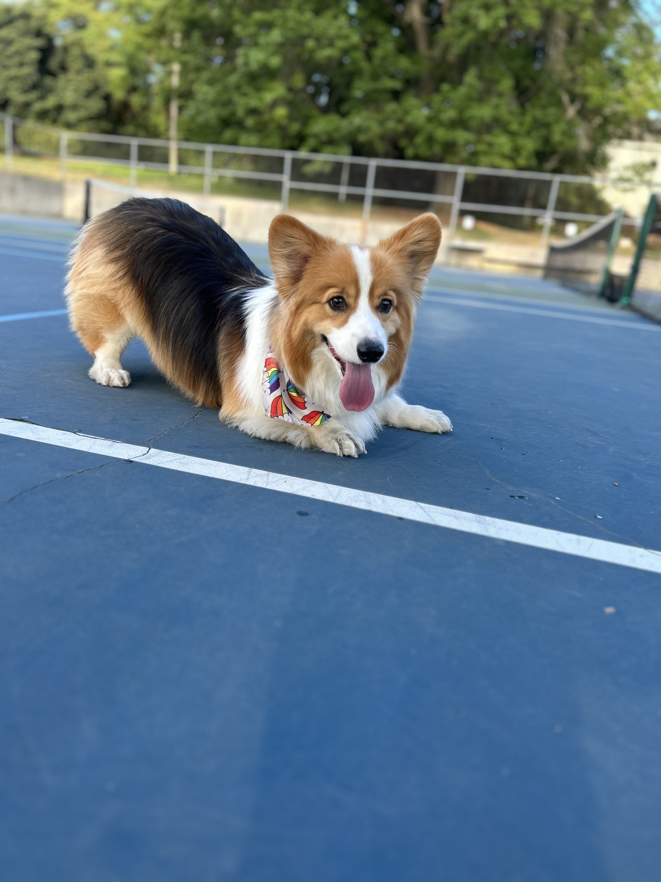
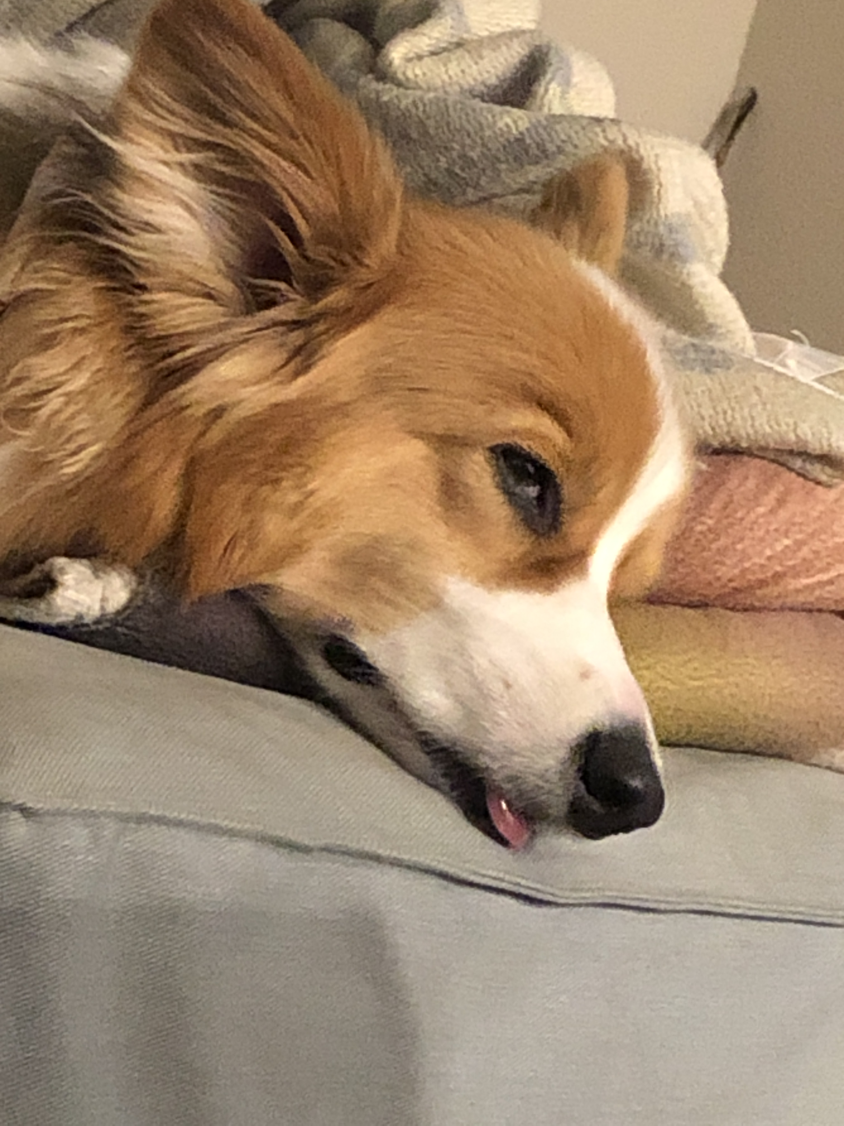
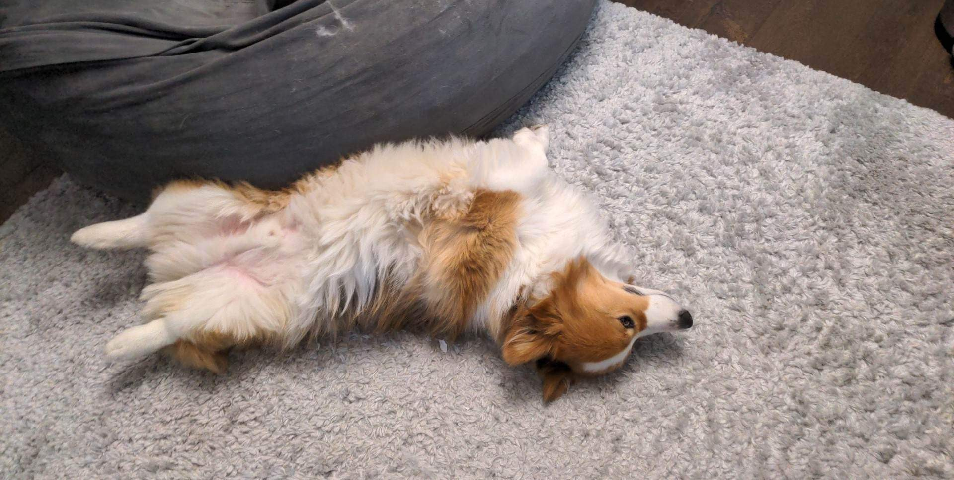
Aside: Gumball

Slide 22
Announcements, Reminders (again)
P0 was released on Wednesday and is due Tuesday, Jan 21st
Expect C0 grades ~ 1 week from submission (we’ll announce on Ed)
Next Monday Jan 20th: MLK Day, IPL is closed
Reminder: Ed megathreads
More helpful website resources
Grading Rubrics
Ed Shortcuts
Search Site button

