Slide 1
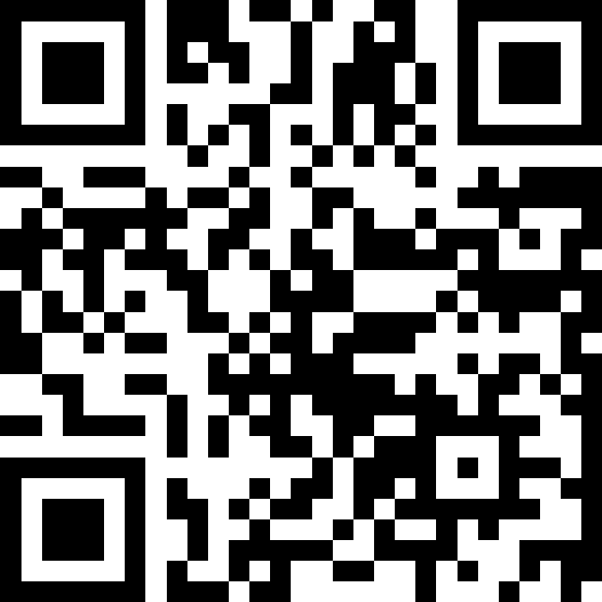
Expressions and Datatypes
BEFORE WE START
Talk to your neighbors:
What’s your favourite song right now?
LEC 02
Music: 121 25wi lecture playlist ❄️
Instructor:
Matt Wang
TAs:
Ailsa Alice Chloë Christopher
Ethan Hanna Hannah Hibbah
Janvi Judy Julia Kelsey
Lucas Luke Maitreyi Merav
Ruslana Samrutha Sam Shayna
Sushma Vivian

Slide 2
Announcements, Reminders
Creative Project 0 due tonight by 11:59 PM
Programming Assignment 0 releases later today
making a receipt generator!
due Tuesday, Jan 21st at 11:59 PM
now on regular “cadence” (Wed release, due following Tue)
IPL is open! Schedule & instructions on website.
“Extra resources” tab – more practice! (with a caveat)

Slide 3
Reminder: Post-Section Work
Due at midnight on each quiz section day (except quizzes)
not strictly “did you go to quiz section”, though going helps
graded on attempt/effort only
helps your TAs plan quiz section!
Optional (not part of your grade)
but, 12/16 give you an extra resub
up to you on whether or not you think it’s helpful
You will get PSW completion grades on Canvas
sorry! the only way for us to do this :(

Slide 4
Intro Survey – things we’re excited for!
“Learning programming” / “Learning how to code”
“Being introduced to the world of computer science”
“I love working on things where I can be creative with what I do.”
“Getting to meet people and problem solve with others.”
“understanding a mysterious world of tech”
“Learning how to program in JAVA!”
“Matt”

Slide 5
Reassuring worries from intro survey (1/2)
Common: responses along the lines of… “not knowing how to code”
You’re in the right place! This class expects zero prior knowledge.
Difficulty, workload, pace, & falling behind
recognizing that programming can be difficult (if it was easy: why have a class?)
as a result, have built many support systems (section, IPL, office hours, Ed, etc.)
if you feel like you’re struggling: reach out early!
especially with pace of quarter system

Slide 6
Reassuring worries from intro survey (2/2)
Grades, competitiveness, this class being a “weed-out” class
explicitly not the goal of this class
course designed against this (minimum grade guarantees, resubmissions, etc.)
Quizzes & final exams
timed assessments can be stressful – but we’ll build you up there slowly!
will have many practice resources (though, be wary of overfitting!)
Not doing the optional work
really mature thought!
something to work on over time (and build discipline)

Slide 7
PCM Recap: Data Types & Expressions
Programming is about data; we tell Java what type of data we have!
Data types (so far): int, double, String, boolean
note: only String is capitalized!
All values in a (Java) program have a type!
some are “obvious”, e.g. 42 or "hello world"
aside: these are called “literals”
some are more complicated expressions!

Slide 8
PCM Recap: Operators
We learned a ton of operators!
Numerical:
+ Addition
- Subtraction
* Multiplication
/ Division (tricky!)
% Modulo (or “mod”)
<, >, <=, >=, ==, != Relational
Strings:
+ Concatenation (not addition!)
Booleans:
! Logical Not
&& Logical And
|| Logical Or
== and != Relational

Slide 9
PCM Recap: Precedence
Operators have precedence (an order of operations).
In Math:
Parentheses
Exponent
Multiplication
Division
Addition
Subtraction
In Java:
Parentheses
Logical not
Multiplication, Modulo, Division
Addition (and concatenation), Subtraction
Relational operators
Equality operators
Logical AND
Logical OR

Slide 10
Expressions in “little steps”
5 + 2 * 4
1 + 2 / 3
6 * 5 % 7
8
0
30
13
1
2

Slide 11
PCM Recap: Conversions
When mixing types in an expression, Java will convert one type to the other and then perform the operation “normally”.
Some conversions are straightforward:
ints can be converted to doubles (add .0)
ints and doubles can be converted to Strings (add "")
So, Java does these for you! (is this good? controversial!)

Slide 12
New: Conversions (Gone Wrong!!)
Other conversions are “lossy”, because you lose data.
e.g. to make 3.14 an int, you’d probably pick either 3 or 4 – but either one loses data
Java won’t do this automatically for you – you need to “ask”.
called a cast: you’ll see this in Friday’s PCM + in P0
Some conversions don’t make sense.
how would you convert "Beyoncé" to an int? double?
Java really doesn’t let you do these…

Slide 13
Work on Expressions and Types Practice (1)
Ed lesson linked from course calendar
Work with folks around you!
TAs & I will walk around and help!
5 * 3 + 1.0
8 / 3 * 2.0
8.0 / 3 * 2
"Hello" + "world"
1 + "2" + 3
1 + 2 + "3"
1 + "2" + (3 + 4)

Slide 14
Part 1 Walkthrough
"Hello" + "world"
"Helloworld"
5 * 3 + 1.0
8 / 3 * 2.0
8.0 / 3 * 2
.0
2
15
.0
2.666…
.0
16.0
4.0
5.333…
1 + "2" + 3
1 + 2 + “3”
1 + "2" + (3 + 4)
" "
" "
" "
" "
"12"
" "
"12"
7
3
"123"
"33"
"127"

Slide 15
Work on Expressions and Types Practice (2)
Ed lesson linked from course calendar
Work with folks around you!
TAs & I will walk around and help!
5 * 3 < 12
10 % 3 == 10 / 3
5 < 9 || (7 != 7)
!(1 + 2 == 3 && 10 % 4 > 2)

Slide 16
Part 2 Walkthrough (1)
5 * 3 < 12
10 % 3 == 10 / 3
5 < 9 || (7 != 7)
15
1
false
1 == 10 / 3
15 < 12
5 < 9 || false
false
3
1 == 3
true
true || false
false
true

Slide 17
Part 2 Walkthrough (2)
!(1 + 2 == 3 && 10 % 4 > 2)
!(1 + 2 == 3 && 2 > 2)
!( 3 == 3 && 2 > 2)
!( 3 == 3 && false )
!( true && false )
!( false )
true

Slide 18
Ed time :)
Applying what we learned to variables!

Slide 19
What’s in a (variable) name or String?
Switch over to Ed and do some experiments (with a partner), then report back on sli.do.
What types of characters are “allowed” in Strings?
What types of characters are “allowed” in variable names?
sli.do #cse121

Slide 20
Food for Thought!
This is the beginning of a very interesting rabbit hole!
(but also, a decision made by the Java designers)
Whether or not you program for a career, you will also make decisions like these!
for example, what’s a “valid name”?
a theme we’ll revisit (and something to continuously reflect on!)

Slide 21
Announcements, Reminders (again)
Creative Project 0 due tonight by 11:59 PM
Programming Assignment 0 releases later today
making a receipt generator!
due Tuesday, Jan 21st at 11:59 PM
now on regular “cadence” (Wed release, due following Tue)
IPL is open! Schedule & instructions on website.
“Extra resources” tab – more practice! (with a caveat)

