Slide 1
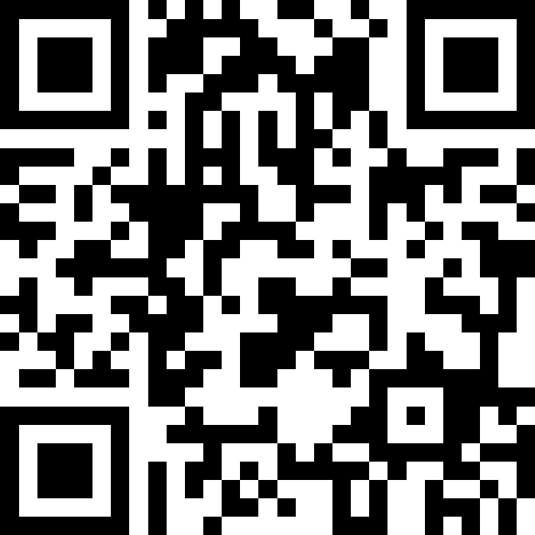
Final Exam Review & Victory Lap
BEFORE WE START
Talk to your neighbours:
What will you miss from winter? What are you excited to leave behind?
LEC 19
Music: 121 25wi lecture playlist ❄️
Instructor:
Matt Wang
TAs:
Ailsa Alice Chloë Christopher
Ethan Hanna Hannah Hibbah
Janvi Judy Julia Kelsey
Lucas Luke Maitreyi Merav
Ruslana Samrutha Sam Shayna
Sushma Vivian

Slide 2
Announcements, Reminders (general)
R7 (+ extra resub) due Thu, Mar 20th – all assignments eligible
note: all extra resub emails have gone out at this point!
today is the last day for IPL & instructor office hours
Final Exam: Tuesday, March 18th from 12:30 - 2:20 in KNE 130, 220*
look at seating charts and let me know ASAP if you’re not there!
review Exam page of website (with policies & resources)
TA-led review session: Sun, March 16th from 5:30-7:50 PM, ARC 147

Slide 3
Evaluations and Awards
Please give us feedback!
Course Evals are due Sunday, March 16th at 11:59 PM
A section eval link
B section eval link
TA Evals are also due Sunday, March 16th at 11:59 PM
Bob Bandes TA award nominations open! (nominate your goat)

Slide 4
Exam Review Preamble
Acknowledging: live exam review can be stressful (and feel rushed)!
Today’s goal:
practicing how to trace through complicated code, on paper
helpful for tracing & comprehension problems
helpful for debugging problems (to find the bug)
helpful for programming problems (to “test” your code)
not writing code or “fixing” the bug (though I’ll do that too)

Slide 5
Your Task
I’ll give you about 5 minutes with a debugging spec.
Your goal is just to trace through the buggy code (on the back): why does it produce the incorrect output?
Assume that the random numbers from the nextInt calls really are 2, 9, 10, 8, and 1 (that’s not the bug).
Do not write any code!
One note: this is from a much older 121 exam. This is not exactly the format of recent debugging problems, but helps us with this skill!

Slide 6
Applications of CS
or “What can I do with what I learned?” – outside of just “write code”:
Detect and prevent toxicity online & recognize disinformation
Help deaf & hard-of-hearing people identify sounds
Develop a programming language that celebrates the world’s languages
Build battery-free robots & put them on insects (and... track murder hornets?)
Computational knitting & carpentry
Create an interactive atlas of millions of refugee experiences
Fix Olympic badminton & identify cheating in chess
and so much more!

Slide 7
… including our assignments! (1/2)
Computational Biology & Medicine (P2, P3)
fun fact: Matt did some DNA sequencing (P3+++) in grad school
in CSE: Chris Thachuk, Linda Shapiro, Sara Mostafavi, Su-In Lee
Computational Art (C0, C1)
UW CSE has many unique intersections of CS + art!
“Cultural-Centric Computational Embroidery” (CSE + iSchool)
“Computational Illusion Knitting”, “How to Knit Objects Weird”
“WasteBanned: Supporting zero waste fashion design”

Slide 8
… including our assignments! (2/2)
Games & Graphics (C1, C3)
at UW: many labs in CSE and iSchool’s GAMER group
fun fact: Foldit is a crowd-sourced game for protein folding
David Baker shared this year’s Nobel Prize in Chemistry, in part for this!!
Social Computing (P1, C2)
at UW: Amy Zhang’s Social Futures Lab + so much of iSchool
and many side quests (in lecture, section, PCM): accessibility (e.g. UW CREATE), weather forecasting, chatbots, and lots of math

Slide 9
Closing the loop on P3 reflections – topics
Y’all listed many other applications of CS too! Some common areas:
environmental & climate science
architecture
physics
sports analytics and health
business & finance
geography

Slide 10
P3 reflections & music
“Just recently, I've used computer science in two of my interests that involve other fields. […] The other was using it to write a wavetable synthesizer that I used to make music.”
“In music production, mixing, and sound design, you use computer programs to synthesis sounds very similar to coding, with inputs, outputs, modifications, and parameters.”
CS + music is actually huge and very fascinating – Matt’s first-ever internship was implementing audio processing filters. Super cool!!

Slide 11
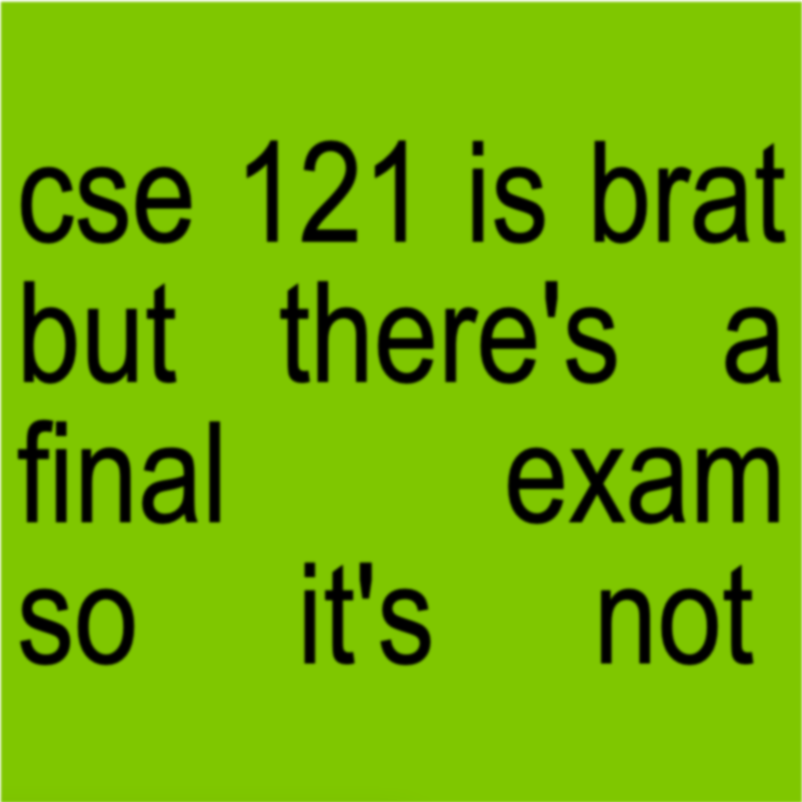
cse 121 is brat

Slide 12
Future Courses
More 12X!
or “What can I do next?”
Course | Overview
CSE 122 | Data structures, object-oriented programming
CSE 123 | More OOP, recursion
Non-majors
Course | Overview
CSE 154 | Intro. to web programming (several languages)
CSE 160 | Intro programming, data analysis (Python)
CSE 163 | Intermediate programming, data analysis (Python)
CSE 180 | Introduction to data science (Python)
CSE 373 | Data structures and algorithms (in Java)
CSE 374 | Low-level programming and tools (C/C++)
CSE 412 | Intro to Data Visualization
CSE 416 | Intro. to Machine Learning
CSE 493E | Accessibility
Majors
Course | Overview
CSE 311 | Mathematical foundations
CSE 331 | Software design/implementation
CSE 340 | Interaction programming (mobile apps)
CSE 341 | Programming languages (!!)
CSE 351 | Hardware / Software Interface
Other tech-related majors: Informatics, ACMS, HCDE, Electrical & Computer Engineering, …
See: https://www.cs.washington.edu/academics/ugrad/current-students and https://www.cs.washington.edu/academics/ugrad/nonmajor-options/nonmajor-courses

Slide 13
Closing the loop on P3 reflections – journey
We also asked you to reflect on your journey learning CS!
Impossible to adequately summarize them all, but the biggest theme was combating myths about computer science:
what programming & computer science is
what makes computer science hard (it’s not just syntax!!)
what you need to be a “good” programmer (not always math!!)
what programmers & computer scientists look like
that one bad experience means you’ll always be bad at it

Slide 14
… and some funny answers
“However, when I started hearing laufey play in the background, seeing the small ice breaker questions on the slideshow, all that dread seemed to melt away.”
“The lectures were enjoyable and I always found Matt's jokes funny, I would always giggle or chuckle at least once during lecture.”
String You = "CSE 121"; System.out.println("Never Gonna Give" + You + "Up");

Slide 15
Generalizing beyond CS
Some of you said, ”I’m glad I took this class, but no more CS for me”
That’s totally valid!
Some lessons from this class that could apply more broadly:
how to break big problems into smaller subproblems
how to isolate what part of a system is broken
attention to detail
how to learn (and reflect) effectively

Slide 16
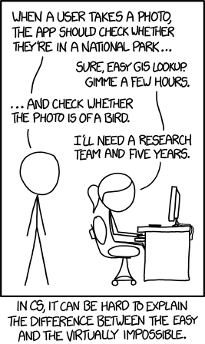
Frequently Asked Questions
How can I get better at programming?
Practice!
How can I learn to X?
Classes, books, videos, or self-learn!
CS (as a field) has lots of free resources :)
What should I do next?
Anything you’re interested in!
but: hard to tell what’s easy and what’s hard
Should I learn another language? Which one?
That depends – what do you want to do?

Slide 17
Aside: Cute Programming Language Logos

Slide 18
Spring Break Project: Tic Tac Toe
Build your own Tic Tac Toe game + “AI”! (one of the TA’s choice ideas)
How would you represent a Tic Tac Toe game in Java? (hint: arrays will be very, very helpful!)
Write a method that tells you if a Tic Tac Toe game is won.
Write a method that gets input from the user and “makes” a move.
Wrap it all up – into a nice two-player game!

Slide 19
Spring Break Project: Tic Tac Toe++
Make some “AI” that…
just makes a random valid move (you should be able to beat this!)
tries to make a “good” move (~ some if statements)
never loses
Tic Tac Toe is a “solved game”: a perfect player will never lose.
Or, extend this idea to other grid-based games!
similar-ish: connect four, checkers, battleship
much harder: sudoku, chess, go, othello

Slide 20
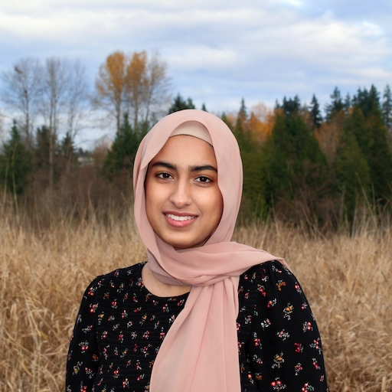
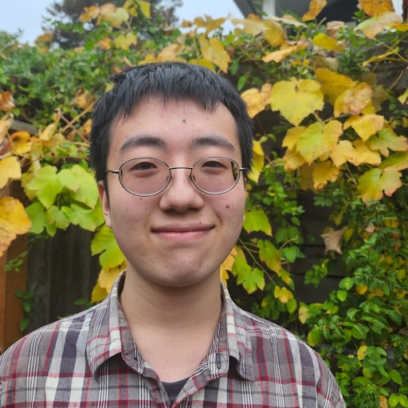
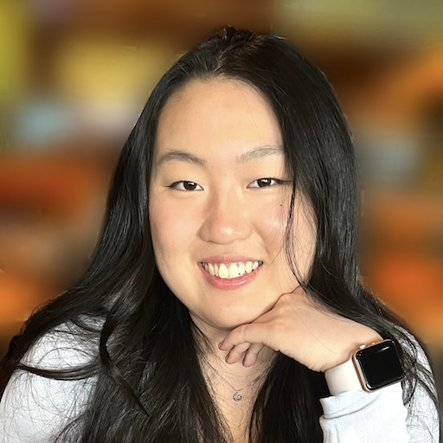
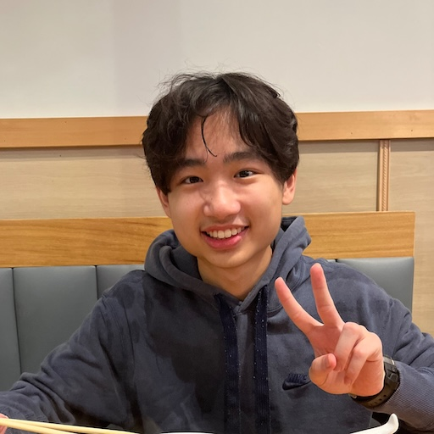
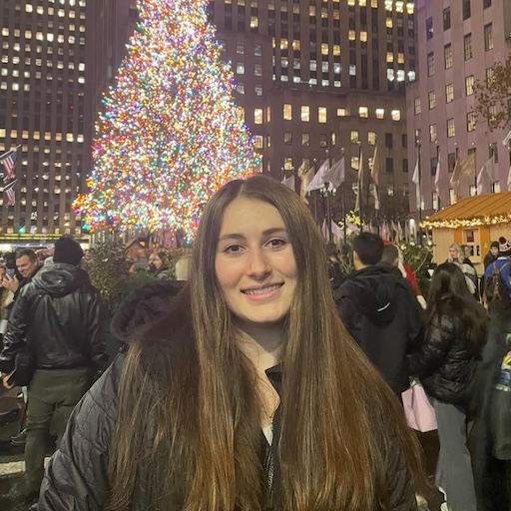
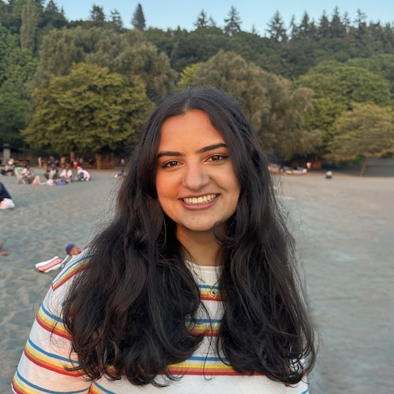
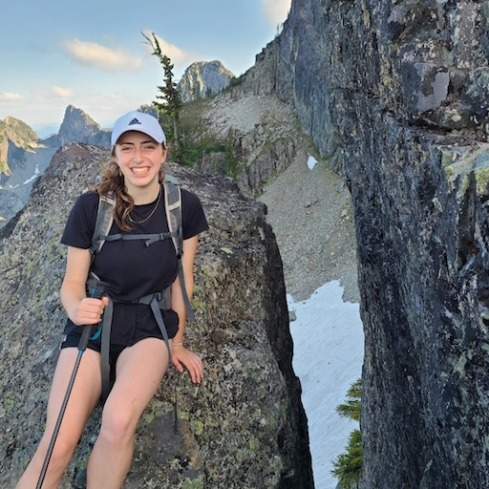
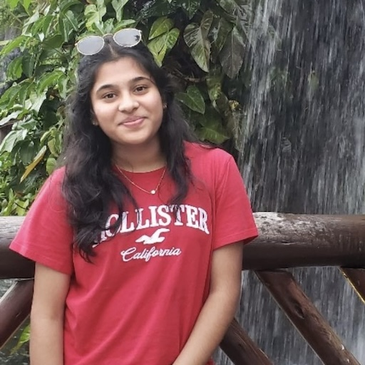
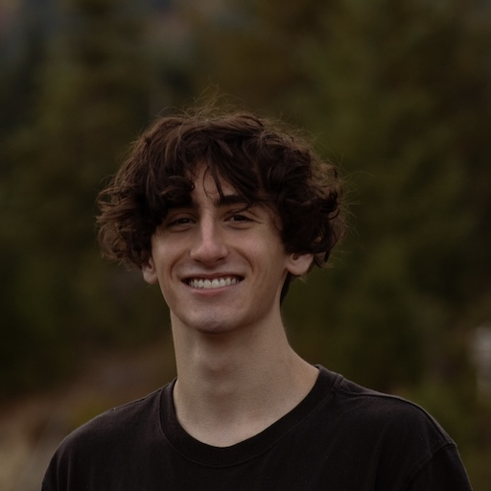
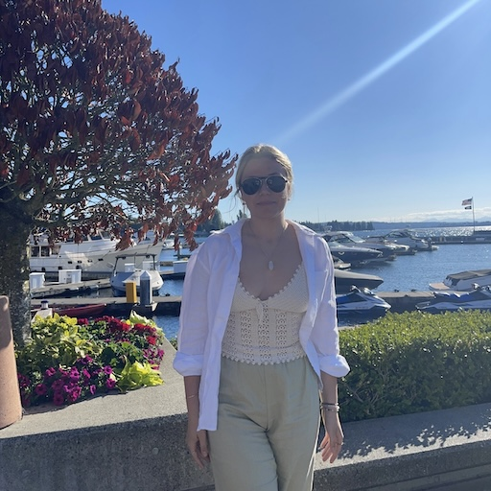
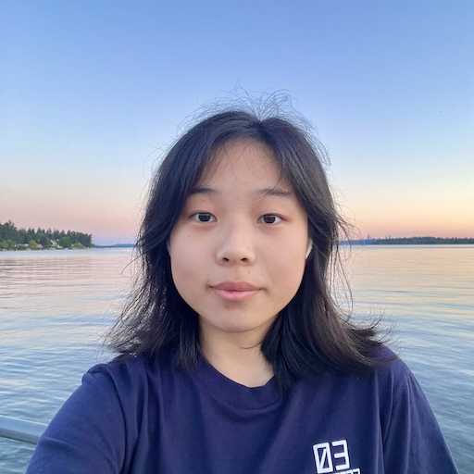
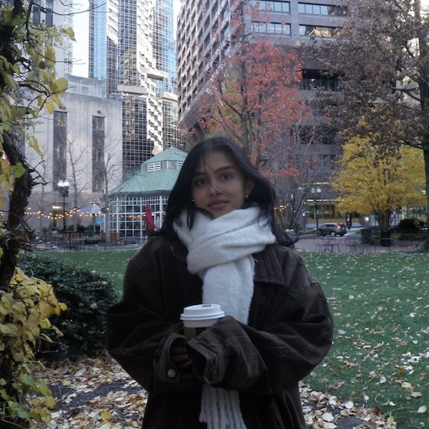
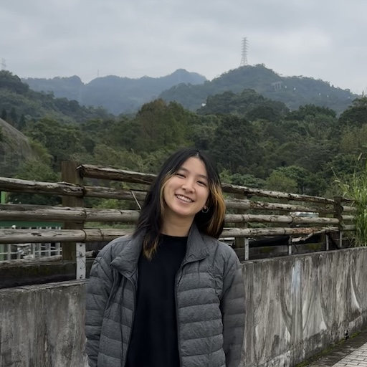
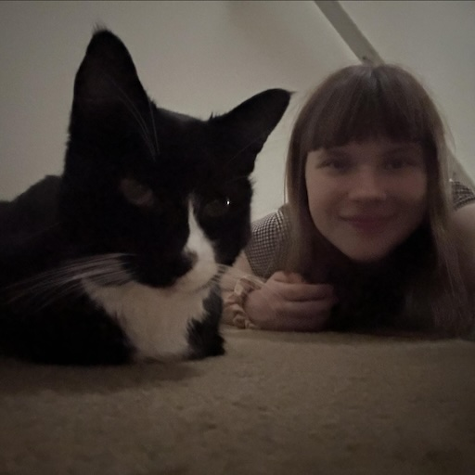
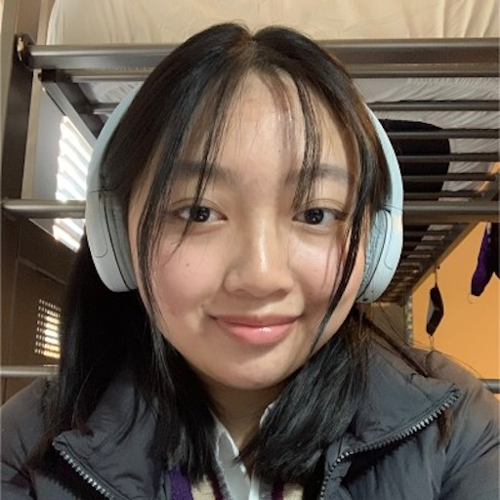
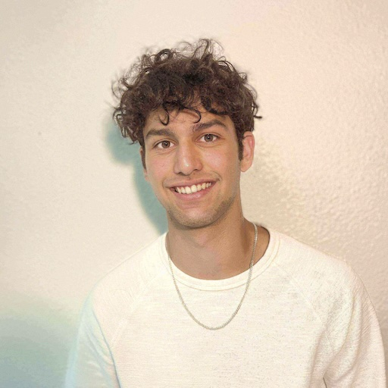
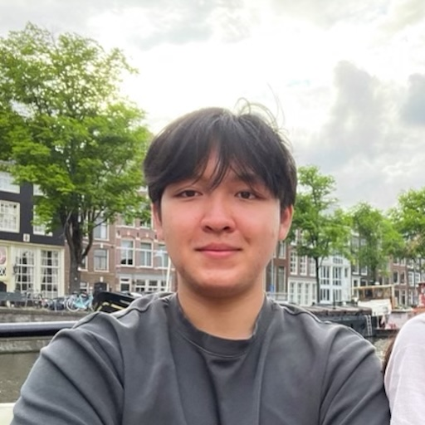
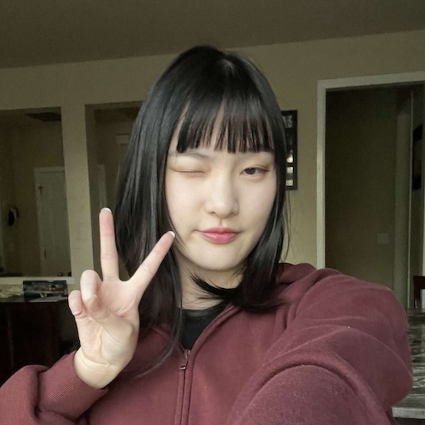
Thank your lovely TAs!
20

Slide 21
Thank you!
Ask Me (Almost) Anything!
sli.do #cse121

