Slide 1
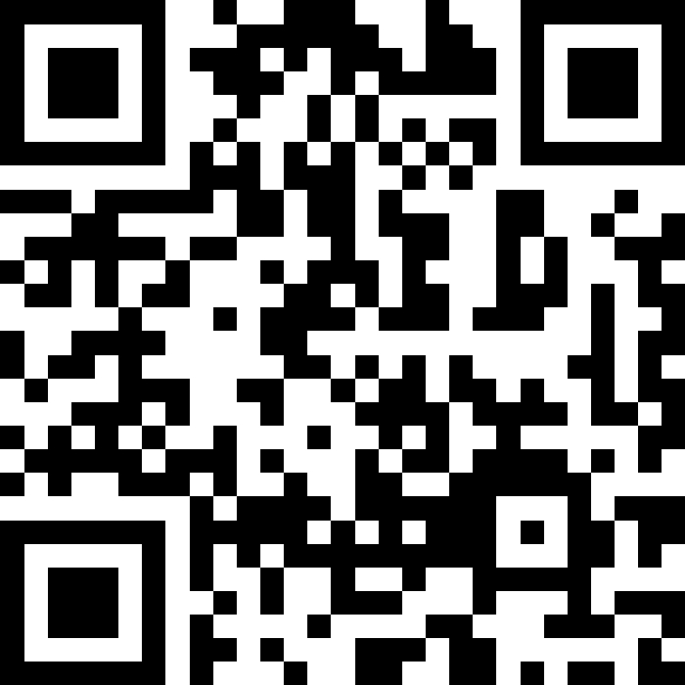
Final Exam Review
BEFORE WE START
Talk to your neighbours:
What are your spring break plans?
LEC 18
Music: 121 25wi lecture playlist ❄️
Instructor:
Matt Wang
TAs:
Ailsa Alice Chloë Christopher
Ethan Hanna Hannah Hibbah
Janvi Judy Julia Kelsey
Lucas Luke Maitreyi Merav
Ruslana Samrutha Sam Shayna
Sushma Vivian

Slide 2
Announcements, Reminders (general)
P3 and R6 due tomorrow (Thursday, Mar 13th)
R7 due Thursday, March 20th – all assignments eligible
extra resub (if you have it) has same due date, eligibility
IPL closes Friday, March 14th
My (Matt’s) last office hour is also Friday, March 14th :’)
Final Exam: Tuesday, March 18th from 12:30 - 2:20 in KNE 130, 220*
seating charts are now available on course website!
let me know if you are not in the seating chart!
Keep eyes peeled for a mega announcement tonight combing these!

Slide 3
More Exam Resources
TA-led Review Session
Sunday, March 16th from 5:30 – 7:50 PM in ARC 147
planned to be recorded, but in-person is best!
stay tuned for follow-up announcements!
Further practice resources
new: exam tips page!
new: exam resources bank!
new: course glossary!
and: make use of existing practice problems & materials!

Slide 4
Pause – Foreshadowing
Later today, we will do 1-2 exam review problems together, on paper.
If you don’t have either:
the problem spec
and/or scratch paper
Please raise your hand now; a TA will give you some as I talk!

Slide 5
In reading P2 reflections... (1/2)
We were thrilled reading your P2 reflections!! Some neat points:
clear consensus of potential for bias (related to the video!)
particular callouts for insurance & zip codes (proxies for wealth)
(also, many funny/sad comments about healthcare in the US)
less consensus on how to resolve these issues
many suggested removing insurance and/or zip codes
others suggested prioritizing low-income zip codes, people who came from afar, or those with no insurance
noting pragmatic reasons why hospitals may have to care

Slide 6
In reading P2 reflections... (2/2)
loved improvement ideas! (many: medical history & measurements)
tension: should we consider disability? Gender? Race?
excluding from algorithm could reduce bias, discrimination
but, systemic exclusion from medical care/knowledge
an extremely challenging issue (with laws, but laws =/= morals)
concerns about creating a score like this at all
feels wrong? (but also, we have to do it!)
hard to know if we’re right (there’s no tests! no solution!)
only helping “high priority patients” could skip chronic illnesses

Slide 7
… and C3 reflections!
Many lovely reflections on accessibility (and super cool extensions)!
Synthesizing some summaries serendipitously:
disability is a wide spectrum, and is often ignored
many commented not thinking about colorblindness!
also: “temporary” or “situational” disabilities
accessibility features are broad and help everyone
more modalities for information (subtitles, avoiding “just” colour)
providing options (e.g. graphics, remapping controls, difficulty)

Slide 8
A bit of y’all in C3!
“As a colorblind person myself, it has been sometimes challenging and frustrating to play some games which do not have in built color palettes or tones that you can change.”
“I've been on the unfair end of accessibility issues with video games, since I have joint problems and mobility issues in my hands (nintendo joy-cons are a HUGE pain)! I can't play a lot of games for very long since the controls are very repetitive, I'm glad this is being mentioned.”
“I watched the motor skills video, just because I have worked on developing adaptations for young kids with disabilities to be able to play with games.”

Slide 9
A broader takeaway
Some themes underlying P2 & C3’s reflections:
Technology is not separate from people – or issues people face!
Solving these issues is hard!
many issues are technically challenging (e.g. C3)
arguably, most have no straightforward resolutions (P2, C3)
First step is starting the conversation (i.e. with reflections), but it’s far from the last.
We’ll talk a bit more about this on Friday! (as part of “what’s next”!)

Slide 10
Evaluations and Awards
I hope I’ve convinced you … we read everything you write!!
Please give us feedback!
Course Evals are due Sunday, March 16th at 11:59 PM
TA Evals are also due Sunday, March 16th at 11:59 PM
Feedback is incredibly helpful – many of us will teach 121 again!
Bob Bandes TA award nominations open!
thought your TA was the goat? write them a nomination!
fun fact: some of our faculty won the award when they were TAs!
fun fact #2: a 121 TA won the award last year :))

Slide 11
these next two (hidden) slides were for A lecture only!

Slide 12
Think: Individual Work Time (~ 5 minutes)
goals:
figure out the length of the result array, for the “both even” and the “either/both is odd” cases, and set it up
write out the syntax
add the first half of the first array to your result array
keep going if you finish early!

Slide 13
Pair & Share (~ 5 minutes)
discussion ideas:
compare
method headers
extra object creation – if there was any
handling the “both even” and “either/both is odd” cases
how did you make these choices?
what parts of the specification or the problem helped you get to that conclusion?

Slide 14
Announcements, Reminders (again)
P3 and R6 due tomorrow (Thursday, Mar 13th)
R7 due Thursday, March 20th – all assignments eligible
extra resub (if you have it) has same due date, eligibility
IPL closes Friday, March 14th
My (Matt’s) last office hour is also Friday, March 14th :’)
Final Exam: Tuesday, March 18th from 12:30 - 2:20 in KNE 130, 220*
seating charts are now available on course website!
let me know if you are not in the seating chart!
Keep eyes peeled for a mega announcement tonight combing these!

