Slide 1

2D Arrays
BEFORE WE START
Talk to your neighbours:
What’s left on your
Winter bucket list?
LEC 15
Music: 121 25wi lecture playlist ❄️
Instructor:
Matt Wang
TAs:
Ailsa Alice Chloë Christopher
Ethan Hanna Hannah Hibbah
Janvi Judy Julia Kelsey
Lucas Luke Maitreyi Merav
Ruslana Samrutha Sam Shayna
Sushma Vivian

Slide 2
Announcements, Reminders
C3 released yesterday, due Tuesday, Mar 4th
R5 due next Thursday, Mar 6th (eligible: P1, C2, P2)
Quiz 2 on Thursday, Mar 6th
  can’t make it? email me before your quiz!
Next Wednesday’s PCM + class:
  is secretly quiz prep! (array patterns and practice)
  is a guest lecture! (from our lovely head TA, Hannah)
  has a question that guides Wed’s lecture: please do this!
In the future: final exam on Tue, March 18th from 12:30-2:20 PM

Slide 3

PCM Review: 2D Arrays
An array of arrays!
The type of each individual element is another array!
Your first example of “nested data structures”
There will be more if you take CSE 122!
int[][]
double[][]
String[][]
boolean[][]
char[][]

Slide 4
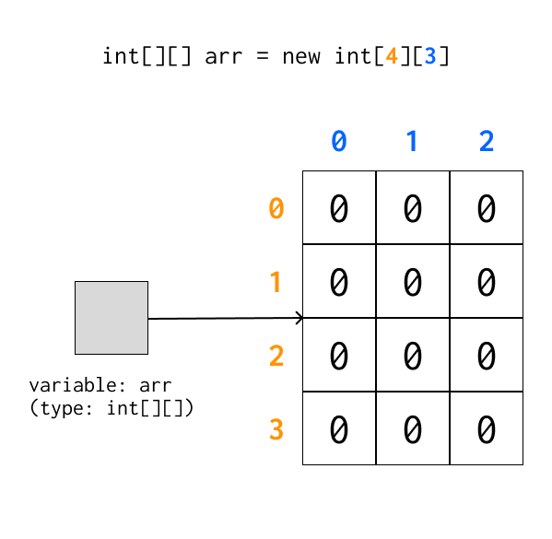
PCM Review: 2D Arrays as Rows and Columns
Can think of the two dimensions as “rows” and “columns”.
Individual elements are row-first, then column (“row-major”)
arr[2][1]

Slide 5
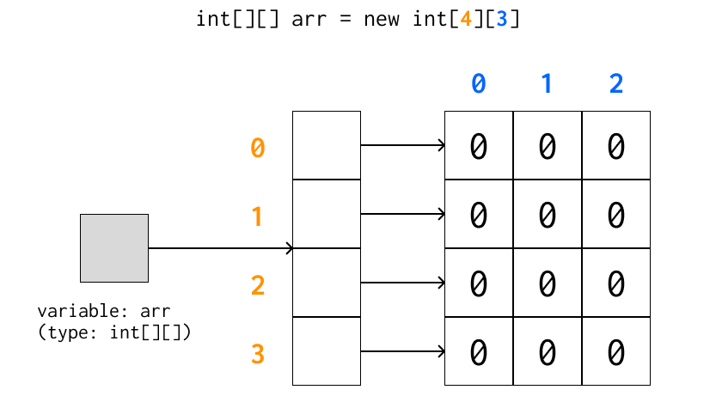
A more accurate view (reference semantics)

Slide 6
PCM Review: 2D Array Traversals
for each row…
for (int i = 0; i < list.length; i++) {
for (int j = 0; j < list[i].length; j++) {
// do something with list[i][j]
}
}
for each element within a row…

Slide 7
Arrays Utility Class (and methods)
Method | Description
Arrays.toString(array); | Returns a String representing the array, such as "[10, 30, -25, 17]"
Arrays.equals(array1, array2); | Returns true if the two arrays contain the same elements in the same order
Arrays.deepToString(array); | Returns a String representing the array; if the array contains other arrays as elements, the String represents their contents, and so on. For example, "[[99, 151], [30, 5]]"
Arrays.deepEquals(array1, array2); | Returns true if the two arrays contain the same elements in the same order; if the array(s) contain other arrays as elements, their contents are tested for equality, and so on.

Slide 8
Applications of 2D Arrays
Matrices
  Useful in so many applications in math, engineering, and statistics
  Fundamental to machine learning & AI
  P3 is one real-life application of this! (bioinformatics)
Board games
  e.g. chess, checkers, tic-tac-toe, sudoku
Tabular or grid-like data
  e.g. scorekeeping, gradebook, census data
Image processing

Slide 9
matrixAdd
23 | 96 | 18 | 4 | 64
45 | 40 | 18 | 44 | 34
92 | 13 | 77 | 71 | 12
93 | 169 | 84 | 83 | 103
136 | 115 | 91 | 143 | 81
119 | 77 | 98 | 105 | 13
70 | 73 | 66 | 79 | 39
91 | 75 | 73 | 99 | 47
27 | 64 | 21 | 34 | 1

Slide 10
matrixAdd: first row
23 | 96 | 18 | 4 | 64
45 | 40 | 18 | 44 | 34
92 | 13 | 77 | 71 | 12
i: 0
j: 0
93 | 169 | 84 | 83 | 103
136 | 115 | 91 | 143 | 81
119 | 77 | 98 | 105 | 13
70 | 73 | 66 | 79 | 39
91 | 75 | 73 | 99 | 47
27 | 64 | 21 | 34 | 1

Slide 11
matrixAdd: 0,0
23 | 96 | 18 | 4 | 64
45 | 40 | 18 | 44 | 34
92 | 13 | 77 | 71 | 12
i: 0
j: 0
93 | 169 | 84 | 83 | 103
136 | 115 | 91 | 143 | 81
119 | 77 | 98 | 105 | 13
70 | 73 | 66 | 79 | 39
91 | 75 | 73 | 99 | 47
27 | 64 | 21 | 34 | 1

Slide 12
matrixAdd: 0,1
23 | 96 | 18 | 4 | 64
45 | 40 | 18 | 44 | 34
92 | 13 | 77 | 71 | 12
i: 0
j: 1
93 | 169 | 84 | 83 | 103
136 | 115 | 91 | 143 | 81
119 | 77 | 98 | 105 | 13
70 | 73 | 66 | 79 | 39
91 | 75 | 73 | 99 | 47
27 | 64 | 21 | 34 | 1

Slide 13
matrixAdd: 0,2
23 | 96 | 18 | 4 | 64
45 | 40 | 18 | 44 | 34
92 | 13 | 77 | 71 | 12
i: 0
j: 2
93 | 169 | 84 | 83 | 103
136 | 115 | 91 | 143 | 81
119 | 77 | 98 | 105 | 13
70 | 73 | 66 | 79 | 39
91 | 75 | 73 | 99 | 47
27 | 64 | 21 | 34 | 1

Slide 14
matrixAdd: 0,3
23 | 96 | 18 | 4 | 64
45 | 40 | 18 | 44 | 34
92 | 13 | 77 | 71 | 12
i: 0
j: 3
93 | 169 | 84 | 83 | 103
136 | 115 | 91 | 143 | 81
119 | 77 | 98 | 105 | 13
70 | 73 | 66 | 79 | 39
91 | 75 | 73 | 99 | 47
27 | 64 | 21 | 34 | 1

Slide 15
matrixAdd: 0,4
23 | 96 | 18 | 4 | 64
45 | 40 | 18 | 44 | 34
92 | 13 | 77 | 71 | 12
i: 0
j: 4
93 | 169 | 84 | 83 | 103
136 | 115 | 91 | 143 | 81
119 | 77 | 98 | 105 | 13
70 | 73 | 66 | 79 | 39
91 | 75 | 73 | 99 | 47
27 | 64 | 21 | 34 | 1

Slide 16
matrixAdd: 1,0
23 | 96 | 18 | 4 | 64
45 | 40 | 18 | 44 | 34
92 | 13 | 77 | 71 | 12
i: 1
j: 0
93 | 169 | 84 | 83 | 103
136 | 115 | 91 | 143 | 81
119 | 77 | 98 | 105 | 13
70 | 73 | 66 | 79 | 39
91 | 75 | 73 | 99 | 47
27 | 64 | 21 | 34 | 1

Slide 17
matrixAdd: 1,1
23 | 96 | 18 | 4 | 64
45 | 40 | 18 | 44 | 34
92 | 13 | 77 | 71 | 12
i: 1
j: 1
93 | 169 | 84 | 83 | 103
136 | 115 | 91 | 143 | 81
119 | 77 | 98 | 105 | 13
70 | 73 | 66 | 79 | 39
91 | 75 | 73 | 99 | 47
27 | 64 | 21 | 34 | 1

Slide 18
matrixAdd: 1,2
23 | 96 | 18 | 4 | 64
45 | 40 | 18 | 44 | 34
92 | 13 | 77 | 71 | 12
i: 1
j: 2
93 | 169 | 84 | 83 | 103
136 | 115 | 91 | 143 | 81
119 | 77 | 98 | 105 | 13
70 | 73 | 66 | 79 | 39
91 | 75 | 73 | 99 | 47
27 | 64 | 21 | 34 | 1

Slide 19
matrixAdd: 1,3
23 | 96 | 18 | 4 | 64
45 | 40 | 18 | 44 | 34
92 | 13 | 77 | 71 | 12
i: 1
j: 3
93 | 169 | 84 | 83 | 103
136 | 115 | 91 | 143 | 81
119 | 77 | 98 | 105 | 13
70 | 73 | 66 | 79 | 39
91 | 75 | 73 | 99 | 47
27 | 64 | 21 | 34 | 1

Slide 20
matrixAdd: 1,4
23 | 96 | 18 | 4 | 64
45 | 40 | 18 | 44 | 34
92 | 13 | 77 | 71 | 12
i: 1
j: 4
93 | 169 | 84 | 83 | 103
136 | 115 | 91 | 143 | 81
119 | 77 | 98 | 105 | 13
70 | 73 | 66 | 79 | 39
91 | 75 | 73 | 99 | 47
27 | 64 | 21 | 34 | 1

Slide 21
matrixAdd: 2,0
23 | 96 | 18 | 4 | 64
45 | 40 | 18 | 44 | 34
92 | 13 | 77 | 71 | 12
i: 2
j: 0
93 | 169 | 84 | 83 | 103
136 | 115 | 91 | 143 | 81
119 | 77 | 98 | 105 | 13
70 | 73 | 66 | 79 | 39
91 | 75 | 73 | 99 | 47
27 | 64 | 21 | 34 | 1

Slide 22
matrixAdd: 2,1
23 | 96 | 18 | 4 | 64
45 | 40 | 18 | 44 | 34
92 | 13 | 77 | 71 | 12
i: 2
j: 1
93 | 169 | 84 | 83 | 103
136 | 115 | 91 | 143 | 81
119 | 77 | 98 | 105 | 13
70 | 73 | 66 | 79 | 39
91 | 75 | 73 | 99 | 47
27 | 64 | 21 | 34 | 1

Slide 23
matrixAdd: 2,2
23 | 96 | 18 | 4 | 64
45 | 40 | 18 | 44 | 34
92 | 13 | 77 | 71 | 12
i: 2
j: 2
93 | 169 | 84 | 83 | 103
136 | 115 | 91 | 143 | 81
119 | 77 | 98 | 105 | 13
70 | 73 | 66 | 79 | 39
91 | 75 | 73 | 99 | 47
27 | 64 | 21 | 34 | 1

Slide 24
matrixAdd: 2,3
23 | 96 | 18 | 4 | 64
45 | 40 | 18 | 44 | 34
92 | 13 | 77 | 71 | 12
i: 2
j: 3
93 | 169 | 84 | 83 | 103
136 | 115 | 91 | 143 | 81
119 | 77 | 98 | 105 | 13
70 | 73 | 66 | 79 | 39
91 | 75 | 73 | 99 | 47
27 | 64 | 21 | 34 | 1

Slide 25
matrixAdd: 2,4
23 | 96 | 18 | 4 | 64
45 | 40 | 18 | 44 | 34
92 | 13 | 77 | 71 | 12
i: 2
j: 4
93 | 169 | 84 | 83 | 103
136 | 115 | 91 | 143 | 81
119 | 77 | 98 | 105 | 13
70 | 73 | 66 | 79 | 39
91 | 75 | 73 | 99 | 47
27 | 64 | 21 | 34 | 1

Slide 26
matrixAdd: finished!
23 | 96 | 18 | 4 | 64
45 | 40 | 18 | 44 | 34
92 | 13 | 77 | 71 | 12
93 | 169 | 84 | 83 | 103
136 | 115 | 91 | 143 | 81
119 | 77 | 98 | 105 | 13
70 | 73 | 66 | 79 | 39
91 | 75 | 73 | 99 | 47
27 | 64 | 21 | 34 | 1

Slide 27
readData: processing input
How many days' data would you like to input? 3
Next day's data:
Temperature in Seattle? 44
Temperature in Tacoma? 40
Temperature in Bothell? 43
Next day's data:
Temperature in Seattle? 42
Temperature in Tacoma? 40
Temperature in Bothell? 44
Next day's data:
Temperature in Seattle? 42
Temperature in Tacoma? 41
Temperature in Bothell? 43
...

Slide 28
readData: days
How many days' data would you like to input? 3
Next day's data:
Temperature in Seattle? 44
Temperature in Tacoma? 40
Temperature in Bothell? 43
Next day's data:
Temperature in Seattle? 42
Temperature in Tacoma? 40
Temperature in Bothell? 44
Next day's data:
Temperature in Seattle? 42
Temperature in Tacoma? 41
Temperature in Bothell? 43
...
 | Seattle | Tacoma | Bothell
1
2
3

Slide 29
readData: 1, Seattle
How many days' data would you like to input? 3
Next day's data:
Temperature in Seattle? 44
Temperature in Tacoma? 40
Temperature in Bothell? 43
Next day's data:
Temperature in Seattle? 42
Temperature in Tacoma? 40
Temperature in Bothell? 44
Next day's data:
Temperature in Seattle? 42
Temperature in Tacoma? 41
Temperature in Bothell? 43
...
 | Seattle | Tacoma | Bothell
1 | 44
2
3

Slide 30
readData: 1, Tacoma
How many days' data would you like to input? 3
Next day's data:
Temperature in Seattle? 44
Temperature in Tacoma? 40
Temperature in Bothell? 43
Next day's data:
Temperature in Seattle? 42
Temperature in Tacoma? 40
Temperature in Bothell? 44
Next day's data:
Temperature in Seattle? 42
Temperature in Tacoma? 41
Temperature in Bothell? 43
...
 | Seattle | Tacoma | Bothell
1 | 44 | 40
2
3

Slide 31
readData: 1, Bothell
How many days' data would you like to input? 3
Next day's data:
Temperature in Seattle? 44
Temperature in Tacoma? 40
Temperature in Bothell? 43
Next day's data:
Temperature in Seattle? 42
Temperature in Tacoma? 40
Temperature in Bothell? 44
Next day's data:
Temperature in Seattle? 42
Temperature in Tacoma? 41
Temperature in Bothell? 43
...
 | Seattle | Tacoma | Bothell
1 | 44 | 40 | 43
2
3

Slide 32
readData: 2, Seattle
How many days' data would you like to input? 3
Next day's data:
Temperature in Seattle? 44
Temperature in Tacoma? 40
Temperature in Bothell? 43
Next day's data:
Temperature in Seattle? 42
Temperature in Tacoma? 40
Temperature in Bothell? 44
Next day's data:
Temperature in Seattle? 42
Temperature in Tacoma? 41
Temperature in Bothell? 43
...
 | Seattle | Tacoma | Bothell
1 | 44 | 40 | 43
2 | 42
3

Slide 33
readData: 2, Tacoma
How many days' data would you like to input? 3
Next day's data:
Temperature in Seattle? 44
Temperature in Tacoma? 40
Temperature in Bothell? 43
Next day's data:
Temperature in Seattle? 42
Temperature in Tacoma? 40
Temperature in Bothell? 44
Next day's data:
Temperature in Seattle? 42
Temperature in Tacoma? 41
Temperature in Bothell? 43
...
 | Seattle | Tacoma | Bothell
1 | 44 | 40 | 43
2 | 42 | 40
3

Slide 34
readData: 2, Bothell
How many days' data would you like to input? 3
Next day's data:
Temperature in Seattle? 44
Temperature in Tacoma? 40
Temperature in Bothell? 43
Next day's data:
Temperature in Seattle? 42
Temperature in Tacoma? 40
Temperature in Bothell? 44
Next day's data:
Temperature in Seattle? 42
Temperature in Tacoma? 41
Temperature in Bothell? 43
...
 | Seattle | Tacoma | Bothell
1 | 44 | 40 | 43
2 | 42 | 40 | 44
3

Slide 35
readData: 2, Seattle
How many days' data would you like to input? 3
Next day's data:
Temperature in Seattle? 44
Temperature in Tacoma? 40
Temperature in Bothell? 43
Next day's data:
Temperature in Seattle? 42
Temperature in Tacoma? 40
Temperature in Bothell? 44
Next day's data:
Temperature in Seattle? 42
Temperature in Tacoma? 41
Temperature in Bothell? 43
...
 | Seattle | Tacoma | Bothell
1 | 44 | 40 | 43
2 | 42 | 40 | 44
3 | 42

Slide 36
readData: 2, Tacoma
How many days' data would you like to input? 3
Next day's data:
Temperature in Seattle? 44
Temperature in Tacoma? 40
Temperature in Bothell? 43
Next day's data:
Temperature in Seattle? 42
Temperature in Tacoma? 40
Temperature in Bothell? 44
Next day's data:
Temperature in Seattle? 42
Temperature in Tacoma? 41
Temperature in Bothell? 43
...
 | Seattle | Tacoma | Bothell
1 | 44 | 40 | 43
2 | 42 | 40 | 44
3 | 42 | 41

Slide 37
readData: 2, Bothell
How many days' data would you like to input? 3
Next day's data:
Temperature in Seattle? 44
Temperature in Tacoma? 40
Temperature in Bothell? 43
Next day's data:
Temperature in Seattle? 42
Temperature in Tacoma? 40
Temperature in Bothell? 44
Next day's data:
Temperature in Seattle? 42
Temperature in Tacoma? 41
Temperature in Bothell? 43
...
 | Seattle | Tacoma | Bothell
1 | 44 | 40 | 43
2 | 42 | 40 | 44
3 | 42 | 41 | 43

Slide 38
computeAverages
How many days' data would you like to input? 3
…
The average values for each location were [42.666666666666664, 40.333333333333336, 43.333333333333336]
 | Seattle | Tacoma | Bothell
1 | 44 | 40 | 43
2 | 42 | 40 | 44
3 | 42 | 41 | 43
42.667 | 40.333 | 43.333
Average of Seattle temperatures
(44 + 42 + 42) / 3

Slide 39
Announcements, Reminders (again)
C3 released yesterday, due Tuesday, Mar 4th
R5 due next Thursday, Mar 6th (eligible: P1, C2, P2)
Quiz 2 on Thursday, Mar 6th
  can’t make it? email me before your quiz!
Next Wednesday’s PCM + class:
  is secretly quiz prep! (array patterns and practice)
  is a guest lecture! (from our lovely head TA, Hannah)
  has a question that guides Wed’s lecture: please do this!
In the future: final exam on Tue, March 18th from 12:30-2:20 PM

