Slide 1
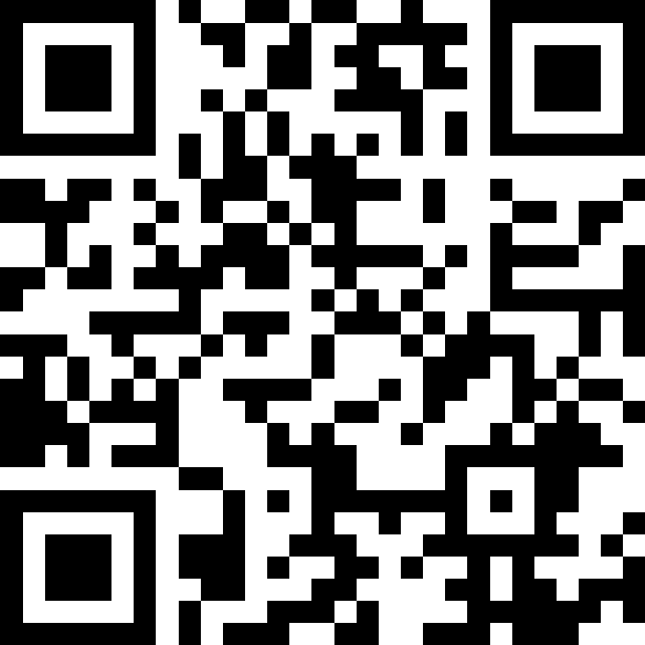
Reference Semantics
BEFORE WE START
Talk to your neighbours:
What do you do to destress?
LEC 14
Music: 121 25wi lecture playlist ❄️
Instructor:
Matt Wang
TAs:
Ailsa Alice Chloë Christopher
Ethan Hanna Hannah Hibbah
Janvi Judy Julia Kelsey
Lucas Luke Maitreyi Merav
Ruslana Samrutha Sam Shayna
Sushma Vivian

Slide 2
Announcements, Reminders
C3 released tonight, due Tuesday, Mar 4th
R4 due tomorrow (eligible: C1, P1, C2)
Quiz 2 on Thursday, Mar 6th
includes everything up to today’s lecture
can’t make it? email me before your quiz!
Announcement explaining extra resub (from PSWs) is out!
In the future: final exam on Tue, March 18th from 12:30-2:20 PM
many, many more details coming after Quiz 2

Slide 3
A bit on structured group work in section
thanks for your continued feedback & thoughts!
from poll: entire class >> yourself/pairs/small group
“People tend to not talk to each other or answer questions in quiz section. I'm not sure [whether] it's because they fear being wrong or they're just not interested. Maybe putting us in pairs/small groups could take off a bit of the pressure.”
after much discussion and work, expect to see…
more paper worksheets (building mental models + finals prep)
more opt-in pair/small-group section activities
section problems with a tighter/timeboxed scope

Slide 4
Think Pair Share: tracing (think)
What would the array a store at the end of this arrayMystery method if {-20, 20, 26, 32, 50, 3} was passed in?
{-20, 20, 26, 32, 50, 3}
{-15, 25, 31, 37, 55, 8}
{-15, 25, 31, 37, 50, 3}
{-15, 20, 26, 37, 50, 3}
public static void arrayMystery(int[] a) {
for (int i = a.length - 1; i >= 1; i--) {
if (a[i] > a[i - 1] + 10) {
a[i - 1] = a[i - 1] + 5;
}
}
}

Slide 5
Think Pair Share: tracing (pair)
What would the array a store at the end of this arrayMystery method if {-20, 20, 26, 32, 50, 3} was passed in?
{-20, 20, 26, 32, 50, 3}
{-15, 25, 31, 37, 55, 8}
{-15, 25, 31, 37, 50, 3}
{-15, 20, 26, 37, 50, 3}
public static void arrayMystery(int[] a) {
for (int i = a.length - 1; i >= 1; i--) {
if (a[i] > a[i - 1] + 10) {
a[i - 1] = a[i - 1] + 5;
}
}
}

Slide 6
Tracing through arrayMystery
i
{-20, 20, 26, 32, 50, 3}
public static void arrayMystery(int[] a) {
for (int i = a.length - 1; i >= 1; i--) {
if (a[i] > a[i - 1] + 10) {
a[i - 1] = a[i - 1] + 5;
}
}
}
a

Slide 7
PCM Review: Value Semantics
int a
Our “default” model for variables:
applies to primitive types
variables/parameters hold a copy of the actual value
3
99
int b
3
int a = 3;
int b = a;
a = 99;

Slide 8
PCM Review: Reference Semantics
int[] list1
applies to object types
importantly, arrays!
variables/parameters hold a reference to the object
99
4
8
15
int[] list1 = {4, 8, 15};
int[] list2 = list1;
list1[0] = 99;
int[] list2

Slide 9
Think Pair Share: someMethod (think)
Without knowing what someMethod does, what are the possible values of num?
anything!
just 42
int num = 42;
someMethod(num);
System.out.println(num);

Slide 10
Think Pair Share: anotherMethod (think)
Without knowing what anotherMethod does, what are the possible values of nums[0]?
anything!
just 42
int[] nums = {42, 43, 44};
anotherMethod(nums);
System.out.println(nums[0]);

Slide 11
Think Pair Share: combined methods (pair)
num: anything num[0]: anything
num: 42 num[0]: anything
num: anything num[0]: 42
num: 42 num[0]: 42
Without knowing what someMethod or anotherMethod do, what are the possible values of num and num[0]?
int num = 42;
someMethod(num);
System.out.println(num);
int[] nums = {42, 43, 44};
anotherMethod(nums);
System.out.println(nums[0]);

Slide 12
Value Semantics & Methods
boolean test = true;
flipValue(test);
public static void flipValue(boolean b) {
b = !b;
}

Slide 13
Reference Semantics & Methods
boolean[] tests = {true, false, false, false};
flipValues(tests);
public static void flipValues(boolean[] b) {
for (int i = 0; i < b.length; i++) {
b[i] = !b[i];
}
}

Slide 14
PCM Review: null
null is the absence of a reference!
sort of the “zero” for references
default value for object types (e.g. Random, Scanner, and String)
A NullPointerException is an error that happens when you ask null to “do something”, which includes:
calling .toUpperCase() on null? NullPointerException!
calling .nextInt() on null? NullPointerException!
many, many more

Slide 15
Aside: the “billion dollar mistake”
From Sir Tony Hoare (“inventor” of null, Turing award winner):
“I call it my billion-dollar mistake… […] But I couldn’t resist the temptation to put in a null reference, simply because it was so easy to implement. This has led to innumerable errors, vulnerabilities, and system crashes, which have probably caused a billion dollars of pain and damage in the last forty years.” (quote from 2009 talk)

Slide 16
PCM Review: avoiding NullPointerException
if (strs[i] != null) {
System.out.println(strs[i].toUpperCase());
} else {
System.out.println("element " + i + " is null.");
}

Slide 17
Announcements, Reminders (again)
C3 released tonight, due Tuesday, Mar 4th
R4 due tomorrow (eligible: C1, P1, C2)
Quiz 2 on Thursday, Mar 6th
includes everything up to today’s lecture
can’t make it? email me before your quiz!
Announcement explaining extra resub (from PSWs) is out!
In the future: final exam on Tue, March 18th from 12:30-2:20 PM
many, many more details coming after Quiz 2

