Slide 1
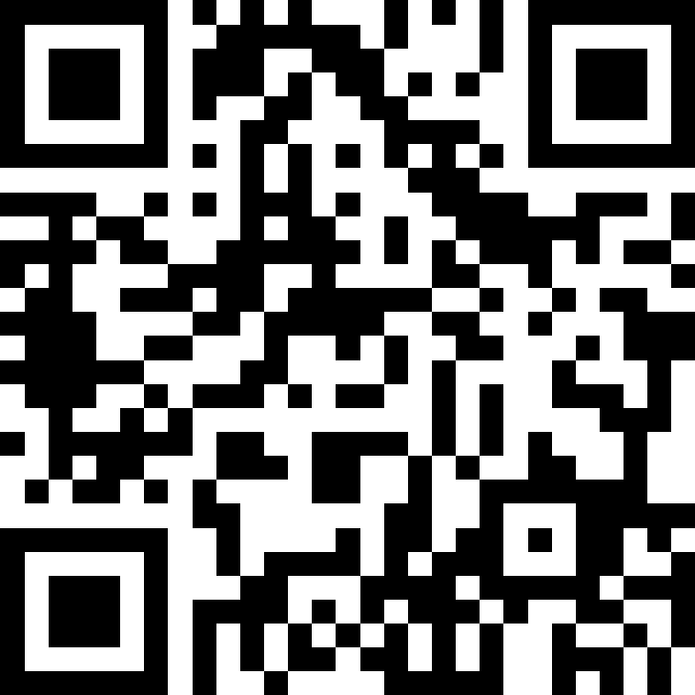
Arrays
BEFORE WE START
Talk to your neighbours:
What hobby do you want to pick up?
LEC 13
Music: 121 25wi lecture playlist ❄️
Instructor:
Matt Wang
TAs:
Ailsa Alice Chloë Christopher
Ethan Hanna Hannah Hibbah
Janvi Judy Julia Kelsey
Lucas Luke Maitreyi Merav
Ruslana Samrutha Sam Shayna
Sushma Vivian

Slide 2
Announcements, Reminders
P2 due next Tuesday, Feb 25th
R4 released, due Thursday, Feb 27th tomorrow (eligible: C1, P1, C2)
Quiz 2 on Thursday, Mar 6th
includes everything up to next Wed’s lecture
can’t make it? email me before your quiz!
Quiz 1 grades released before Quiz 2
reminder: tell us your thoughts on structured section practice!

Slide 3
PCM Review: Arrays
New data structure that stores multiple items, in order
elements must all be the same type
zero-based indexing
must decide (and fix) size when created
arr.length to get arr’s length
Arrays.toString(arr) to get a nice String version

Slide 4
PCM Review: Array Traversal Pattern
for (int i = 0; i < arr.length; i++) {
// do something with arr[i]
}

Slide 5
Think Pair Share: array length (think)
Which of these expressions gives us the last element of an array arr?
arr[arr.length()]
arr[length()]
arr[arr.length]
arr[arr.length() - 1]
arr[arr.length - 1]

Slide 6
Think Pair Share: array length (think)
Which of these expressions gives us the last element of an array arr?
arr[arr.length()]
arr[length()]
arr[arr.length]
arr[arr.length() - 1]
arr[arr.length - 1]

Slide 7
Announcements, Reminders (again)
P2 due next Tuesday, Feb 25th
R4 released, due Thursday, Feb 27th tomorrow (eligible: C1, P1, C2)
Quiz 2 on Thursday, Mar 6th
includes everything up to next Wed’s lecture
can’t make it? email me before your quiz!
Quiz 1 grades released before Quiz 2
reminder: tell us your thoughts on structured section practice!

